Slide 1

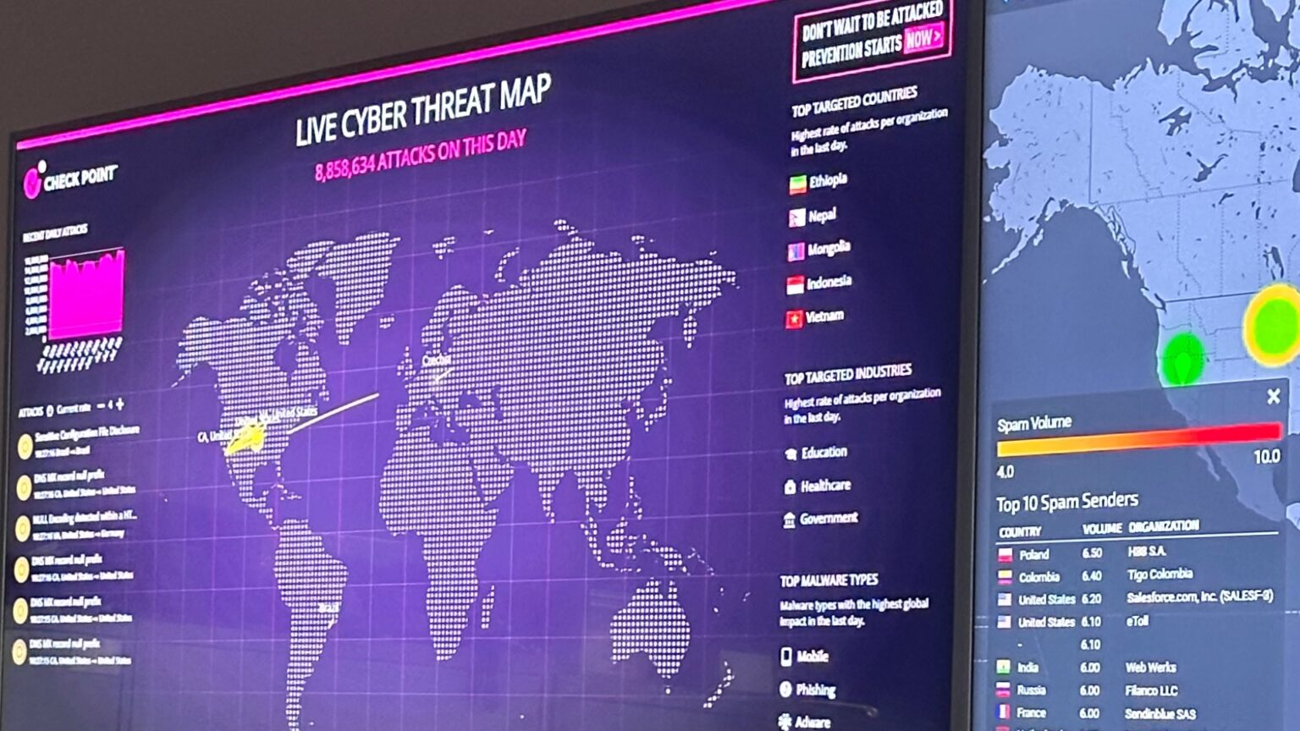
OLCF Upgrades Its Network Security Infrastructure
Scientific Achievement
A major upgrade to the Oak Ridge Leadership Computing Facility’s Network Intrusion Detection System (NIDS) has strengthened defenses, reinforcing one of the nation’s most powerful computing resources against hidden threats.
This system enhancement, which required two years of careful planning and execution, has significantly strengthened the OLCF’s ability to monitor and secure network traffic.
Significance and Impact
By protecting critical research and safeguarding sensitive data, these advancements ensure the continued reliability of high-performance computing, which drives breakthroughs in science, energy innovation, and national security.
NIDS can now process traffic at speeds of up to 400 gigabits per second, four times faster than its former 100 Gbps specification.
This quadrupling of capacity not only enhances the OLCF’s ability to track potential intrusions but also ensures a secure environment for conducting scientific research.
A cyber threat map is displayed inside the Security Operations Center at Oak Ridge National Laboratory. Credit: Angela Gosnell/ORNL, U.S. Dept. of Energy
Technical Approach
With the NIDS upgrade, system analysts can clearly see patterns in web traffic and differentiate between traffic that’s coming from web browsers, scientific data transfers or system services.
The project was completed using open-source software tools that enhance network security so that the NIDS upgrade strengthens the organization’s defenses against potential threats.
PI(s)/Facility Lead(s): Ryan Adamson, Jakob Becklehimer, Carl Bai
Collaborating Institutions: Oak Ridge National Laboratory
ASCR Program: Oak Ridge Leadership Computing Facility
ASCR PM: Ben Brown
Publication(s) for this work:

