Slide 1
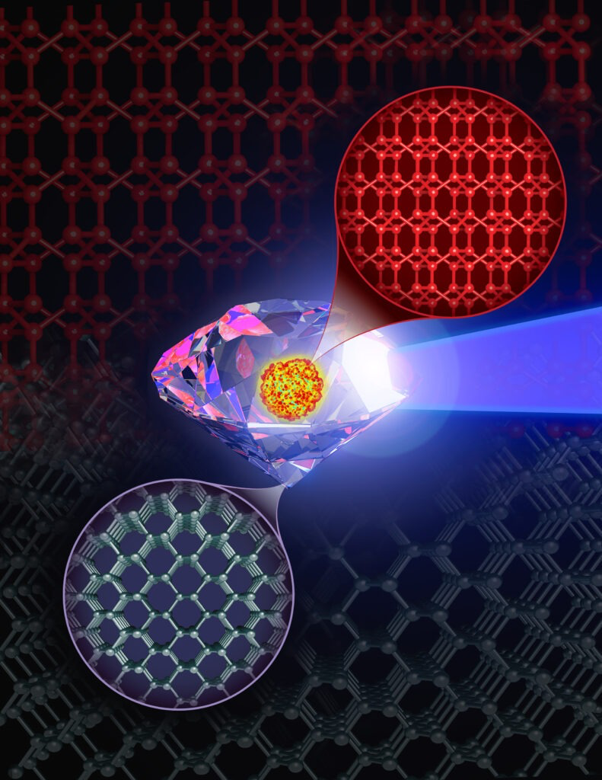
Frontier Simulations Could Help Build a Better Diamond Supercomputer study guides effort to create otherworldly BC8 on Earth
The Science Diamonds form when extreme heat and pressure pack carbon atoms together to create the hardest material on this planet. The precious stones not only decorate fine jewelry but perform service in the most demanding industrial jobs worldwide. Mining crews pierce bedrock with diamond-tipped drill bits. Engravers use diamond knives and saws to make incisions in quartz and granite. Scientists have theorized an even harder substance exists on other planets — a superdiamond known as BC8, made up of eight carbon atoms for a diamond’s every four. Extreme pressures and temperatures at the core of an exoplanet twice Earth’s size or larger could create the necessary conditions to produce such materials. Synthesizing BC8 under laboratory conditions could open a new vista of industrial possibilities, courtesy of a material harder than the hardest thing in nature. The effort would require 10 million times the pressure of Earth’s atmosphere and temperatures equal to those on the sun’s surface. Various experiments have tried to create BC8 and failed, all at great expense. To predict what it might take to synthesize this substance, researchers would need a highly accurate way to simulate these complex interactions between carbon atoms in a billion-atom sample under a variety of conditions.
The Impact The world’s fastest supercomputer helped researchers simulate synthesizing a material harder and tougher than diamond — or any other substance on Earth. The study, led by the University of South Florida, used Frontier to predict the likeliest strategy to synthesize such a material, thought to exist only within the interiors of giant exoplanets, or planets beyond our solar system – at least so far. Frontier’s exascale speeds of more than 1 quintillion calculations per second brought the goal within reach for the first time. None of the traditional classical interatomic or quantum models could offer that kind of detail at scale. To achieve the required level of accuracy, the team trained a novel machine-learning interatomic model by using an extensive cache of quantum mechanical data on various states of carbon, including BC8.
Researchers used ORNL’s Frontier supercomputer to simulate synthesizing BC8, a material harder and tougher than diamond that could offer a wide range of potential uses for industry and other applications. Credit: Mark Meamber, LLNL
PI/Facility Lead(s): Ivan Oleynik, Univ. South Florida
ASCR Program/Facility: OLCF/Frontier
ASCR PM: Christine Chalk
Funding: ALCC
Publication(s) for this work: Kien Nguyen-Cong, et al., The Journal of Physical Chemistry Letters 2024 15 (4), 1152-1160

