Slide 1



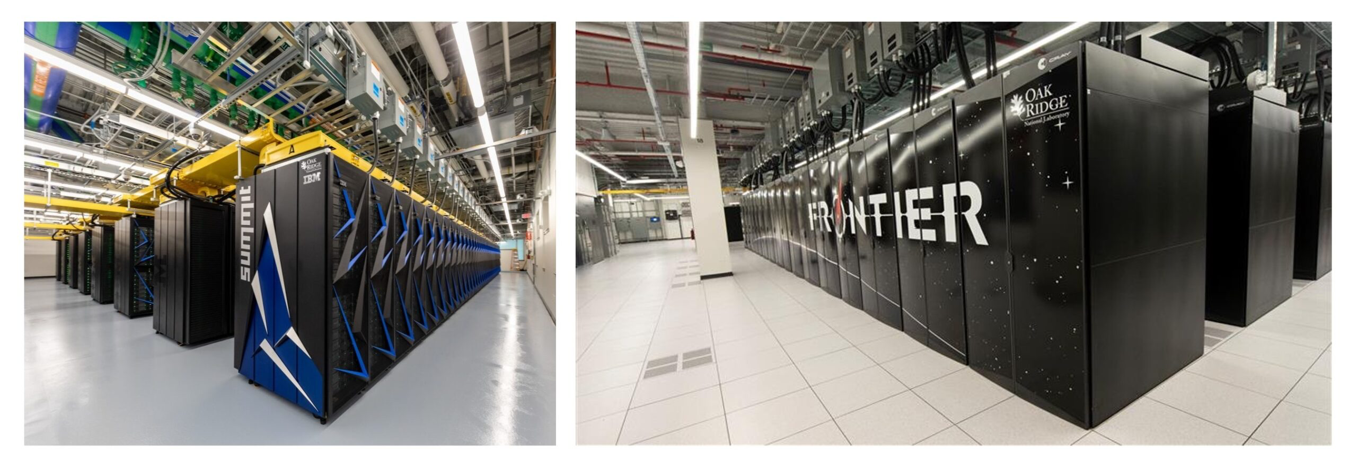
Quantum Computing Experiment Realizes Verifiably Random Number
Scientific Achievement
Researchers used the unique capabilities of a quantum computer to generate a verifiably random number in a study published in the journal Nature.
These results provide valuable insights into the intersection of quantum computing and high-performance computing.
Significance and Impact
Banking transactions and the submission of credentials via user IDs and passwords all rely on encryption, which in turn requires the use of random numbers to generate encryption keys.
This study brings closer the usability of quantum computing for practical, real-world applications and will be vital to further research in statistical sampling, cryptography and numerical simulations and other fields.
Researchers used the unique capabilities of a quantum computer to generate a verifiably random number, a potential step toward quantum advancements in encryption, network security and similar realms. The team cross-checked the results using classical supercomputers, including ORNL’s Frontier and Summit. Credit: Carlos Jones/ORNL, U.S. Dept. of Energy
Technical Approach
The research team used time on Quantinuum’s H2 quantum computer to execute random circuit sampling and perform a certified randomness expansion protocol, which outputs more randomness than it takes as input.
The team verified the results by using a workflow that combined four supercomputers: Frontier and Summit at ORNL’s Oak Ridge Leadership Computing Facility (OLCF), Polaris at the Argonne Leadership Computing Facility (ALCF) and Perlmutter at the National Energy Research Scientific Computing Center (NERSC).
PI(s)/Facility Lead(s): Marco Pistoia, JPMorgan Chase
Collaborating Institutions: JPMorgan Chase, ORNL, Argonne, Univ. Texas Austin
ASCR Program: Facilities
ASCR PM: Ben Brown
Publication(s) for this work: Liu, M., Shaydulin, R., Niroula, P. et al. ”Certified randomness using a trapped-ion quantum processor.” Nature 640, 343–348 (2025). https://doi.org/10.1038/s41586-025-08737-1

