Slide 1

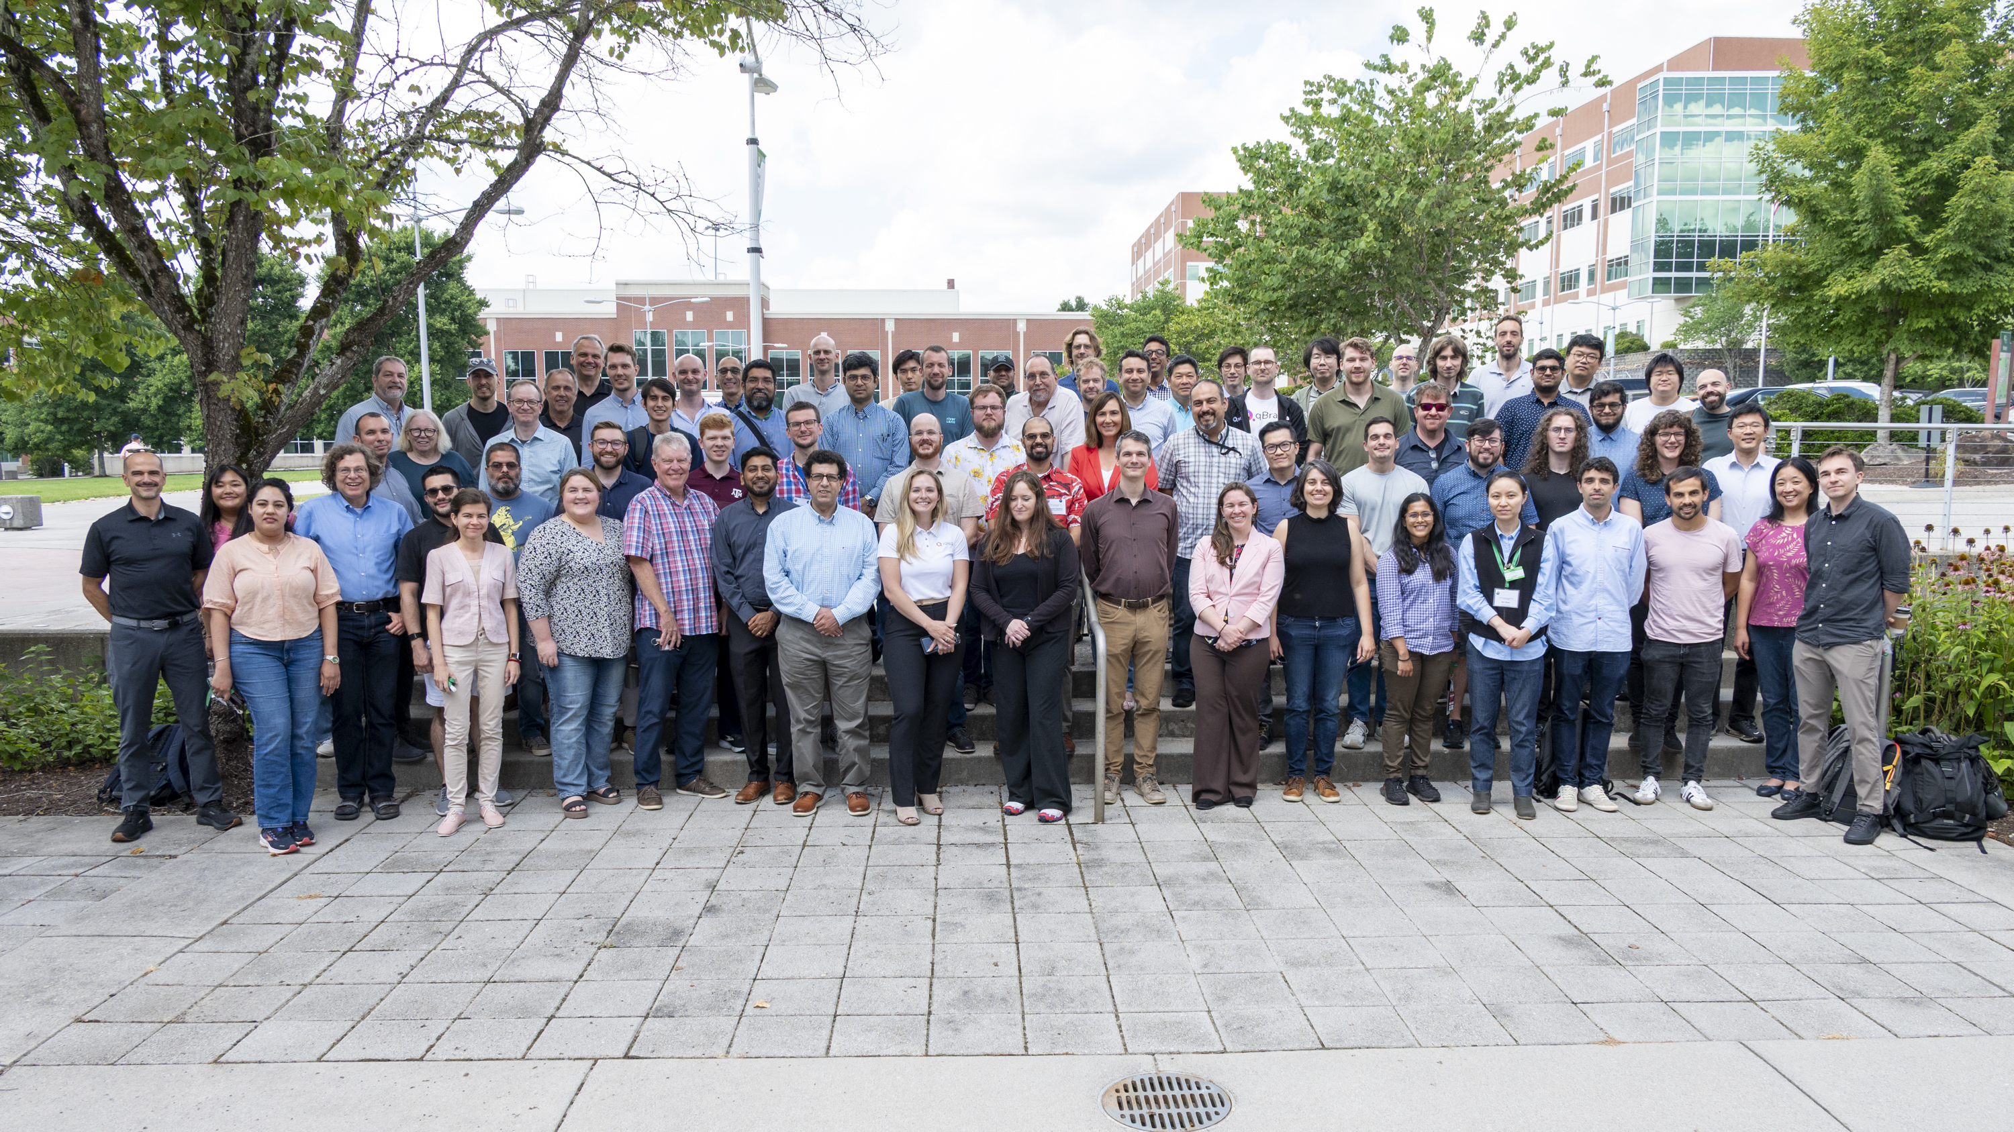

ORNL Hosts Inaugural Quantum Systems and Software Workshop
Scientific Achievement
The Oak Ridge Quantum Software & Systems Workshop welcomed attendees for its inaugural event hosted at Oak Ridge National Laboratory on July 25.
Throughout the day, participants teamed up to plan and design ways to connect different parts of quantum systems to create a practical and easy-to-use open quantum software ecosystem, or openQSE.
OQSSw attendees participated in talks hosted by industry representatives from Quantinuum, IBM and Munich Quantum Valley.
Significance and Impact
The goal of the new initiative, openQSE, is to create a system that combines the strengths of both quantum and traditional computing.
Organizers want openQSE to be a unified initiative to bring together vendors, collaborators, labs, and universities in building an open ecosystem
The openQSE initiative will focus on establishing a common set of interfaces that could be implemented, enabling participants to develop their own modules and seamlessly integrate them into the ecosystem.
The inaugural Quantum Systems and Software workshop hosted 75 registered attendees who came together to help plan and design ways to connect different parts of quantum systems to create a practical and easy-to-use open quantum software ecosystem. Credit: Kurt Weiss/ORNL, U.S. Dept. of Energy
Technical Approach
OpenQSE aims to speed up advancements in quantum software by connecting a rapidly evolving community, creating specialized working groups, and promoting collaboration across different parts of the quantum technology framework.
OpenQSE takes a structured approach that includes defining software component categories, organizing software layers, clarifying boundaries and specifying key interfaces.
PI(s)/Facility Lead(s): Amir Shehata, Travis Humble, Tom Beck
Collaborating Institutions: Oak Ridge National Laboratory
ASCR Program: Oak Ridge Leadership Computing Facility
ASCR PM: Ben Brown
Publication(s) for this work:

