Slide 1
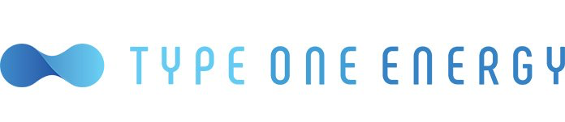

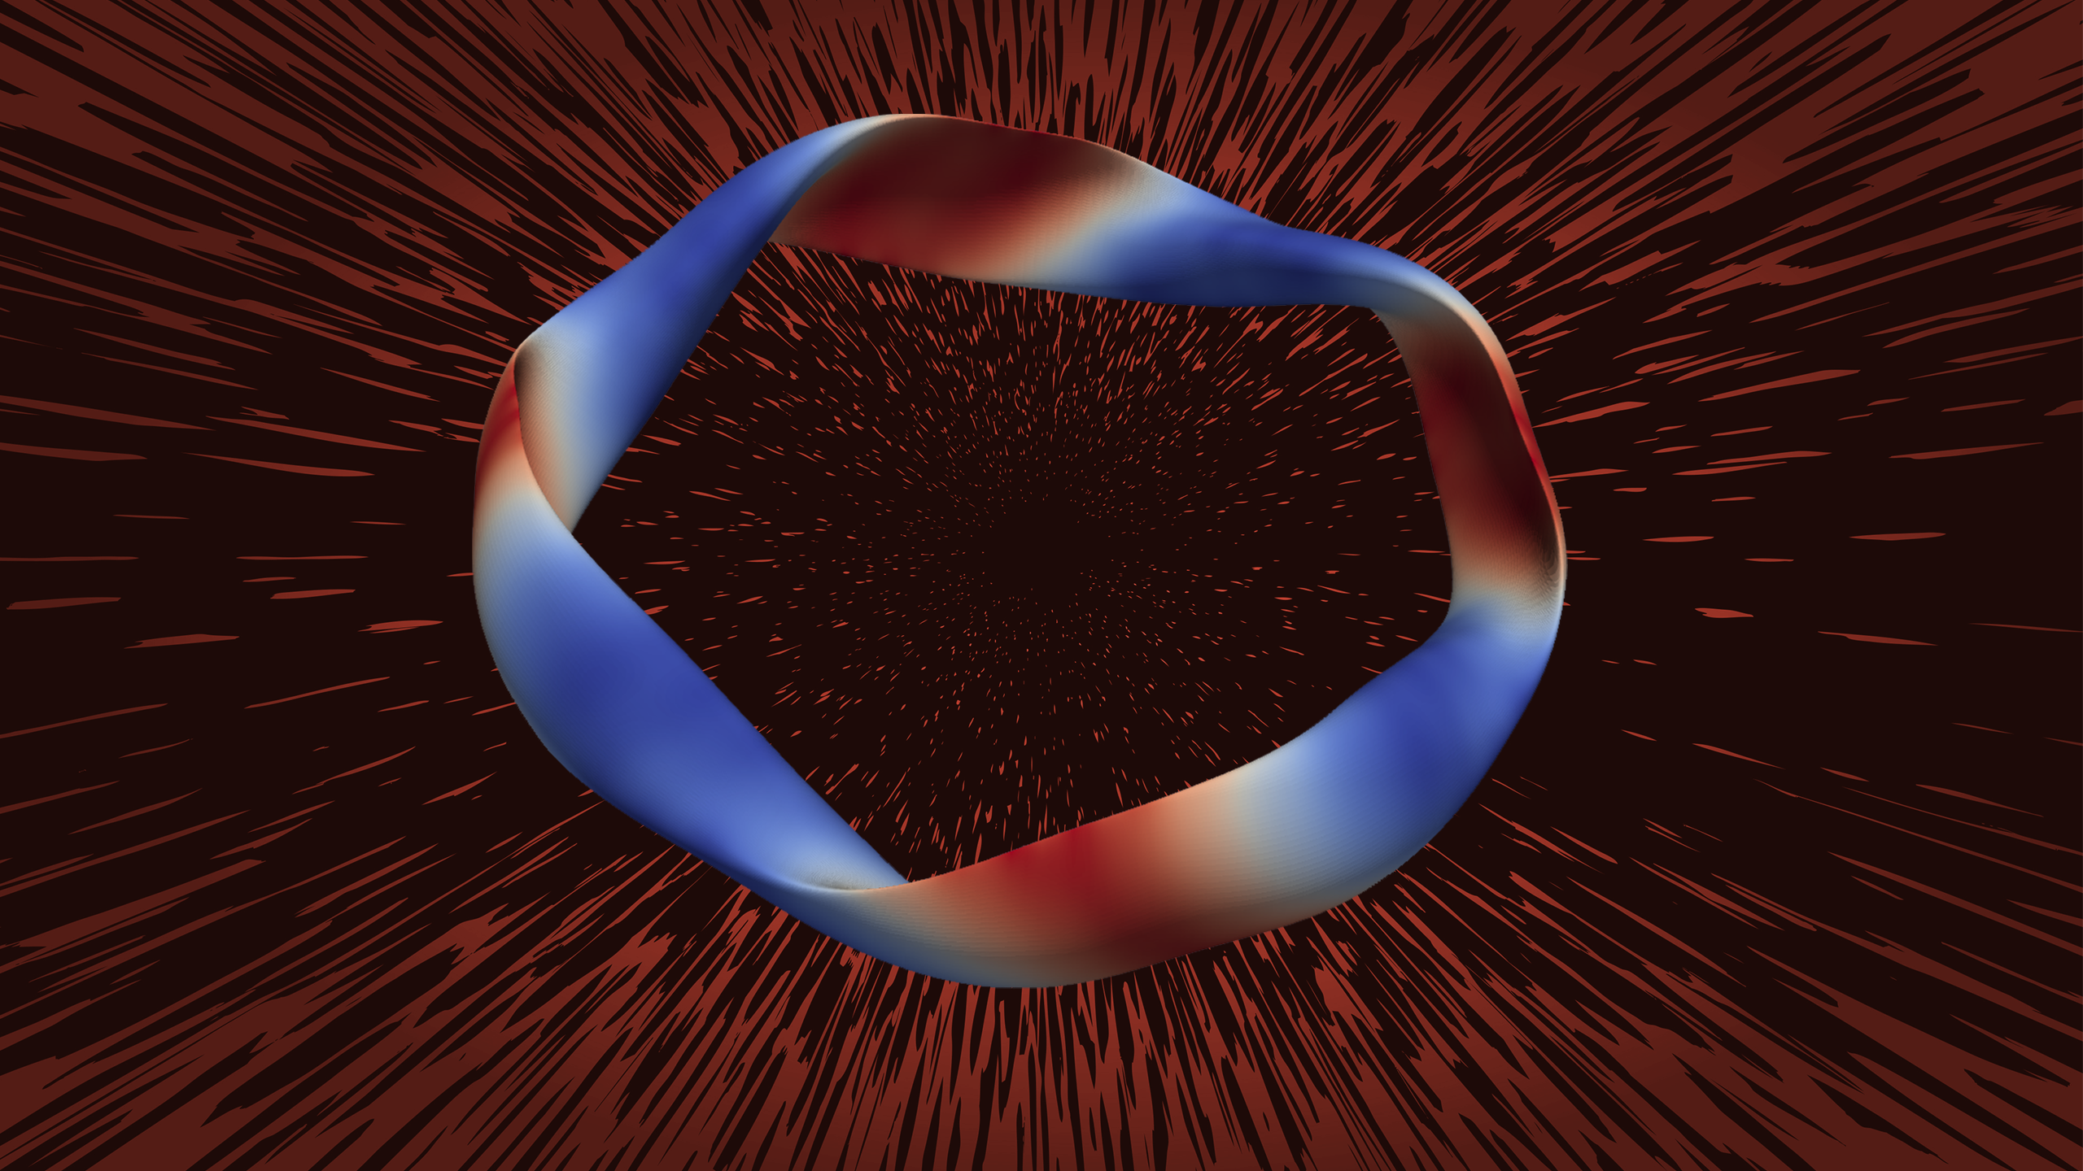
Forging Fusion
Summit supercomputer study speeds power plant design
Scientific Achievement
The nuclear reactions that fuel the sun could soon be harnessed to generate electricity on Earth — with help from supercomputers at the Department of Energy’s Oak Ridge National Laboratory.
Significance and Impact
Type One Energy Group, a Knoxville-based startup, expects to build the world’s most advanced stellarator fusion device by 2030, with a pilot power plant to follow that would produce commercial fusion energy by the mid-2030s. The Type One Energy team discussed their pilot plant concept in a series of six papers recently published in the Journal of Plasma Physics.
The prototype, Infinity One, won’t produce electricity but would demonstrate the company’s design works and clear the path for the pilot plant, Infinity Two, which would generate an effective output of 350 megawatts for the electric grid.
Type One Energy used ORNL’s Summit supercomputer to develop an optimized stellarator fusion power plant concept. Colors indicate the strength of the magnetic field that confines the plasma. Credit: Type One Energy
Technical Approach
The detailed modeling offered by ORNL’s Summit supercomputer, which has since ceased operations, shaved at least a year off the time from drawing board to reality, the company estimates — maybe more.
Summit’s high-resolution modeling speeds of 200 petaflops, or 200 quadrillion calculations per second, helped the Type One Energy team develop the knowledge and tools to make their solution a reality and to confirm an optimized stellarator as an economically viable concept for a fusion power plant.
PI(s)/Facility Lead(s): Walter Guttenfelder, Type One Energy
Collaborating Institutions: NA
ASCR Program: OLCF SummitPlus
ASCR PM: Benjamin Brown
Publication(s) for this work: Guttenfelder W, Mandell NR, Le Bars G, et al. “Predictions of Core Plasma Performance for the Infinity Two Fusion Pilot Plant,” Journal of Plasma Physics. 2025;91(3):E83.
DOI:10.1017/S0022377825000339
Notes:
https://www.olcf.ornl.gov/2025/09/24/forging-fusion/
Related publication: Guttenfelder W, Mandell NR, Le Bars G, et al. “Predictions of Core Plasma Performance for the Infinity Two Fusion Pilot Plant,” Journal of Plasma Physics. 2025;91(3):E83.
DOI:10.1017/S0022377825000339

