Slide 1


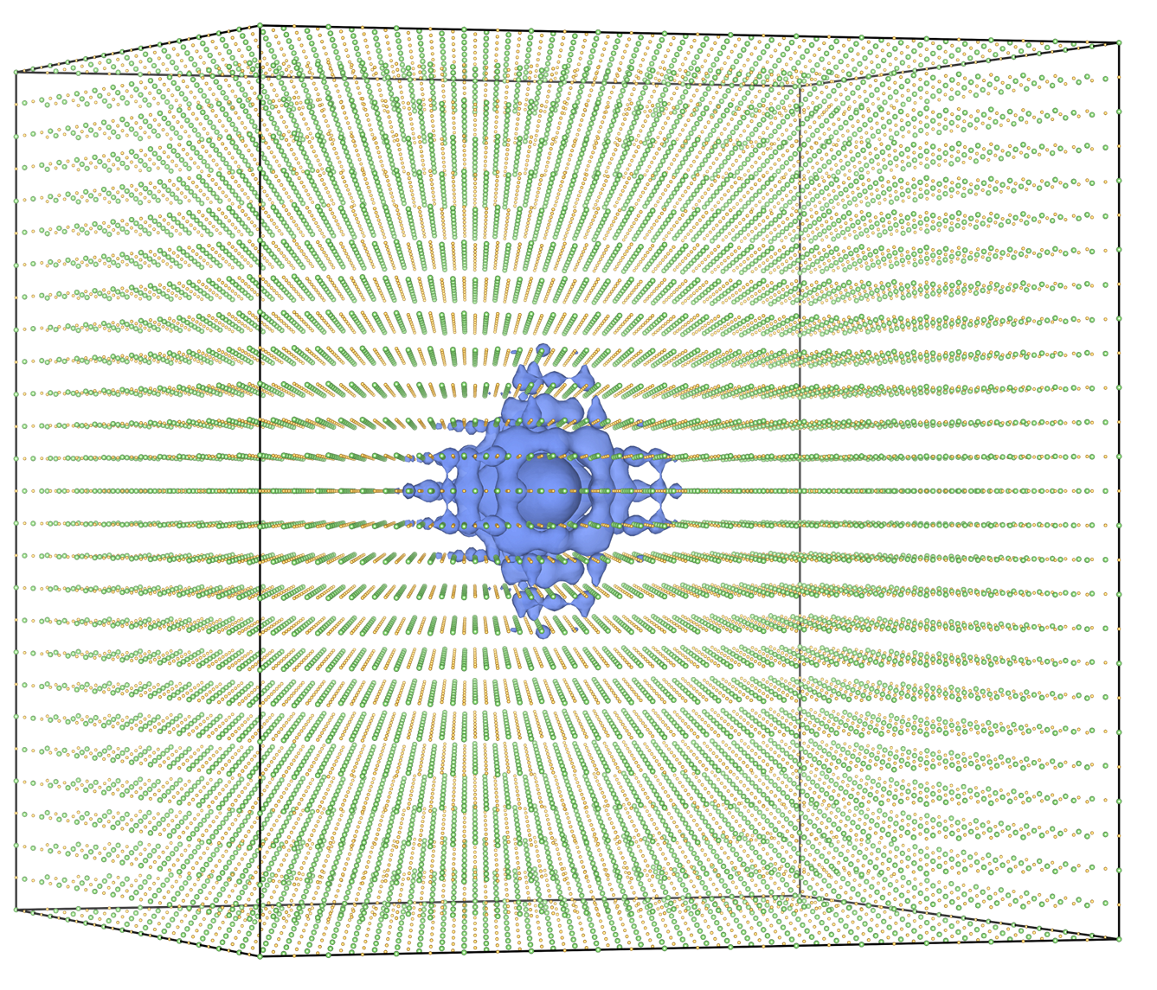
Frontier simulations spin up new details in quantum understanding
Scientific Achievement
Researchers used Frontier to uncover new insights that could pave the way for the next generation of quantum computing, sensing and communications technologies through more efficient control of quantum materials and their properties. The study used a first-principles code, BerkeleyGW, to simulate the coupling of correlated electrons and phonons and their effects on quantum materials as part of the quantum many-body problem.
Significance and Impact
The coupling between electrons, the negatively charged particles present in all atoms, and phonons, or waves of vibrational energy, drives key physical processes such as superconductivity, or the ability to conduct electricity with minimal to no resistance, and photovoltaics, the generation of energy from light. Closer understanding of that coupling and how it occurs could help scientists reproduce and harness those processes for batteries, generators, transistors and more.
The work earned the team a finalist nomination for the Association for Computing Machinery’s Gordon Bell Prize, which honors innovations in applying high-performance computing for scientific discovery.
Researchers used the OLCF’s Frontier supercomputer to simulate the coupling of correlated electrons and phonons and their effects on quantum materials as part of the quantum many-body problem. The work was nominated for the ACM Gordon Bell Prize.
Credit: Jason Smith, ORNL
PI(s)/Facility Lead(s): Mauro Del Ben, LBNL
ASCR Program: OLCF, ALCF
ASCR PM: Benjamin Brown
Publication(s) for this work: Del Ben, et al., “Advancing Quantum Many-Body GW Calculations on Exascale Supercomputing Platforms,” SC '25: Proceedings of the International Conference for High Performance Computing, Networking, Storage and Analysis (2025).
Technical Approach
The team’s computational framework, BerkeleyGW, relied on many-body perturbation theory, a quantum theoretical approach that allows for highly accurate predictions of the electronic structure of complex materials.

