Slide 1

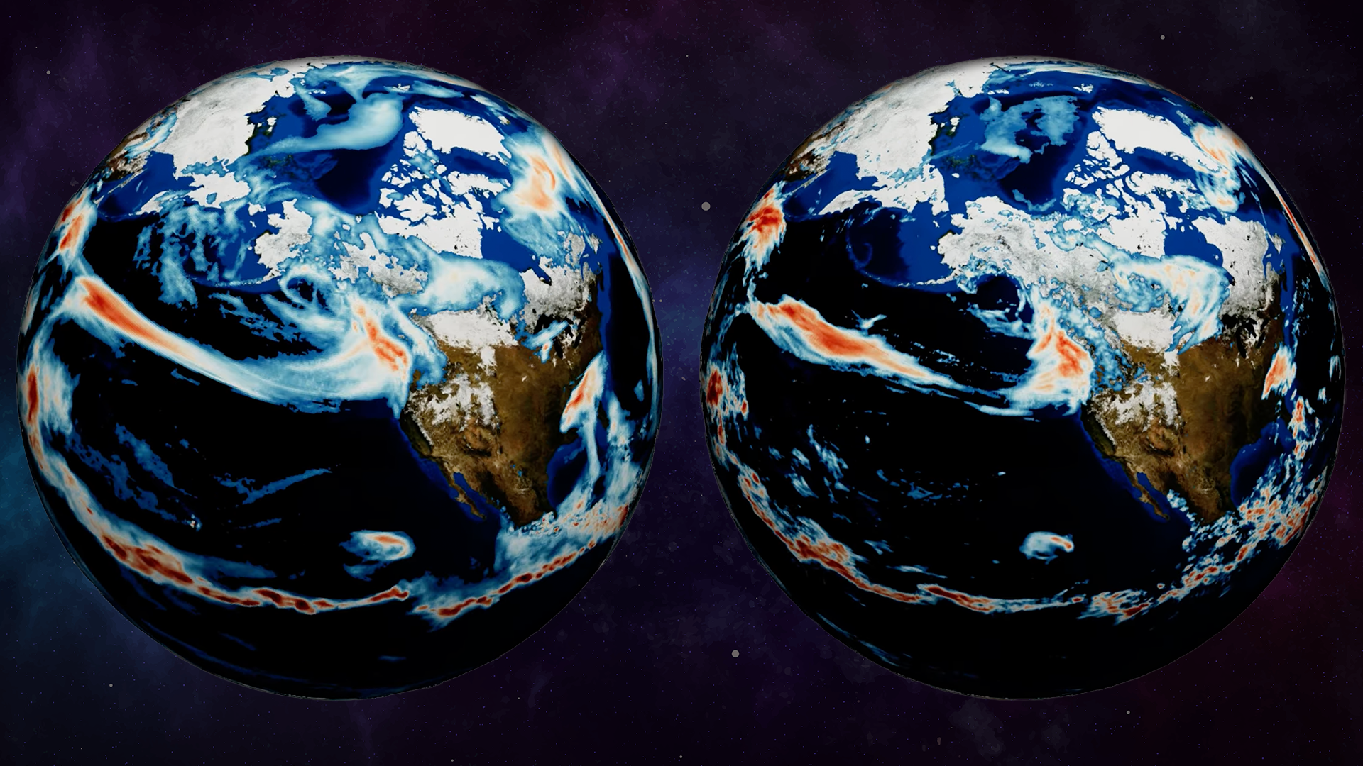
ORBIT-2 takes weather modeling to the next level
Framework offers first complete digital twin approach for modeling data centers of supercomputers in near-real time
Scientific Achievement
Researchers used Frontier to make the world’s largest AI model for weather prediction even larger, more detailed, and more accurate. The second version of the Oak Ridge Base Foundation Model for Earth System Predictability, or ORBIT-2, dials in up-to-the-minute forecasts down to the doorstep level.
Significance and Impact
Training on Frontier, the 2-exaflop HPE Cray EX supercomputing system at ORNL’s Oak Ridge Leadership Computing Facility, pushed the ORBIT-2 model past longtime computational limits to achieve unparalleled speed and accuracy in its predictions, researchers said.
The study earned the team a finalist nomination for the Association for Computing Machinery’s Gordon Bell Special Prize, which honors innovations in applying high-performance computing to weather modeling applications.
The ORBIT-2 model, trained on ORNL’s Frontier supercomputer, delivers weather forecasts in unprecedented detail. Credit: Jason Smith, ORNL
Technical Approach
The ORBIT-2 study builds on the team’s initial ORBIT model, a previous nominee for the Gordon Bell Special Prize. The first model focused on long-range weather forecasting and generated highly accurate predictions up to 30 days in advance.
ORBIT-2 refines those forecasts to precise locations and likely consequences. The model continually evaluates predictions for accuracy and rates confidence levels for each forecast to help control for errors.
PI(s)/Facility Lead(s): Xiao Wang, ORNL
Collaborating Institutions: UAB, AMD, Riken
ASCR Program: OLCF
ASCR PM: Benjamin Brown
Publication(s) for this work: Xiao Wang, et al., “ORBIT-2: Scaling Exascale Vision Foundation Models for Weather and Climate Downscaling” SC '25: Proceedings of the International Conference for High Performance Computing, Networking, Storage and Analysis (2025).

