Slide 1



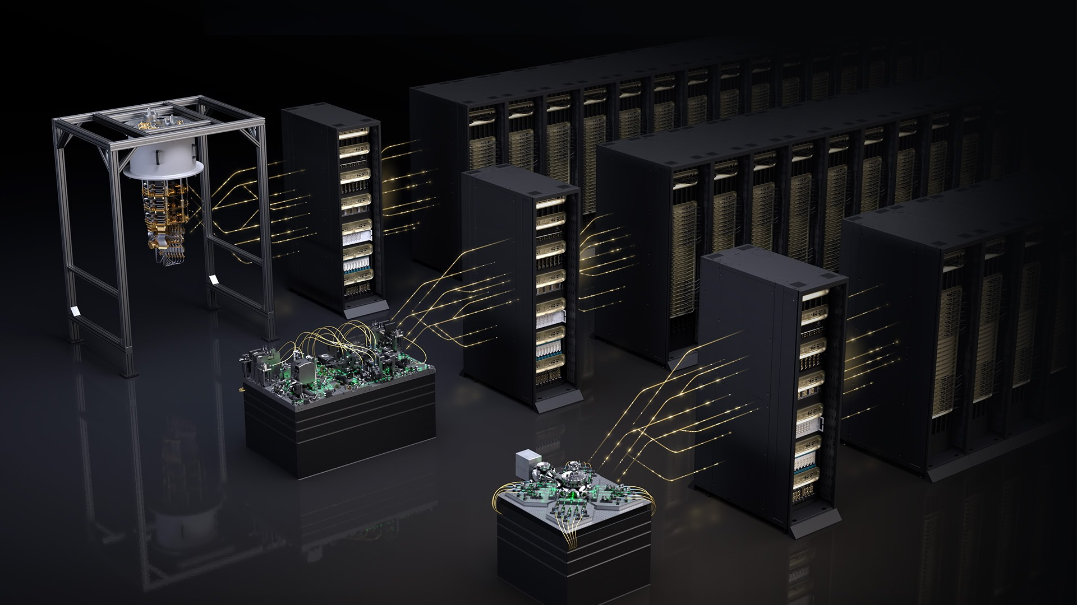
ORNL, NVIDIA, HPE advance quantum computing, AI and HPC for science
Scientific Achievement
Oak Ridge National Laboratory, NVIDIA, and HPE will seek to open new insights into quantum computing and identify potential strategies toward the integration of quantum, artificial intelligence and high-performance computing for scientific discovery. ORNL researchers will leverage NVIDIA NVQLink and NVIDIA CUDA-Q programming tools — designed to integrate classical computing clusters with quantum processors for performing control tasks like quantum error correction and the running of hybrid quantum-classical algorithms.
Significance and Impact
ORNL’s machine will combine classical technology, such as the traditional GPUs and CPUs that power most supercomputers, with hybrid computing platforms through CUDA-Q that use NVIDIA technology to connect with quantum processors as well as emulate their quantum operations without the noise from degrading qubits. The platform will combine HPE’s integration expertise and NVIDIA’s hardware innovation to advance state-of-the-art AI research while enabling the investigation of iterative, low-latency decoding that quantum error correction requires.
This visualization shows hybrid quantum–classical computing.
Credit: NVIDIA
PI(s)/Facility Lead(s): Amir Shehata, ORNL
Collaborating Institutions: NVIDIA, AMD, HPE
ASCR Program: OLCF
ASCR PM: Benjamin Brown
Publication(s) for this work: NA
Technical Approach
NVIDIA CUDA-Q also allows running GPU-accelerated simulations mimicking actual quantum hardware. These are crucial tools for a novel testbed that will explore and compare these advanced technologies side by side.

