Slide 1


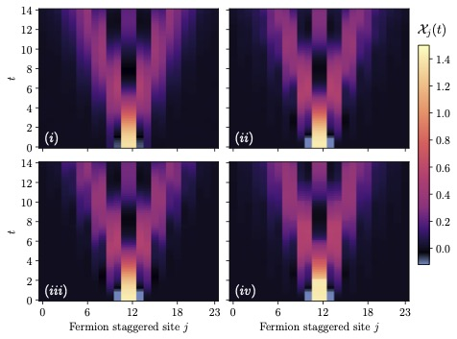
Cracking the Hadron Collision Puzzle
QCUP study probes subatomic reactions with quantum tech
Scientific Achievement
Researchers used quantum simulations to model the collisions of subatomic particles and open new avenues to understand the basics of hadron collisions, a key aspect of high-energy physics. The results illustrate quantum computing’s potential to expand the range of solutions to scientific problems beyond those made possible by classical high-performance computers.
Significance and Impact
Hadrons are subatomic particles composed of quarks and gluons — two types of smaller, indivisible subatomic particles commonly described as the building blocks of matter. The most familiar hadrons are the protons and neutrons found in an atom’s nucleus.
When hadrons collide, the reaction produces huge concentrations of energy and releases a blizzard of particles, all with various energies and compositions. These collisions are considered essential for a deeper understanding of high-energy physics and the study of matter in extreme conditions.
The size of the necessary equations for modeling hadron collisions vastly exceeds the capabilities of current classical computers. Quantum computing could offer an alternative way to simulate these collisions.
Quantum simulations supported by ORNL’s Quantum Computing User Program helped researchers model how a burst of energy evolved over time through a hadron collision, a key aspect of high-energy subatomic physics. Credit: Martin Savage, University of Washington
PI(s)/Facility Lead(s): Martin Savage, University of Washington
Collaborating Institutions: InQubator for Quantum Simulation
ASCR Program: OLCF/QCUP
ASCR PM: Benjamin Brown
Publication(s) for this work: Roland C. Farrell, Marc Illa, Anthony N. Ciaveralla, and Martin J. Savage, “Quantum Simulations of Hadron Dynamics in the Schwinger Model Using 112 Qubits,” Physical Review D 109 (2024): 114510.
DOI:https://doi.org/10.1103/PhysRevD.109.114510
Technical Approach
The research team obtained time on IBM’s Torino quantum computer via ORNL’s Quantum Computing User program and used 112 qubits to evolve a quantized wave packet forward in time. Results showed signatures of hadron propagation.
Notes:
https://www.olcf.ornl.gov/2026/04/21/cracking-the-hadron-collision-puzzle/
Related publication: Roland C. Farrell, Marc Illa, Anthony N. Ciaveralla, and Martin J. Savage. “Quantum Simulations of Hadron Dynamics in the Schwinger Model Using 112 Qubits.” Physical Review D 109 (2024): 114510.
DOI: https://doi.org/10.1103/PhysRevD.109.114510

