Slide 1


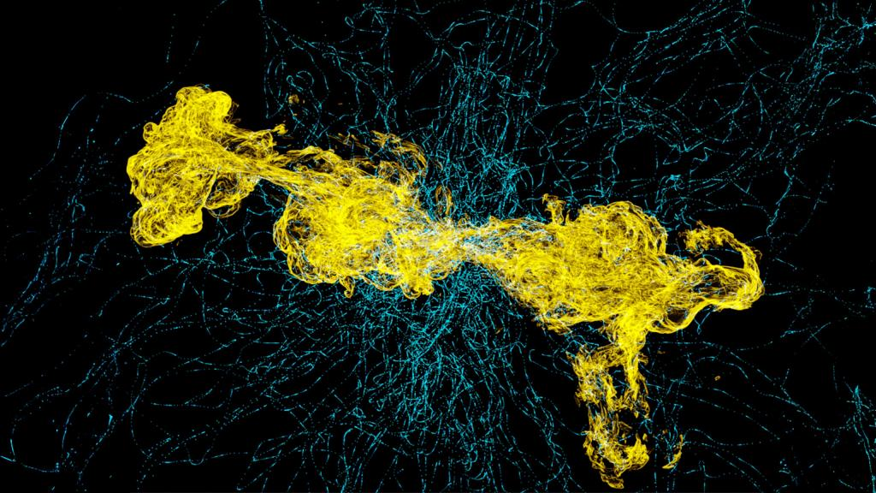
Frontier Simulations Pierce Mysteries of Galactic Nuclei
Study shows how galaxies regulate energy from black holes at cores
Scientific Achievement
To probe the mysteries of how galaxies evolve over time, scientists needed a supercomputer with out-of-this-world computational power.
The results of a study conducted on the Frontier supercomputer at the Department of Energy’s Oak Ridge National Laboratory offer the clearest portrait so far of how some galaxies regulate the energy produced by supermassive black holes at their cores.
Significance and Impact
These black holes — which range up to billions of times the sun’s mass — power phenomena known as active galactic nuclei, which constantly pump heat, dust and gas into their environments. Some of that material orbits the nuclei in luminous regions known as accretion disks.
The Frontier study modeled that energy and turbulence feed into the galactic structures and their formation.
Supermassive black holes constantly pump dust, gas and heat into their environments, creating accretion disks like this one. Credit: Michael Sandoval, ORNL
Technical Approach
The Frontier study used as its test case a black hole of about 10⁹ solar masses, or a billion times the size of the sun, at the center of a galaxy cluster of about 10¹⁵ solar masses, or a quadrillion times the size of the sun — and about a thousand times the mass of the Milky Way galaxy that’s home to Earth.
The study simulated the cluster’s evolution over billions of years, modeling each step of the various jet activity cycles.
PI(s)/Facility Lead(s): Brian O’Shea, Michigan State
Collaborating Institutions: ORNL, University of Hamburg, Cardiff University, NVIDIA
ASCR Program: OLCF
ASCR PM: Benjamin Brown
Publication(s) for this work: Philipp Grete, et al, “The XMAGNET Exascale MHD Simulations of SMBH Feedback in Galaxy Groups and Clusters: Overview and Preliminary Cluster Results,” The Astrophysical Journal. 988: 155 (2025).
DOI: doi.org/10.3847/1538-4357/adde45.
Notes:
https://www.olcf.ornl.gov/2025/09/30/frontier-simulations-pierce-mysteries-of-galactic-nuclei/
Related publication: Philipp Grete, et al, “The XMAGNET Exascale MHD Simulations of SMBH Feedback in Galaxy Groups and Clusters: Overview and Preliminary Cluster Results,” The Astrophysical Journal. 988: 155 (2025).
DOI: doi.org/10.3847/1538-4357/adde45.

