Slide 1

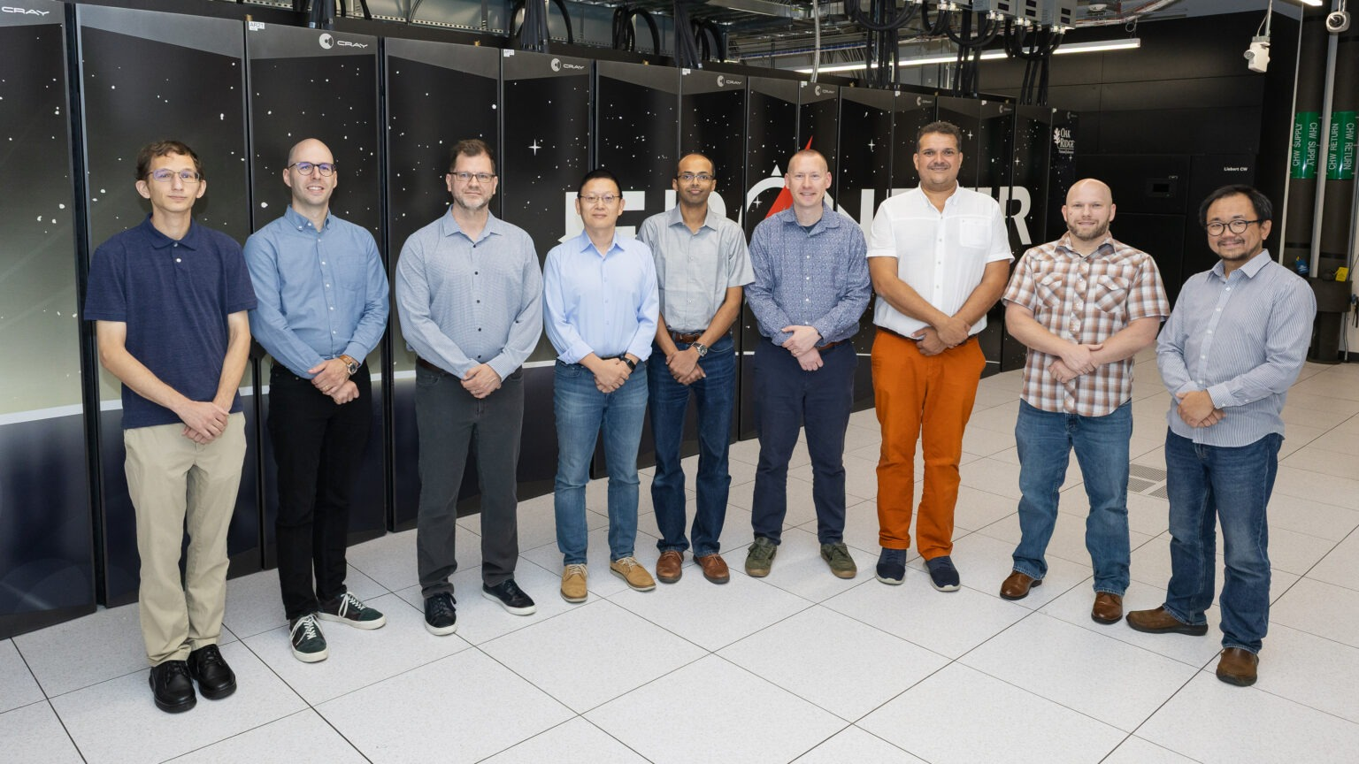
OLCF, HPE Team Honored for ExaDigiT Innovation
Framework offers first complete digital twin approach for modeling data centers of supercomputers in near-real time
Scientific Achievement
A team led by researchers from the Oak Ridge Leadership Computing Facility at the Department of Energy’s Oak Ridge National Laboratory received an R&D 100 Award for their work on ExaDigiT, a first-of-its-kind integrated framework that allows up-to-the-second virtual representation of computing centers for maximum performance.
Significance and Impact
Modeling systems prior to ExaDigiT offered small-scale, narrower models restricted to single perspectives such as power only or cooling only.
ExaDigiT combines modeling of workloads, power and cooling with visualizations and an interactive dashboard to allow optimizations, what-if analysis and virtual prototyping that can be tailored to an individual system’s needs.
The system has been employed not only by Frontier but by other leadership-class supercomputers worldwide.
Members of the ExaDigiT team in front of ORNL’s Frontier supercomputer.
Credit: Cindi Zdrinc, ORNL
Technical Approach
ExaDigit relies on a cluster of models that work with one another to offer a single solution that solves many separate problems.
These models communicate, which allows users to predict cooling rates and tailor power consumption.
PI(s)/Facility Lead(s): Wes Brewer, ORNL
Collaborating Institutions: HPE
ASCR Program: OLCF
ASCR PM: Benjamin Brown
Publication(s) for this work: NA
Notes:
https://www.olcf.ornl.gov/2025/09/24/olcf-hpe-team-honored-for-exadigit-innovation/
Related publication: NA

