Slide 1
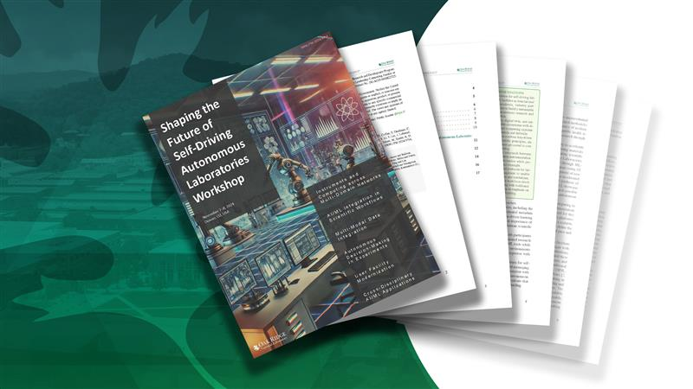
Scientists lay out vision for AI-based ‘labs of the future’ ORNL scientists recently sketched a road map for autonomous research laboratories
A workshop led by scientists at the Department of Energy’s Oak Ridge National Laboratory sketched a road map toward a longtime goal: development of autonomous, or self-driving, next-generation research laboratories.
Key recommendations include:
Establish a national consortium to set standards and promote innovation
Develop software, hardware and networking solutions and digital twins across autonomous laboratory domains
Design hybrid AI systems to integrate data-driven learning with scientific principles
Maintain human oversight of facilities and operations while bridging the time lag between human decisions and autonomous capabilities
Standardize interfaces with lab equipment and data management across institutions
A photo or related graphic
ORNL scientists recently sketched a road map for autonomous research laboratories, or "labs of the future.” Credit: Adam Malin, ORNL
Notes:
https://www.olcf.ornl.gov/2025/02/26/scientists-lay-out-vision-for-ai-based-labs-of-the-future/

