Slide 1

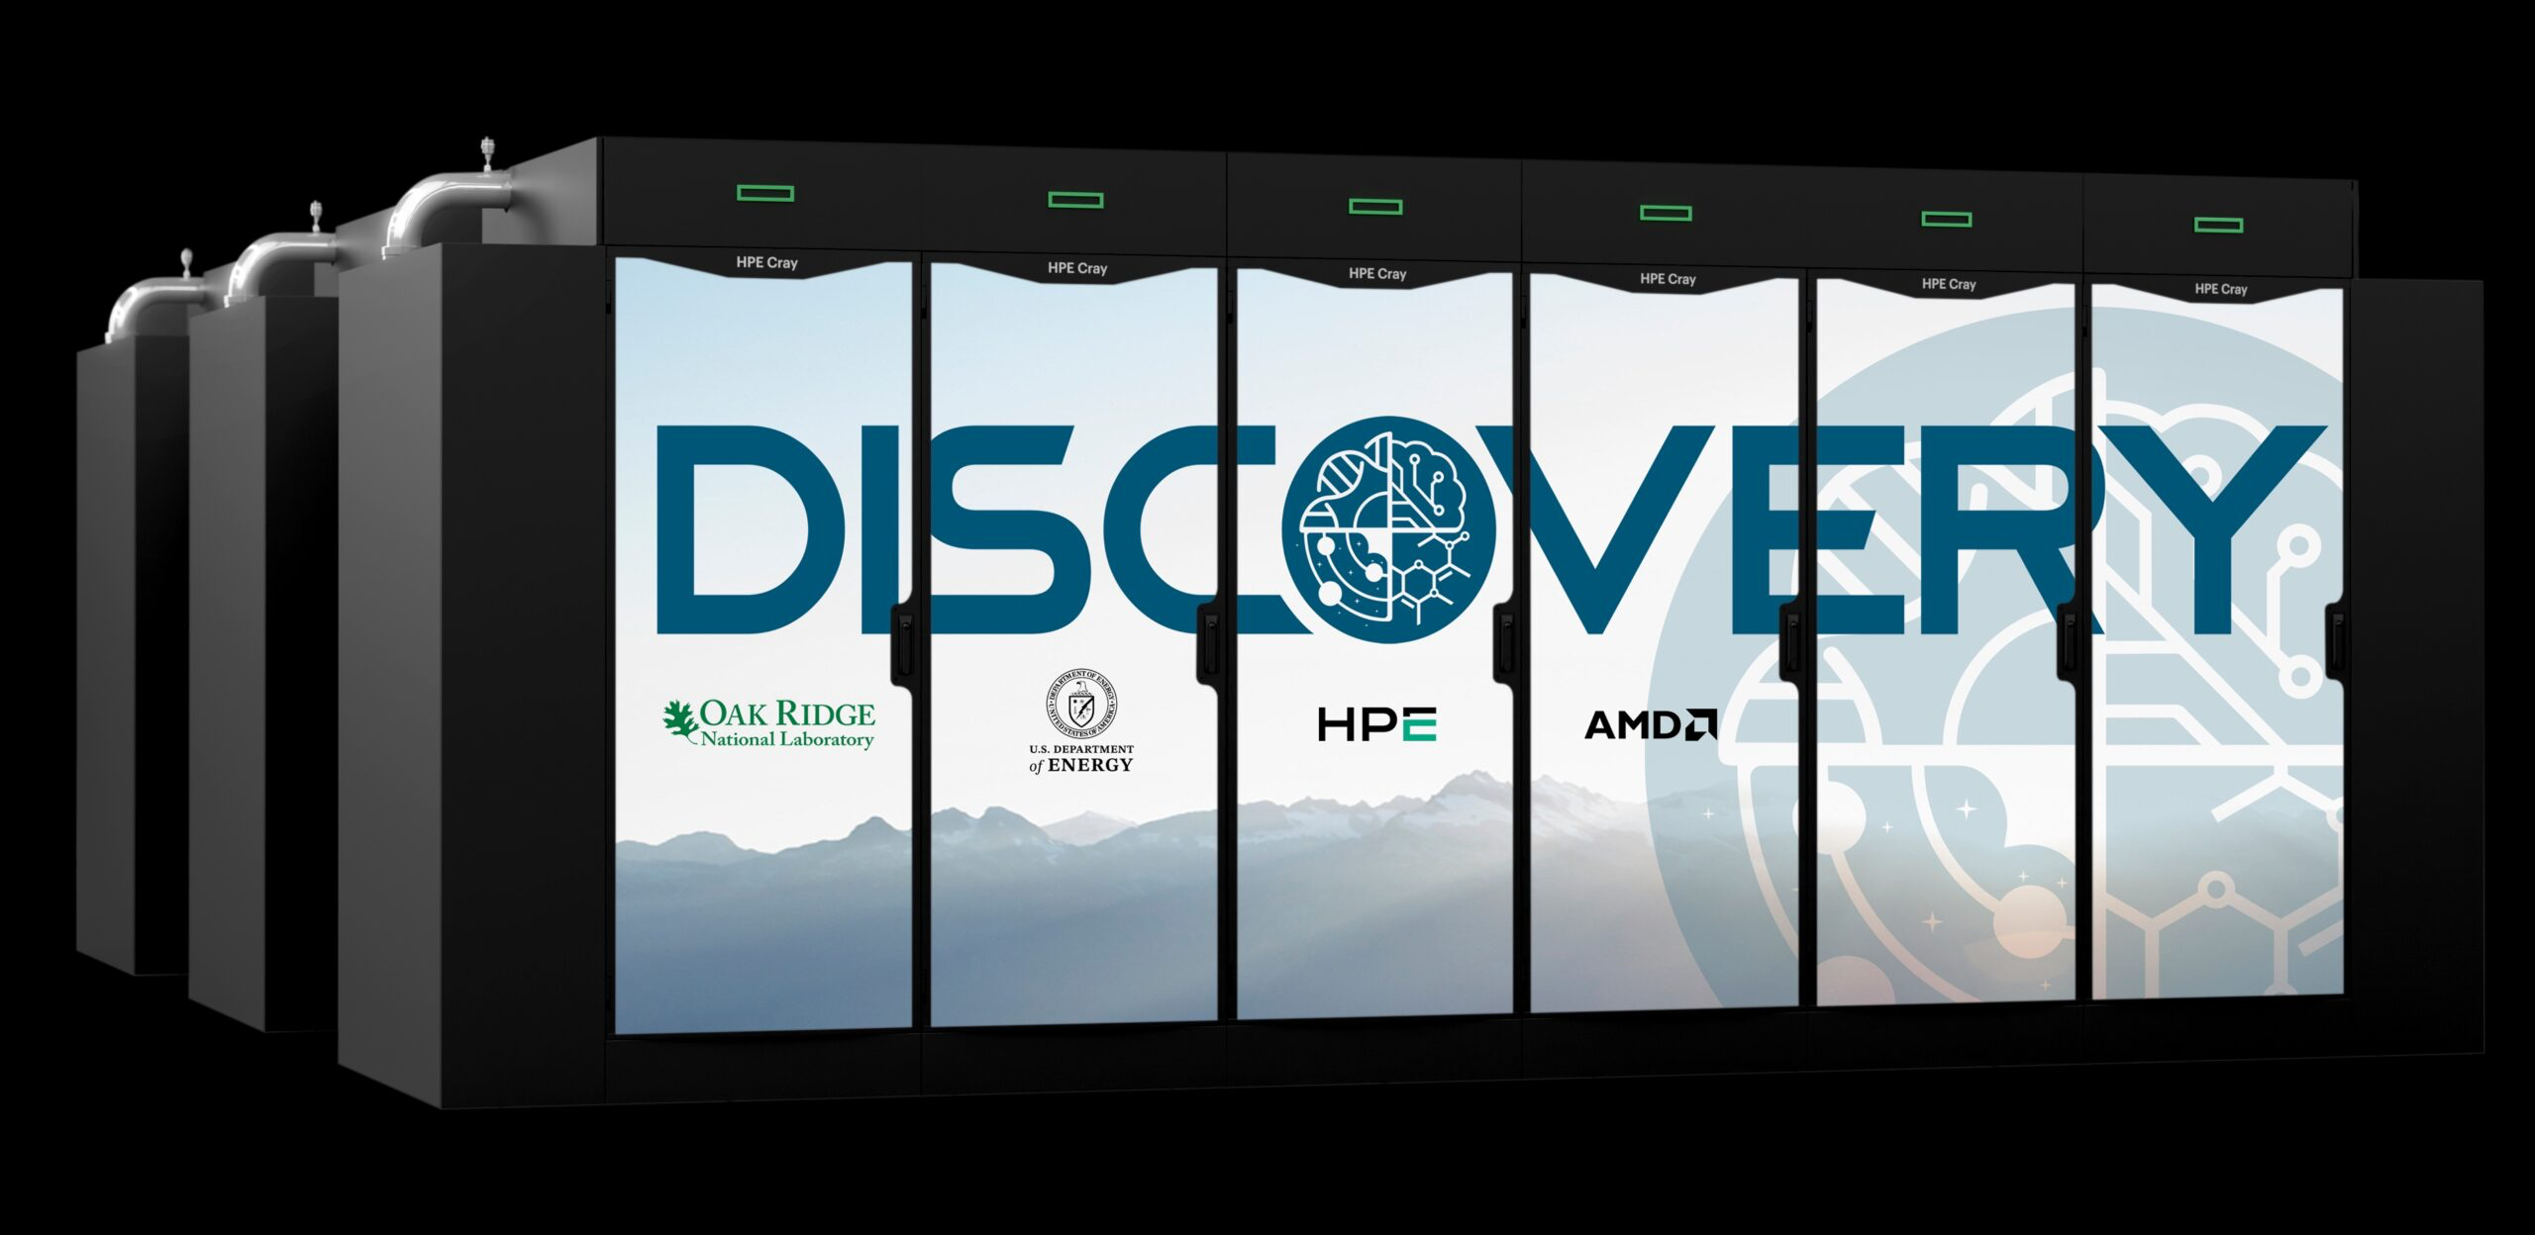

ORNL, AMD and HPE to deliver DOE’s newest AI supercomputers: Discovery and Lux
Scientific Achievement
The U.S. Department of Energy announced its newest supercomputers, Discovery and Lux, at Oak Ridge National Laboratory that will expand America’s leadership in artificial intelligence for scientific computing, strengthen national security, and drive the next generation of Gold Standard Science and innovation.
Significance and Impact
Discovery and Lux are two powerful computing systems designed to help drive new scientific discoveries using artificial intelligence. Both machines will be AMD-accelerated and built by HPE. Discovery will be led by HPE and the AMD-led Lux system will leverage the Oracle Cloud Infrastructure (OCI) as part of the Lux AI Cluster.
Discovery and Lux will enable researchers to explore innovative AI-centric approaches, supporting a new wave of U.S. technological revolutions in energy, manufacturing, medicine and cybersecurity; advancing national leadership; strengthening prosperity; and improving lives.
Technical Approach
ORNL’s Discovery system will be based on the new HPE Cray Supercomputing GX5000, a next generation supercomputer built for the AI era, which is powered by a combination of upcoming next generation AMD EPYC “Venice” processors and AMD Instinct MI430X GPUs.
Lux will employ AMD Instinct™ MI355X GPUs, AMD EPYC™ CPUs, AMD Pensando™ advanced networking, and HPE ProLiant Compute XD685 to deliver a secure, open, and efficient AI software stack for U.S. innovation, supporting large-scale AI training and distributed inference.
ORNL and DOE’s newest AI systems were announced on October 27.
PI(s)/Facility Lead(s): Ashley Barker
Collaborating Institutions: Oak Ridge National Laboratory,
HPE, AMD, OCI
ASCR Program: Oak Ridge Leadership Computing Facility
ASCR PM: Benjamin Brown
Publication(s) for this work: N/A

