Slide 1

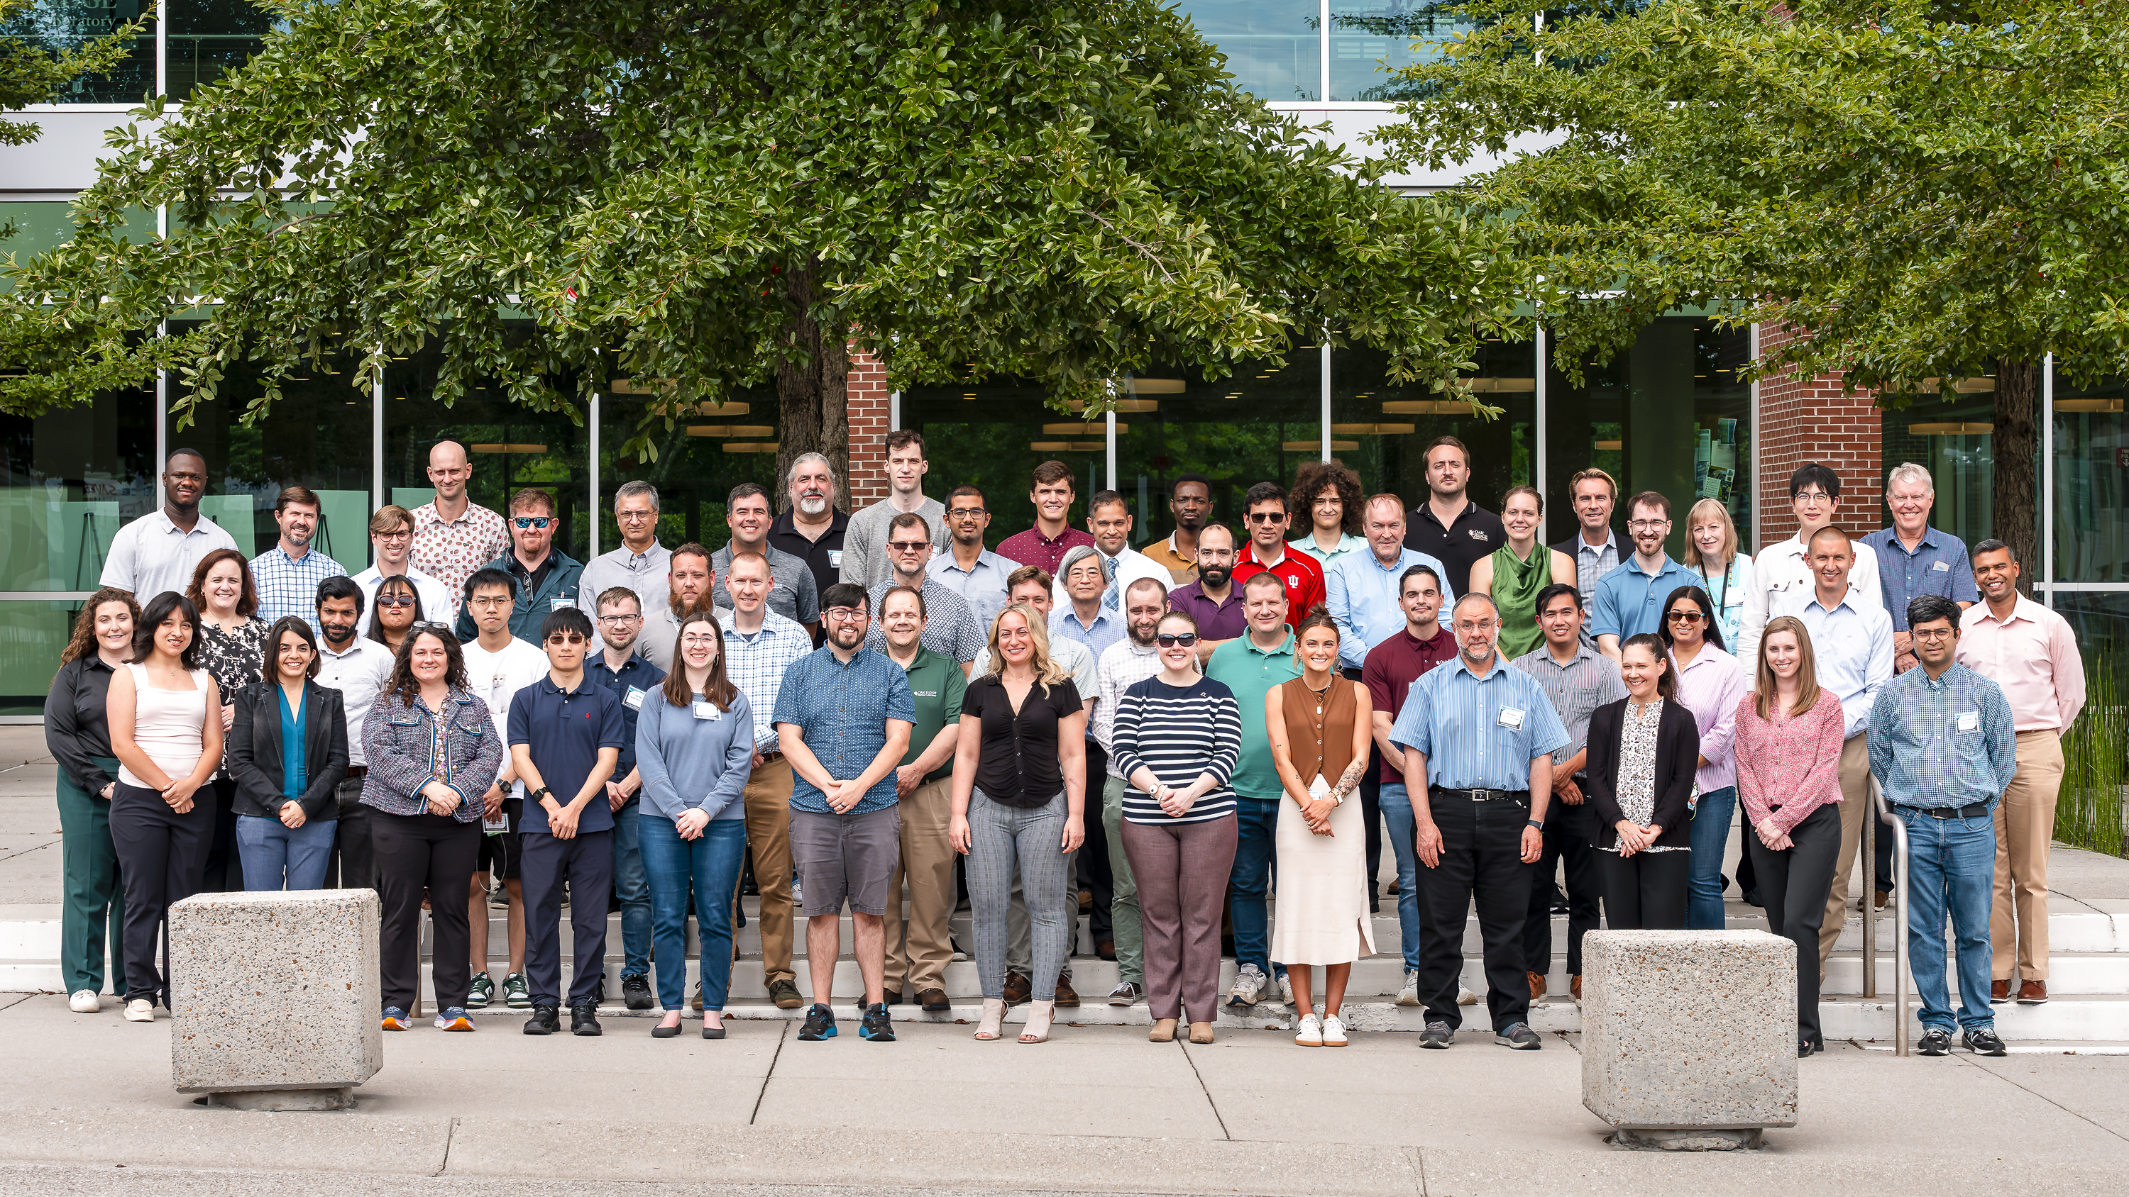
Users of Oak Ridge Leadership Computing Facility gather for 21st annual meeting
Scientific Achievement
The Oak Ridge Leadership Computing Facility (OLCF) welcomed computational scientists from around the world to its 2025 OLCF User Meeting from Aug. 5 – 6.
The event offered attendees an opportunity to share accomplishments, discuss challenges, and explore the road ahead for high-performance computing (HPC) and quantum computing research.
The 21st annual event attracted significant participation with approximately 150 registered attendees.
Significance and Impact
Advancing HPC capabilities and moving toward the convergence of quantum and classical computing to enable next-generation research was a strong theme this year.
Discussions spanned topics from the evolution of HPC tools to the growth of AI and quantum computing in scientific research.
The facility highlighted the steps toward quantum-high-performance computing convergence.
Users gather for a group photo during the OLCF User Meeting on Aug. 5, 2025. Credit: Carlos Jones/ORNL, U.S. Dept. of Energy
Technical Approach
Users got an update on Discovery, the OLCF’s upcoming leadership computing system, will represent a critical step toward creating a “smart exascale ecosystem” that incorporates advanced AI connectivity, integrates scientific workflows, and connects with quantum technologies.
Attendees also learned about the Quantum Computing User Program, which awards time on privately owned quantum devices around the country to support research projects. interfaces.
PI(s)/Facility Lead(s): Verónica Melesse Vergara
Collaborating Institutions: Oak Ridge National Laboratory
ASCR Program: Oak Ridge Leadership Computing Facility
ASCR PM: Ben Brown
Publication(s) for this work:

