Slide 1
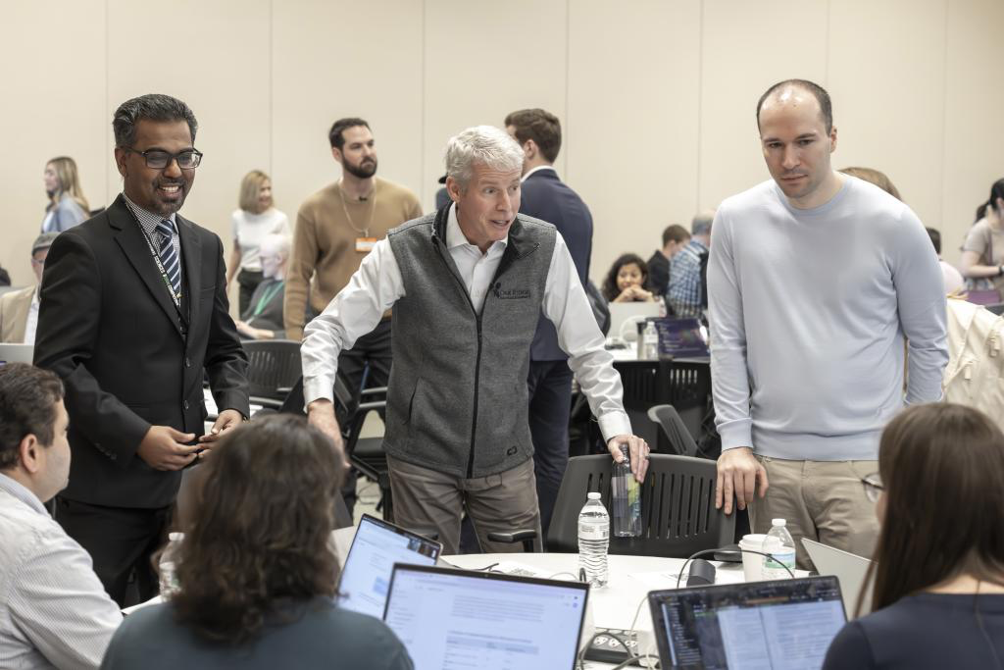
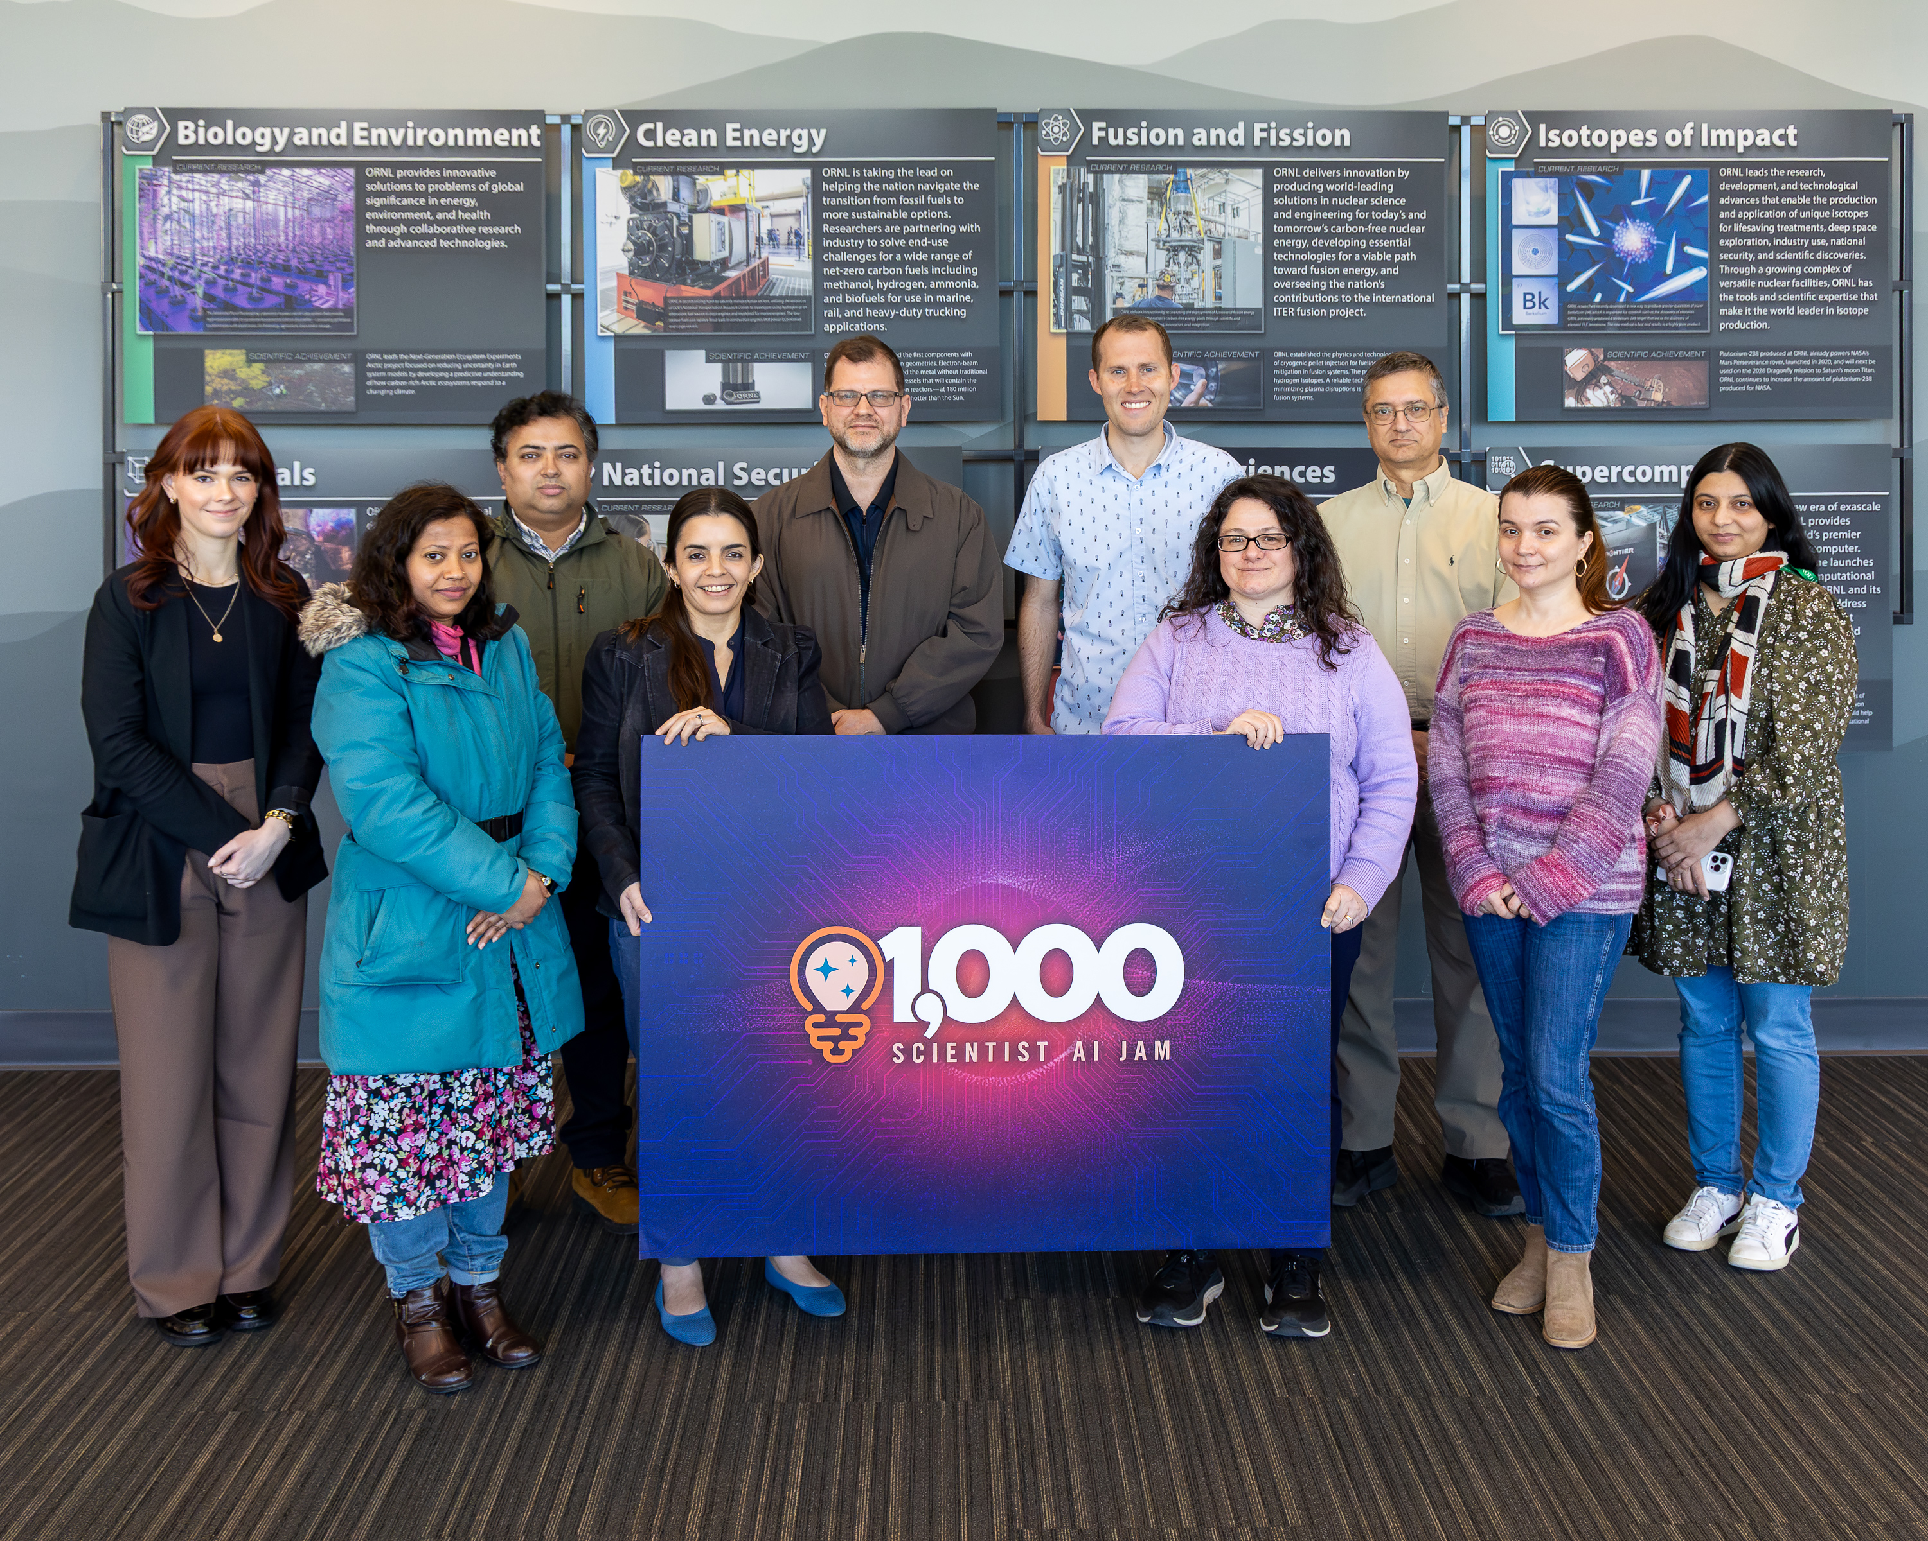
National Labs, Industry Host ‘Jam Session’ to Test AI Models
A first-of-its-kind virtual event brought together leading scientists from 9 national labs
The Department of Energy’s Oak Ridge National Laboratory took part in the “1,000 Scientists AI Jam Session,” a first-of-its-kind virtual event that brought together leading scientists from nine national laboratories to test generative artificial intelligence models for their functionality in scientific research.
ORNL joined Argonne, Berkeley, Livermore, Los Alamos, Idaho and Pacific Northwest national laboratories in the inaugural AI Jam on Feb. 28 to systematically evaluate OpenAI’s and Anthropic’s latest AI models on various scientific challenges.
Department of Energy Secretary Chris Wright observed the event during his visit to ORNL. Along with OpenAI president and co-founder Greg Brockman, Secretary Wright addressed the AI Jam participants and compared the push to advance AI with the Manhattan Project during World War II, which sparked the creation of what would become Oak Ridge National Laboratory.
NCCS staff scientists participated in the DOE 1000 scientist AI Jam: Emily Herron, Khadiza Begam, Tirthankar Ghosal, Verónica Melesse Vergara, Wes Brewer, Richard Messerly, Suzane Parete-Koon, Asim YarKhan, and Maria Batool.
Secretary Wright, center, hears from ORNL participants in the “1,000 Scientists AI Jam Session,” along with ORNL’s Prasanna Balaprakash, left, and OpenAI co-founder Greg Brockman. Credit: Carlos Jones/ORNL, U.S. Dept. of Energy
Some of the NCCS participants (L to R): Emily Herron, Khadiza Begam, Tirthankar Ghosal, Verónica Melesse Vergara, Wes Brewer, Richard Messerly, Suzane Parete-Koon, Asim YarKhan, and Maria Batool.
Notes:
https://www.ornl.gov/news/national-labs-industry-host-jam-session-test-ai-models

