Slide 1
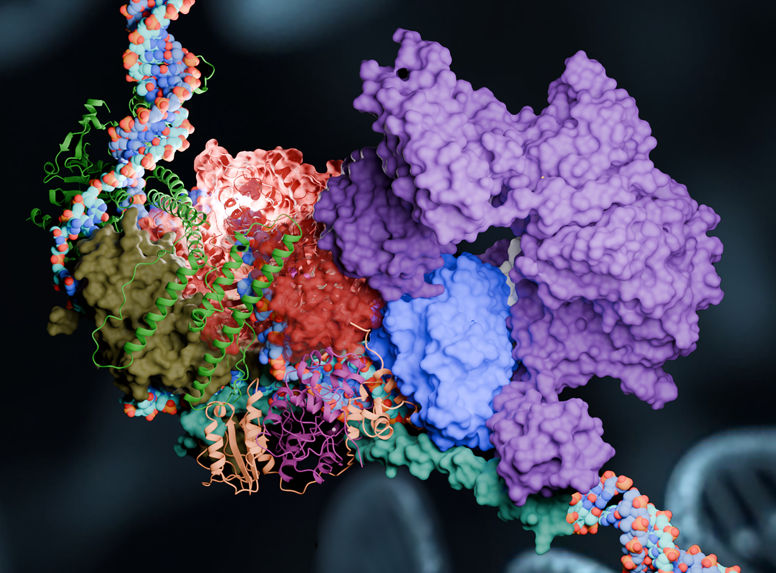
Summit Supercomputer Draws Molecular Blueprint for Repairing Damaged DNA
Scientific Achievement
Scientists used the Summit supercomputer to simulate the actions of the pre-incision complex (PInC), a key component in DNA repair.
PInC is the third and final phase of the nucleotide excision repair (NER), an important molecular pathway that repairs damaged DNA within the cell.
Mutations, or interruptions, in the NER process can cause premature aging and cancer.
Significance and Impact
This breakthrough sheds light on how mutations in DNA repair enzymes lead to genetic diseases and certain types of cancer.
A more comprehensive understanding of the NER process is needed for developing new and improved treatments genetic disorders caused by NER mutations.
The Summit supercomputer revealed how damaged strands of DNA are surgically repaired by a molecular pathway called nucleotide excision repair, or NER. NER’s protein components can change shape to perform different functions of repair on broken strands of DNA (blue and red helix). Credit: Tanmoy Paul, Georgia State University
Technical Approach
PInC was simulated Summit using the NAMD molecular dynamics code.
The AlphaFold2 computer program was used prior to the Summit simulations to predict unknown protein structures and interactions within PInC.
PI(s)/Facility Lead(s): Ivaylo Ivanov
Collaborating Institutions: Oak Ridge National Laboratory, Georgia State University
ASCR Program: INCITE
ASCR PM: Christine Chalk
Publication(s) for this work: Jina Yu, et al., “Molecular architecture and functional dynamics of the pre-incision complex in nucleotide excision repair,” Nature Communications 15, 8511 (2024): DOI: 10.1038/s41467-024-52860-y
Notes:
https://www.olcf.ornl.gov/2025/03/12/summit-supercomputer-draws-molecular-blueprint-for-repairing-damaged-dna/

