Slide 1
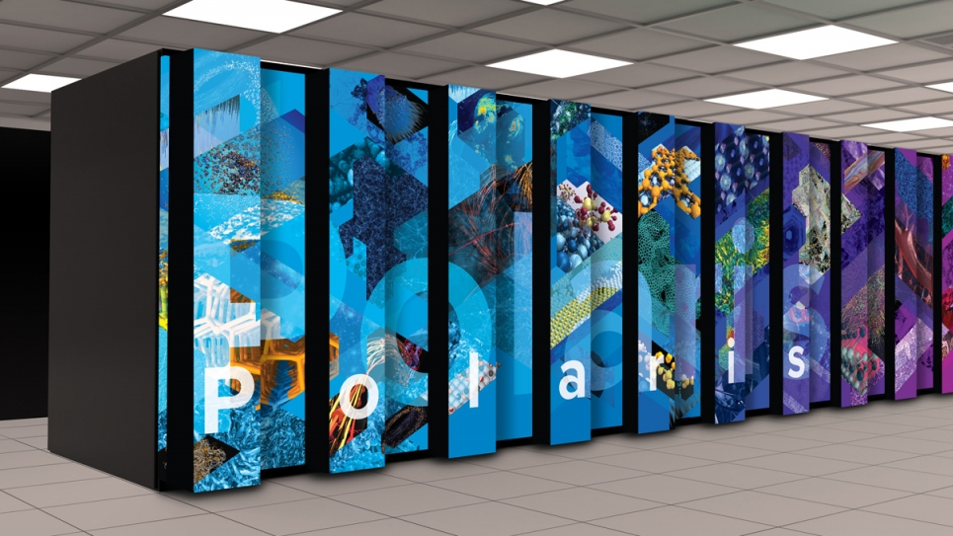
INCITE 2026 is Open
Leadership scale awards on the exascale resources
Call Open: April 9, 2025– June 16, 2025
Decisions announced early November, 2025
INCITE promotes transformational advances in science and technology through large allocations of computer time, supporting resources, and data storage at the Argonne and Oak Ridge Leadership Computing Facilities (LCFs) for compute intensive and/or data intensive large-scale research projects.
https://doeleadershipcomputing.org

