Slide 1

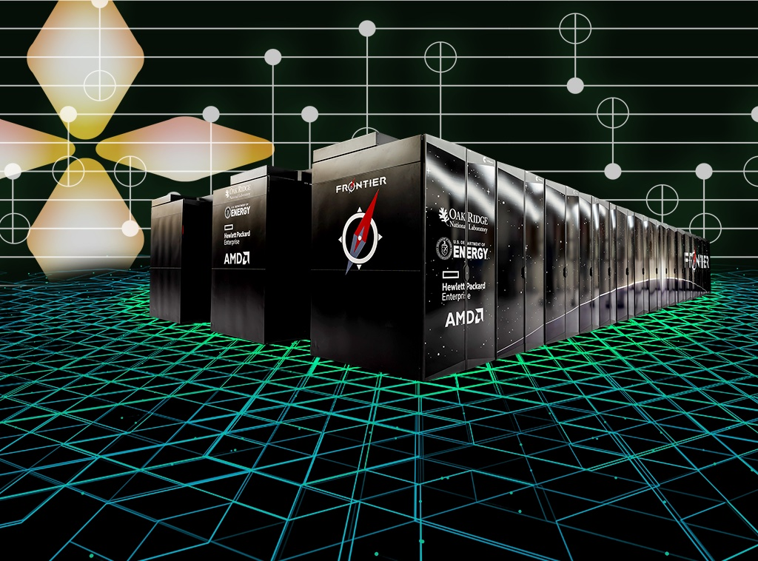
ORNL Study Plans Quantum-HPC Software Stack
Scientific Achievement
ORNL researchers proposed a software architecture that would integrate emerging quantum computers with the world’s fastest supercomputing systems.
A study by researchers at the Department of Energy’s Oak Ridge National Laboratory traces a blueprint for a software architecture that would integrate emerging quantum computers with the world’s fastest supercomputing systems.
Significance and Impact
Finding an effective approach to pair the two distinct computing platforms has become a prime focus for scientists seeking to tap quantum computing’s potential power. The computational capacity of quantum computers, still an emerging computing technology, could ultimately exceed that of classical computers for applications such as scientific modeling.
The study provides a design for a comprehensive tool chain for quantum circuit optimization and execution, allowing programmers to produce performance-portable hybrid applications.
ORNL researchers proposed a software architecture that would integrate emerging quantum computers with the world’s fastest supercomputing systems, such as ORNL’s exascale machine Frontier.
Credit: Jason Smith/ORNL, U.S. Dept. of Energy
Technical Approach
The framework could be used for a quantum computer deployment on the same site as a classical supercomputer such as ORNL’s Frontier. A quantum controller would connect the two machines and act as a kind of interpreter device, translating between quantum and classical computations. The team proposes a specific quantum platform management interface that would simplify this integration and translation, making a variety of combinations easy to deploy.
The study’s proposed framework abstracts hardware-specific details, allowing future designs to be included without fundamentally changing the programming model.
PI(s)/Facility Lead(s): Amir Shehata, Tom Beck
Collaborating Institutions: Oak Ridge National Laboratory
ASCR Program: Oak Ridge Leadership Computing Facility
ASCR PM: Ben Brown
Publication(s) for this work: Shehata, Amir, Peter Groszkowski, Thomas Naughton, Muralikrishnan Gopalakrishnan Meena, Elaine Wong, Daniel Claudino, Rafael Ferreira da Silva, Thomas Beck, “Bridging Paradigms: Designing for HPC-Quantum Convergence,” Future Generation Computer Systems 174, p. 107980 (2026).

