Slide 1
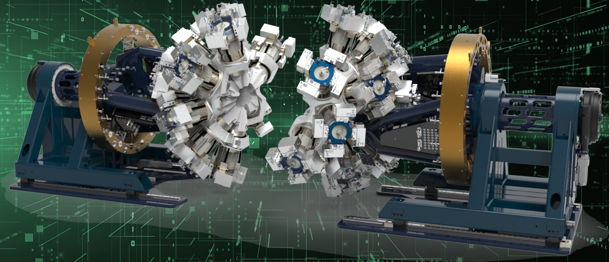
Novel data streaming software connects accelerators to supercomputers Deleria software to stream big data from nuclear physics experiments in real time
Gustav Jansen, a computational nuclear physicist, is working to radically reduce the time it takes to analyze massive datasets from nuclear physics experiments from hours or days to mere seconds using special software he’s developing at ORNL.
Deleria (Distributed Event-Level Experiment Readout and Integrated Analysis) is a novel software platform designed to support the Gamma Ray Energy Tracking Array, or GRETA, a cutting-edge nuclear physics instrument. GRETA is currently under construction at Berkeley Lab and is scheduled to be installed in 2026 at the Facility for Rare Isotope Beams at Michigan State University.
“Our primary goal is to establish a data pipeline for future experimental needs without having to build a local computing infrastructure. The pipeline will also allow us to increase the amount of analysis that is performed online,” said Jansen. “We also intend to show that Deleria can be scaled to work with other research facilities and a broader range of scientific applications.”
The GRETA testbed is part of OLCF’s Advanced Computing Ecosystem, or Ace, a testbed that provides computing and data resources for a wide range of system architectures. ACE is supported by DOE’s Integrated Research Infrastructure, or IRI, an initiative to integrate leadership-class computing centers and research facilities within the U.S. national laboratory system.
Under construction at Berkeley Lab, the Gamma-Ray Energy Tracking Array (GRETA) is a cutting-edge instrument for nuclear physics. Software developed at Oak Ridge National Laboratory will enable GRETA to send data to the nation’s fastest supercomputers for immediate analysis, radically reducing data storage needs and enabling real-time experiment adjustments for optimal results. Credit: Jason Smith/ORNL, Berkeley Lab, U.S. Dept of Energy

