Slide 1

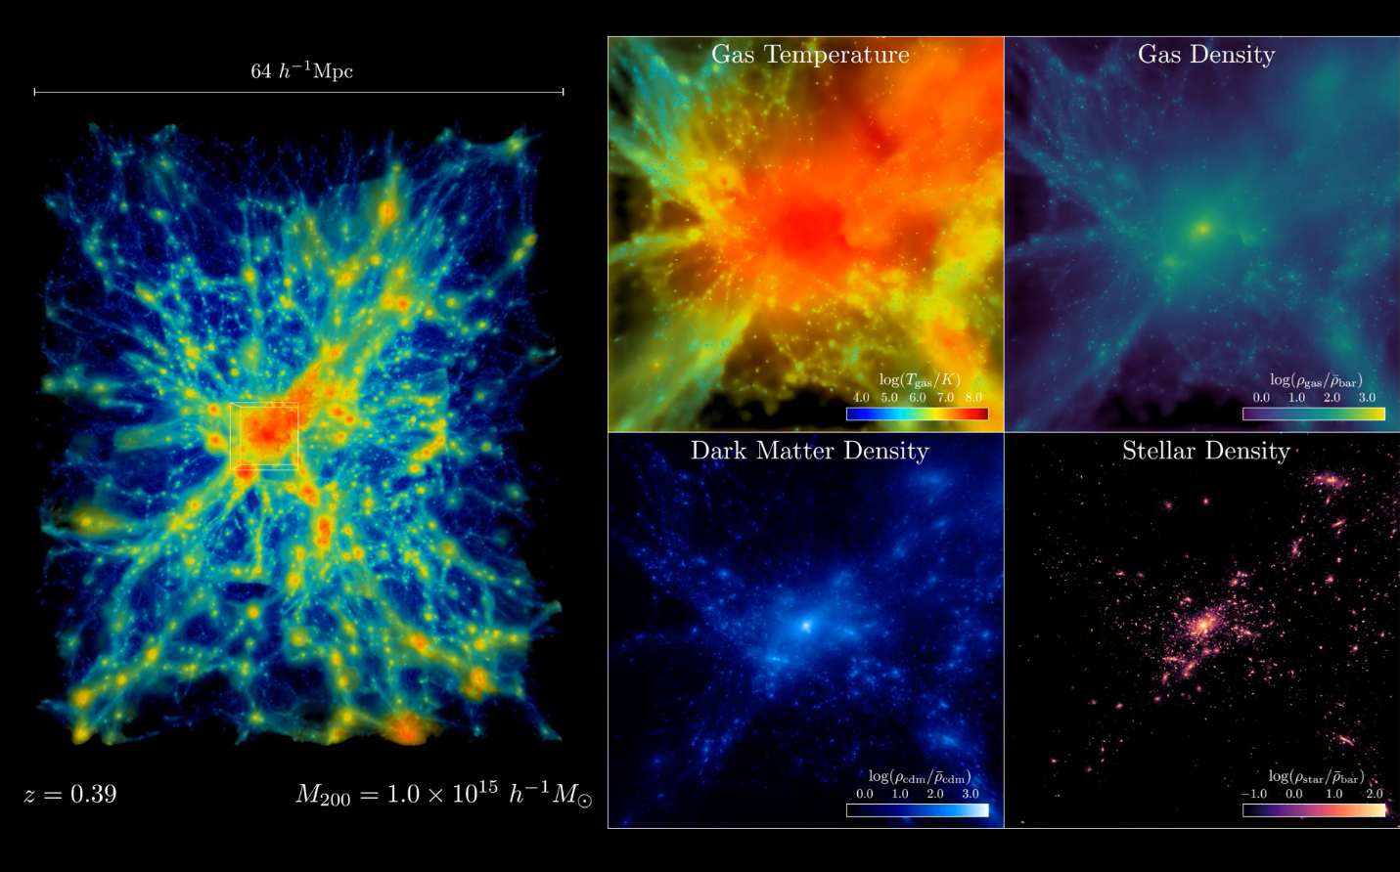
Largest-Ever Universe Simulation up for Supercomputing’s Highest Prize
Scientific Achievement
Researchers at Argonne and Oak Ridge National Laboratories are nominated for the 2025 Gordon Prize for conducting the largest-ever simulation of the universe using the Frontier supercomputer.
The achievement sets a new benchmark for simulating the universe, enabling scientists to study atomic matter and dark matter simultaneously.
Significance and Impact
The simulations tracked 4 trillion particles, represented across 15 billion light-years of space — delivering a 15-fold leap in capability over the previous state-of-the-art simulations.
The simulation size corresponds to surveys undertaken by large telescope observatories, a feat that until now has not been possible at this scale.
Left: HACC simulation about 10 billion years after the Big Bang. Right: Zoomed-in view showing dark matter, stars, and gas. Center: Gas nears 100 million Kelvin (about 180 million °F). Credit: Argonne National Laboratory, U.S. Dept. of Energy.
Technical Approach
Simulations harnessed nearly 9,000 Frontier nodes.
Record-breaking performance enabled via four key innovations
  GPU Tree Solver —data structure that computes gas and dark matter.
  Warp Splitting —algorithm that splits GPU warp for sharing partial results, cutting redundancy and speeding physics calculations.
  In situ GPU-Accelerated End-to-End Analysis — data directly processed on GPU during simulation, reducing need to store massive data sets for post processing.
  Multi-Tiered I/O — buffers simulation data on fast node-local NVMe drives before asynchronously transferring it to the shared parallel file system, overlapping I/O with execution to minimize overhead.
PI(s)/Facility Lead(s): Nick Frontiere
Collaborating Institutions: Argonne National Laboratory
ASCR Program: OLCF
ASCR PM: Benjamin Brown
Publication(s) for this work: Frontiere, et al., “Cosmological Hydrodynamics at Exascale: A Trillion-Particle Leap in Capability,” SC '25: Proceedings of the International Conference for High Performance Computing, Networking, Storage and Analysis (2025). https://doi.org/10.1145/3712285.3771786
Hardware/Hybrid Accelerated Cosmology Code (HACC)
Notes:
In the News:
“Record-Breaking Run on Frontier Sets New Bar for Simulating the Universe in the Exascale Era”
https://www.olcf.ornl.gov/2024/11/19/record-breaking-run-on-frontier-sets-new-bar-for-simulating-the-universe-in-the-exascale-era/

