Slide 1
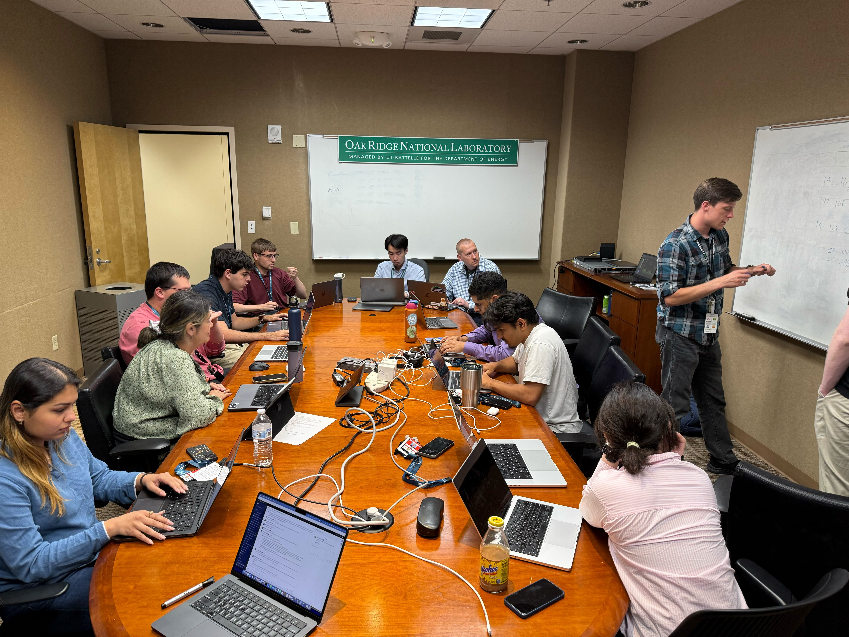
Back to HPC Basics The Oak Ridge Computing Academy aims to fill gap in HPC training with hands-on system administration
Building on a successful pilot with students from this summer’s Pathways to Computing Internship Program, the Oak Ridge Leadership Computing Facility at the Department of Energy’s Oak Ridge National Laboratory will launch a new training program to develop the next generation of advanced computing professionals: hands-on administration of high-performance computing, or HPC, systems.
Set to launch in June 2026, the Oak Ridge Computing Academy, or ORCA, will be an annual event — open to students and professionals — that will task participants with building, configuring, and operating an HPC cluster, thereby providing firsthand experience in how these systems work.
Dr. Fernando Posada, who leads the National Center for Computational Sciences’ System Acceptance and User Environment Group at ORNL, decided to introduce the systems-oriented course to address the shortage of training opportunities in the fundamentals of HPC operations.
Students may lack direct experience in the technical aspects of system administration because it’s not usually part of their degree programs. However, because HPC clusters are the foundation of significant computational science as well as artificial intelligence campaigns, there is a growing need for expertise in this area.
Students in this summer’s Pathways to Computing Internship Program at the Department of Energy’s Oak Ridge National Laboratory learned how to assemble and run a computer cluster. The week-long pilot class is a preview for a dedicated workshop starting in 2026: the Oak Ridge Computing Academy. Credit: Fernando Posada, ORNL, U.S. Dept. of Energy
Posada is refining the coursework based on lessons learned from the pilot and will launch ORCA next June — this time with physical hardware for its participants to work on. Announcements will be made with application requirements and workshop dates.
Notes:
Learn more about the application process here: https://www.olcf.ornl.gov/olcf-6-rfp.

