Slide 1
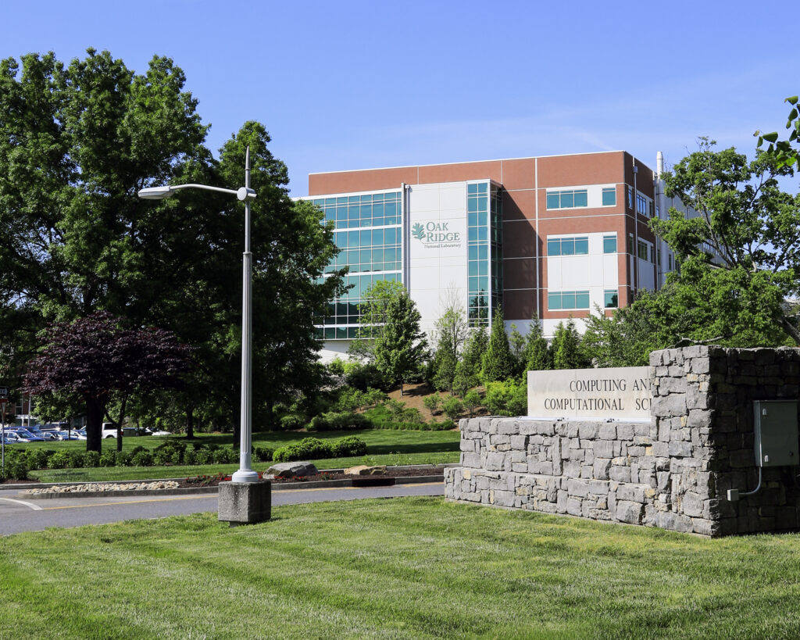
DOE Opens Bids to Construct ORNL’s Next-Generation Supercomputer Contract will be awarded to develop the newest high-performance computing system at the OLCF
The Department of Energy released a request for proposals to advance its leadership in high-performance computing, inviting vendors to submit their plans for a successor to Oak Ridge National Laboratory’s exascale (a quintillion or more calculations per second) supercomputer, Frontier.
The future system, to be called Discovery, will be designed to offer new computational capabilities over Frontier, currently the fastest supercomputer in the world at 1.206 exaflops on the High-Performance Linpack, or HPL, benchmark. The target for Discovery’s delivery to the Oak Ridge Leadership Computing Facility, or OLCF, is 2027 or early 2028. The OLCF is a DOE Office of Science user facility at ORNL and home of Frontier.
The request for proposals, or RFPs, for Discovery sets a wide range of goals for the next-generation system, such as advanced artificial intelligence and machine learning capabilities, improved energy efficiency, full-system modeling and simulation and seamless interoperability with other DOE facilities through the Integrated Research Infrastructure, or IRI, initiative, which seeks to combine research tools and scientific facilities.
Image credit: Carlos Jones/ORNL
Unlike previous RFPs issued by the OLCF, the request does not cite a specific speedup goal over its predecessor, but the facility expects Discovery to deliver three to five times more computational throughput for benchmarks and scientific applications than Frontier.
Vendors will have until 5 p.m. ET on August 30, 2024, to submit their proposals for Discovery. The RFP is being managed by UT-Battelle, which operates Oak Ridge National Laboratory on behalf of the Department of Energy.
Notes:
Learn more about the application process here: https://www.olcf.ornl.gov/olcf-6-rfp.

