Slide 1
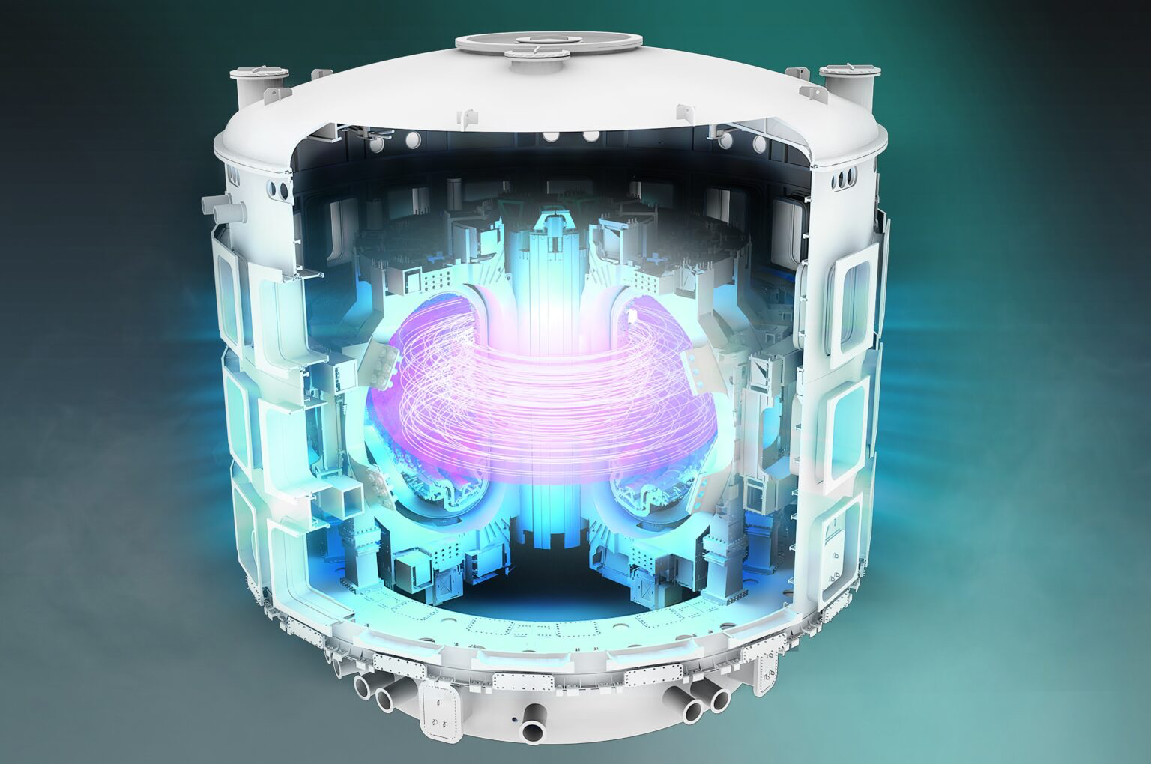
Exascale’s New Frontier: SuperLU/STRUMPACK The open-source, factorization-based sparse solvers get an exascale upgrade
Why exascale needs SuperLU and STRUMPACK One of the most efficient approaches to solving calculations in large-scale multiphysics and multiscale modeling codes is the use of factorization-based algorithms. SuperLU (named after lower-upper factorization) and STRUMPACK (STRUctured Matrix PACKage) are two such open-source, factorization-based sparse solvers that have been widely used for simulation in both industry and academia. However, with the advent of exascale-class supercomputers that enable much larger and higher-resolution simulations, these two CPU-centric packages required major updates to run well on the new GPU-accelerated architectures.
Technical Challenges Exascale supercomputers such as Frontier contain thousands of compute nodes, which hold the system’s CPUs and GPUs. Matrices in many simulation codes must be distributed across all these nodes to fully leverage the machine’s massive parallelism. This distributed computing requires the solver’s algorithms and their work to be communicated and coordinated among these nodes and their GPUs and CPUs. Although integral to distributed parallel computing, this communication becomes an encumbrance at extreme scales.
The SuperLU and STRUMPACK solvers have been used by simulation codes working on projects such as the ITER tokamak, which will be the largest fusion device of its kind when built. Image: US ITER
ECP and Frontier successes The updated SuperLU and STRUMPACK solvers have been successfully implemented in several important simulation codes:
M3D-C1 is used for calculating the equilibrium, stability and dynamics of fusion plasmas.
Omega3P is used for cavity design optimization for projects such as linear particle accelerators.
MFEM is used for scalable finite element discretization research and application development.
These libraries have also been used in higher-level mathematical frameworks, which build on lower-level linear algebra kernels.

