Slide 1
Using Darshan to Profile I/O on Frontier
Jordan Winetrout
05/19/2026
User Assistance, NCCS
Notes:
The video recording that accompanied this training can be found at https://vimeo.com/1193732406?share=copy&fl=sv&fe=ci

Slide 2
Table of Contents: How to Darshan
Setup
Data Generation
Report Analysis

Slide 3
Table of Contents: How to Darshan
Setup
Data Generation
Data Analysis
1. Basic Setup
1. Basic (CLI)
1. Basic (CLI)
2. Intermediate Setup (Runtime Config.)
2. Intermediate (Python)
2. Intermediate (darshan)
3. Advanced Setup (HDF5)
3. Advanced (DXT)
3. Advanced (DXT)
Notes:
Enter presentation mode and click on one of the titles to jump to the relevant slide section.

Slide 4
Symptoms of Bad I/O
Notes:
Hurts Code Performance:
Frequently accessing files on Orion can create bottlenecks, especially in data-intensive applications
At scale ranks can contend for file/directory access limiting performance
Likely causes compute resources to sit idle as I/O is completing
Checkpointing becomes unreliable
Creates ambiguous crashes:
Personally have seen bad I/O cause node crashes or leaves nodes in a bad state
Additionally, various RCCL/NCCL errors are actually b/c of bad I/O
Impacts other users:
1. Since

Slide 5
Hurts code performance:
Creates bottlenecks in data-intensive applications
Rank contention can lock your application
Compute resources are likely to idle
Checkpointing becomes unreliable
Notes:
Hurts Code Performance:
Frequently accessing files on Orion can create bottlenecks, especially in data-intensive applications
At scale ranks can contend for file/directory access limiting performance
Likely causes compute resources to sit idle as I/O is completing
Checkpointing becomes unreliable
Creates ambiguous crashes:
Personally have seen bad I/O cause node crashes or leaves nodes in a bad state
Additionally, various RCCL/NCCL errors are actually b/c of bad I/O
Impacts other users:
1. Since

Slide 6
Hurts code performance:
Creates bottlenecks in data-intensive applications
Rank contention can lock your application
Compute resources are likely to idle
Checkpointing becomes unreliable
Creates ambiguous errors:
I/O cause node crashes
Triggers NCCL/RCCL timeout warnings
Notes:
Hurts Code Performance:
Frequently accessing files on Orion can create bottlenecks, especially in data-intensive applications
At scale ranks can contend for file/directory access limiting performance
Likely causes compute resources to sit idle as I/O is completing
Checkpointing becomes unreliable
Creates ambiguous crashes:
Personally have seen bad I/O cause node crashes or leaves nodes in a bad state
Additionally, various RCCL/NCCL errors are actually b/c of bad I/O
Impacts other users:
1. Since

Slide 7
Hurts code performance:
Creates bottlenecks in data-intensive applications
Rank contention can lock your application
Compute resources are likely to idle
Checkpointing becomes unreliable
Creates ambiguous errors:
I/O cause node crashes
Triggers NCCL/RCCL timeout warnings
Impacts other users:
Orion is shared among all moderate enclave users
Many small, frequent requests can overwhelm the Lustre MDS
Notes:
Hurts Code Performance:
Frequently accessing files on Orion can create bottlenecks, especially in data-intensive applications
At scale ranks can contend for file/directory access limiting performance
Likely causes compute resources to sit idle as I/O is completing
Checkpointing becomes unreliable
Creates ambiguous crashes:
Personally have seen bad I/O cause node crashes or leaves nodes in a bad state
Additionally, various RCCL/NCCL errors are actually b/c of bad I/O
Impacts other users:
1. Since

Slide 8
Creates ambiguous errors:
I/O cause node crashes
Triggers NCCL/RCCL timeout warnings
Impacts other users:
Orion is shared among all moderate enclave users
Many small, frequent requests can overwhelm the Lustre MDS
Hurts code performance:
Creates bottlenecks in data-intensive applications
Rank contention can lock your application
Compute resources are likely to idle
Checkpointing becomes unreliable
Notes:
Hurts Code Performance:
Frequently accessing files on Orion can create bottlenecks, especially in data-intensive applications
At scale ranks can contend for file/directory access limiting performance
Likely causes compute resources to sit idle as I/O is completing
Checkpointing becomes unreliable
Creates ambiguous crashes:
Personally have seen bad I/O cause node crashes or leaves nodes in a bad state
Additionally, various RCCL/NCCL errors are actually b/c of bad I/O
Impacts other users:
1. Since

Slide 9
Setup: The Basics
1. Use the `darshan-runtime/3.4.7-mpi` (non-default) module
Data Generation
Report Analysis
Notes:
The darshan-runtime/3.4.7-mpi version is loaded if you use the cpe/26.03 module

Slide 10
Setup: The Basics
1. Use the `darshan-runtime/3.4.7-mpi` (non-default) module
Data Generation
Report Analysis
[user@login00.frontier ~] module unload darshan-runtime

Slide 11
Setup: The Basics
1. Use the `darshan-runtime/3.4.7-mpi` (non-default) module
Data Generation
Report Analysis
[user@login00.frontier ~] module unload darshan-runtime

Slide 12
Setup: The Basics
Use the `darshan-runtime/3.4.7-mpi` (non-default) module
Use the Cray provided compilers (cc, CC, ftn)
Data Generation
Report Analysis

Slide 13
Setup: The Basics
Use the `darshan-runtime/3.4.7-mpi` (non-default) module
Use the Cray provided compilers (cc, CC, ftn)
Data Generation
Report Analysis
[user@login00.frontier ~]$ ldd my_program.o | grep darshan libdarshan.so.0 => /sw/frontier/…

Slide 14
Setup: The Basics
Use the `darshan-runtime/3.4.7-mpi` (non-default) module
Use the Cray provided compilers (cc, CC, ftn)
LD_PRELOAD the darshan runtime libraries (e.g., Python)
Data Generation
Report Analysis
Notes:
NOTES: system libfabric and darshan paths can be found by doing `module show libfabric` and using the path specified at LD_LIBRARY_PATH.
The darshan path can be found in the same way.

Slide 15
Setup: The Basics
Use the `darshan-runtime/3.4.7-mpi` (non-default) module
Use the Cray provided compilers (cc, CC, ftn)
LD_PRELOAD the darshan runtime libraries (e.g., Python)
Data Generation
Report Analysis
[user@login00.frontier ~]$ srun –N1 –n8 \
--export=LD_PRELOAD=“$LIBFABRIC_PATH $DARSHAN_PATH” \
my_program.o
Pros:
Simple
Lightweight
Cons:
Minimal information
Notes:
NOTES: system libfabric and darshan paths can be found by doing `module show libfabric` and using the path specified at LD_LIBRARY_PATH
The variables should be absolute paths to th libfabric.so or libdarshan.so files.

Slide 16
Setup: The Basics
Pros:
Simple
Lightweight
Cons:
Minimal information
Use the `darshan-runtime/3.4.7-mpi` (non-default) module
Use the Cray provided compilers (cc, CC, ftn)
LD_PRELOAD the darshan runtime libraries (e.g., Python)
Data Generation
Report Analysis
[user@login00.frontier ~]$ srun –N1 –n8 \
--export=LD_PRELOAD=“$LIBFABRIC_PATH $DARSHAN_PATH” \
my_program.o
Notes:
NOTES: system libfabric and darshan paths can be found by doing `module show libfabric` and using the path specified at LD_LIBRARY_PATH

Slide 17
Data Generation: The Basics
Load the `darshan-util` module
Use the `darshan-parser` CLI tool
Data Generation
Report Analysis
[user@login00.frontier ~]$ module load darshan-util
[user@login00.frontier ~]$ darshan-parser --perf user_job_info.darshan
Notes:
NOTES: all darshan logs will be output to /lustre/orion/darshan/frontier/YYYY/M/D folder (the month and day are not 0 padded. e.g., January 1st is 2026/1/1 and not 2026/01/01)

Slide 18
Data Analysis: The Basics
# darshan module information
# executable name
# job start time, end time, metadata
# Darshan module information
---------------------------------------
# mounted filesystem information (probably ignore)
-----------------------------------------------------------------
# *************************
# Aggregated module data
# ************************
# performance
# -----------------
# total_bytes: 25721556255
#
# I/O timing for unique files (seconds):
# ...........................
# unique files: slowest_rank_io_time: 5.945565
# unique files: slowest_rank_meta_only_time: 0.281527
# unique files: slowest_rank_rw_only_time: 5.664038
# unique files: slowest_rank: 0
#
:
# ...........................
# agg_time_by_slowest: 7.037834 # seconds
# agg_perf_by_slowest: 3485.445639 # MiB/s
Load the `darshan-util` module
Use the `darshan-parser` CLI tool
Data Generation
Report Analysis
Notes:
NOTES: all darshan logs will be output to /lustre/orion/darshan/frontier/YYYY/M/D folder (the month and day are not 0 padded. e.g., January 1st is 2026/1/1 and not 2026/01/01)

Slide 19
Data Analysis: The Basics
# darshan module information
# executable name
# job start time, end time, metadata
# Darshan module information
---------------------------------------
# mounted filesystem information (probably ignore)
-----------------------------------------------------------------
# *************************
# Aggregated module data
# ************************
# performance
# -----------------
# total_bytes: 25721556255
#
# I/O timing for unique files (seconds):
# ...........................
# unique files: slowest_rank_io_time: 5.945565
# unique files: slowest_rank_meta_only_time: 0.281527
# unique files: slowest_rank_rw_only_time: 5.664038
# unique files: slowest_rank: 0
#
:
# ...........................
# agg_time_by_slowest: 7.037834 # seconds
# agg_perf_by_slowest: 3485.445639 # MiB/s
Load the `darshan-util` module
Use the `darshan-parser` CLI tool
Data Generation
Report Analysis
NOTE: If you do not have any Darshan MODULES loaded then you will see aggregated module data
Notes:
NOTES: all darshan logs will be output to /lustre/orion/darshan/frontier/YYYY/M/D folder (the month and day are not 0 padded. e.g., January 1st is 2026/1/1 and not 2026/01/01)

Slide 20
Setup: Intermediate
Provide environment variables at runtime – config variables
  export DXT_ENABLE_IO_TRACE=1
  export DARSHAN_MOD_ENABLE="LUSTRE, POSIX, STDIO,MPI-IO,DXT_POSIX,DXT_MPIIO”
Data Generation
Report Analysis
Notes:
NOTES: system libfabric and darshan paths can be found by doing `module show libfabric` and using the path specified at LD_LIBRARY_PATH
Probably the most useful variable would be to enable certain modules (e.g., LUSTRE and Darshan extended (DXT)).
However, certain environment variables can alter configuration parameters (eg., DARSHAN_MODMEM or DARSHAN_INTERNAL_TIMING)

Slide 21
Setup: Intermediate
Provide environment variables at runtime – config variables
  export DXT_ENABLE_IO_TRACE=1
  export DARSHAN_MOD_ENABLE="LUSTRE, POSIX, STDIO,MPI-IO,DXT_POSIX,DXT_MPIIO”
Provide a Darshan config file at runtime:
  export DARSHAN_CONFIG_PATH=”./darshan.conf”
Data Generation
Report Analysis
Notes:
NOTES: system libfabric and darshan paths can be found by doing `module show libfabric` and using the path specified at LD_LIBRARY_PATH
Probably the most useful variable would be to enable certain modules (e.g., LUSTRE and Darshan extended (DXT)).
However, certain environment variables can alter configuration parameters (eg., DARSHAN_MODMEM or DARSHAN_INTERNAL_TIMING)

Slide 22
Setup: Intermediate
[user@login00.frontier ~]$ cat darshan.conf
MAX_RECORDS 4096 LUSTRE, POSIX, STDIO,MPI-IO,DXT_POSIX,DXT_MPIIO
NAME_EXCLUDE /tmp/* DXT_POSIX,DXT_MPIIO
NAME_INCLUDE /tmp/myapplication/exception DXT_POSIX,DXT_MPIIO
DARSHAN_INTERNAL_TIMING 1
[user@login00.frontier ~]$
Provide environment variables at runtime – config variables
  export DARSHAN_MOD_ENABLE="LUSTRE, POSIX, STDIO,MPI-IO,DXT_POSIX,DXT_MPIIO”
Provide a Darshan config file at runtime:
  export DARSHAN_CONFIG_PATH=”./darshan.conf”
Data Generation
Report Analysis
Notes:
Format (Note: there is no header or interpreter directive on the first line):
MAX_RECORDS [value] [list of comma-separated modules the value should apply to]
NAME_EXCLUDE [comma-separated list of regex values] [comma-separated list of modules the exclusion should apply to]
NAME_INCLUDE [comma-separated list of regex values (overrides NAME_EXCLUDE)]

Slide 23
Setup: Intermediate
[user@login00.frontier ~]$ cat darshan.conf
MAX_RECORDS 4096 LUSTRE, POSIX, STDIO,MPI-IO,DXT_POSIX,DXT_MPIIO
NAME_EXCLUDE /tmp/* DXT_POSIX,DXT_MPIIO
NAME_INCLUDE /tmp/myapplication/exception DXT_POSIX,DXT_MPIIO
DARSHAN_INTERNAL_TIMING 1
[user@login00.frontier ~]$
Provide environment variables at runtime – config variables
  export DARSHAN_MOD_ENABLE="LUSTRE, POSIX, STDIO,MPI-IO,DXT_POSIX,DXT_MPIIO”
Provide a Darshan config file at runtime:
  export DARSHAN_CONFIG_PATH=”./darshan.conf”
Data Generation
Report Analysis
NOTE: DXT modules increase runtime cost (~1%). Should be used when the rank and/or OST granularity is required.
Notes:
Format (Note: there is no header or interpreter directive on the first line):
MAX_RECORDS [value] [list of comma-separated modules the value should apply to]
NAME_EXCLUDE [comma-separated list of regex values] [comma-separated list of modules the exclusion should apply to]
NAME_INCLUDE [comma-separated list of regex values (overrides NAME_EXCLUDE)]

Slide 24
Setup: Intermediate (Python Env)
1. Install the `darshan` and `dxt-explorer` python libraries
Data Generation
Report Analysis
[user@login00.frontier ~]$ module load miniforge3
(base) [user@login00.frontier ~]$ conda create –n darshan python=3.12
(base) [user@login00.frontier ~]$ source activate darshan
(darshan) [user@login00.frontier ~]$ pip install darshan dxt-explorer
Notes:
Format (Note: there is no header or interpreter directive on the first line):
MAX_RECORDS [value] [list of comma-separated modules the value should apply to]
NAME_EXCLUDE [comma-separated list of regex values] [comma-separated list of modules the exclusion should apply to]
NAME_INCLUDE [comma-separated list of regex values (overrides NAME_EXCLUDE)]

Slide 25
Data Generation: Intermediate (darshan)
1. Use the `darshan` module to view I/O stats
Data Generation
Report Analysis
(darshan) [user@login00.frontier ~]$ python –m darshan [command] file.darshan
job_stats | file_stats | summary*
Terminal output Use `--module` flag to view aggregate module statistics (default: POSIX) | Terminal output Use `--module` flag to view per-file module statistics (default: POSIX) | HTML output `--enable_dxt_heatmap` if DXT modules were used
https://darshan.readthedocs.io/en/3.5.0/darshan-util/pydarshan/docs/usage.html
Notes:
All Darshan output files can be found at /lustre/orion/darshan/frontier/YYYY/M/D
There are primarily 3 commands to use with the ’darshan’ python module `job_stats`, `file_stats`, and `summary`. `summary` is probably the most useful in terms of visualizing I/O performance
The module flag (--module or –m) takes a single module name as an argument (e.g., python –m darshan file_stats –m STDIO my_darshan_output.darshn)

Slide 26
Data Generation: Intermediate (darshan)
(darshan) [user@login00.frontier ~]$ python –m darshan job_stats file.darshan
1. Use the `darshan` module to view I/O stats
Data Generation
Report Analysis
job_stats | file_stats | summary*
Terminal output Use `--module` flag to view aggregate module statistics (default: POSIX) | Terminal output Use `--module` flag to view per-file module statistics (default: POSIX) | HTML output `--enable_dxt_heatmap` if DXT modules were used
https://darshan.readthedocs.io/en/3.5.0/darshan-util/pydarshan/docs/usage.html
Notes:
All Darshan output files can be found at /lustre/orion/darshan/frontier/YYYY/M/D
There are primarily 3 commands to use with the ’darshan’ python module `job_stats`, `file_stats`, and `summary`. `summary` is probably the most useful in terms of visualizing I/O performance
The module flag (--module or –m) takes a single module name as an argument (e.g., python –m darshan file_stats –m STDIO my_darshan_output.darshn)

Slide 27
Data Generation: Intermediate (darshan)
(darshan) [user@login00.frontier ~]$ python –m darshan job_stats file.darshan
Darshan [MODULE] Job Stats
job | perf_by_slowest | time_by_slowest | total_bytes | total_files
job id: 4582657 uid: 19000 nprocs: 6 start time: 05/19/2026 end time: 05/19/2026 runtime: 10 m executable name: pytorch.py log file: user_pytorch.darshan | 6.00 GiB/s | 1.00 s | 5.50 GiB | 100
TOTAL (1 jobs) | 6.00 GiB/s | 1.00 s | 5.50 GiB | 100
1. Use the `darshan` module to view I/O stats
Data Generation
Report Analysis
job_stats | file_stats | summary*
Terminal output Use `--module` flag to view aggregate module statistics (default: POSIX) | Terminal output Use `--module` flag to view per-file module statistics (default: POSIX) | HTML output `--enable_dxt_heatmap` if DXT modules were used
https://darshan.readthedocs.io/en/3.5.0/darshan-util/pydarshan/docs/usage.html
Notes:
All Darshan output files can be found at /lustre/orion/darshan/frontier/YYYY/M/D
There are primarily 3 commands to use with the ’darshan’ python module `job_stats`, `file_stats`, and `summary`. `summary` is probably the most useful in terms of visualizing I/O performance
The module flag (--module or –m) takes a single module name as an argument (e.g., python –m darshan file_stats –m STDIO my_darshan_output.darshn)
jobs_stats and file_stats data can be exported as a csv

Slide 28
Data Generation: Intermediate (darshan)
(darshan) [user@login00.frontier ~]$ python –m darshan file_stats file.darshan
Darshan [MODULE] File Stats
file | bytes_read | bytes_written | reads | writes | total_jobs
/lustre/orion/path/to/file1 | 880 MiB | 0 Bytes | 100 | 0 | 1
/lustre/orion/path/to/file2 | 928 MiB | 0 Bytes | 116 | 0 | 1
/lustre/orion/path/to/file3 | 0 Bytes | 256 KiB | 0 | 32 | 1
… | … | … | … |  | 1
/lustre/orion/path/to/file100 | 6.46 KiB | 144.72 KiB | 16 | 32 | 1
TOTAL (100 files) | 5.50 GiB |  |  |  | 1
1. Use the `darshan` module to view I/O stats
Data Generation
Report Analysis
job_stats | file_stats | summary*
Terminal output Use `--module` flag to view aggregate module statistics (default: POSIX) | Terminal output Use `--module` flag to view per-file module statistics (default: POSIX) | HTML output `--enable_dxt_heatmap` if DXT modules were used
https://darshan.readthedocs.io/en/3.5.0/darshan-util/pydarshan/docs/usage.html
Notes:
All Darshan output files can be found at /lustre/orion/darshan/frontier/YYYY/M/D
There are primarily 3 commands to use with the ’darshan’ python module `job_stats`, `file_stats`, and `summary`. `summary` is probably the most useful in terms of visualizing I/O performance
The module flag (--module or –m) takes a single module name as an argument (e.g., python –m darshan file_stats –m STDIO my_darshan_output.darshn)
jobs_stats and file_stats data can be exported as a csv

Slide 29
Data Analysis: Intermediate (darshan)
(darshan) [user@login00.frontier ~]$ python –m darshan summary file.darshan
Report generated successfully.
Saving report at location: /path/to/html/output
(darshan)[user@login00.frontier ~]$
1. Use the `darshan` module to view I/O stats
Data Generation
Report Analysis
job_stats | file_stats | summary*
Terminal output Use `--module` flag to view aggregate module statistics (default: POSIX) | Terminal output Use `--module` flag to view per-file module statistics (default: POSIX) | HTML output `--enable_dxt_heatmap` if DXT modules were used
https://darshan.readthedocs.io/en/3.5.0/darshan-util/pydarshan/docs/usage.html
Notes:
All Darshan output files can be found at /lustre/orion/darshan/frontier/YYYY/M/D
There are primarily 3 commands to use with the ’darshan’ python module `job_stats`, `file_stats`, and `summary`. `summary` is probably the most useful in terms of visualizing I/O performance
The module flag (--module or –m) takes a single module name as an argument (e.g., python –m darshan file_stats –m STDIO my_darshan_output.darshn)
jobs_stats and file_stats data can be exported as a csv

Slide 30
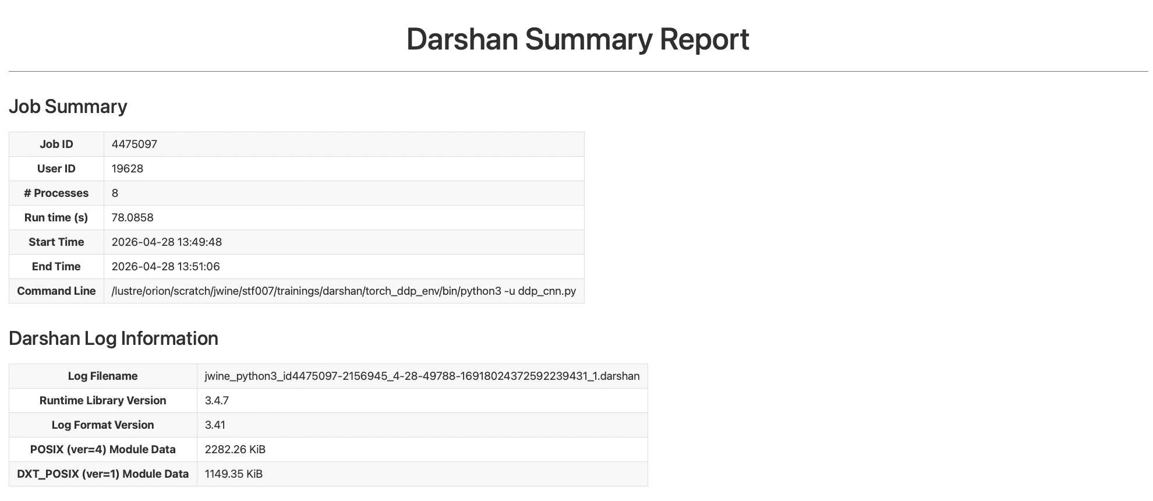
Data Analysis: Intermediate (darshan)
Data Generation
Report Analysis
Notes:
All Darshan output files can be found at /lustre/orion/darshan/frontier/YYYY/M/D
There are primarily 3 commands to use with the ’darshan’ python module `job_stats`, `file_stats`, and `summary`. `summary` is probably the most useful in terms of visualizing I/O performance
The module flag (--module or –m) takes a single module name as an argument (e.g., python –m darshan file_stats –m STDIO my_darshan_output.darshn)
jobs_stats and file_stats data can be exported as a csv

Slide 31
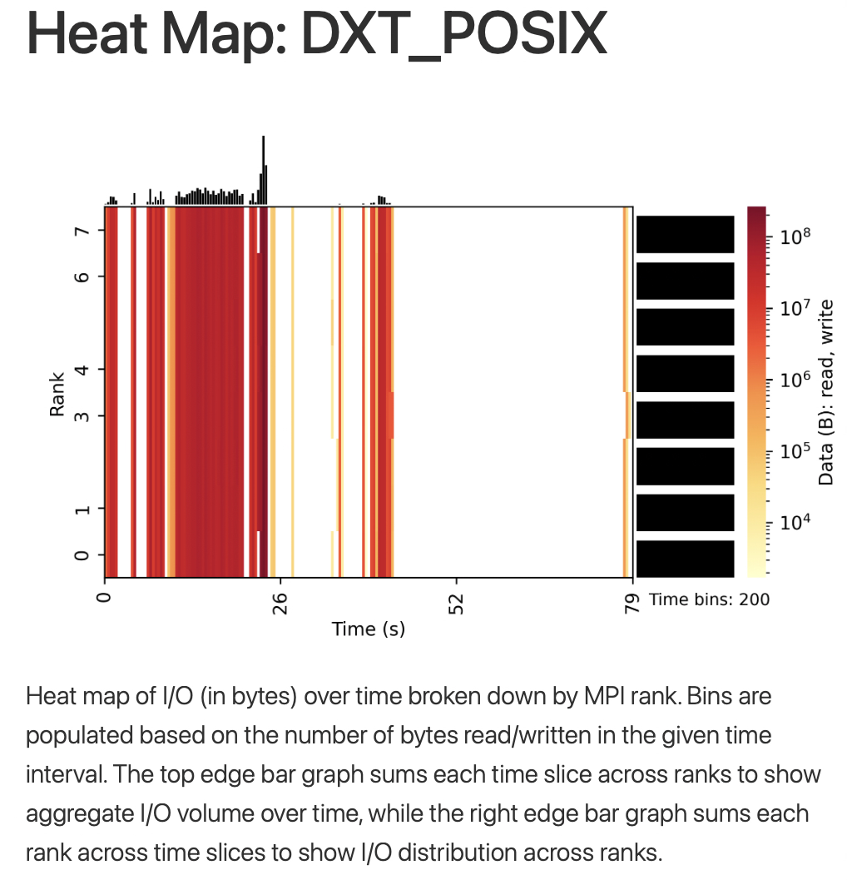
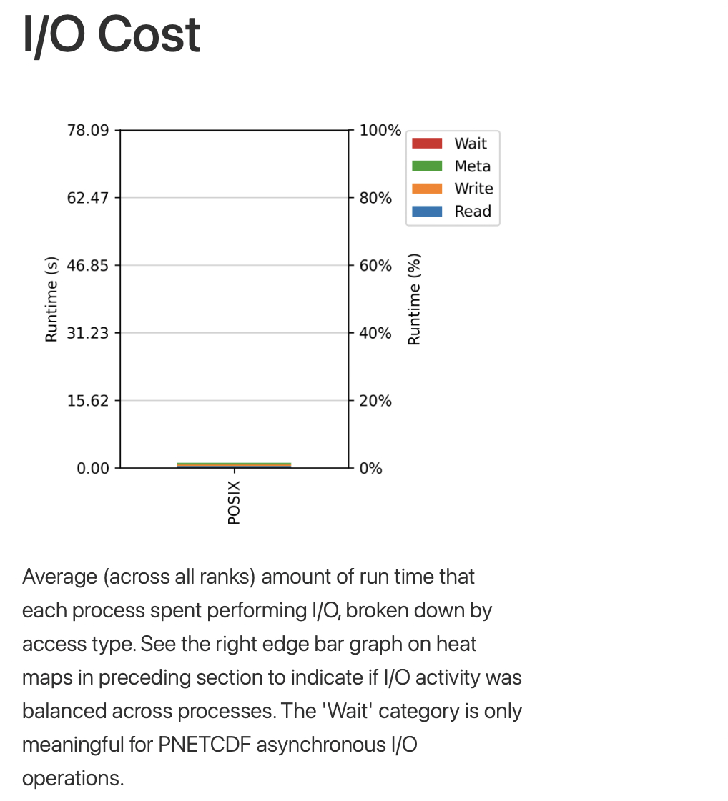
Data Analysis: Intermediate (darshan)
Data Generation
Report Analysis
Notes:
All Darshan output files can be found at /lustre/orion/darshan/frontier/YYYY/M/D
There are primarily 3 commands to use with the ’darshan’ python module `job_stats`, `file_stats`, and `summary`. `summary` is probably the most useful in terms of visualizing I/O performance
The module flag (--module or –m) takes a single module name as an argument (e.g., python –m darshan file_stats –m STDIO my_darshan_output.darshn)
jobs_stats and file_stats data can be exported as a csv

Slide 32
Data Analysis: Intermediate (darshan)
Bins of aggregate I/O volume over time
Data Generation
Report Analysis
Bins of aggregate I/O volume across ranks
Application runtime (s)
Notes:
All Darshan output files can be found at /lustre/orion/darshan/frontier/YYYY/M/D
There are primarily 3 commands to use with the ’darshan’ python module `job_stats`, `file_stats`, and `summary`. `summary` is probably the most useful in terms of visualizing I/O performance
The module flag (--module or –m) takes a single module name as an argument (e.g., python –m darshan file_stats –m STDIO my_darshan_output.darshn)
jobs_stats and file_stats data can be exported as a csv

Slide 33
Data Analysis: Intermediate (darshan)
Data Generation
Report Analysis
Notes:
All Darshan output files can be found at /lustre/orion/darshan/frontier/YYYY/M/D
There are primarily 3 commands to use with the ’darshan’ python module `job_stats`, `file_stats`, and `summary`. `summary` is probably the most useful in terms of visualizing I/O performance
The module flag (--module or –m) takes a single module name as an argument (e.g., python –m darshan file_stats –m STDIO my_darshan_output.darshn)
jobs_stats and file_stats data can be exported as a csv

Slide 34
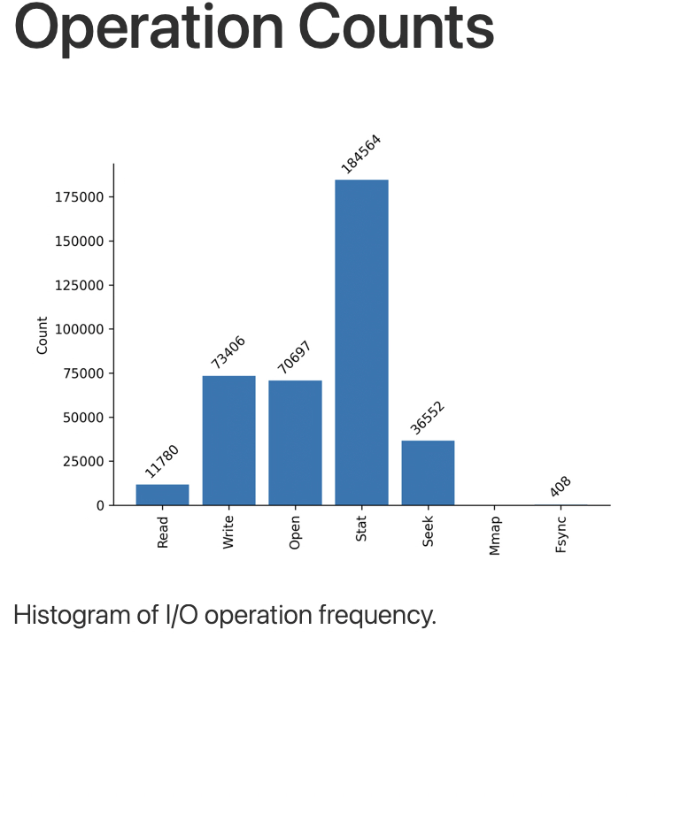
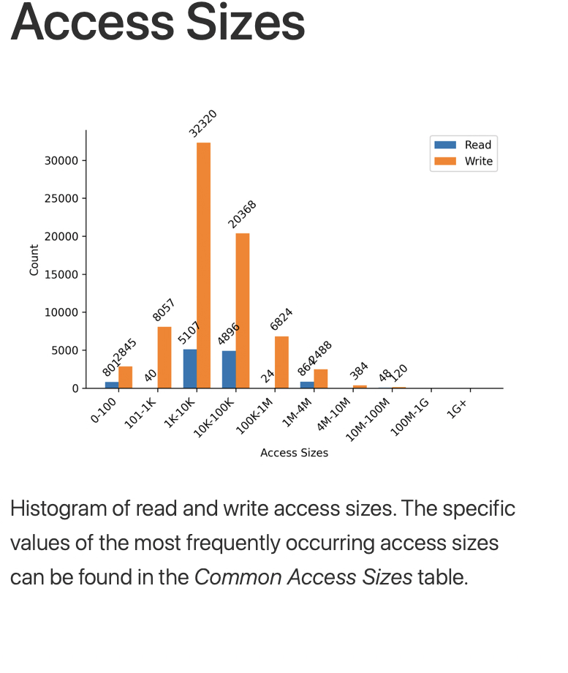
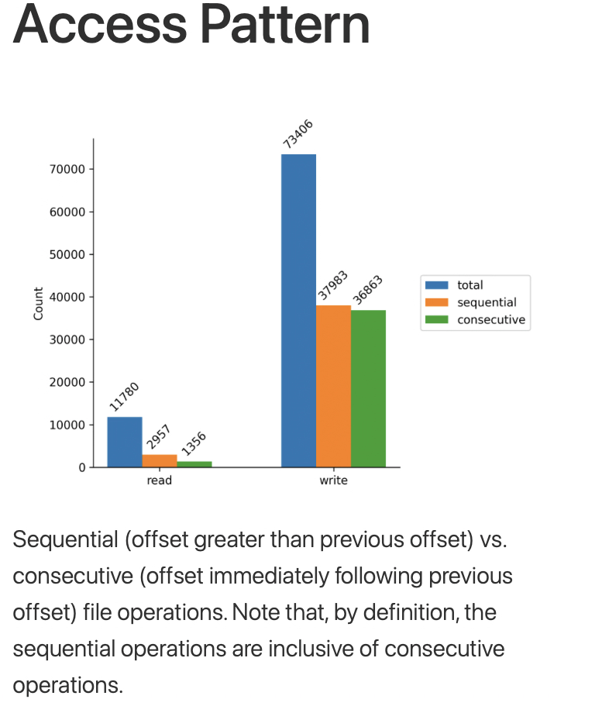
Data Analysis: Intermediate (darshan)
Data Generation
Report Analysis
LUSTRE BEST PRACTICES
Avoid accessing attributes of files and directories: open(), openat(), stat(), statx(), etc.
Avoid small files (aim for >=1GB)
Avoid having many files in a single directory
Avoid accessing the same file region of appending to the same file from many processes.
Notes:
All Darshan output files can be found at /lustre/orion/darshan/frontier/YYYY/M/D
There are primarily 3 commands to use with the ’darshan’ python module `job_stats`, `file_stats`, and `summary`. `summary` is probably the most useful in terms of visualizing I/O performance
The module flag (--module or –m) takes a single module name as an argument (e.g., python –m darshan file_stats –m STDIO my_darshan_output.darshn)
jobs_stats and file_stats data can be exported as a csv

Slide 35
Data Analysis: Intermediate (darshan)
LUSTRE BEST PRACTICES
Avoid accessing attributes of files and directories: open(), openat(), stat(), statx(), etc.
Avoid small files (aim for >=1GB)
Avoid having many files in a single directory
Avoid accessing the same file region of appending to the same file from many processes.
Data Generation
Report Analysis
Notes:
All Darshan output files can be found at /lustre/orion/darshan/frontier/YYYY/M/D
There are primarily 3 commands to use with the ’darshan’ python module `job_stats`, `file_stats`, and `summary`. `summary` is probably the most useful in terms of visualizing I/O performance
The module flag (--module or –m) takes a single module name as an argument (e.g., python –m darshan file_stats –m STDIO my_darshan_output.darshn)
jobs_stats and file_stats data can be exported as a csv

Slide 36
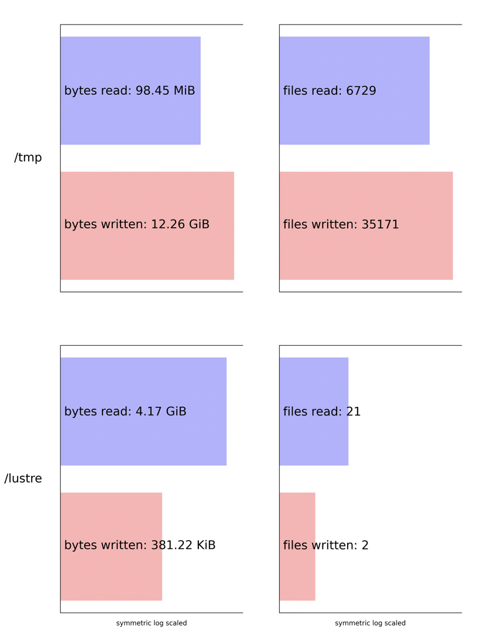
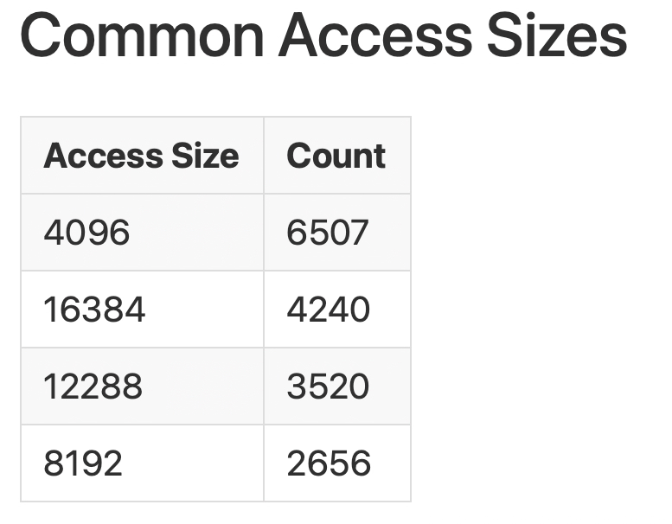
Data Analysis: Intermediate (darshan)
Data Generation
Report Analysis
Notes:
All Darshan output files can be found at /lustre/orion/darshan/frontier/YYYY/M/D
There are primarily 3 commands to use with the ’darshan’ python module `job_stats`, `file_stats`, and `summary`. `summary` is probably the most useful in terms of visualizing I/O performance
The module flag (--module or –m) takes a single module name as an argument (e.g., python –m darshan file_stats –m STDIO my_darshan_output.darshn)
jobs_stats and file_stats data can be exported as a csv

Slide 37
Presentation Checkpoint
Where we’ve been
Where we’re going
How to use darshan-parser CLI to analyze Darshan output files
How to link darshan-runtime to your executable
How to configure Darshan at runtime
How to install and use the ‘darshan’ Python library to analysis Darshan reports
Quick note on profiling applications that use HDF5
How to use the dxt-explorer library
Wrap up and questions

Slide 38
Setup: Advanced (HDF5 support)
HDF5 I/O profiling is not natively supported on any darshan-runtime module on Frontier
A custom darshan-runtime configuration is required:
  submit a ticket to help@olcf.ornl.gov
  email winetroutjj@ornl.gov
export DARSHAN_MOD_ENABLE=“H5F,H5D,…”
Data Generation
Report Analysis
Notes:
All Darshan output files can be found at /lustre/orion/darshan/frontier/YYYY/M/D
There are primarily 3 commands to use with the ’darshan’ python module `job_stats`, `file_stats`, and `summary`. `summary` is probably the most useful in terms of visualizing I/O performance
The module flag (--module or –m) takes a single module name as an argument (e.g., python –m darshan file_stats –m STDIO my_darshan_output.darshn)
jobs_stats and file_stats data can be exported as a csv

Slide 39
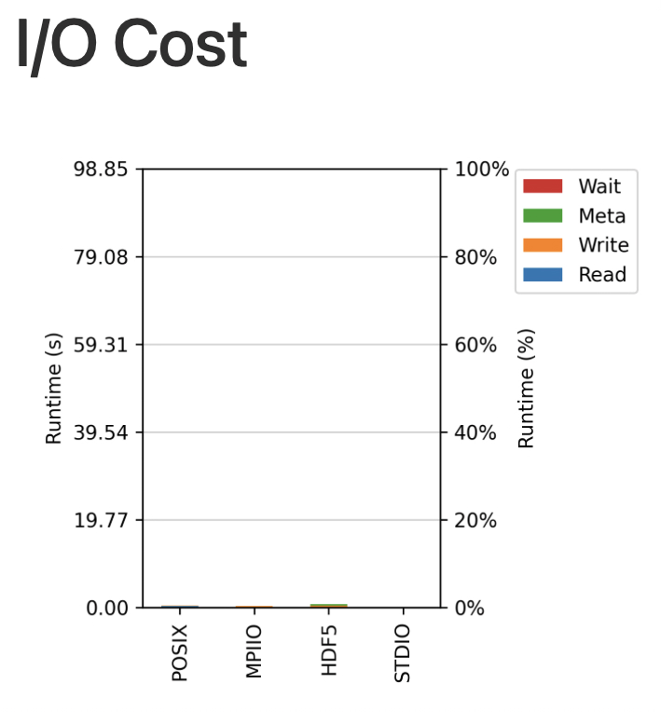
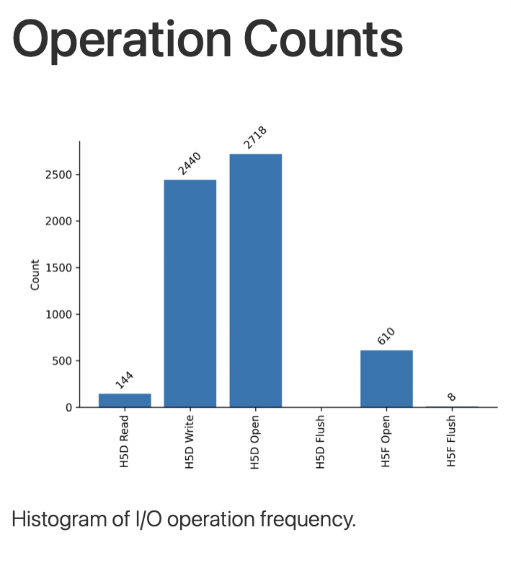
Data Analysis: Advanced (HDF5 support)
HDF5-specific plots
Data Generation
Report Analysis
Notes:
All Darshan output files can be found at /lustre/orion/darshan/frontier/YYYY/M/D
There are primarily 3 commands to use with the ’darshan’ python module `job_stats`, `file_stats`, and `summary`. `summary` is probably the most useful in terms of visualizing I/O performance
The module flag (--module or –m) takes a single module name as an argument (e.g., python –m darshan file_stats –m STDIO my_darshan_output.darshn)
jobs_stats and file_stats data can be exported as a csv

Slide 40
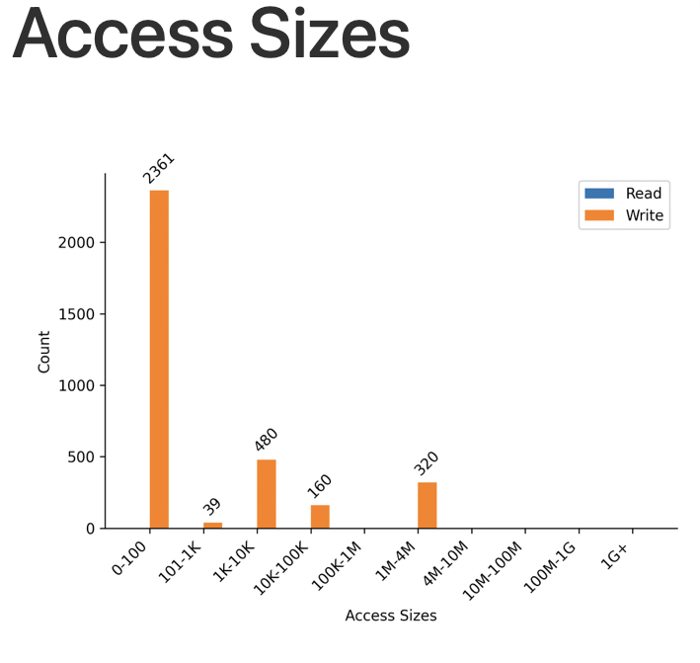
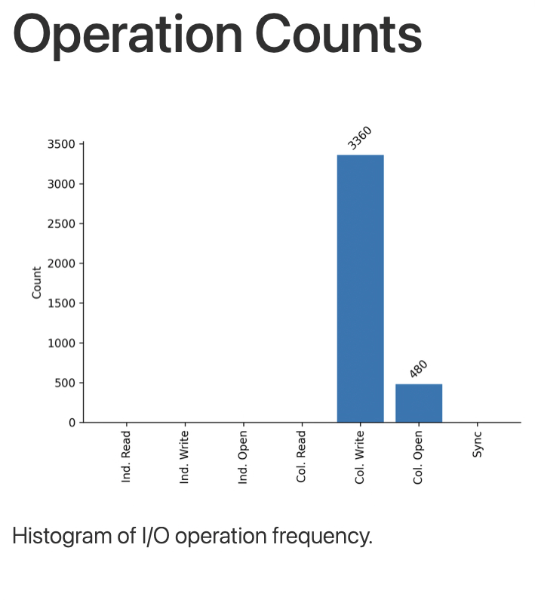
Data Analysis: Advanced (HDF5 support)
MPI-IO-specific plots
Data Generation
Report Analysis
Notes:
All Darshan output files can be found at /lustre/orion/darshan/frontier/YYYY/M/D
There are primarily 3 commands to use with the ’darshan’ python module `job_stats`, `file_stats`, and `summary`. `summary` is probably the most useful in terms of visualizing I/O performance
The module flag (--module or –m) takes a single module name as an argument (e.g., python –m darshan file_stats –m STDIO my_darshan_output.darshn)
jobs_stats and file_stats data can be exported as a csv

Slide 41
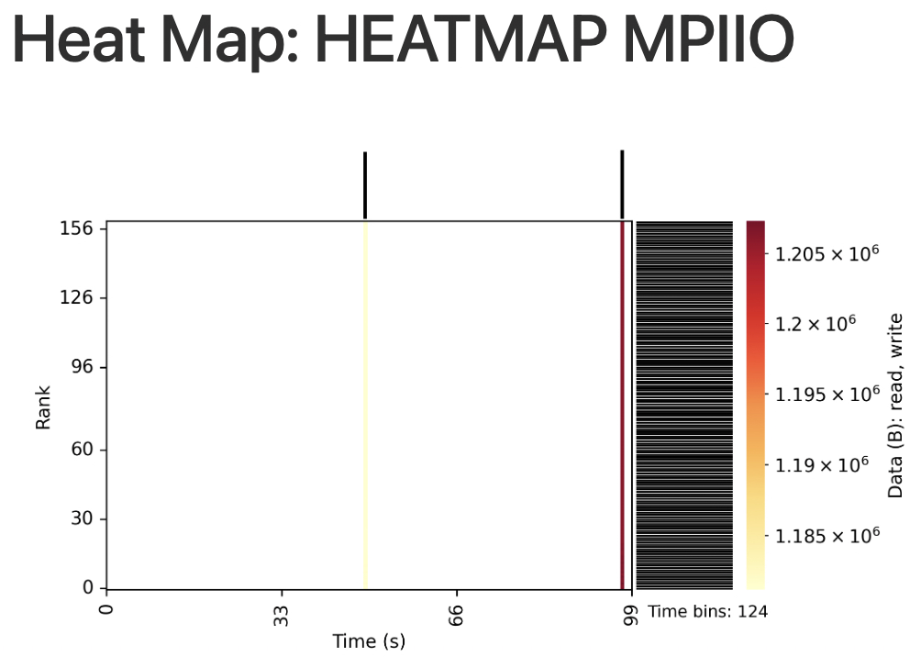
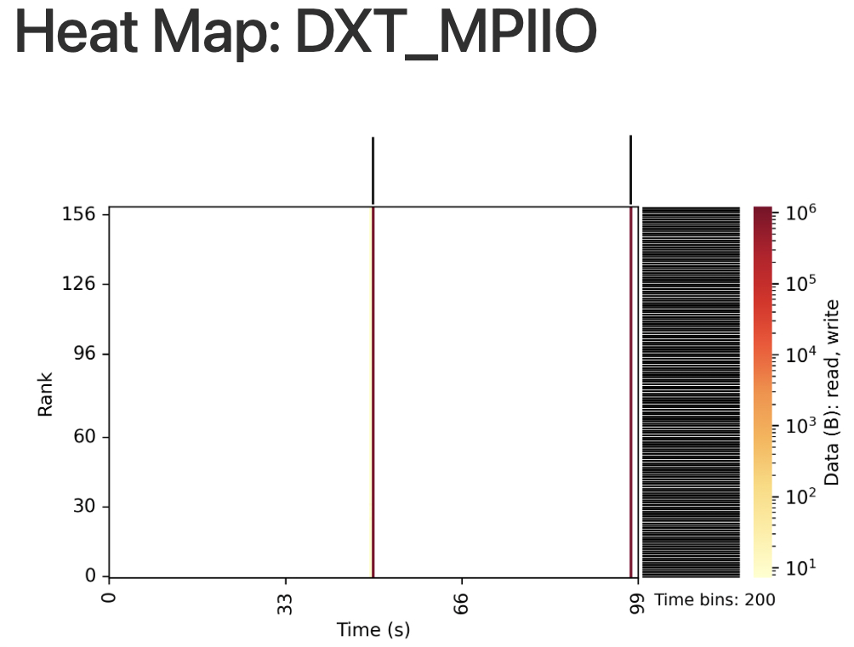
Data Analysis: Advanced (HDF5 support)
MPI-IO-specific plots
Data Generation
Report Analysis
Notes:
All Darshan output files can be found at /lustre/orion/darshan/frontier/YYYY/M/D
There are primarily 3 commands to use with the ’darshan’ python module `job_stats`, `file_stats`, and `summary`. `summary` is probably the most useful in terms of visualizing I/O performance
The module flag (--module or –m) takes a single module name as an argument (e.g., python –m darshan file_stats –m STDIO my_darshan_output.darshn)
jobs_stats and file_stats data can be exported as a csv

Slide 42
Data Generation: Advanced (DXT)
Data Generation
Report Analysis
(darshan) [user@login00.frontier ~]$ dxt-explorer [flags] file.darshan
-s | -u | -st | -oo
Generates the “spatiality” plot Show the spatial access pattern (i.e., contiguous, strided, or random) made by each rank | Generates the “operation” plot with option to display “unbalanced” workloads (if applicable) | Generates the “operation” plot with option to display “stragglers” (i.e., highlights slowest ranks) | Generates the “ost-usage-operation” plot. Shows usage of each OST server for read and write operations.
WARNING: Less reliable than `darshan` library outputs
https://dxt-explorer.readthedocs.io/en/latest/index.html
Notes:
All Darshan output files can be found at /lustre/orion/darshan/frontier/YYYY/M/D
There are primarily 3 commands to use with the ’darshan’ python module `job_stats`, `file_stats`, and `summary`. `summary` is probably the most useful in terms of visualizing I/O performance
The module flag (--module or –m) takes a single module name as an argument (e.g., python –m darshan file_stats –m STDIO my_darshan_output.darshn)
jobs_stats and file_stats data can be exported as a csv

Slide 43
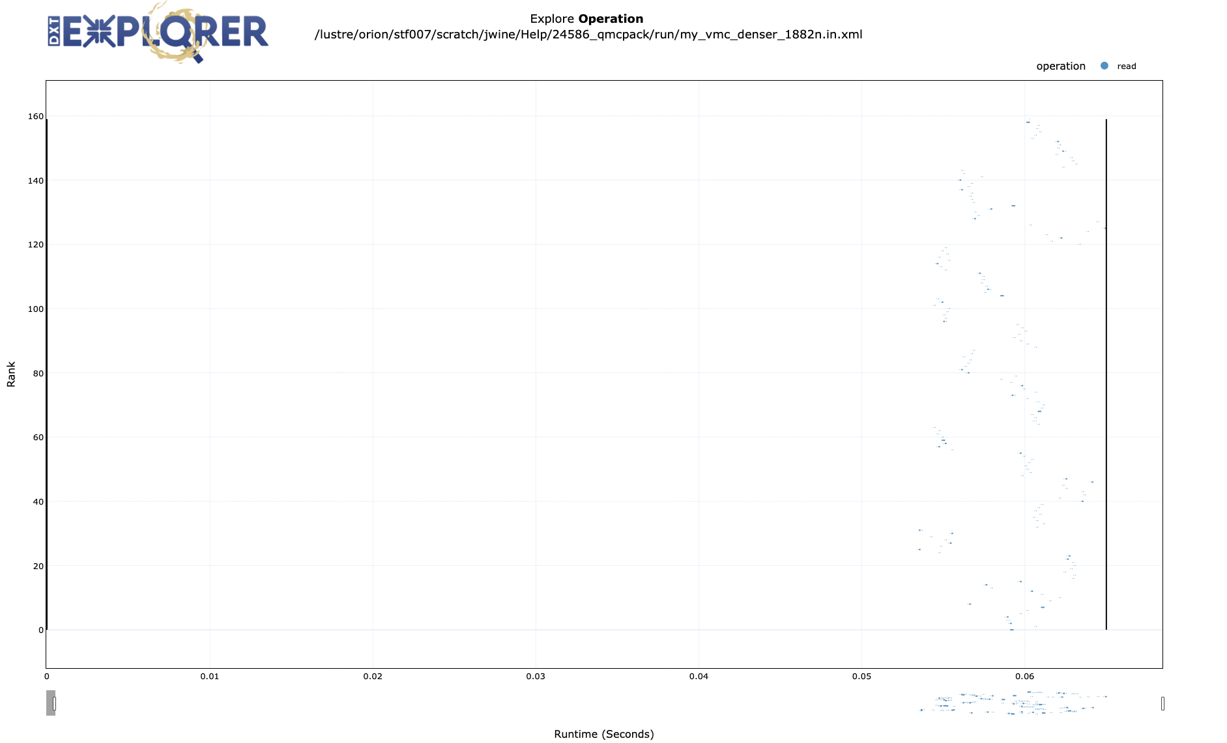
Data Analysis: Advanced (DXT)
Data Generation
Report Analysis
https://dxt-explorer.readthedocs.io/en/latest/index.html
Notes:
All Darshan output files can be found at /lustre/orion/darshan/frontier/YYYY/M/D
There are primarily 3 commands to use with the ’darshan’ python module `job_stats`, `file_stats`, and `summary`. `summary` is probably the most useful in terms of visualizing I/O performance
The module flag (--module or –m) takes a single module name as an argument (e.g., python –m darshan file_stats –m STDIO my_darshan_output.darshn)
jobs_stats and file_stats data can be exported as a csv

Slide 44
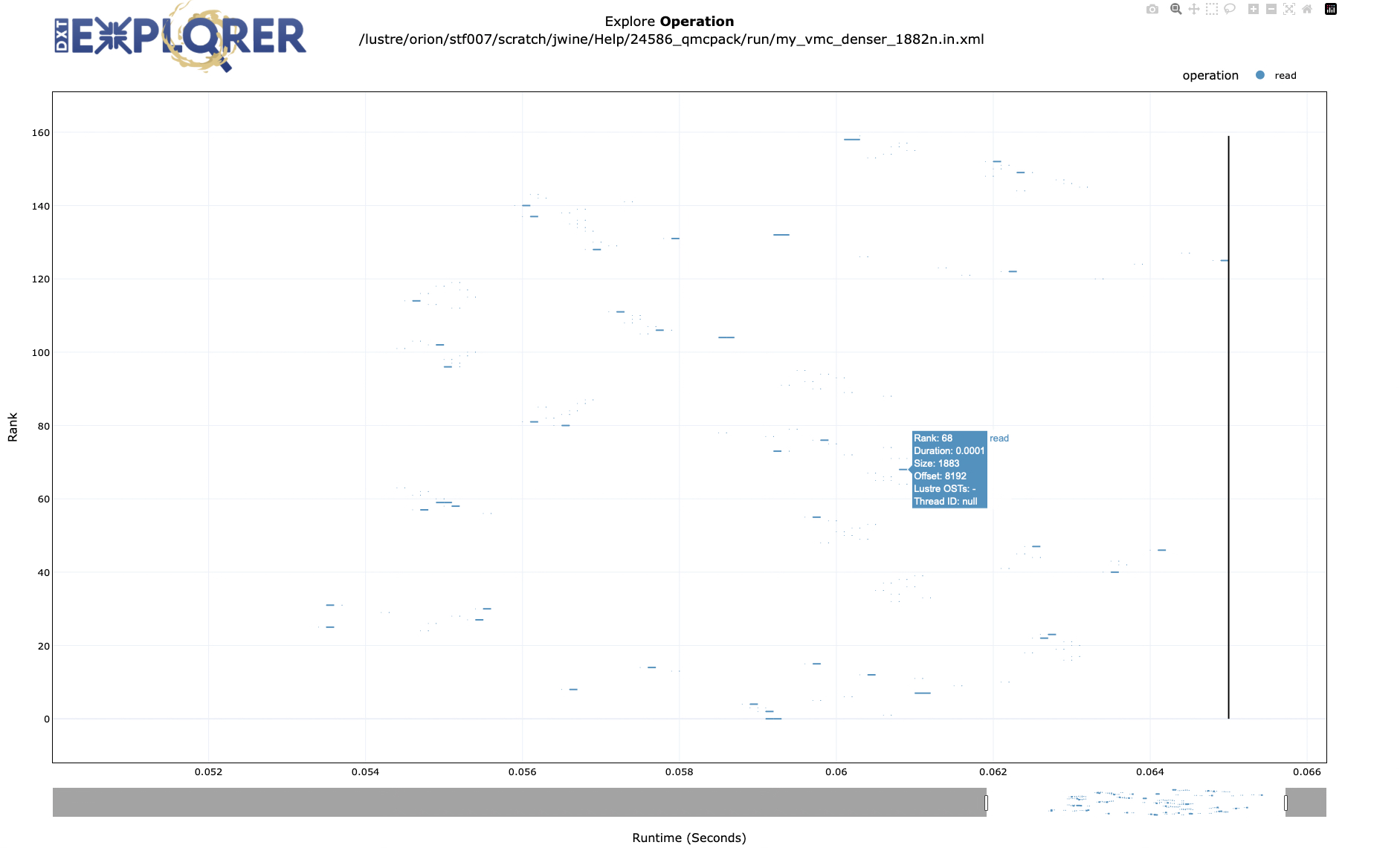
Data Analysis: Advanced (DXT)
Data Generation
Report Analysis
https://dxt-explorer.readthedocs.io/en/latest/index.html
Notes:
All Darshan output files can be found at /lustre/orion/darshan/frontier/YYYY/M/D
There are primarily 3 commands to use with the ’darshan’ python module `job_stats`, `file_stats`, and `summary`. `summary` is probably the most useful in terms of visualizing I/O performance
The module flag (--module or –m) takes a single module name as an argument (e.g., python –m darshan file_stats –m STDIO my_darshan_output.darshn)
jobs_stats and file_stats data can be exported as a csv

Slide 45
Bonus Techniques

Slide 46
Data Generation: Advanced (DXT)
[user@login00.frontier ~]$ module load darshan-util
[user@login00.frontier ~]$ darshan-dxt-parser user_job_info.darshan
# DXT, file_id: 0123456789, file_name: /lustre/orion/path/to/file.txt
# DXT, rank: 0, hostname: frontier00067
# DXT, write_count: 4, read_count: 3
# DXT, mnt_pt: /, fs_type: overlay
# DXT, Lustre stripe components:
# [Component 1] stripe_ext: 0 - 262144, stripe_size: 262144, stripe_count: 0, OSTs:
# [Component 2] stripe_ext: 262144 - 8388608, stripe_size: 1048576, stripe_count: 1, OSTs: 975
# Module Rank Wt/Rd Segment Offset Length Start(s) End(s) [OST]
X_POSIX 0 write 0 0 3092480 12.8181 12.8189
X_POSIX 0 write 1 3092480 2228 12.8189 12.8189 [975]
X_POSIX 0 write 2 0 4096 12.8257 12.8257
X_POSIX 0 write 3 4096 3170 12.8257 12.8258
X_POSIX 0 read 0 0 501163 10.6973 10.6981
X_POSIX 0 read 1 0 10 12.8752 12.8781
X_POSIX 0 read 2 0 127 12.8794 12.8794

Slide 47
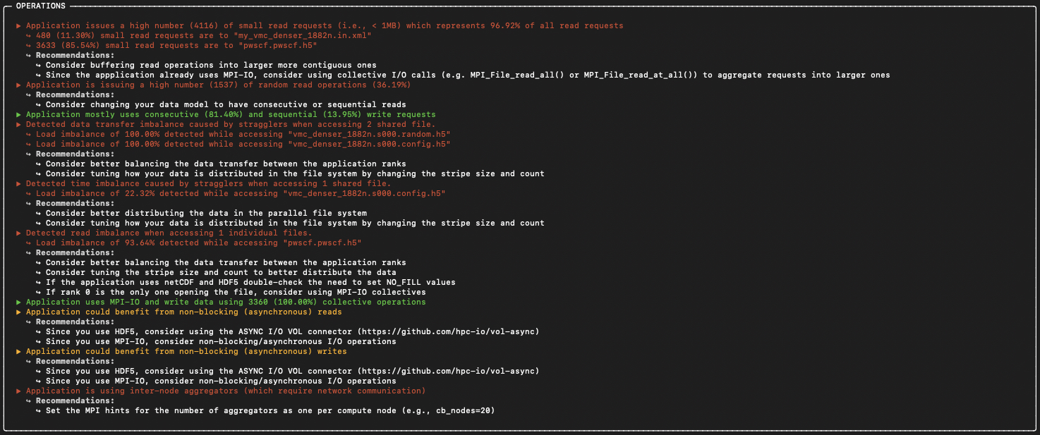
Data Analysis: Basic (drishti)
(darshan) [user@login00.frontier ~]$ drishti user_job_info.darshan

Slide 48
Data Analysis: Basic (drishti)
(darshan) [user@login00.frontier ~]$ drishti user_job_info.darshan

Slide 49
Conclusions
I/O performance is often overlooked but can have substantial impact on user-local and systemwide performance
The Darshan library can be utilized to understand application I/O behavior
The ‘darshan’ and ‘dxt-explorer’ Python libraries are used to visualize and analyze Darshan output files
If you still need help with I/O performance submit a help ticket to help@olcf.ornl.gov or sign up for Office Hours: Monday 2-3 EDT and Wednesday from 1-2 pm EDT

