Slide 1

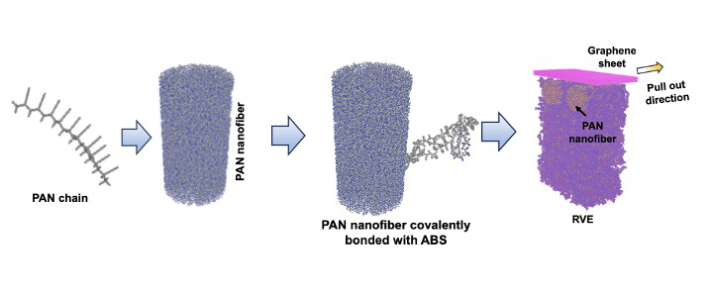
Frontier Simulates Stronger Carbon Fiber
Scientific Achievement
The Frontier supercomputer was used to simulate 5 million atoms to study a novel process for making carbon-fiber composites stronger and more cost efficient by incorporating a reinforced layer of polyacrylonitrile nanofibers (PAN nanofibers).
The simulations showed that PAN nanofibers with a diameter of approximately 6 nanometers offered the best performance.
Significance and Impact
Failure in carbon-fiber composites typically happen at the interface between the carbon-fiber strands and the polymer matrix exterior.
Incorporating PAN nanofibers at the interface redirects stress from the carbon fibers into the surrounding polymer to improve load distribution and overall strength.
Insights could lead to new, ultradurable materials for airplanes, vehicles and a wide range of applications that require stronger, more lightweight materials.
The achievement is likely the first hierarchical, fully atomistic simulation of a complete bulk PAN nanofiber integrated within a polymer matrix without relying on any assumptions or simplified calculations which could only be done with a leadership-class supercomputer.
The material is assembled and tested for strength. Strands of PAN fibers with varying diameters are bundled and tightly bonded to a polymer coating for reinforcement. A graphene sheet is used to simulate pulling on the material to identify weak points.
PI(s)/Facility Lead(s): Swarnava Ghosh
Collaborating Institutions: ORNL
ASCR Program: Facilities
ASCR PM: Benjamin Brown
Publication(s) for this work: Sumit Gupta, et al., “Designing Physicochemically-Ordered Interphases for High-Performance Composites,” Advanced Functional Materials (2025): doi.org/10.1002/adfm.202502972.
Technical Approach
PAN nanofibers with diameters between 6 and 10 nanometers were modeled the Large-scale Atomic/Molecular Massively Parallel Simulator (LAMMPS).
Access to Frontier was provided via a Director’s Discretionary allocation.
Notes:
In the News:
“Simulations Reveal the Secret to Strengthening Carbon Fiber”
https://www.olcf.ornl.gov/2025/06/19/simulations-reveal-the-secret-to-strengthening-carbon-fiber/
“Nanofibers yield stronger, tougher carbon fiber composites”
https://www.ornl.gov/news/nanofibers-yield-stronger-tougher-carbon-fiber-composites

