Slide 1

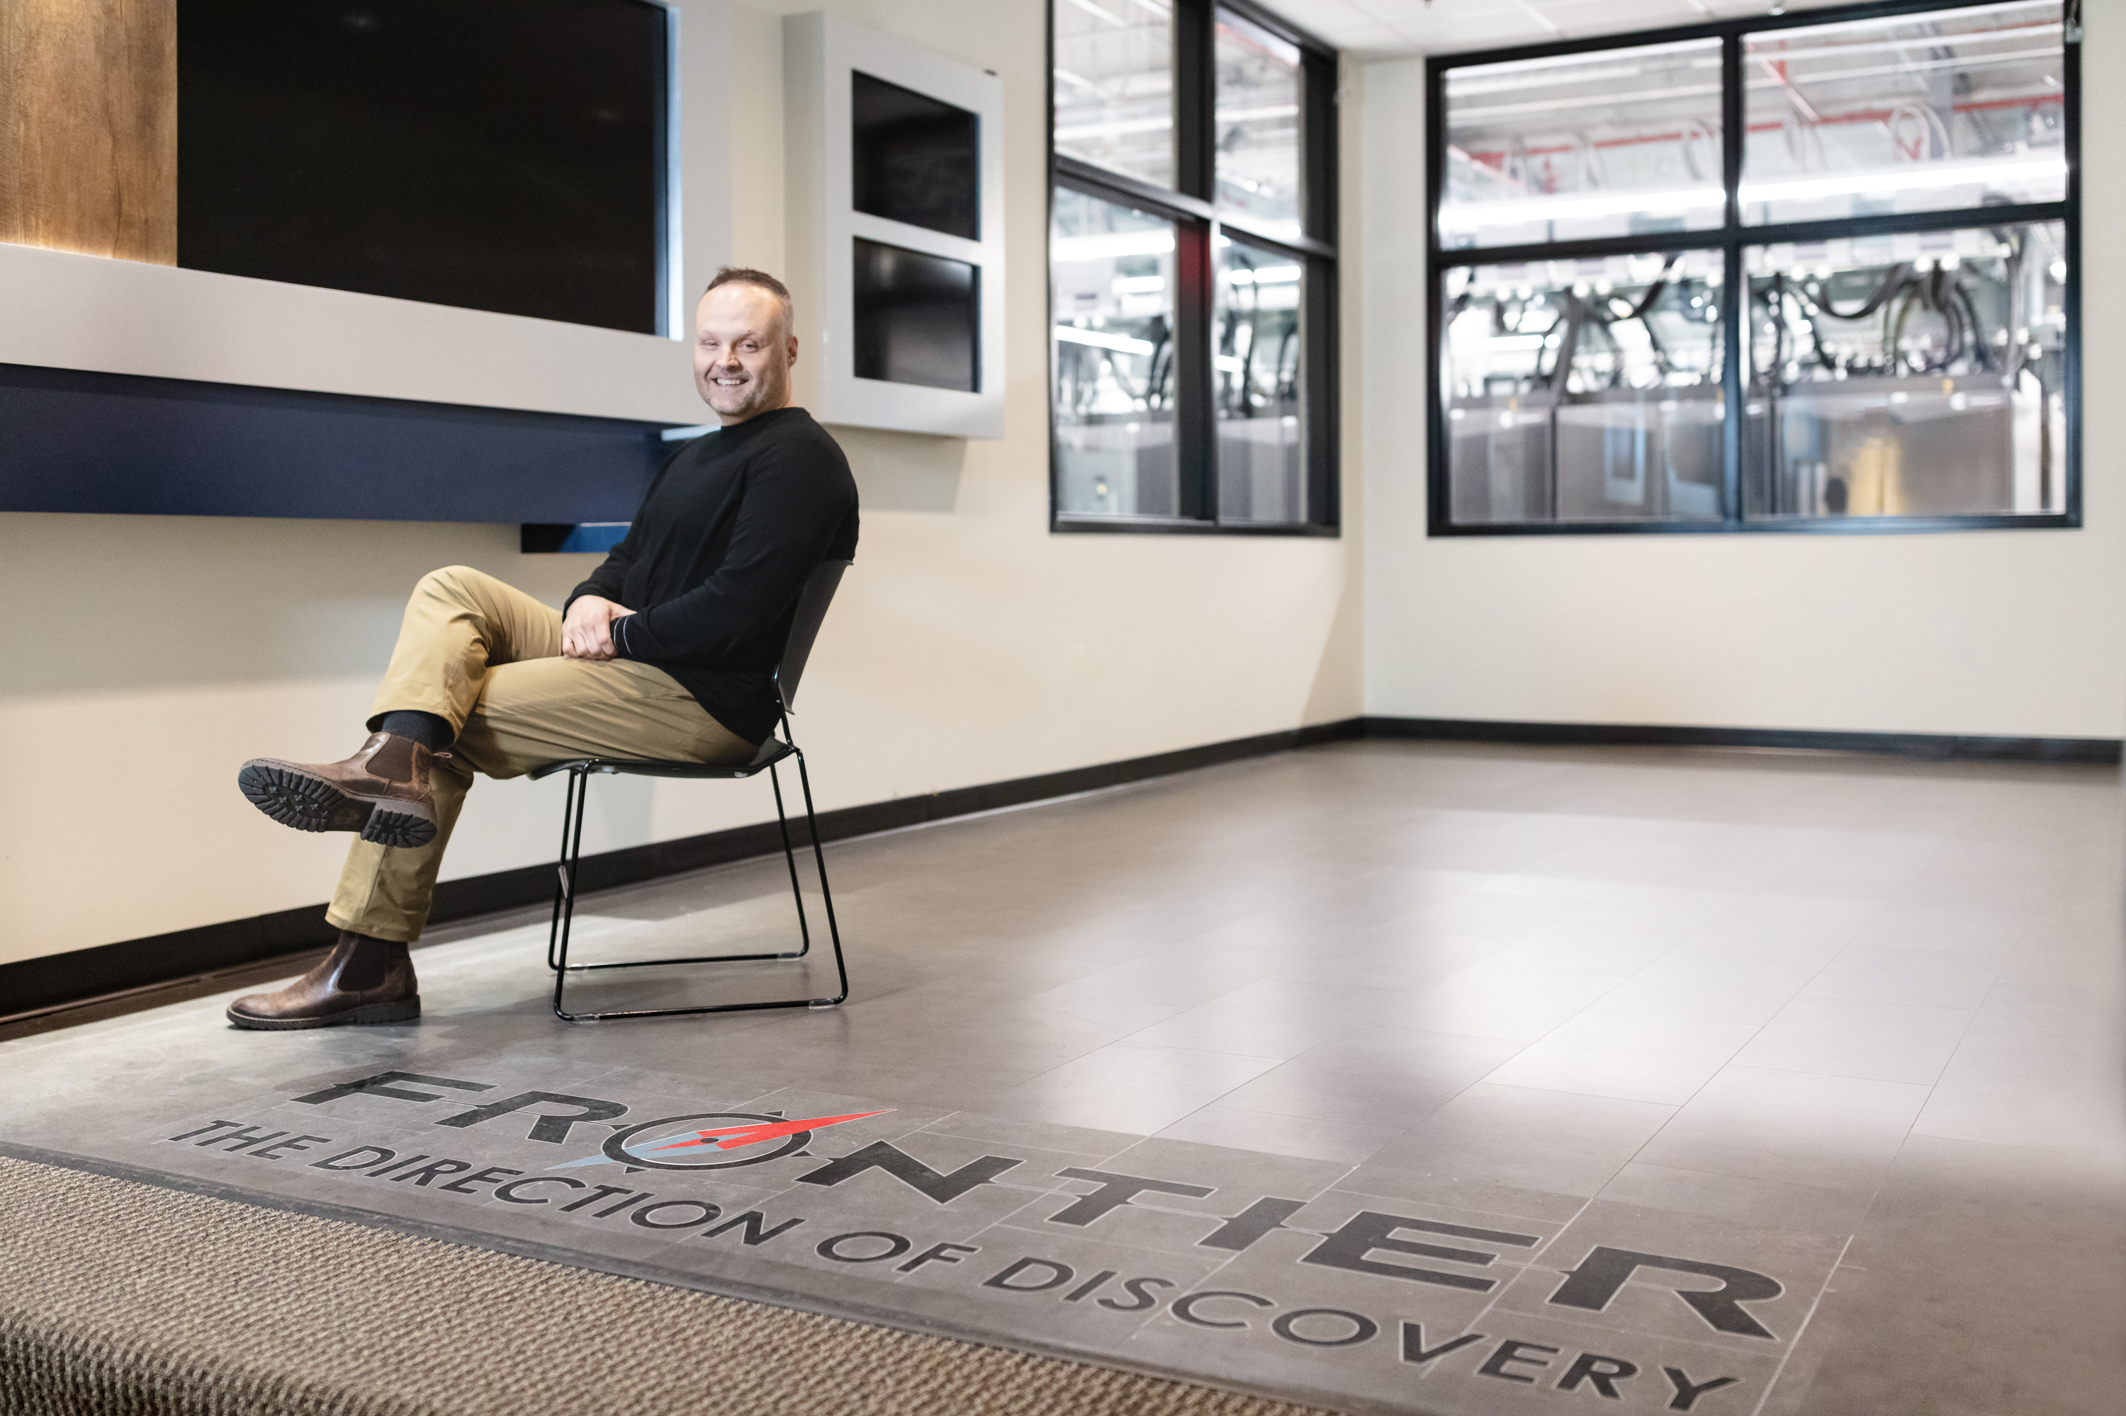
OLCF’s Bronson Messer Named APS Fellow
Scientific Achievement
Bronson Messer, a distinguished staff scientist at the Department of Energy’s Oak Ridge Leadership Computing Facility (OLCF) at Oak Ridge National Laboratory, has been named a Fellow of the American Physical Society (APS), one of the highest honors bestowed by the organization.
Messer was nominated by the APS Forum on Outreach and Engaging the Public for his exceptional efforts in making physics accessible and exciting to a wide audience.
Significance and Impact
The citation recognizes Messer “for conveying the excitement and universal impact of physics to students, teachers, professionals and the public via talks, multimedia, laboratory tours, popular national events, and for direct outreach to underserved Appalachian students and teachers.”
In addition to his leadership role at OLCF, Messer also serves as a Joint Faculty Professor in the Department of Physics and Astronomy at the University of Tennessee.
The sixth annual Quantum Computing User Forum hosted over 140 registered attendees and featured research presentations, panel discussions, interactive workshops and an in-depth poster session. Credit: Kurt Weiss/ORNL, U.S. Dept. of Energy
Technical Approach
His contributions have also earned him several honors, including the Oak Ridge Postdoctoral Association’s Mentor of the Year award in 2020 and the prestigious R&D 100 Awards in 2022 for his leadership on the Flash-X Software Project.
PI(s)/Facility Lead(s): Bronson Messer
Collaborating Institutions: Oak Ridge National Laboratory
ASCR Program: Oak Ridge Leadership Computing Facility
ASCR PM: Benjamin Brown
Publication(s) for this work: n/a

