Slide 1

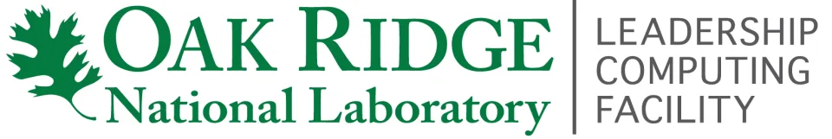
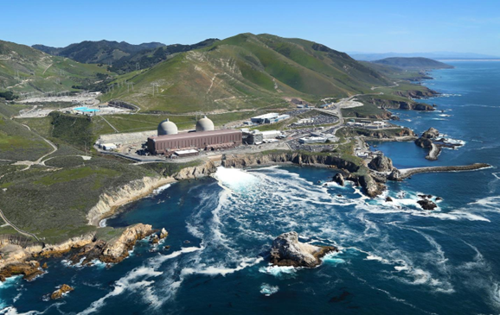
Frontier Supercomputer Ushers in New Era of Nuclear AI
Scientific Achievement
Tech company Atomic Canyon and the Diablo Canyon nuclear power plant used Frontier to develop AI models designed to significantly reduce the time and resources the nuclear industry spends searching the millions of complex nuclear documents related to licensing, regulations, parts, maintenance records, engineering evaluations, and plant procedures.
Significance and Impact
Atomic Canyon’s AI platform allows users to find information faster and more efficiently and also provides clear and meaningful context to complex information, making it easier for nuclear power professionals to understand and develop problem-solving solutions.
The AI models are open-source and available to anyone in the nuclear industry.
Once fully developed, the AI models could be used in plants all across the country.
In July, Atomic Canyon and ORNL signed a memorandum of understanding that outlines their shared intentions to further develop nuclear AI technology.
The Diablo Canyon nuclear power plant, perched on the Pacific Coast, supplies about 8% of California’s electricity. Through collaborations with Atomic Canyon and ORNL, Diablo Canyon is the first U.S. nuclear power plant to use generative AI. Credit: PG&E
Technical Approach
The AI models were trained based on the roughly 53-million pages of digital information contained within the Nuclear Regulatory Commission’s Agencywide Documents Access and Management System.
Notes:
In the News:
“Oak Ridge National Laboratory, Atomic Canyon to accelerate nuclear licensing with AI”
https://www.ornl.gov/news/oak-ridge-national-laboratory-atomic-canyon-accelerate-nuclear-licensing-ai

