Slide 1

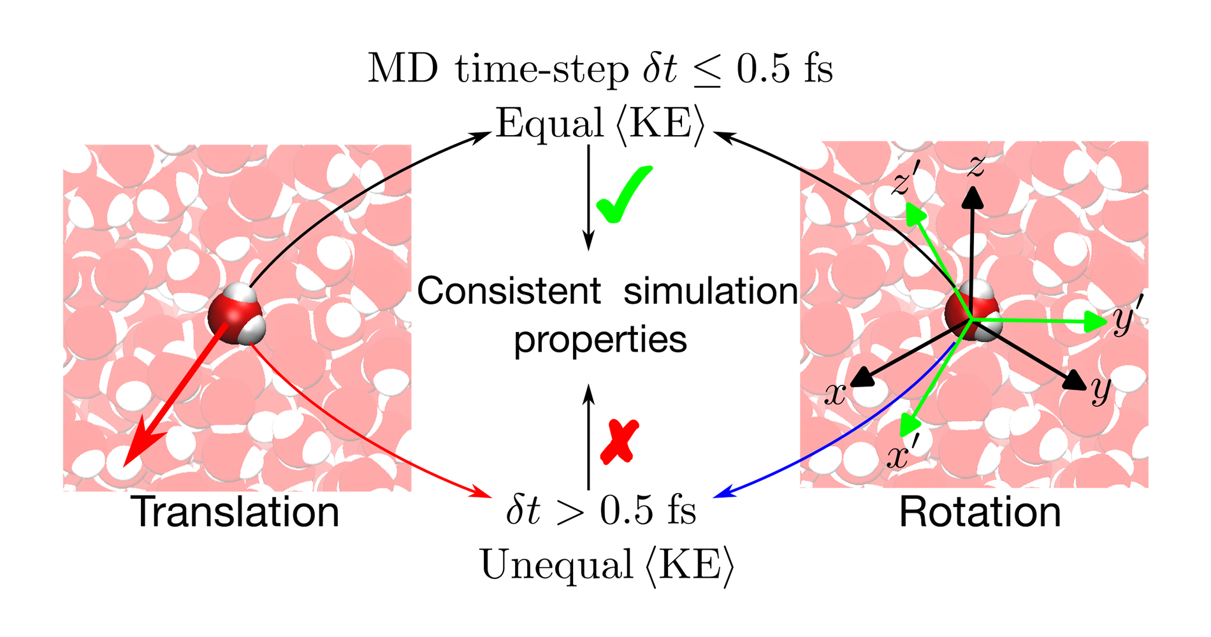
Getting the Matrix of Life Right
Scientific Achievement
More than a year ago, computational scientists at ORNL published a study that raised a serious question about a long-standing methodology used by researchers who conduct molecular dynamics simulations involving water.
Now, the same ORNL team has published a new study that reaffirms their original observations. The team’s calculations reveal that the potential for errors caused by using a 2 (or more) femtosecond time step is even greater than anticipated.
Time steps are the time intervals at which computer simulations are analyzed, which can affect the cost of computations. The study found that 0.5 femtosecond time steps are more accurate than 2 femtosecond time steps, which have been widely used for the last 50 years due to their lower computational cost.
Significance and Impact
Industries ranging from pharmaceutical to petroleum rely on accurate water simulations to attain a competitive edge for their products and operations.
Although the team did hear from some skeptical peers about the findings of their initial study, it was also cited as a reference in papers published in Molecular Physics, Physical Chemistry Chemical Physics, ACS Nano, and the Journal of Chemical Theory and Computation.
In molecular dynamics simulations of water systems, where water molecules are treated as rigid bodies, it is important to use a small time-step. This small time-step helps ensure that the average rotational energy of a water molecule matches its average translational energy, which leads to more accurate predictions of the simulation's properties. Image: Dilip Asthagiri, ORNL. U.S. Dept. of Energy.
PI(s)/Facility Lead(s): Dilip Asthagiri, Tom Beck, ORNL
Collaborating Institutions: ORNL
ASCR Program: OLCF Staff Program
ASCR PM: Benjamin Brown
Publication(s) for this work: Dilipkumar N. Asthagiri, Arjun Valiya Parambathu, and Thomas L. Beck, “Consequences of the Failure of Equipartition for the p–V Behavior of Liquid Water and the Hydration Free Energy Components of a Small Protein,” Chemical Science 16 (March 2025): 7503–12, https://doi.org/10.1039/D4SC08437C.
Technical Approach
In their new study, the team used Frontier to simulate samples of liquid water, and they explored various system sizes and different combinations of temperature and pressure.
They conducted these simulations at time steps that ranged from 0.5 to 3.5 femtoseconds in intervals of 0.5 femtoseconds.

Slide 2
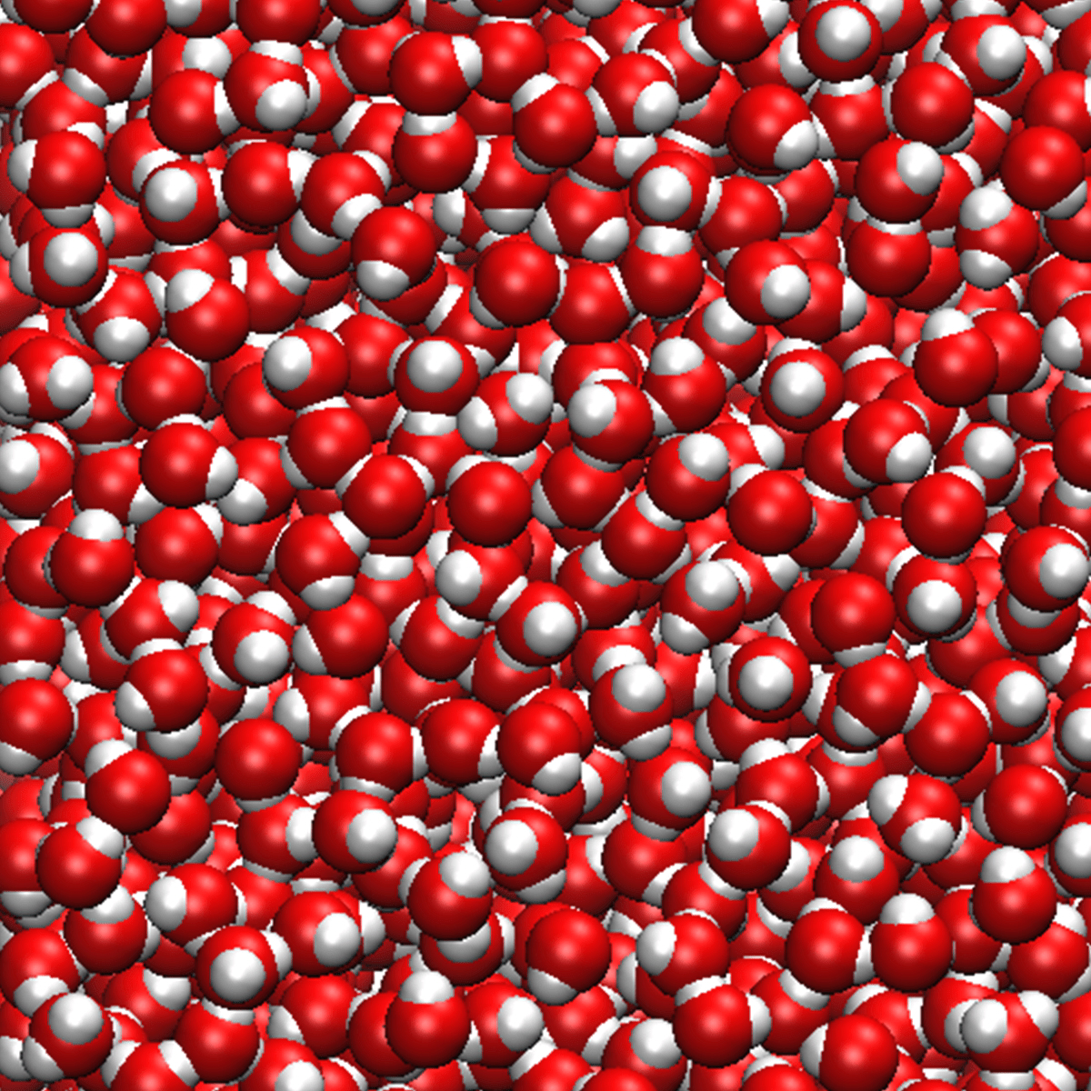
Optional: One captivating image or video and a blurb for social-media use.
Water is the most prevalent component of biomolecular simulations — from protein ensembles to nucleic acids — and inaccurately simulating it can lead to errors for research results in biomolecular structure, function, dynamics and assembly. In a new study, ORNL researchers show how using a 2 (or more) femtosecond time step can cause such inaccurate water simulations. Image: Dilip Asthagiri, ORNL. U.S. Dept. of Energy.
Notes:
Original study: https://pubs.acs.org/doi/10.1021/acs.jctc.3c01153?ref=pdf

