Slide 1



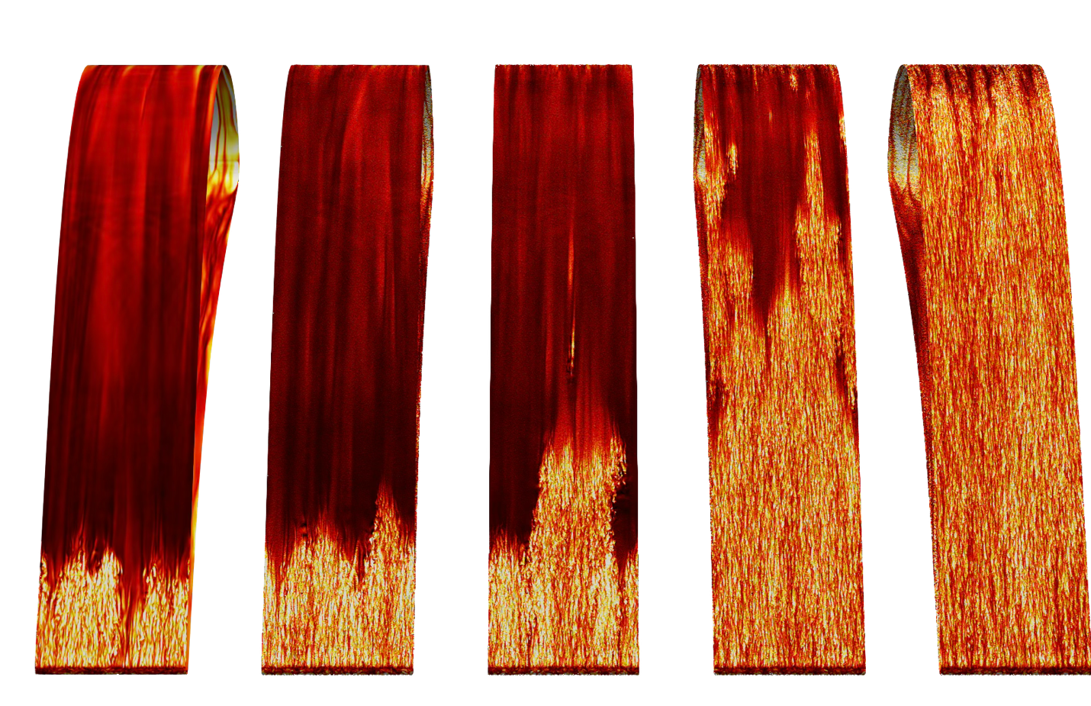
High-Fidelity Insights of Turbine Aerothermal Performance
Scientific Achievement
With unprecedented simulations of 10 to 20 billion grid points in size with 10¹⁷ degrees of freedom (variables that must be solved), researchers at the University of Melbourne in Australia used Frontier to investigate how the surface degradation of turbine blades affects their aerothermal performance.
Such component wear may be an expected mechanical outcome, but making accurate predictions of its effects on jet engines requires computer models with a level of complexity not feasible until now with the exascale power of Frontier.
Significance and Impact
The study’s results could help improve jet engine efficiency and durability, reducing fuel use and extending component life — advances that support national goals for energy efficiency and technological competitiveness.
GE Aerospace has been working with the University of Melbourne for more than a decade to better understand high-pressure turbine (HPT) fluid dynamics. It is using these insights in the design of its next-generation HPTs, including GE Aerospace’s work with NASA on their Hybrid Thermally Efficient Core Project to develop more fuel-efficient commercial aircraft engines.
This visualization shows the instantaneous wall heat flux on the suction surface of turbine blades in a high-pressure turbine engine. The levels of surface roughness in the leading-edge region are increasing from left to right and affects how the engine transfers heat along its turbine blades. Credit: Thomas Jelly, University of Melbourne, Australia.
PI/Facility Lead: Dr. Richard Sandberg, Chair of Computational Mechanics, Department of Mechanical Engineering
Collaborating Institutions: University of Melbourne
ASCR Program: INCITE
ASCR PM: Benjamin Brown
Publication(s) for this work: Thomas O. Jelly, Massimiliano Nardini, Richard D. Sandberg, Paul Vitt, and Greg Sluyter, “Effects of Localized Non-Gaussian Roughness on High-Pressure Turbine Aerothermal Performance: Convective Heat Transfer, Skin Friction, and the Reynolds’ Analogy,” ASME Journal of Turbomachinery (May 2025): DOI: 10.1115/1.4067354.
Technical Approach
The Melbourne team updated its High-Performance Solver for Turbulence and Aeroacoustics Research (HiPSTAR) code to be the first truly engine-representative, 3D, high-fidelity model of an HPT with microscale surface degradations.
Optimized for Frontier’s AMD GPU accelerators, HiPSTAR’s simulations of surface degradation took a few weeks to compute. For comparison, they would have required more than 1,000 years to complete on a laptop computer.

