Slide 1


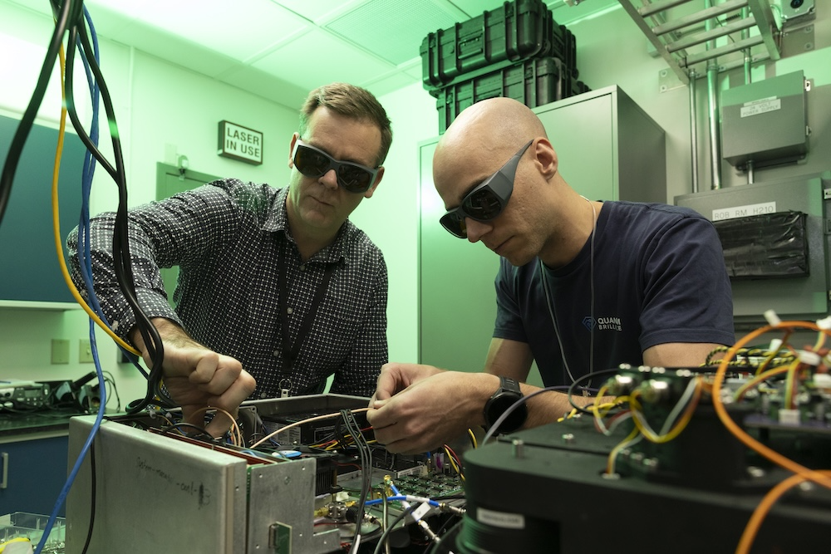
Q&A: Inside Quantum Brilliance’s Computer Technology
Scientific Achievement
While most experimental quantum computers demand extreme cooling, the Quantum Brilliance platform delivers quantum coherence in a compact, room-temperature package.
Andreas Sawadsky, Quantum Brilliance’s technology and innovation manager, discussed the company’s technical approach to quantum computing.
Significance and Impact
”It’s the first time we’re delivering a multiple-hybrid system parallelized in a cluster — a significant milestone as it represents the world’s first cluster of parallelized QPUs integrated into an HPC environment.”
“At ORNL, we’re exploring a future where clusters of QPUs can scale like classical accelerators — the idea being that if a single QPU can outperform a single GPU in a given task, then a cluster of 100 QPUs should similarly outperform a cluster of 100 GPUs.”
A team of Quantum Brilliance engineers, including (from left) Leigh Cameron and Cameron Walters, reassembled and calibrated the system in ORNL's laser calibration laboratory. Credit: Carlos Jones, ORNL, U.S. Dept. of Energy
Technical Approach
”Quantum Brilliance’s platform falls under the category of solid-state spin-based quantum technologies. At the core of our QPUs are nitrogen-vacancy, or NV, centers in diamond.”
“These NV centers host nuclear spins that serve as qubits, the fundamental units of quantum information.”
“We manipulate these qubits using laser light and microwave pulses to initialize, control, and read out their quantum states — enabling the execution of quantum algorithms.”
PI(s)/Facility Lead(s): Thomas Beck/ORNL
Collaborating Institutions: Quantum Brilliance
ASCR Program: OLCF
ASCR PM: Benjamin Brown
Publication(s) for this work: Thomas Beck, et al., “Integrating quantum computing resources into scientific HPC ecosystems,” Future Generation Computer Systems, December 2024.

