Slide 1


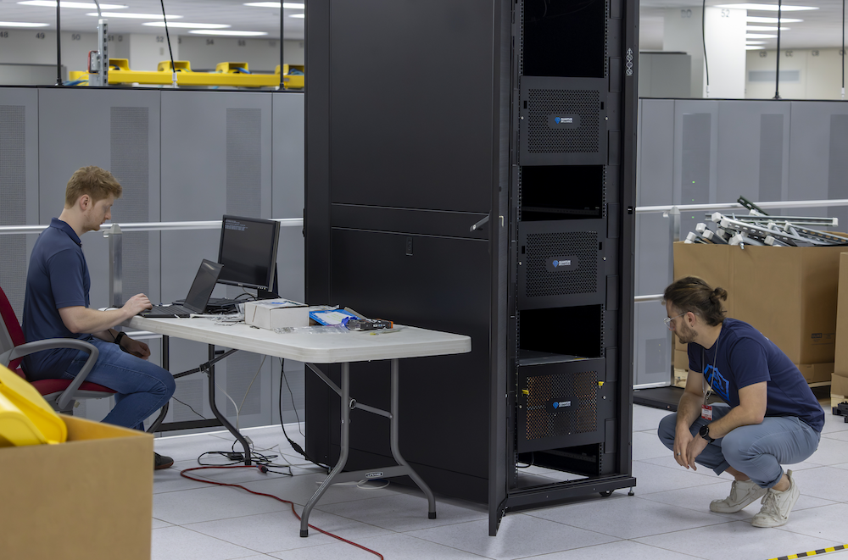
OLCF Pioneers Quantum-Classical Hybrid Computing
Scientific Achievement
In partnership with technology company Quantum Brilliance, the OLCF has taken a big step in the advance of quantum computers for scientific discovery with the installation of the company's Quantum Development Kit cluster on-site.
Lab staff will use the cluster to explore ways to integrate this emerging technology into classical high-performance computing infrastructures and tap its potential for massive computational power gains.
Significance and Impact
Quantum computing is a technology that's still in its formative stages compared to classical supercomputers such as the OLCF’s exascale-class Frontier. But it holds potential to exponentially increase processing power for certain kinds of problems, including quantum mechanics
Last year, the OLCF published a paper in Future Generation Computing Systems proposing a framework to integrate quantum and classical computing, reflecting its commitment to hybrid computing research.
Installed in the OLCF’s Advanced Computing Ecosystem testbed, the cluster of three Quantum Development Kits, or QDKs, features three parallelized QPUs for a total of six qubits. Quantum Brilliance engineers (from left) Lachlan Whichello and Reuben Singer fine-tune the system. Credit: Carlos Jones/ ORNL, U.S. Dept. of Energyq1
Technical Approach
Although most current quantum computer systems are prone to high error rates, with physically large architectures that require extreme cooling to retain quantum coherence, the diamond-based QPUs used by Quantum Brilliance operate at room temperature in a relatively small package.
The company’s quantum system is a hybrid full-stack platform that integrates a quantum processing unit, or QPU, alongside GPU and CPU components, allowing it to support parallel and hybrid quantum-classical workflows.
PI(s)/Facility Lead(s): Thomas Beck/ORNL
Collaborating Institutions: Quantum Brilliance
ASCR Program: OLCF
ASCR PM: Benjamin Brown
Publication(s) for this work: Thomas Beck, et al., “Integrating quantum computing resources into scientific HPC ecosystems,” Future Generation Computer Systems, December 2024.

