Slide 1

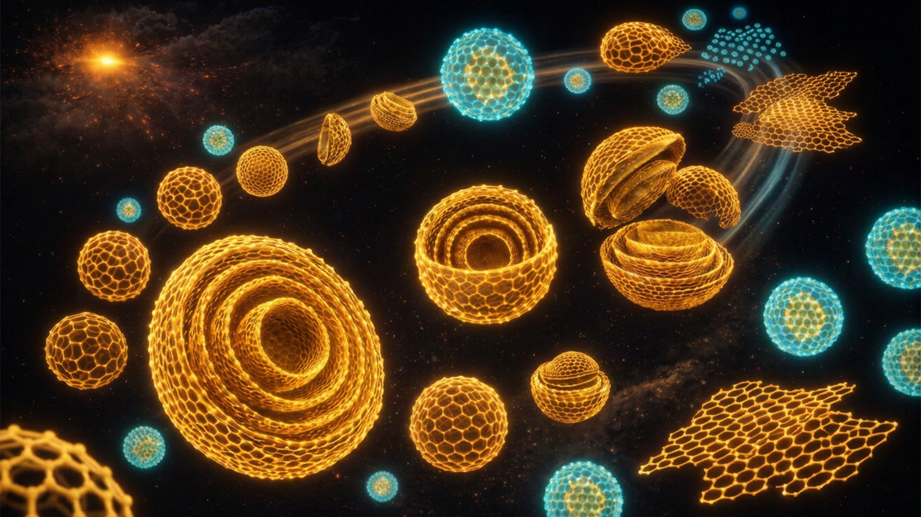
Nanodiamonds and Beyond: Designing Carbon Materials with Artificial Intelligence at Exascale
Scientific Achievement
Carbon is one of nature’s most versatile elements, capable of forming materials that are stronger than steel, lighter than plastic and adaptable to countless applications.
Using the Frontier supercomputer and artificial intelligence and drawing on expertise in multiple disciplines, Argonne scientists are learning to predict and control how tiny carbon crystals respond under extreme conditions.
Significance and Impact
This work, published in the journal Carbon, could lead to breakthroughs in medicine, energy storage and national security while showcasing the power of supercomputing and artificial intelligence in modern science.
Using this technique, researcher could predict what kind of nanocarbon will form from a given set of condition and scientists can design new materials on a computer first, rather than relying on lengthy trial-and-error experiments in the lab, saving both time and research funds.
Evolution pathways of post-detonation nanodiamonds into carbon nano-onions and carbon dots under extreme thermodynamic conditions following a detonation event. Structures are based on exascale molecular dynamics simulations and visually enhanced with AI to optimize the spatial arrangement, lighting and aesthetics. (Image by Eliu Huerta & Xiaoli Yan, Data Science and Learning division/Argonne National Laboratory.)
Technical Approach
The team used Argonne’s Aurora supercomputer and ORNL’s Frontier supercomputer to simulate carbon material transformations atom by atom.
The Delta and DeltaAI systems at the National Center for Supercomputing Applications at the University of Illinois Urbana-Champaign were also used to perform some of the simulations of the carbon structures.
The computer models act like ultrahigh-speed cameras, letting scientists watch carbon atoms move and bond in slow motion as conditions change.
PI(s)/Facility Lead(s): Eliu Huerta
Collaborating Institutions: Argonne National Laboratory
ASCR Program: INCITE
ASCR PM: Benjamin Brown
Publication for this work: Xiaoli Yan, Millicent A. Firestone, Murat Keçeli, Santanu Chaudhuri, Eliu Huerta, “From atomistic models to machine learning: Predictive design of nanocarbons under extreme conditions,” Carbon. 252, 121366 (2026): https://doi.org/10.1016/j.carbon.2026.121366.

