Slide 1


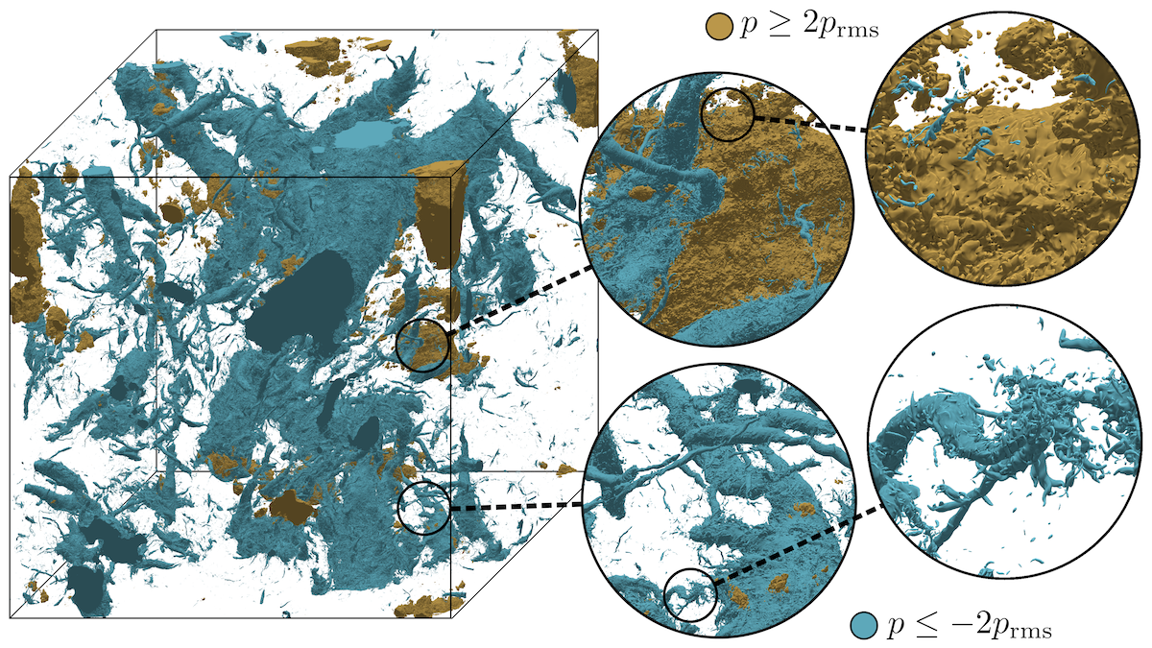
Simulating Turbulence at a Record 35-Trillion Grid Points
Scientific Achievement
Using Frontier, researchers from the Georgia Institute of Technology performed the largest direct numerical simulation (DNS) of turbulence in three dimensions, attaining a record resolution of 35 trillion grid points.
Additionally, they were able to simulate flows at a very high Reynolds number — 2,500 — which provides a higher degree of physical fidelity than possible before.
Significance and Impact
The team’s results offer new insights into the underlying properties of the turbulent fluid flows that govern the behaviors of a variety of natural and engineered phenomena — from ocean and air currents to combustion chambers and airfoils.
Improving our understanding of turbulent fluctuations can lead to practical advancements in many areas, including more accurately predicting the weather and designing more efficient vehicles.
Some data from the simulations are now publicly available online at the Johns Hopkins Turbulence Database, which receives funding from the National Science Foundation.
This visualization shows moderately large pressure fluctuations within a 32,768³ turbulence simulation, including 5x and 25x zoom-in views. The negative fluctuations organize into tornado-like structures with a very broad range of sizes — a hallmark of turbulence that has been difficult to see conclusively in smaller-scale simulations. Credit: Georgia Institute of Technology
Technical Approach
To achieve these results on Frontier, the researchers implemented a simulation protocol called “multiresolution independent simulation.”
This approach involved running multiple short, high-resolution bursts on top of longer but lower-resolution simulations. By carefully “upgrading” the resolution over short times and then averaging over many of these segments, they studied the smallest scales of turbulence without needing to simulate the whole flow for a long time.
PI(s)/Facility Lead(s): Dr. P. K. Yeung
Collaborating Institutions: Georgia Institute of Technology
ASCR Program: INCITE
ASCR PM: Benjamin Brown
Publication for this work: P. K. Yeung, Kiran Ravikumar, Rohini Uma-Vaideswaran, Daniel L. Dotson, Katepalli R. Sreenivasan, Stephen B. Pope, Charles Meneveau, and Stephen Nichols, “Small-scale properties from exascale computations of turbulence on a 32,768³ periodic cube,” Journal of Fluid Mechanics 1019 (2025): https://doi.org/10.1017/jfm.2025.10493.

