Slide 1



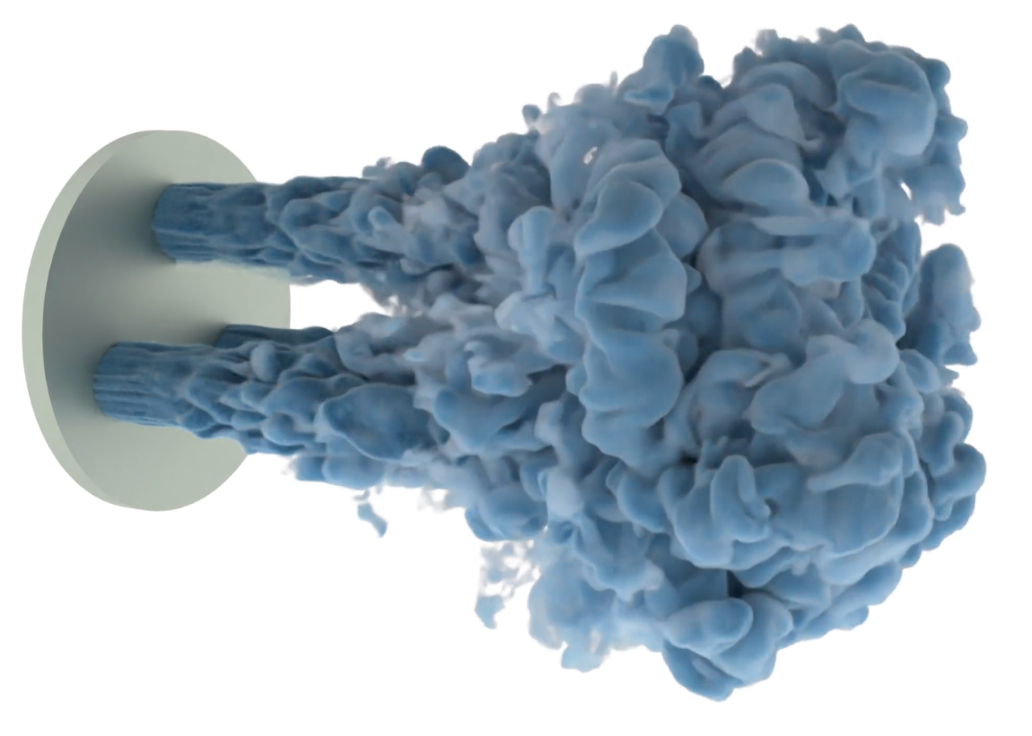
Shock Treatment for CFD Simulations
Scientific Achievement
A team of researchers from the Georgia Institute of Technology conducted the largest-ever computational fluid dynamics (CFD) simulation of high-speed compressible fluid flows on the Frontier supercomputer.
This simulation achieved a resolution of over 100 trillion grid points, thereby surpassing former records of 10 trillion grid points for a compressible CFD simulation on CPU-only supercomputers and 35 trillion for incompressible fluid flow simulated on the GPU-equipped Frontier.
Significance and Impact
CFD simulations are often used to predict the behaviors of new aircraft designs, showing the potential interactions of proposed rockets and airplanes — and their engines — with the atmosphere.
The team simulated an array of 1,500 Mach 14 rocket engines and their interacting exhaust plumes. Rocket designs that feature clusters of engines, such as SpaceX’s Starship, are becoming more prevalent.
Predicting how all those engines’ exhaust plumes may interact upon launch will help rocket designers avoid mishaps — especially with the scale and speed afforded by the Georgia Tech team’s method.
On the Frontier supercomputer, a team of researchers from Georgia Institute of Technology simulated an array of 1,500 Mach 14 rocket engines and their interacting exhaust plumes. They used a new computational technique called information geometric regularization, along with a unified CPU-GPU memory approach, to achieve the largest-ever computational fluid dynamics simulation of over 100 trillion grid points. Image: Spencer Bryngelson, Georgia Institute of Technology
Technical Approach
The team applied its own new computational technique called information geometric regularization, or IGR. It replaces the discontinuities of fluid-flow “shocks” with near discontinuities that still preserve the main flow features, such as post-shock behavior.
The researchers also employed a unified CPU-GPU shared-memory approach for their calculations, which resulted in far less memory usage per grid point.
.
PI(s)/Facility Lead(s): Spencer Bryngelson
Collaborating Institutions: Georgia Institute of Technology
ASCR Program: OLCF Director’s Discretionary Program
ASCR PM: Benjamin Brown
Publication(s) for this work: S. Bryngelson, et al., “Simulating many-engine spacecraft: Exceeding 100 trillion grid points via information geometric regularization and the Multicomponent Flow Code flow solver.” (Gordon Bell Prize entry.) doi: 10.48550/arXiv.2505.07392.

