Slide 1

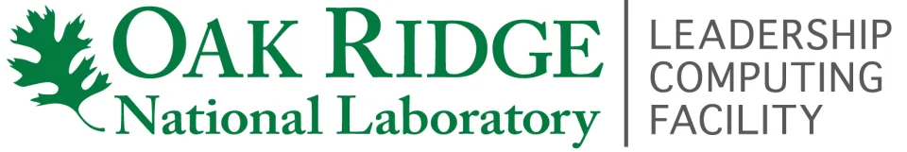
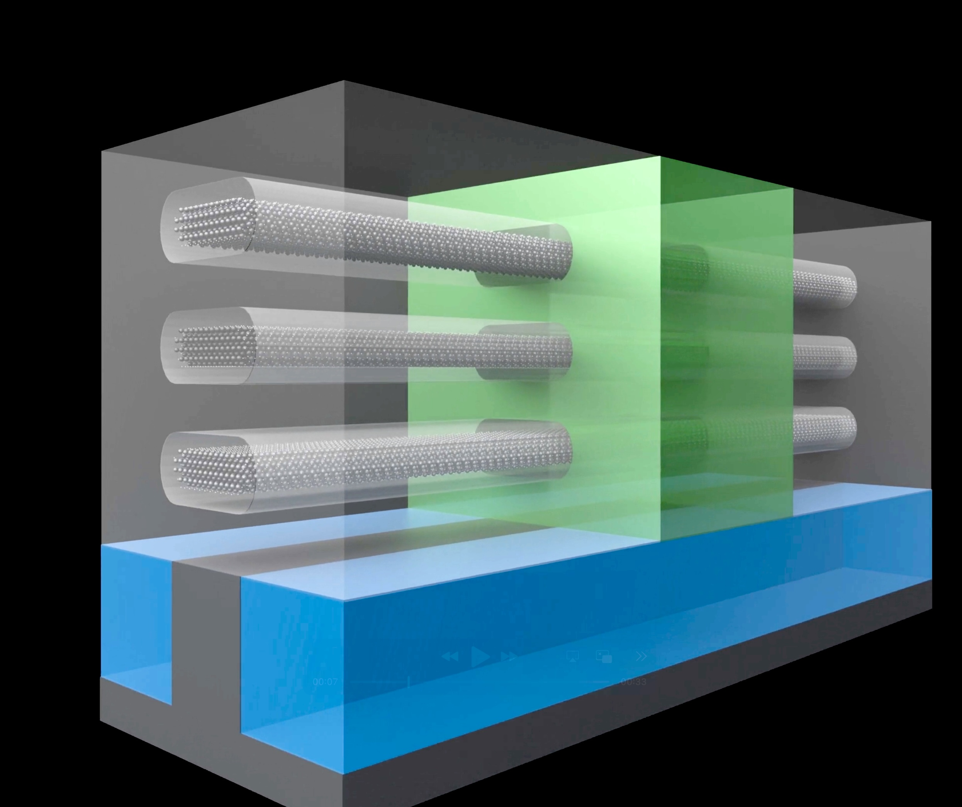
Simulating Next-Generation Transistors at Exascale
Scientific Achievement
Researchers from the Swiss Federal Institute of Technology in Zurich, Switzerland (ETH Zurich) have developed a new framework to capture the quantum mechanical effects inherent in the designs of nanoscale electronic devices, such as next-generation nanoribbon field-effect transistors (NRFETs).
The team’s open-source code, Quantum Transport Simulations at the Exascale and Beyond (QuaTrEx), demonstrated a record-breaking level of performance on the exascale-class Frontier supercomputer.
QuaTrEx produced transistor simulations roughly an order of magnitude larger than previous quantum transport simulations of interacting electrons in materials.
Significance and Impact
The QuaTrEx framework can provide semiconductor engineers with much more accurate insights through advanced modeling capabilities unavailable in current state-of-the-art simulation tools.
These computational achievements have made the ETH Zurich team finalists for the Association for Computing Machinery’s 2025 Gordon Bell Prize for outstanding achievement in high-performance computing.
Nanoribbon field-effect transistors are emerging as the latest, silicon-based technology that can operate at ultrascaled dimensions while providing the necessary computing power for modern electronic devices, from cell phones to GPUs. QuaTrEx gives semiconductor engineers much more advanced modeling tools to design NRFETs and other nanoscale electronic devices. Credit: Mathieu Luisier, ETH Zurich.
PI(s)/Facility Lead(s): Mathieu Luisier, ETH Zurich
Collaborating Institutions: ETH Zurich
ASCR Program: OLCF Director’s Discretionary 2025
ASCR PM: Benjamin Brown
Publication(s) for this work: N. Vetsch, et al., "Ab-initio Quantum Transport with the GW Approximation, 42,240 Atoms, and Sustained Exascale Performance." 2025 International Conference for High Performance Computing, Networking, Storage, and Analysis (SC25).
Technical Approach
QuaTrEx is written in the general-purpose Python programming language, which allowed the team to leverage highly optimized libraries in a portable way.
Python’s flexibility also allows the code to run on different computing platforms, including the Swiss National Supercomputing Centre’s Alps supercomputer and its NVIDIA GPUs.

