Slide 1
Slate Hackathon Aug 25-26

Slide 2
Agenda
Day 1
Time | Title
10m | Presentation: Welcome and Introduction to Slate
30m | Tutorial modules: Quickstart & Exploring Deployments
10m | Discussion: Managing Configuration
30m | Tutorial modules: Deploying Applications with Helm & Databases
5m | Presentation: Integration with OLCF
30m | Tutorial modules: Integration with OLCF & Debugging
5m | Wrap up & Next steps
Day 2
Time | Title
2h | Continue tutorial modules & breakout rooms for specific engagements

Slide 3
Introduction to Slate

Slide 4
Why Kubernetes for HPC Workflows?
For Users
Access to HPC resources from service containers
Similar user experience when compared to batch scheduling paradigm
Growing industry standard for designing portable services that can be run anywhere
Operations
Kubernetes allows users to declare their intent and operations to implement and realize that intent
We make use of this in order to enforce operational policy such as running containers as a particular UID/GID and enforcing authentication on exposed services
Kubernetes provides a single scheduling interface for both users and operations to run their workloads

Slide 5
Slate Services at OLCF
Production Clusters
Automation Users
External HTTP Services
TCP/UDP Services
Uses resource quota and limit systems in Kubernetes, projects get Kubernetes namespaces to run their services
Container image build service available for building container images
Runs Red Hat OpenShift
Containers run as Project-level automation users
Access to batch job scheduler for Summit and Rhea
Access to parallel filesystems like Alpine (GPFS) and OLCF home/project areas
Can expose HTTP services on the Internet
These services are transparently protected by NCCS Authentication and are accessible by other project members
Useful for web-based dashboards
Can expose TCP and UDP services inside OLCF for accessing applications running in Kubernetes from compute nodes

Slide 6
Slate at OLCF

Slide 7
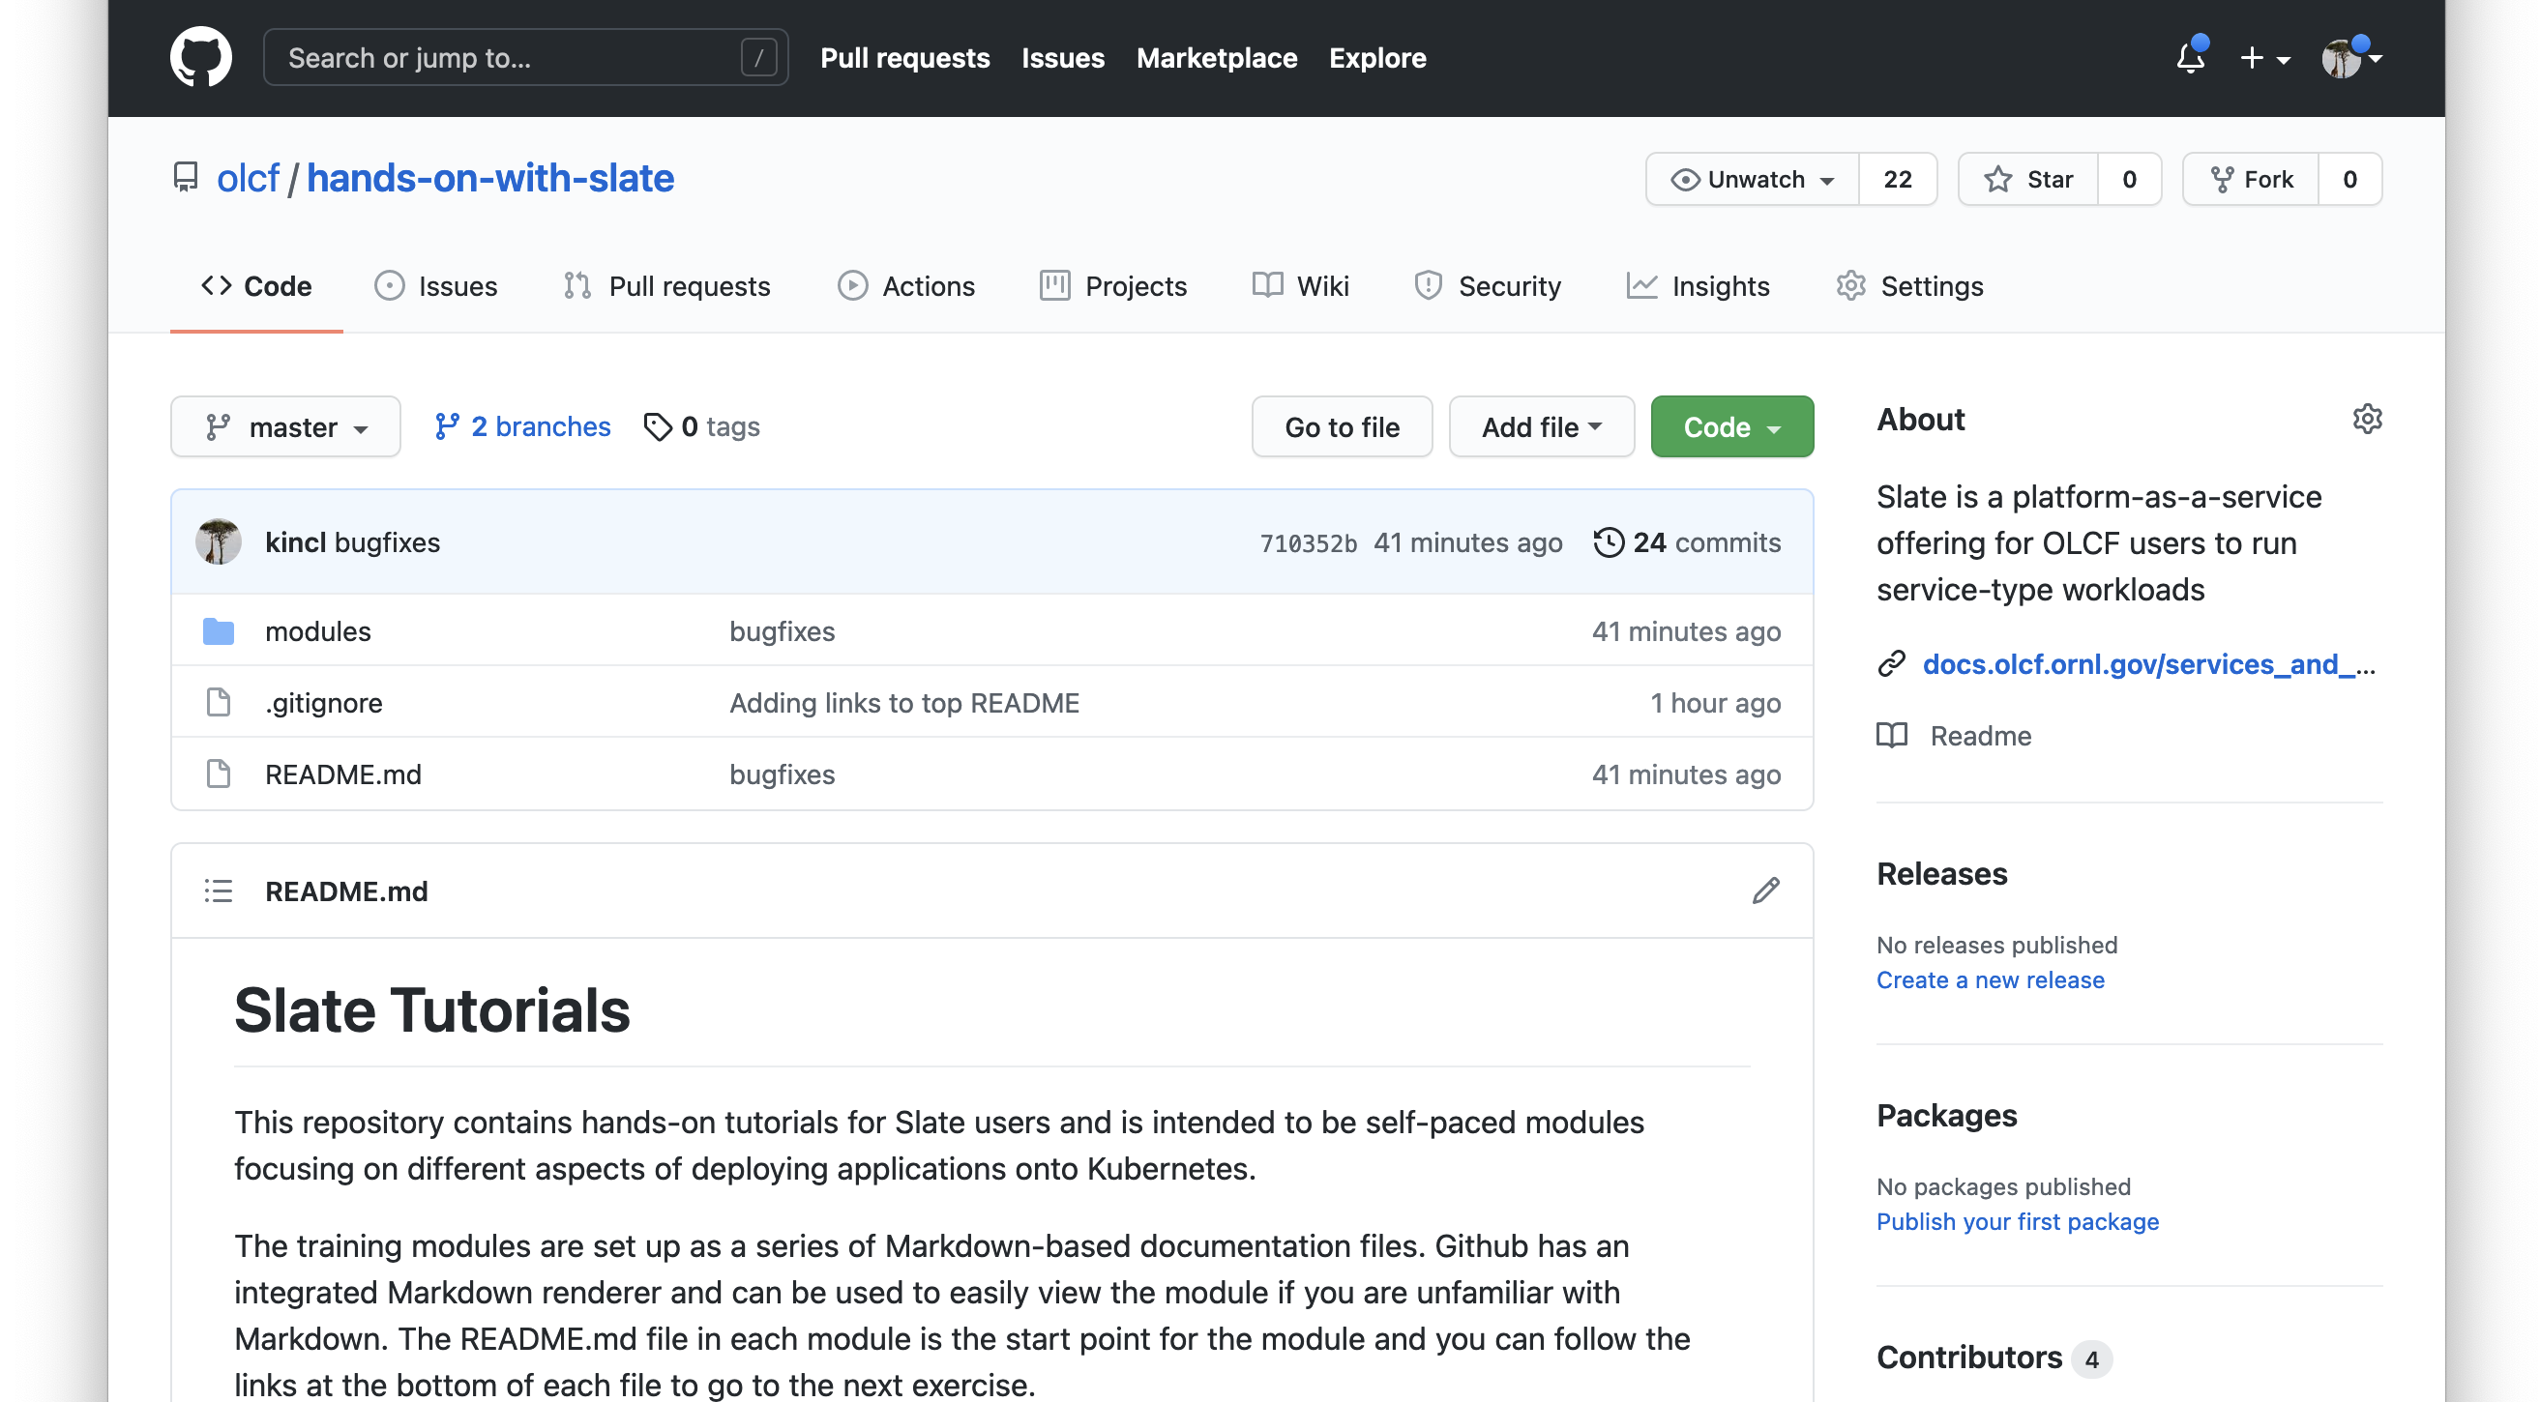
Hands-on with Slate: Tutorial Modules
https://github.com/olcf/hands-on-with-slate
Use OLCF Slate Hackathon Slack!
https://olcfslatehackathon.slack.com

Slide 8
Integration with OLCF

Slide 9
HPC Workflow Facility Constraints
Allow for users to manage their own workflow systems/databases/web portals
Diverse ecosystem of tools makes it difficult for User Assistance and Operations groups to support everything
Why not just use SSH keys for remote access?
Our moderate security controls require remote actions to be authenticated with RSA two-factor credentials
Instead we allow running workflow systems inside of our security boundary
Need separate resource from HPC compute clusters which run batch schedulers

Slide 10
HPC Workflow Requirements
Upon surveying existing workflow systems we came up with the following requirements:
Run a persistent service that can stay running across system reboots
Talk to batch submission system for current queue information and for job submission
Interact with files on parallel filesystems (GPFS/Lustre/NFS)

Slide 11
Why Kubernetes for HPC Workflows?
For Users
Access to HPC resources from service containers
Similar user experience when compared to batch scheduling paradigm
Growing industry standard for designing portable services that can be run anywhere
Operations
Kubernetes allows users to declare their intent and operations to implement and realize that intent
We make use of this in order to enforce operational policy such as running containers as a particular UID/GID and enforcing authentication on exposed services
Kubernetes provides a single scheduling interface for both users and operations to run their workloads

Slide 12
Slate at OLCF

Slide 13
Access to Alpine and Summit

Slide 14
Conclusion

Slide 15
Survey
https://www.surveymonkey.com/r/6PWVYF7

