Slide 1
Working Effectively With the HPC Software Ecosystem
Dr. David M. Rogers
Computational Scientist
ORNL NCCS
rogersdm@ornl.gov

Slide 2


Presentation Acknowledgments
This work is licensed under a Creative Commons Attribution 4.0 International License. (CC BY 4.0).
Includes contributions from Bernholdt, David E.; Dubey, Anshu; Heroux, Michael; O'Neal, Jared (2019): SC19 Tutorial: Better Scientific Software. figshare. Presentation. (10.6084/m9.figshare.10114880.v4)
Thanks to comments & feedback from Elaine Raybourn and Mark Miller

Slide 3
What?
IDEAS Goals:
Enable increased scientific productivity
Develop an interdisciplinary and agile approach to the scientific software ecosystem
ECP Goals (2016-2022):
Provide breakthrough solutions that address our most critical challenges in scientific discovery, energy assurance, economic competitiveness, and national security
Bring together research, development, and deployment activities as part of a capable, enduring exascale computing ecosystem
Your Goals (probably):
Fast overall time to solution on ever harder science problems

Slide 4
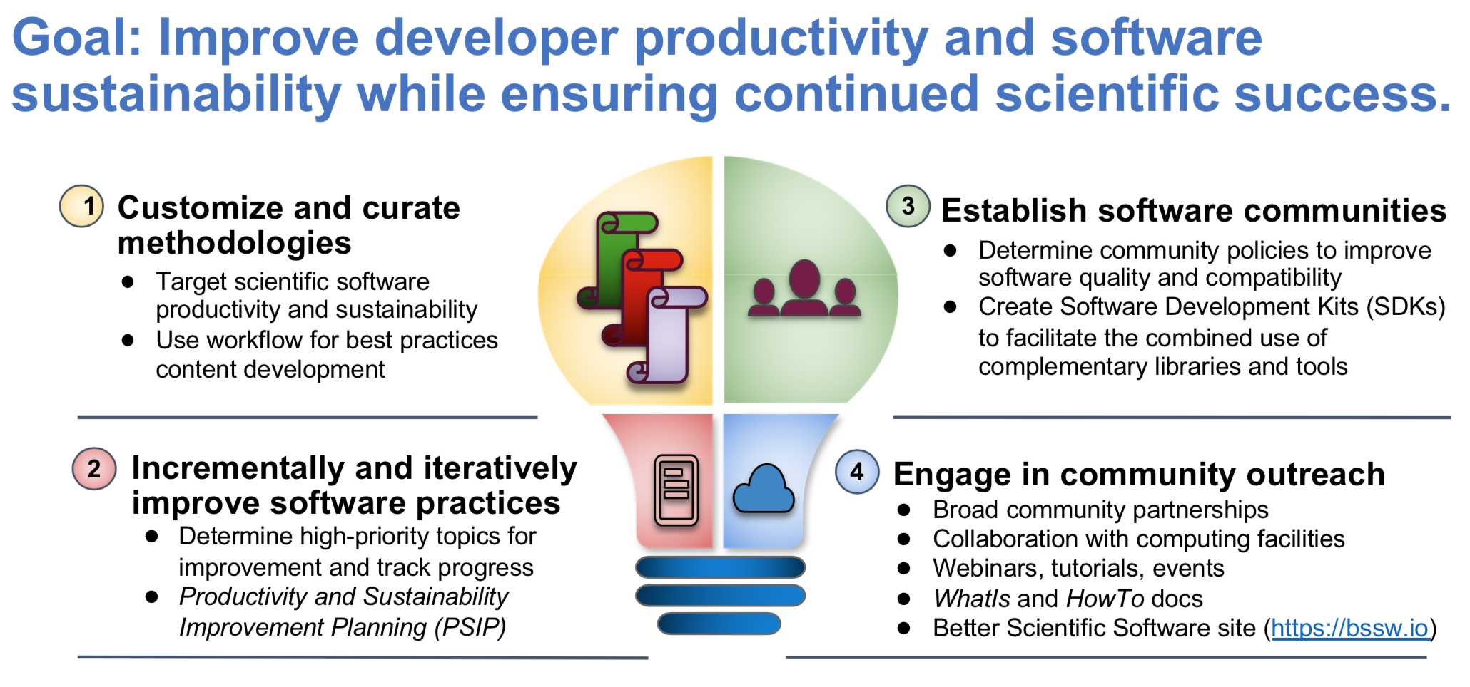
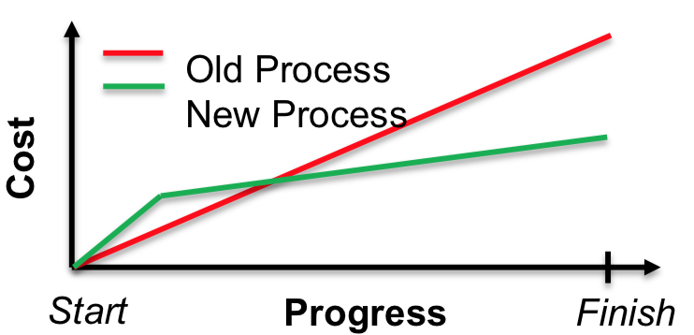

IDEAS In a Nutshell
test, revise, deploy
Quickly survey practices and techniques here
identify, analyze, prototype

Slide 5
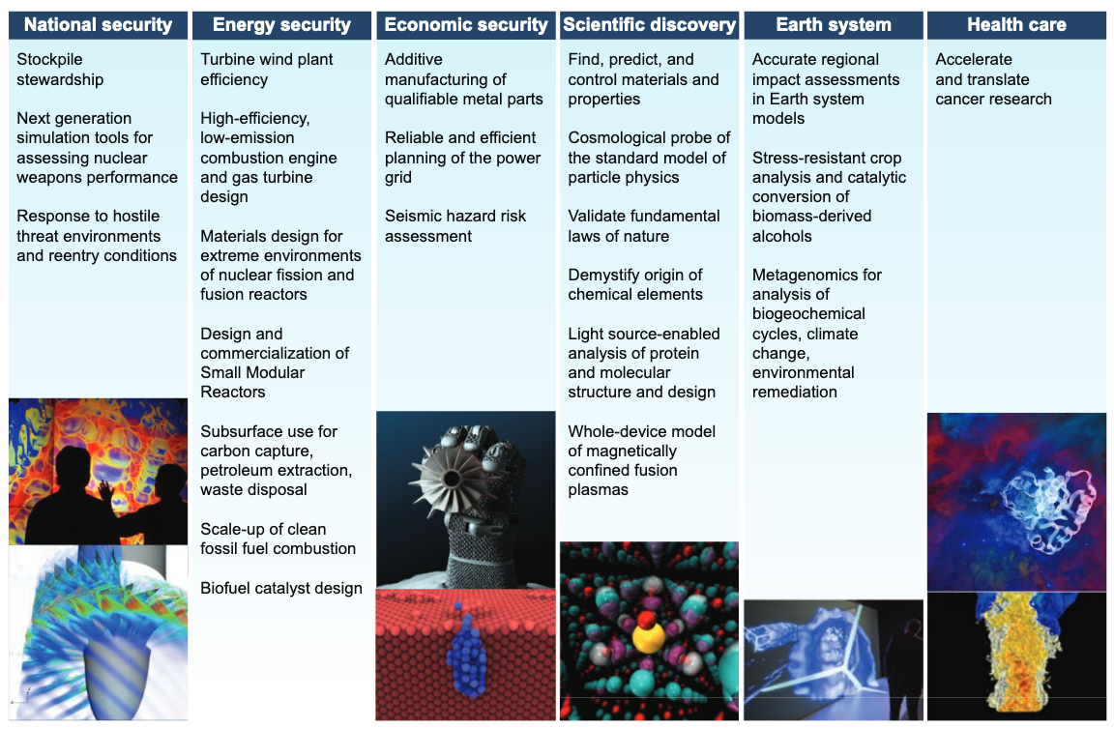
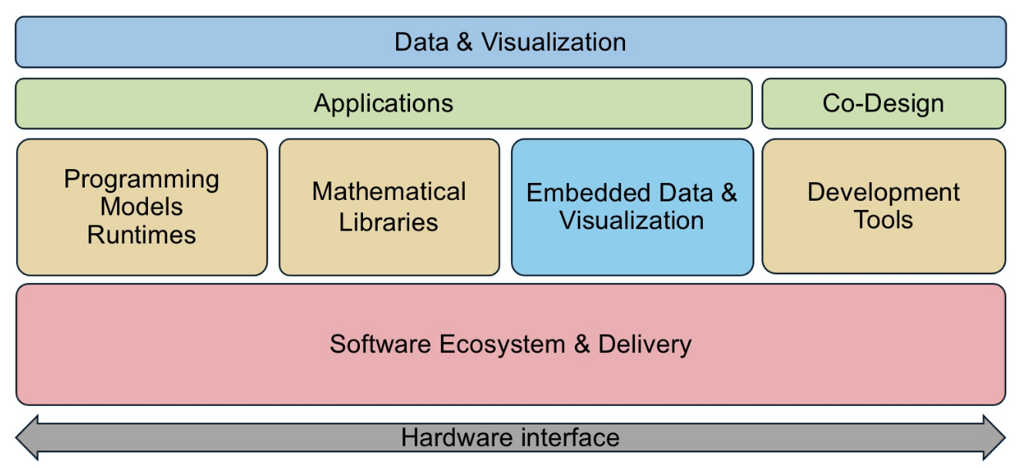
ECP In a Nutshell
Application Development
Software Technology
https://www.exascaleproject.org/reports/

Slide 6
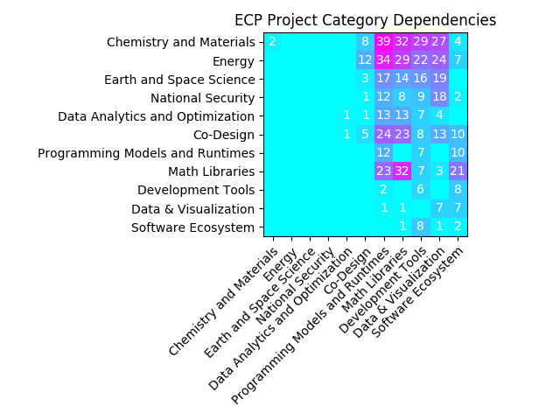
ECP In a Nutshell
Active collaboration and code linking is happening inside and outside DOE

Slide 7
Case-in-point: The Checklist
Use the GNU debugger to chase down a segfault
Survey at least one ECP library (ST) code
Try out cmake (targets are better in 3.12+)
Compare doxygen with sphinx-doc.
Open an issue (bug or feature request) with an open-source project.
Try out personal or project kanban (presentation 3)
Create a pass/fail code test for your project
Test out gcov
Test-run a CI job (Jenkins/Travis/Gitlab CI)
Write an onboarding checklist for your team

Slide 8


Deep Dive: plugging into dense linear algebra
Dense linear algebra on CPU/GPU, how hard could it be?
kernels & tile sizes differ by device
communication patterns are mostly the same (but may vary by dimension)
optimization cheat-codes are machine-dependent
Elemental
High-Performance Linpack
/ Chameleon

Slide 9
Objective: Benchmark @ Scale
Will this work for me?
Is the library design compatible with my code
Matrix layout & size assumptions
Assumes very large dims (int64 sizes) and dense, tiled layout
Parallel distribution & code control flow
(apparently) only high-level, synchronous API
Is it well-documented?
Text description of how to construct key data objects
API documentation of major function calls
Are there reproducible, easy to run benchmarks? – quick advertisement for MiniApps / MiniTests
Is it easy to compile next to my code?
Let’s learn by doing.

Slide 10

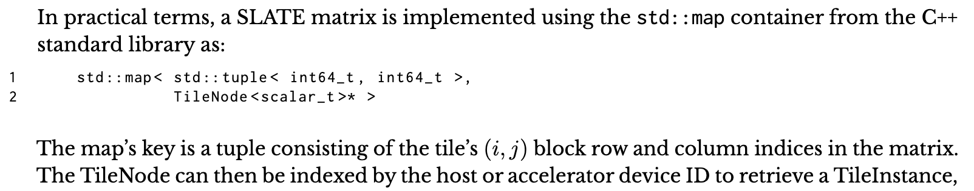
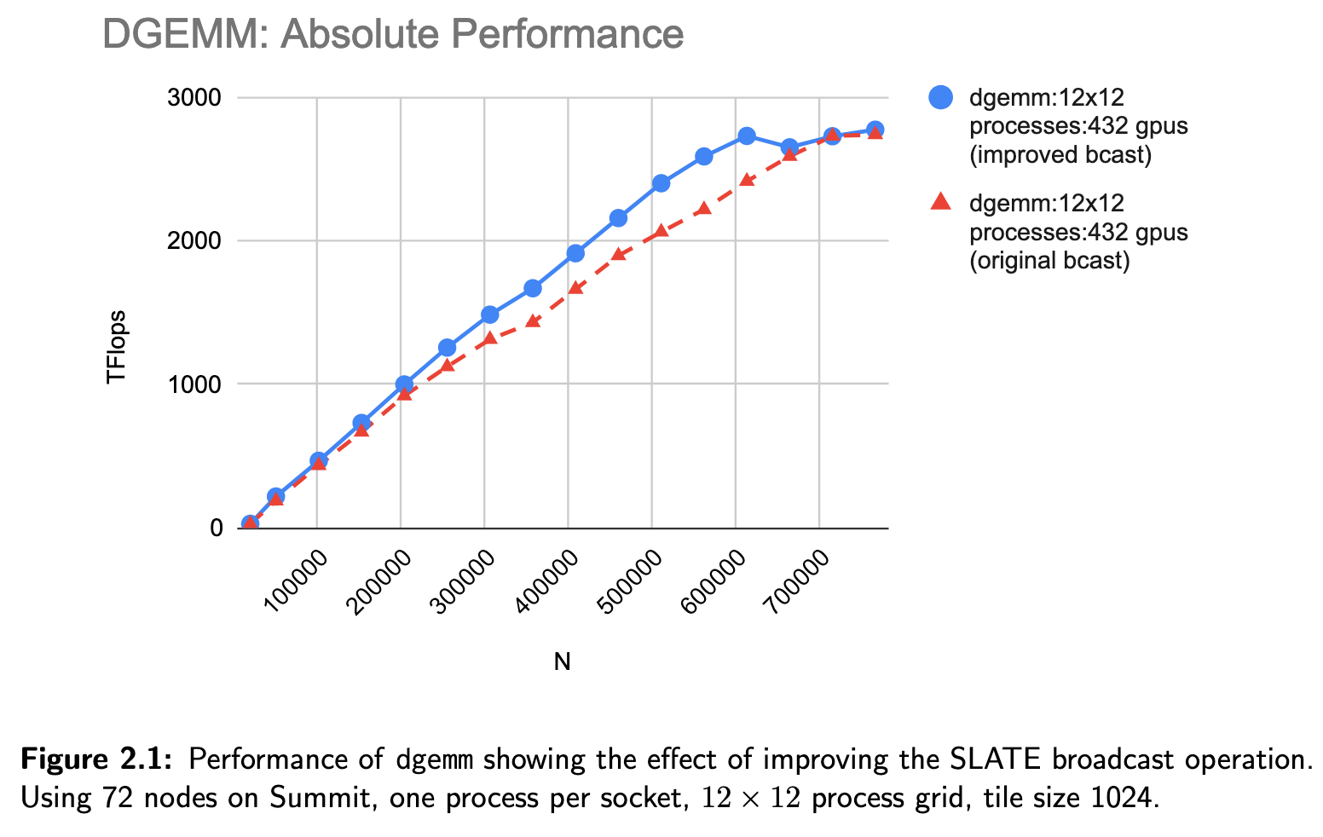
Testing…
Design Compatibility?
https://www.icl.utk.edu/files/publications/2019/icl-utk-1315-2019.pdf
Performance?
https://www.icl.utk.edu/files/publications/2020/icl-utk-1314-2020.pdf

Slide 11
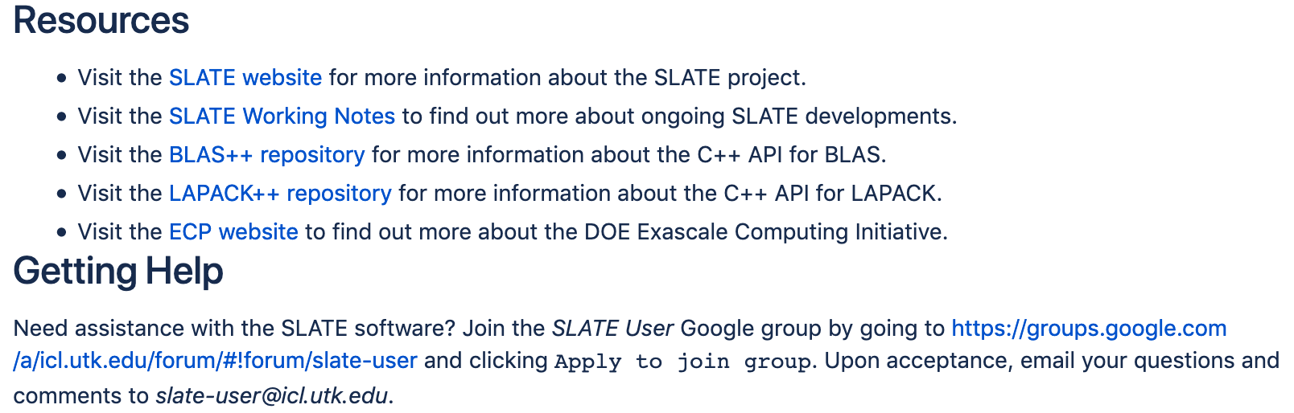
Testing…
Documentation?
https://bitbucket.org/icl/slate/src/default/docs/sphinx/overview.rst
Ease of compilation?
LIBS_LAPACKPP = \
-L${lapackpp_dir}/lib -Wl,-rpath,${lapackpp_dir}/lib –llapackpp
LIBS = ${LIBS_SLATE} ${LIBS_LAPACKPP} ${LIBS_BLASPP} ${LIBS_CUDA}
%: %.cc
${CXX} -o $@ $< ${CXXFLAGS} ${LIBS}

Slide 12
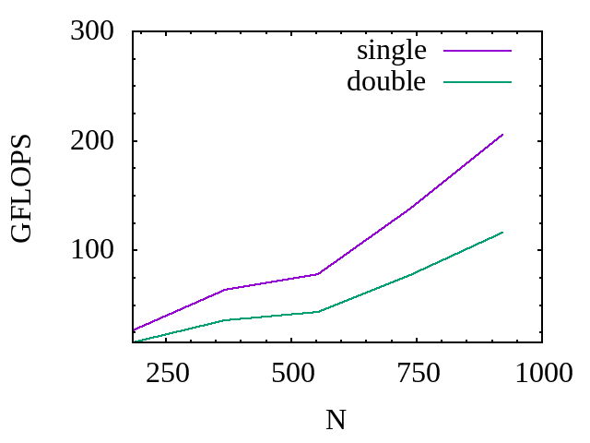
Testing…
int n = mpi.ranks; // # GPUs
int64_t M = n*20480*7; // 140k DOFs per GPU
int64_t N = M*3/28000; // electron pairs
template <typename scalar_type>
void test_syrk_syr2k(int64_t N, int64_t M, int pN, int pM) {
scalar_type alpha = 2.0, beta = 1.0;
int64_t nb=256;
slate::Matrix<scalar_type> A( N, M, nb, 1, pM, comm );
slate::Matrix<scalar_type> B( N, M, nb, 1, pM, comm );
slate::SymmetricMatrix<scalar_type>
S( slate::Uplo::Lower, N, nb, pN, pN, comm );
A.insertLocalTiles(slate::Target::Devices);
B.insertLocalTiles(slate::Target::Devices);
S.insertLocalTiles(slate::Target::Devices);
// S = alpha A B^T + alpha B A^T + beta S
{ Timed timer("syr2k", mpi_rank);
syr2k( alpha, A, B, beta, S ); }
}
Fit for my use
case?
Not so good on tall, skinny matrices (right now)
but we get a chance to collaborate
Disclaimer: much more testing
is needed before confirming
timing results, and I may be
using things wrong here…

Slide 13
Keep Calm and Carry On
Key Takeaways:
Download a copy of this presentation
Use the checklist as a study guide
Rate your own project
Contact me with questions on software best practices, or if you get stuck
Focus on your project objectives.
Collaborate with upstream & downstream teams.
Contribute reproducible benchmarks and tutorials to the community.
Continually evaluate & adapt your own process.
Call out code quality, maintainability, documentation, and collaboration in your project milestones!

