Slide 1
User Documentation Updates
Bill Renaud

Slide 2
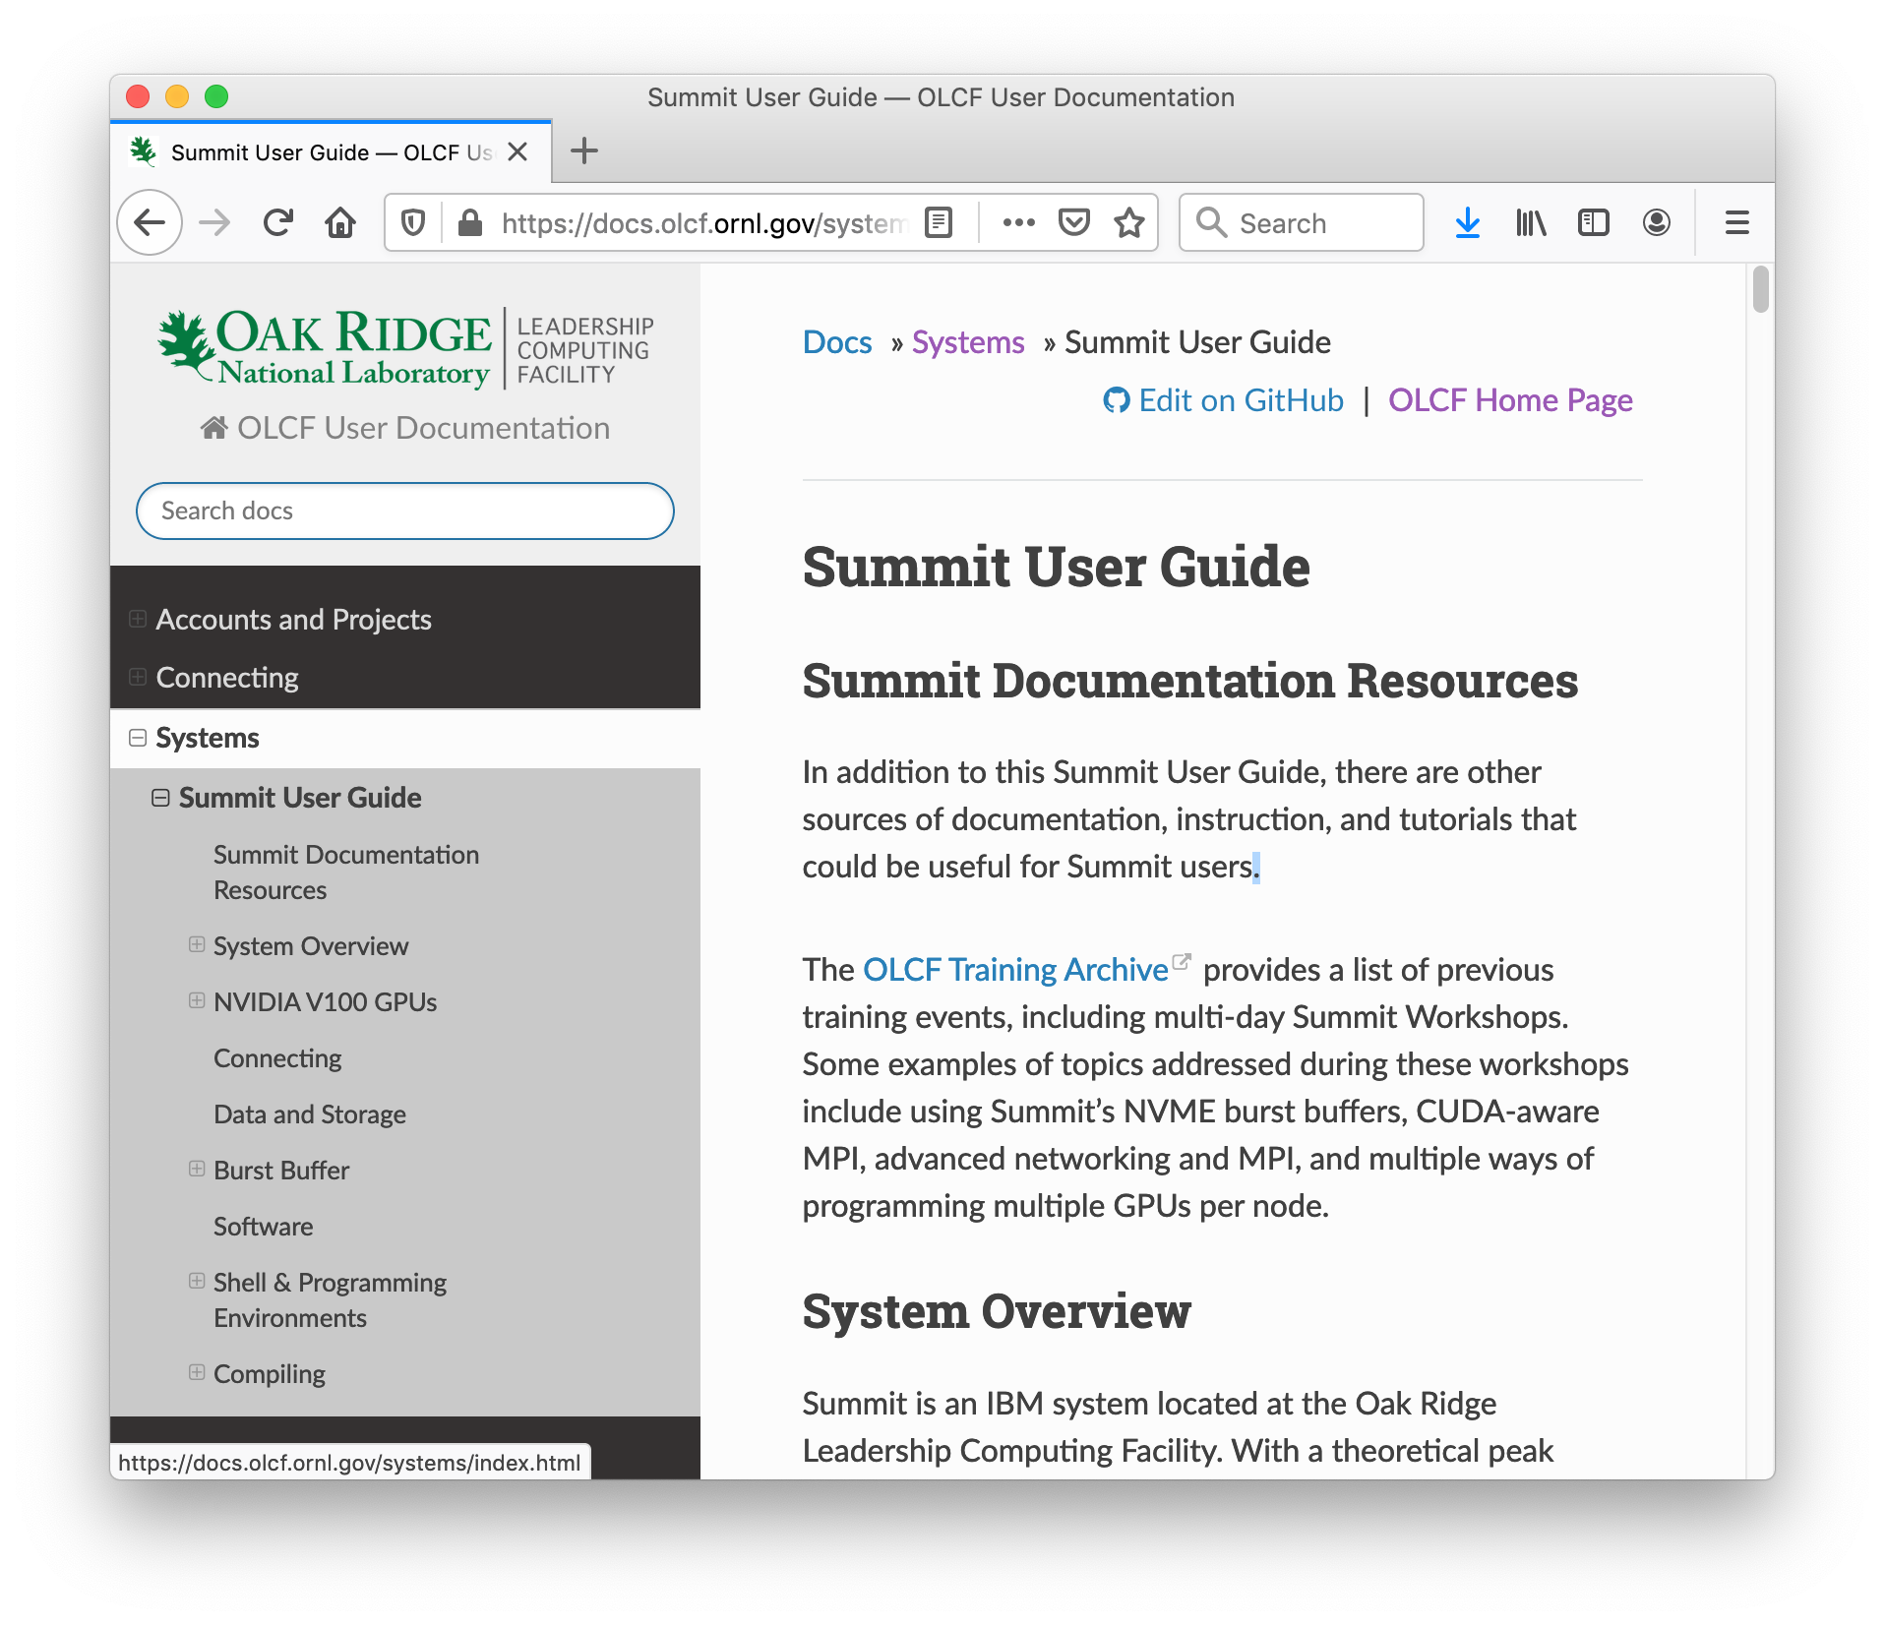
OLCF Documentation Updates
In 2019, we moved
user guides & other
documentation to
a new site:
docs.olcf.ornl.gov

Slide 3
OLCF Documentation Updates
Content is maintained in a github repo
(https://github.com/olcf/olcf-user-docs repo)
Fosters greater collaboration between OLCF, vendors, and users in creating/maintaining documentation
You can help
  Open issues if you notice an error or have a suggestion
  You can also contribute to documentation…

Slide 4
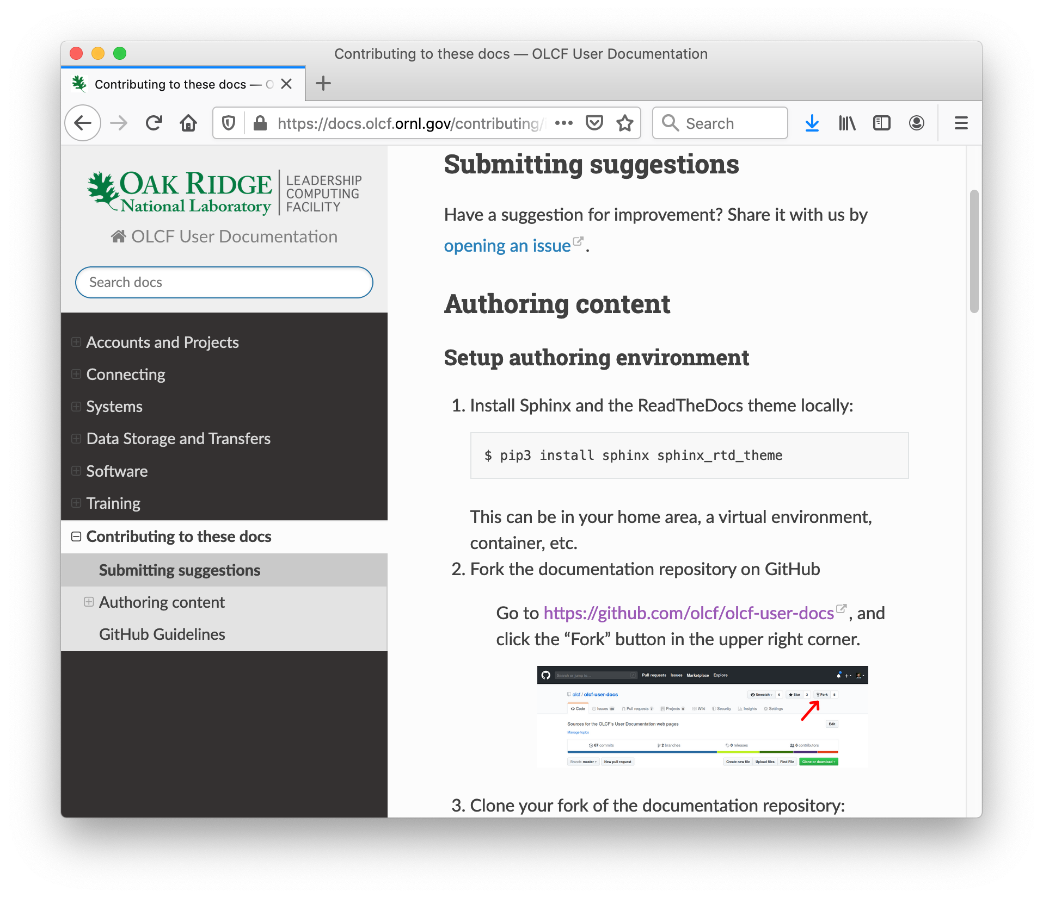
Contributing to Documentation
Guidance for raising
issues and editing documentation is available on the site
For more information, see
https://vimeo.com/421178489
(or link to Sept 2019 User Concall on Training Archive page)

Slide 5
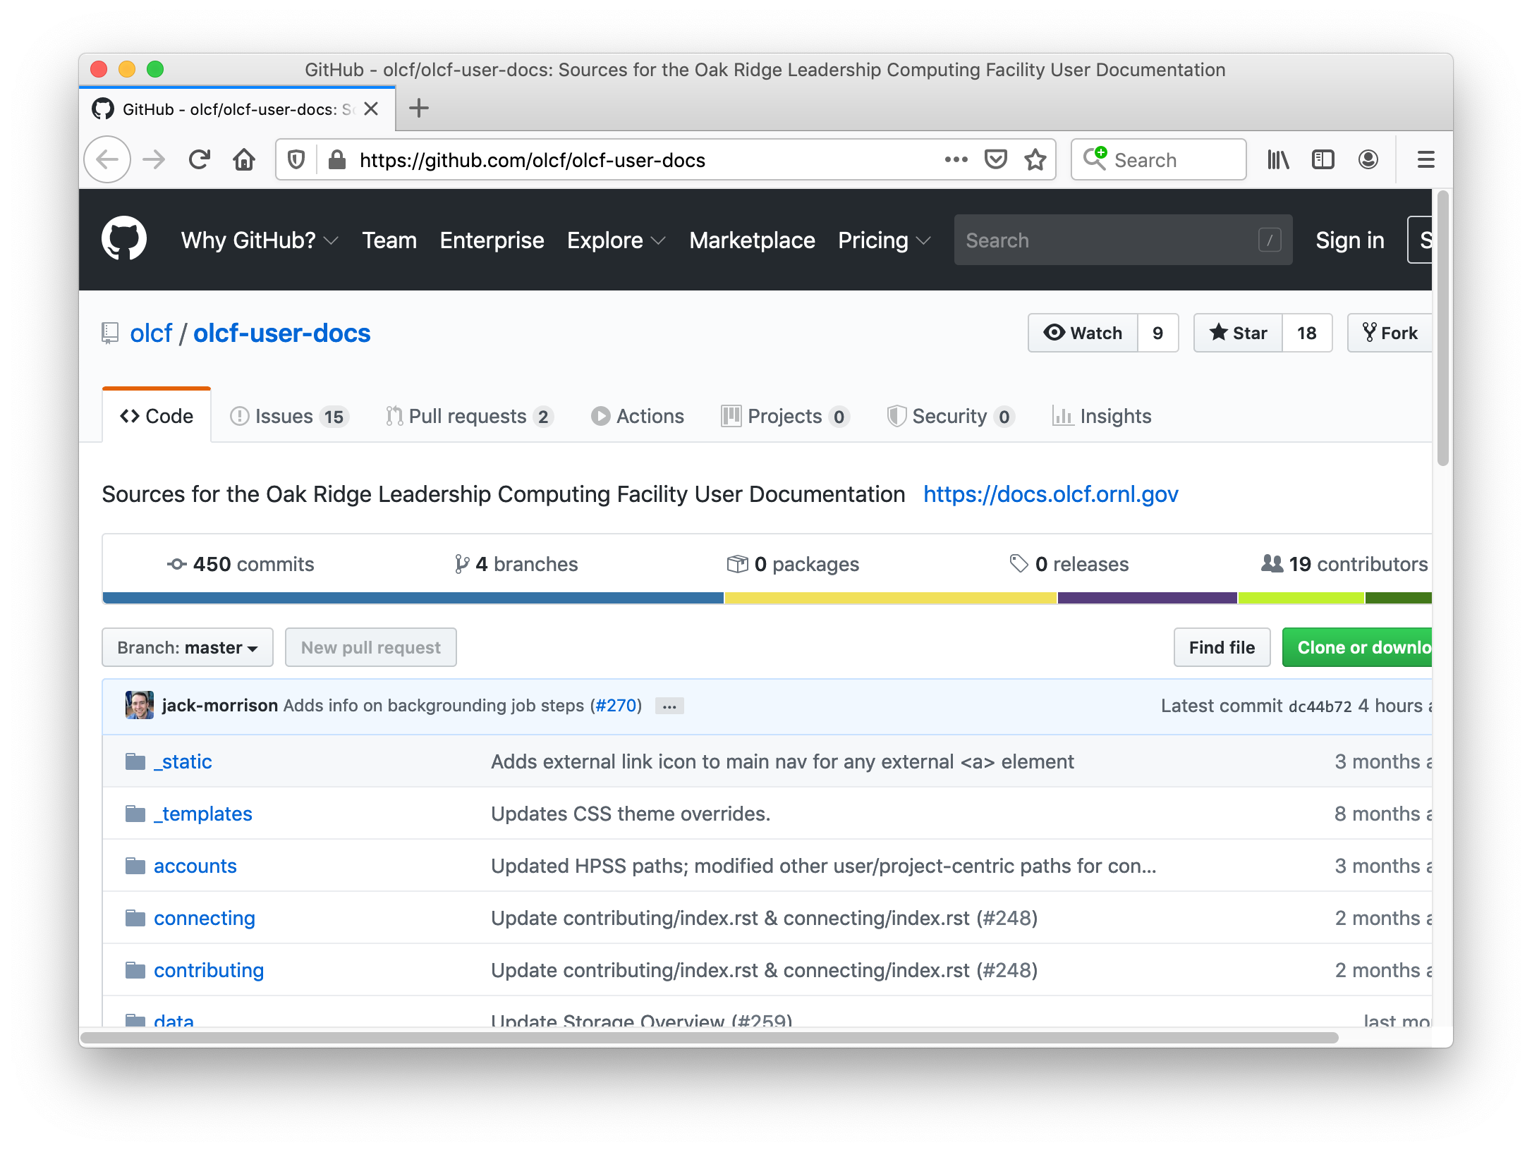
Contributing to Documentation

