Slide 1
Slate Service Overview
High Performance Compute and Data Group
Jason Kincl
HPC Systems Engineer
kincljc@ornl.gov

Slide 2
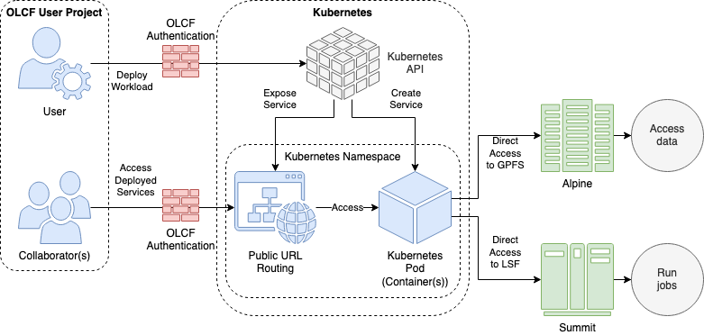
What is Slate
Slate is the OLCF container orchestration service
Slate is comprised of two user-facing clusters:
Marble (with access to Summit/Alpine)
Onyx (with access to Ascent/Wolf)
Slate clusters run the Red Hat OpenShift distribution of Kubernetes
Slate allocations are available to OLCF projects

Slide 3
Who is it for
The Slate service is targeted at projects that need to run extra services usually to support automation workflows
Generally supported use cases:
Scientific workflow systems
Continuous Integration
Data portals
Databases
Cluster capabilities:
Cross-submit jobs to other OLCF resources
Access to parallel filesystems (NFS/GPFS)

Slide 4
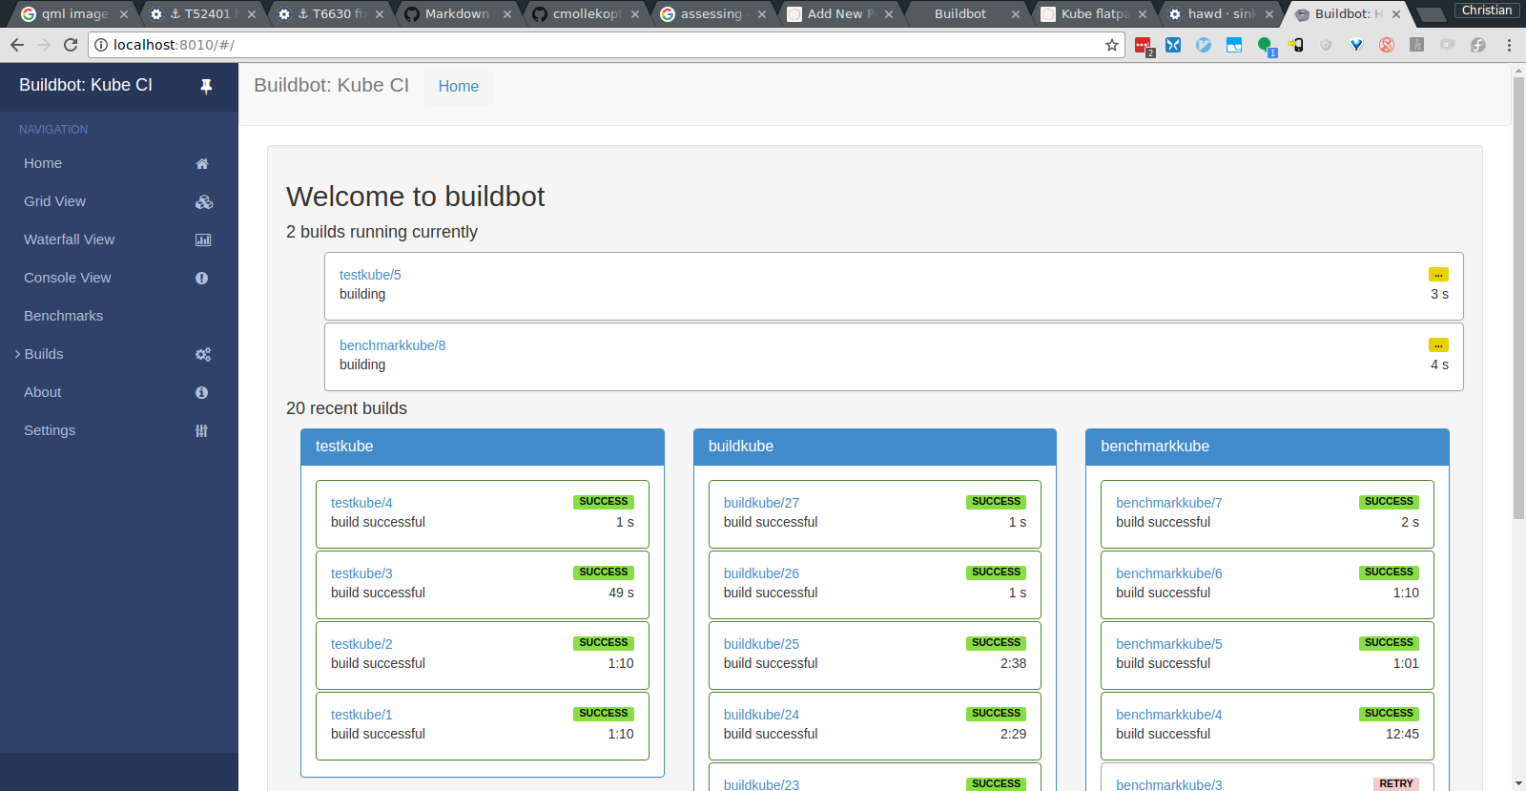

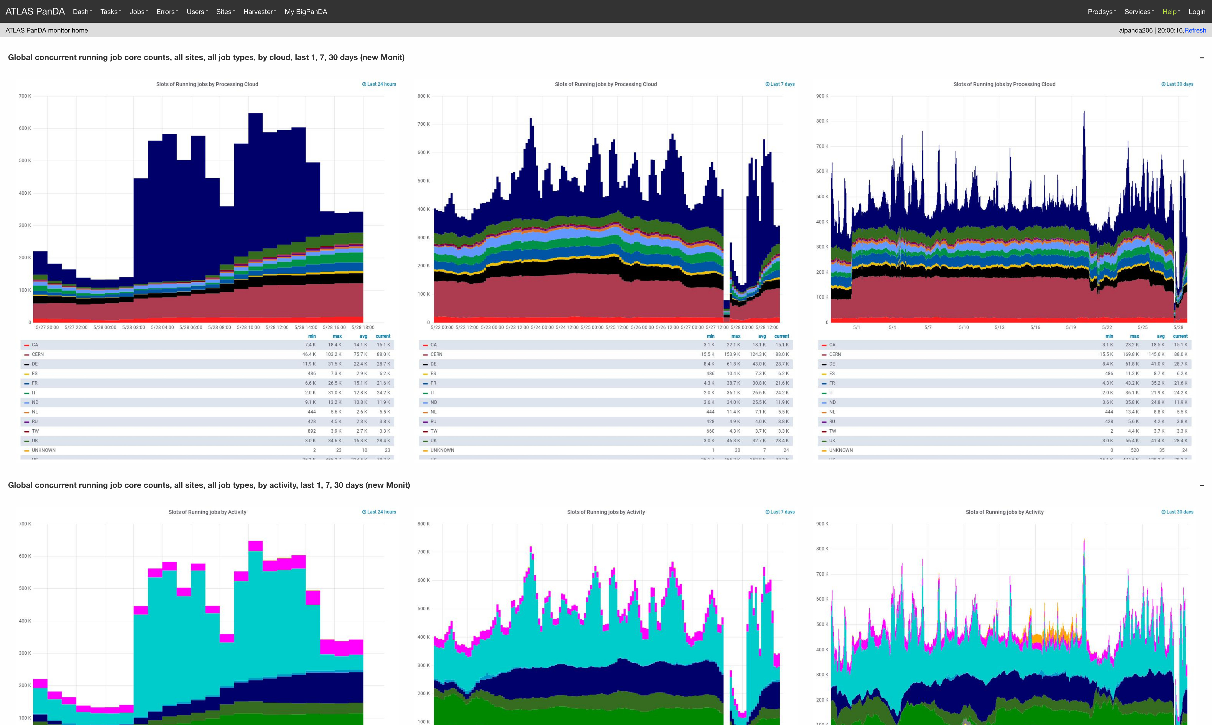


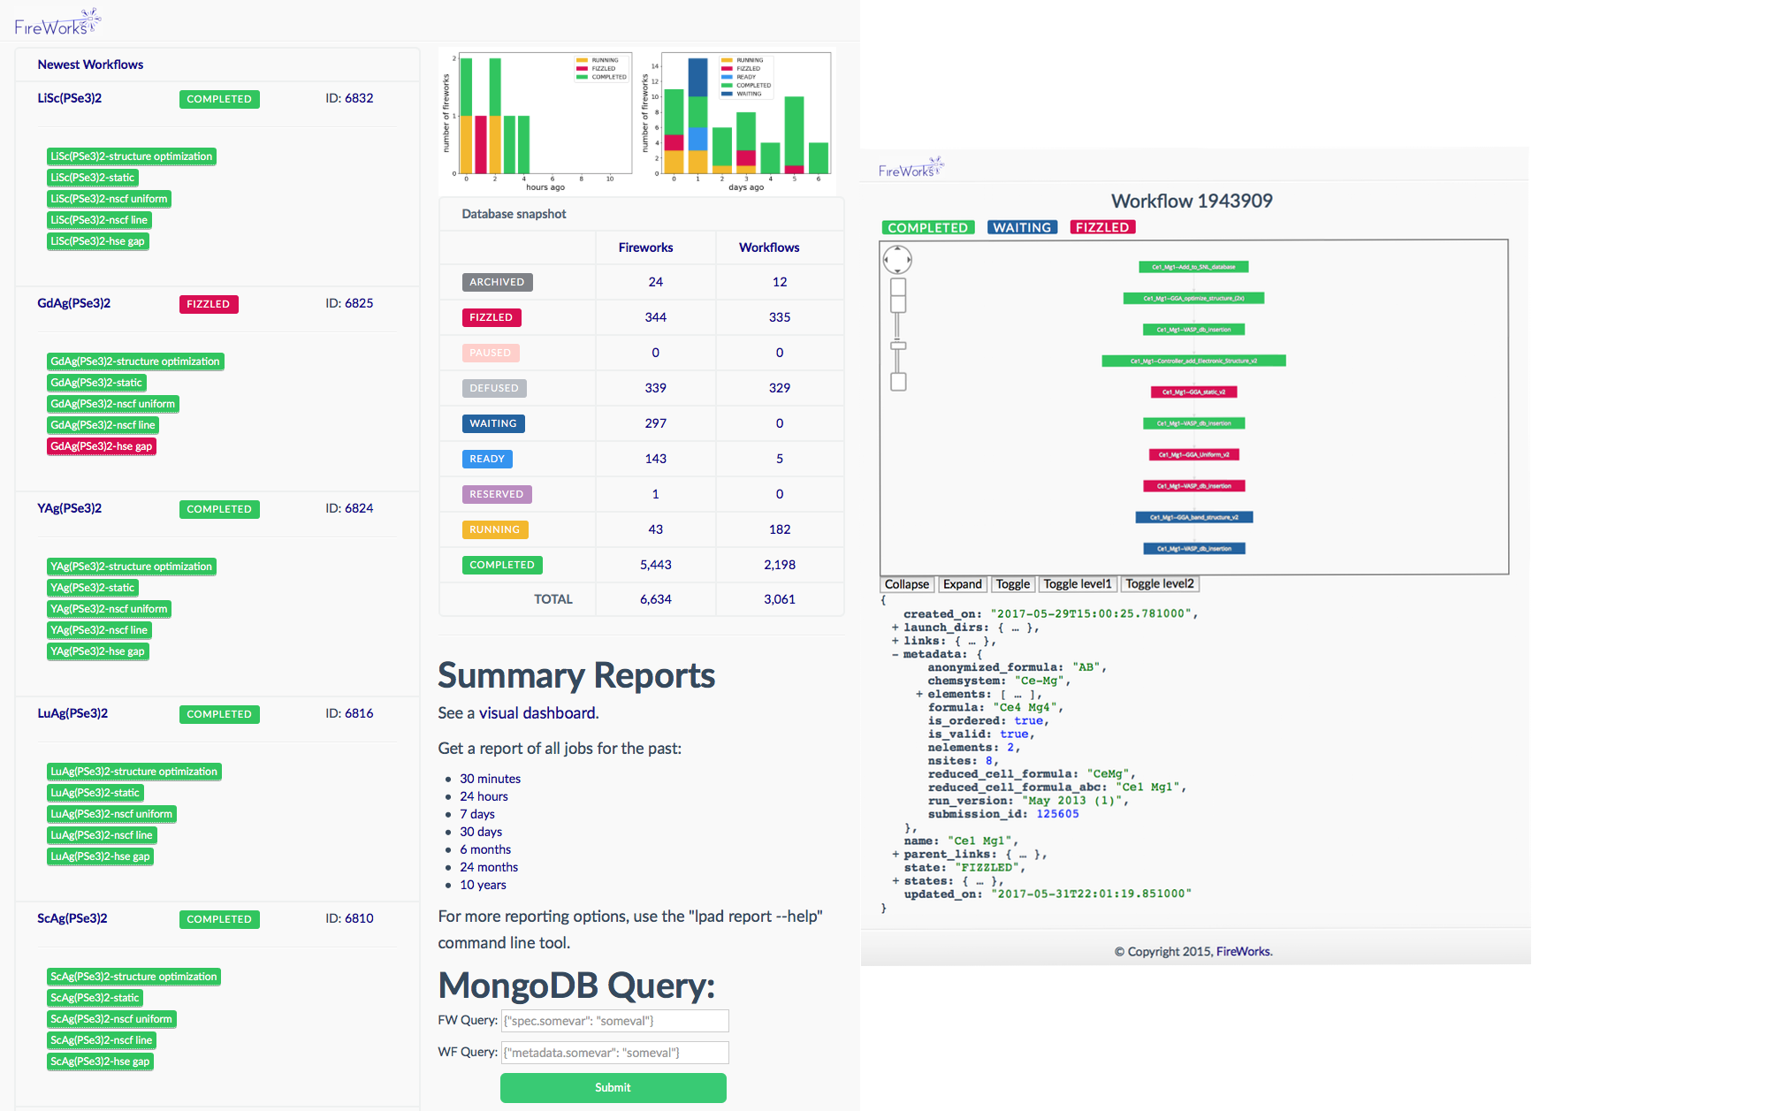




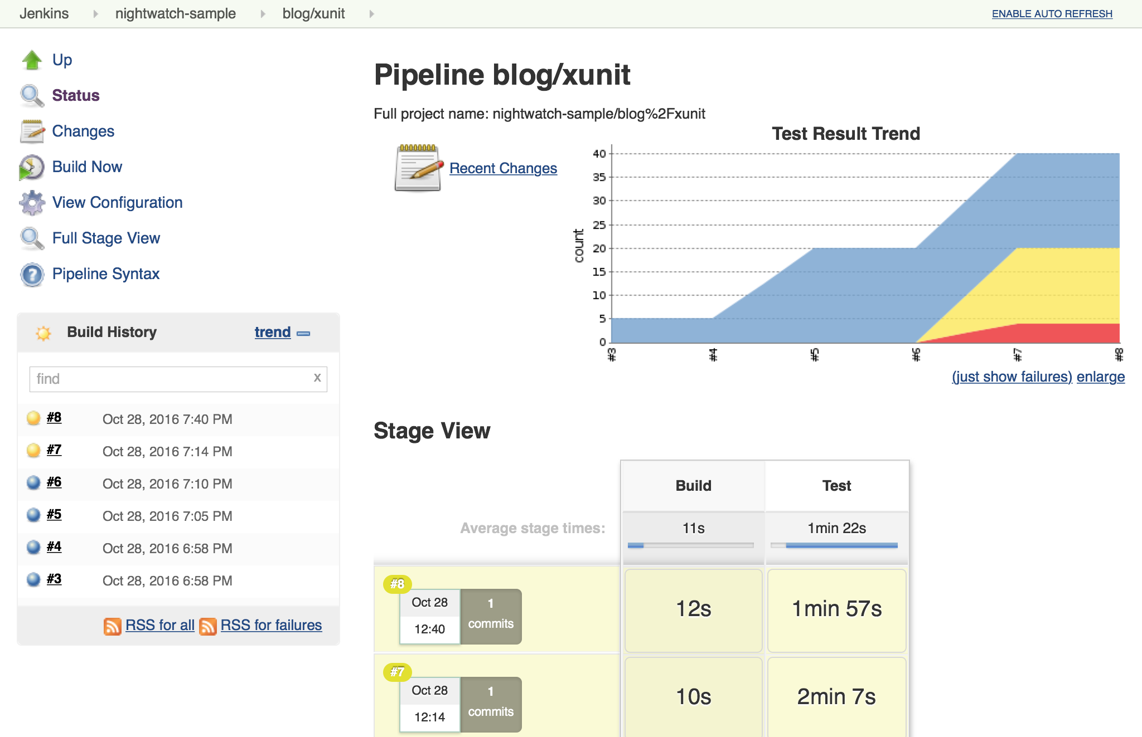
User Highlights
Scientific Workflow Systems
Continuous Integration
Databases
A BigPanDA instance is deployed by a project to provide workflow capabilities like the ATLAS experiment at the LHC at CERN
The Fireworks workflow manager is deployed by projects to automate job submission and data transfer
Buildbot and Jenkins are deployed by projects doing continuous integration testing by running tests with cross submission on OLCF clusters from Slate
MySQL, PostgreSQL and MongoDB are all deployed by projects supporting a diverse set of applications

Slide 5
Slate User Documentation
User Assistance and Outreach
Ryan Prout
proutrc@ornl.gov

Slide 6
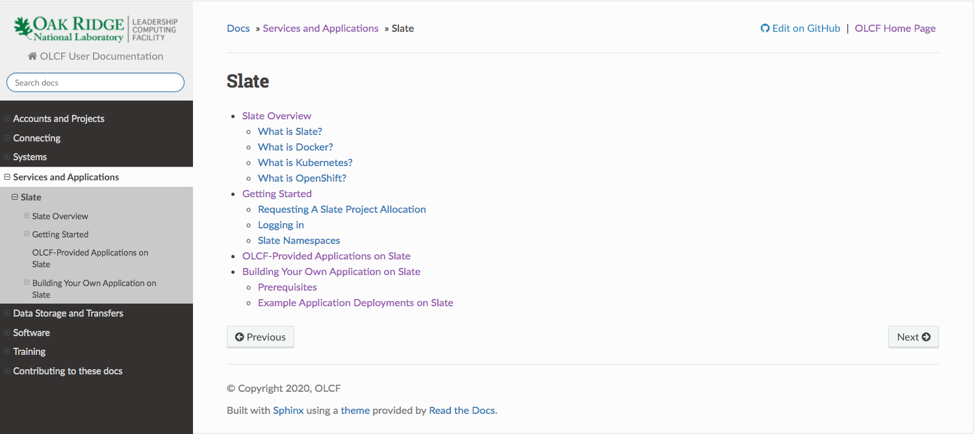
Services and Applications
https://docs.olcf.ornl.gov/services_and_applications/slate/index.html

Slide 7
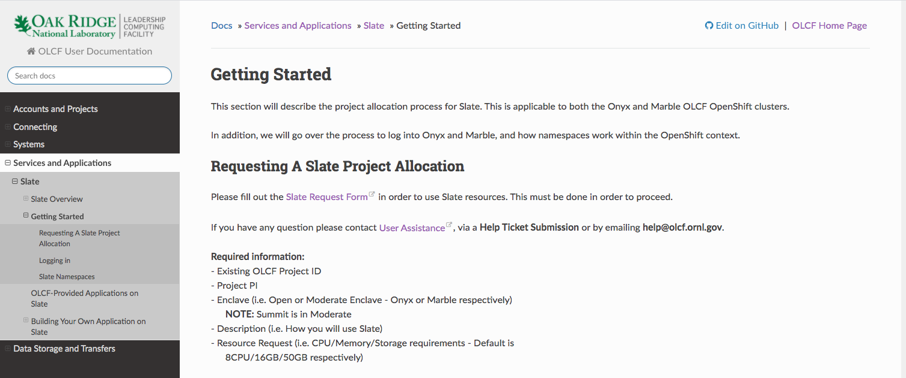
Requesting Slate Resources
https://docs.olcf.ornl.gov/services_and_applications/slate/getting_started.html

Slide 8
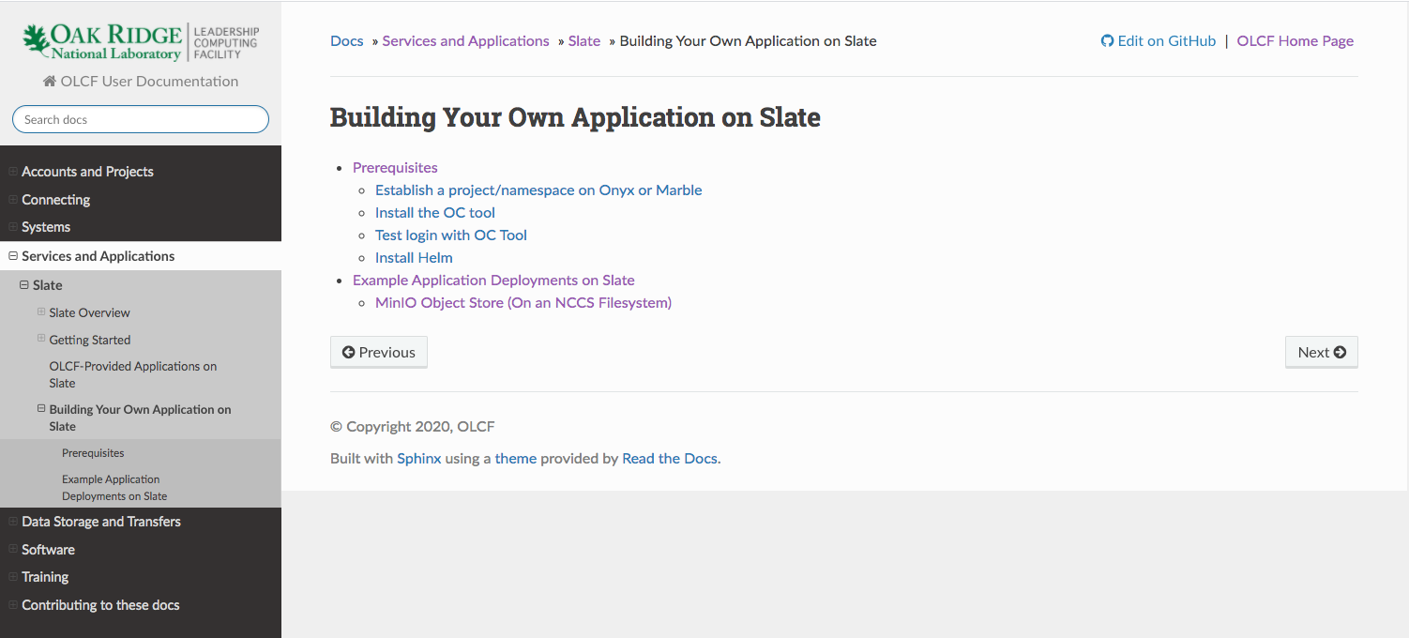
Working with Slate
https://docs.olcf.ornl.gov/services_and_applications/slate/building_your_own_application/index.html

Slide 9
Get Started
Please explore the documentation!
Request Slate resources for your project and get started.
The example application is a great way to get familiar with Slate resources.
Let us know how we can help: help@olcf.ornl.gov

Slide 10
Upcoming Slate Training Event
We will be holding a training and hackathon for getting started with Slate soon
Stay tuned!

