Slide 1
2020 OLCF User Meeting
2019 Survey Results Review
- Ashley Barker

Slide 2
OLCF User Survey Specifics
Conducted by the Oak Ridge Institute for Science and Education (ORISE), using questions developed by the OLCF with input provided by ORISE.
Contained a mixture of questions soliciting ratings, information, and free form comments
2019 survey was substantially revised
Total number of possible items on the survey was reduced by ~56%, from 181 to only 80
The average response time was 9.8 minutes, approximately half of the 18.5-minute response time in 2018.
Survey response rate increased from 34% in 2018 to 46% in 2019
Description | 2018 survey | 2019 survey
Response Rate | 422 (34%) | 578 (46%)
OLCF user <1 year | 23% | 32%
OLCF user 1–2 years | 22% | 21%
OLCF user >2 years | 55% | 47%

Slide 3
2019 Key User Survey Results
Users score OLCF on a 1-5 scale.
1 = Very Dissatisfied
2 = Dissatisfied,
3 = Neither Satisfied nor Dissatisfied
4 = Satisfied
5 = Very Satisfied
Survey Question | 2018 Target | 2018 Actual | 2019 Target | 2019 Actual
Overall OLCF Satisfaction | 3.5/5.0 | 4.6/5.0 | 3.5/5.0 | 4.5/5.0
Overall Satisfaction with Support Received | - | - | 3.5/5.0 | 4.6/5.0
Overall Satisfaction with the Website | 3.5/5.0 | 4.4/5.0 | 3.5/5.0 | 4.4/5.0
Overall Satisfaction with Communications | 3.5/5.0 | 4.4/5.0 | 3.5/5.0 | 4.6/5.0
Overall Satisfaction with OLCF Support Services (across all support teams) | 3.5/5.0 | 4.5/5.0 | 3.5/5.0 | 4.5/5.0
Overall Satisfaction with Problem Resolution | 3.5/5.0 | 4.6/5.0 | 3.5/5.0 | 4.5/5.0
Overall Satisfaction with the Compute Resources | 3.5/5.0 | 4.6/5.0 | 3.5/5.0 | 4.6/5.0

Slide 4
2019 User Survey Results Across Programs
Allocation Program | Percentage of Responses
INCITE | 55%
ALCC | 29%
DD | 33%
ECP | 23%
Early Science | 9%
The survey results among our five programs did not vary greatly. We received the most responses from our INCITE users and the least amount from our Early Science users.
 |  | INCITE | ALCC | DD | ECP | ES
Overall Satisfaction | Mean | 4.5 | 4.5 | 4.6 | 4.5 | 4.5
 | Variance | .44 | .40 | .35 | .38 | .37
 | Std Deviation | .66 | .63 | .59 | .62 | .61
Overall Satisfaction with User Support | Mean | 4.4 | 4.5 | 4.5 | 4.4 | 4.5
 | Variance | .45 | .38 | .42 | .40 | .49
 | Std Deviation | .67 | .62 | .65 | .63 | .70

Slide 5
Problem Resolution Key Survey Results
The OLCF received an average rating of 4.5 for all questions related to problem resolution.
“The Survey Says”
“Great help desk; knowledgeable staff with considerable expertise; impressive computing facilities”
“They are very responsive and seem to care that problems get addressed properly on the various systems. In many ways, OLCF is the model I have in my head for how a science-centric data center should operate.”
“OLCF is responsive and nimble. It is easy to get information, questions answered, and find the right person/group to help work through problems.”
“Apart from the great computational resources, one of the best qualities of OLCF is the highly qualified staff. I was involved in the DIRAC CAAR project, and the OLCF contribution to it was really a game changer.”
“Aside from world-class supercomputers, the user support and extensive documentation stands out as the best qualities of OLCF.”
Survey Question | Average
Quality of OLCF response to reported issues | 4.6/5.0
Timeliness of OLCF response to reported issues | 4.5/5.0
Usefulness of support and training documentation | 4.5/5.0
Overall satisfaction with problem resolution | 4.6/5.0

Slide 6
Problem Resolution
Tickets are tracked using Request Tracker (RT) and users may submit tickets via email, the online request form, in person, or by phone.
Each ticket has an assigned owner, but all members of the OLCF support groups are copied on the initial ticket notification describing the problem.
“Addressing a problem" means that all necessary corrective actions for the reported problem have been identified and carried out.
90% of all tickets were addressed within 3 business days, exceeding the problem resolution target.
The OLCF addressed 3,229 tickets in 2019 (increase of 1,031 from 2018)
Running jobs and account issues were the top ticket categories in both 2018 and 2019.

Slide 7
Survey Feedback for Improvement
Search capabilities on the OLCF website
“I usually have a hard time finding the information I need or feel like it is not in a logical location. This issue has been improving with recent updates to the site though and is less of a problem now.”
Ticket visibility
“The OLCF support ticket system lacks end-user visibility, which is a MAJOR problem for tracking of ongoing problems, especially those affecting entire research groups.”

Slide 8
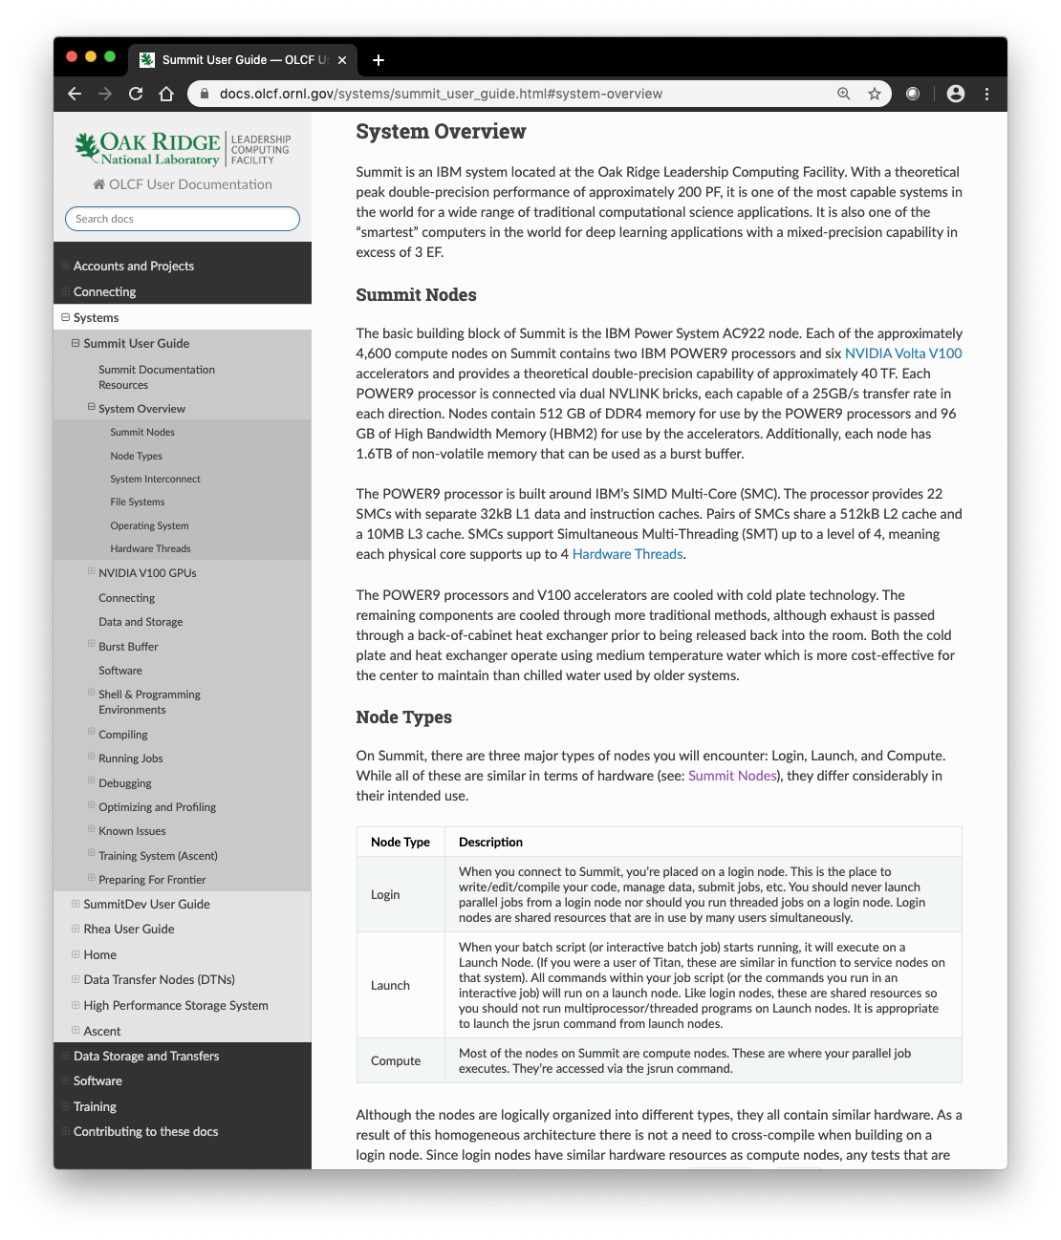
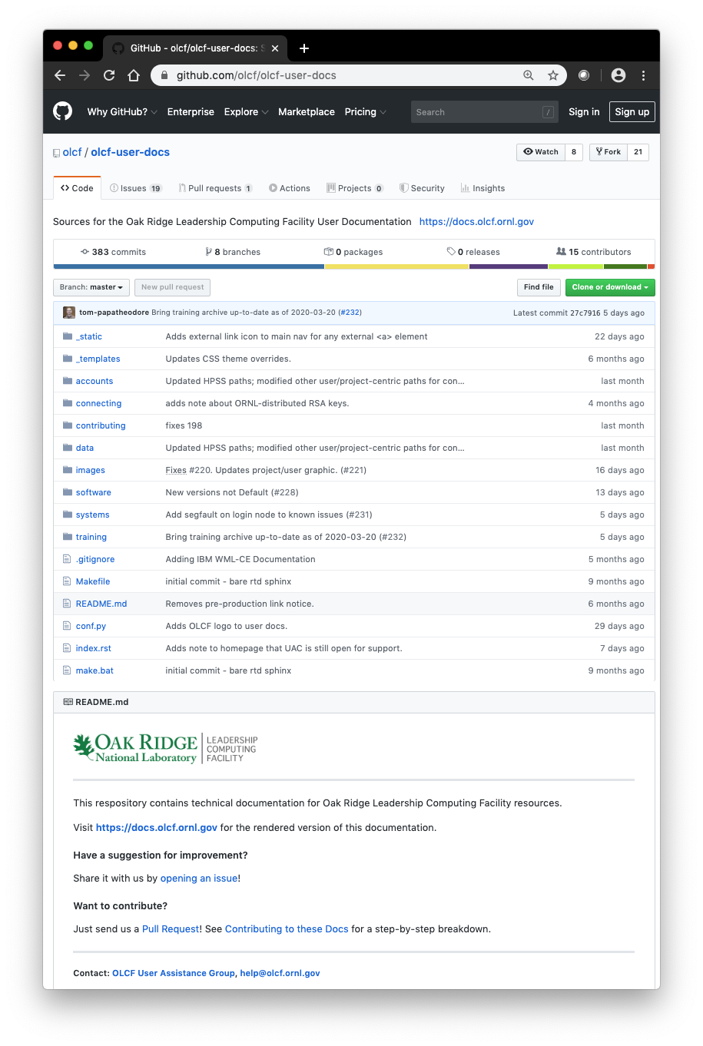
Continuous Improvement: Documentation
Extensive, always-available documentation is one of the OLCF’s most successful training and reference tools for end-users
OLCF documentation sources have been migrated to a public GitHub repository
Allows end-users, vendor partners, or general public to directly propose changes and improvements
OLCF Staff must approve all changes
Leverages a git-based workflow commonly used for open-source software collaboration and development
Version control provides a detailed history, and ability to easily roll back changes
Rendered documentation is available at https://docs.olcf.ornl.gov
Changes are adopted with no website downtime
In response to user feedback, this new website improves full-documentation searchability while retaining separate sections for each system

Slide 9
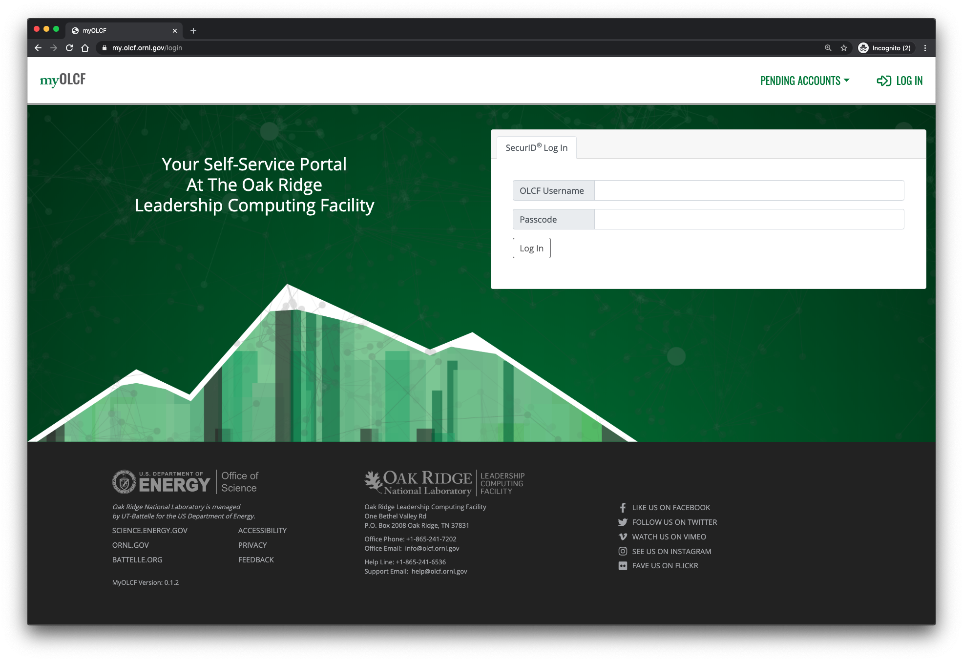
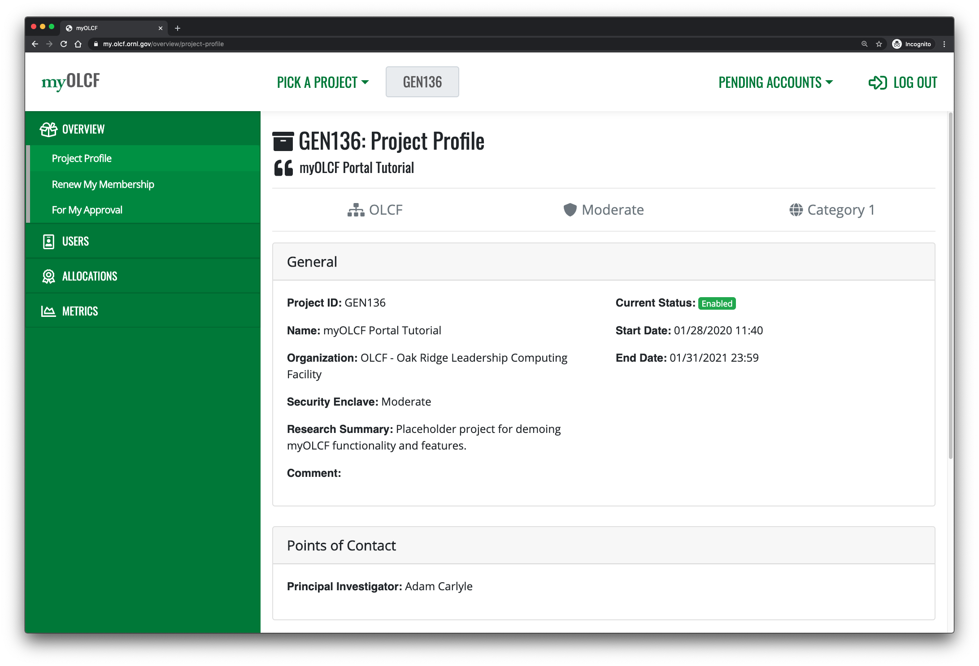
Continuous Improvement: MyOLCF
Approve user account requests
Schedule identity assurance appointments
See more info about their project
File/update quarterly progress reports
MyOLCF is a new self-service web portal for PIs and users
Enable PIs and end-users to make data-driven decisions about projects
Reduce administrative burden on OLCF PIs
Lays foundation for many new features

Slide 10
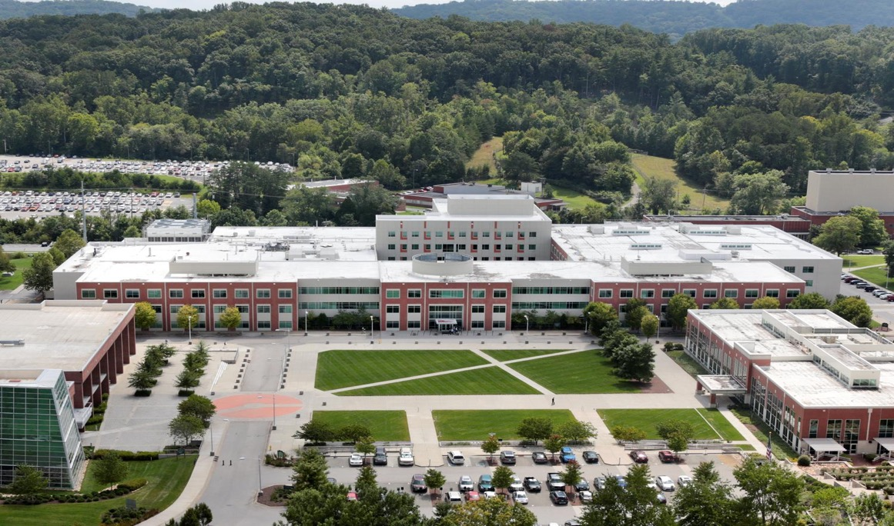

Questions?
10 Managed by UT-Battelle for the Department of Energy
Notes:
10

