Slide 1
OLCF User Group Executive Board

Slide 2
OLCF User Group Executive Board
The OLCF User Group (OUG) is the users group for the OLCF User Facility at the Oak Ridge National Laboratory.
provide advice and feedback to the OLCF on the current and future state of OLCF operations and services
promote the effective use of the high performance computing facilities at the OLCF by sharing information about experiences in using the facility
A ten-member OUG Executive Board represents the OUG to the OLCF and serves as advocates for the OLCF user community.
https://www.olcf.ornl.gov/about-olcf/oug/

Slide 3
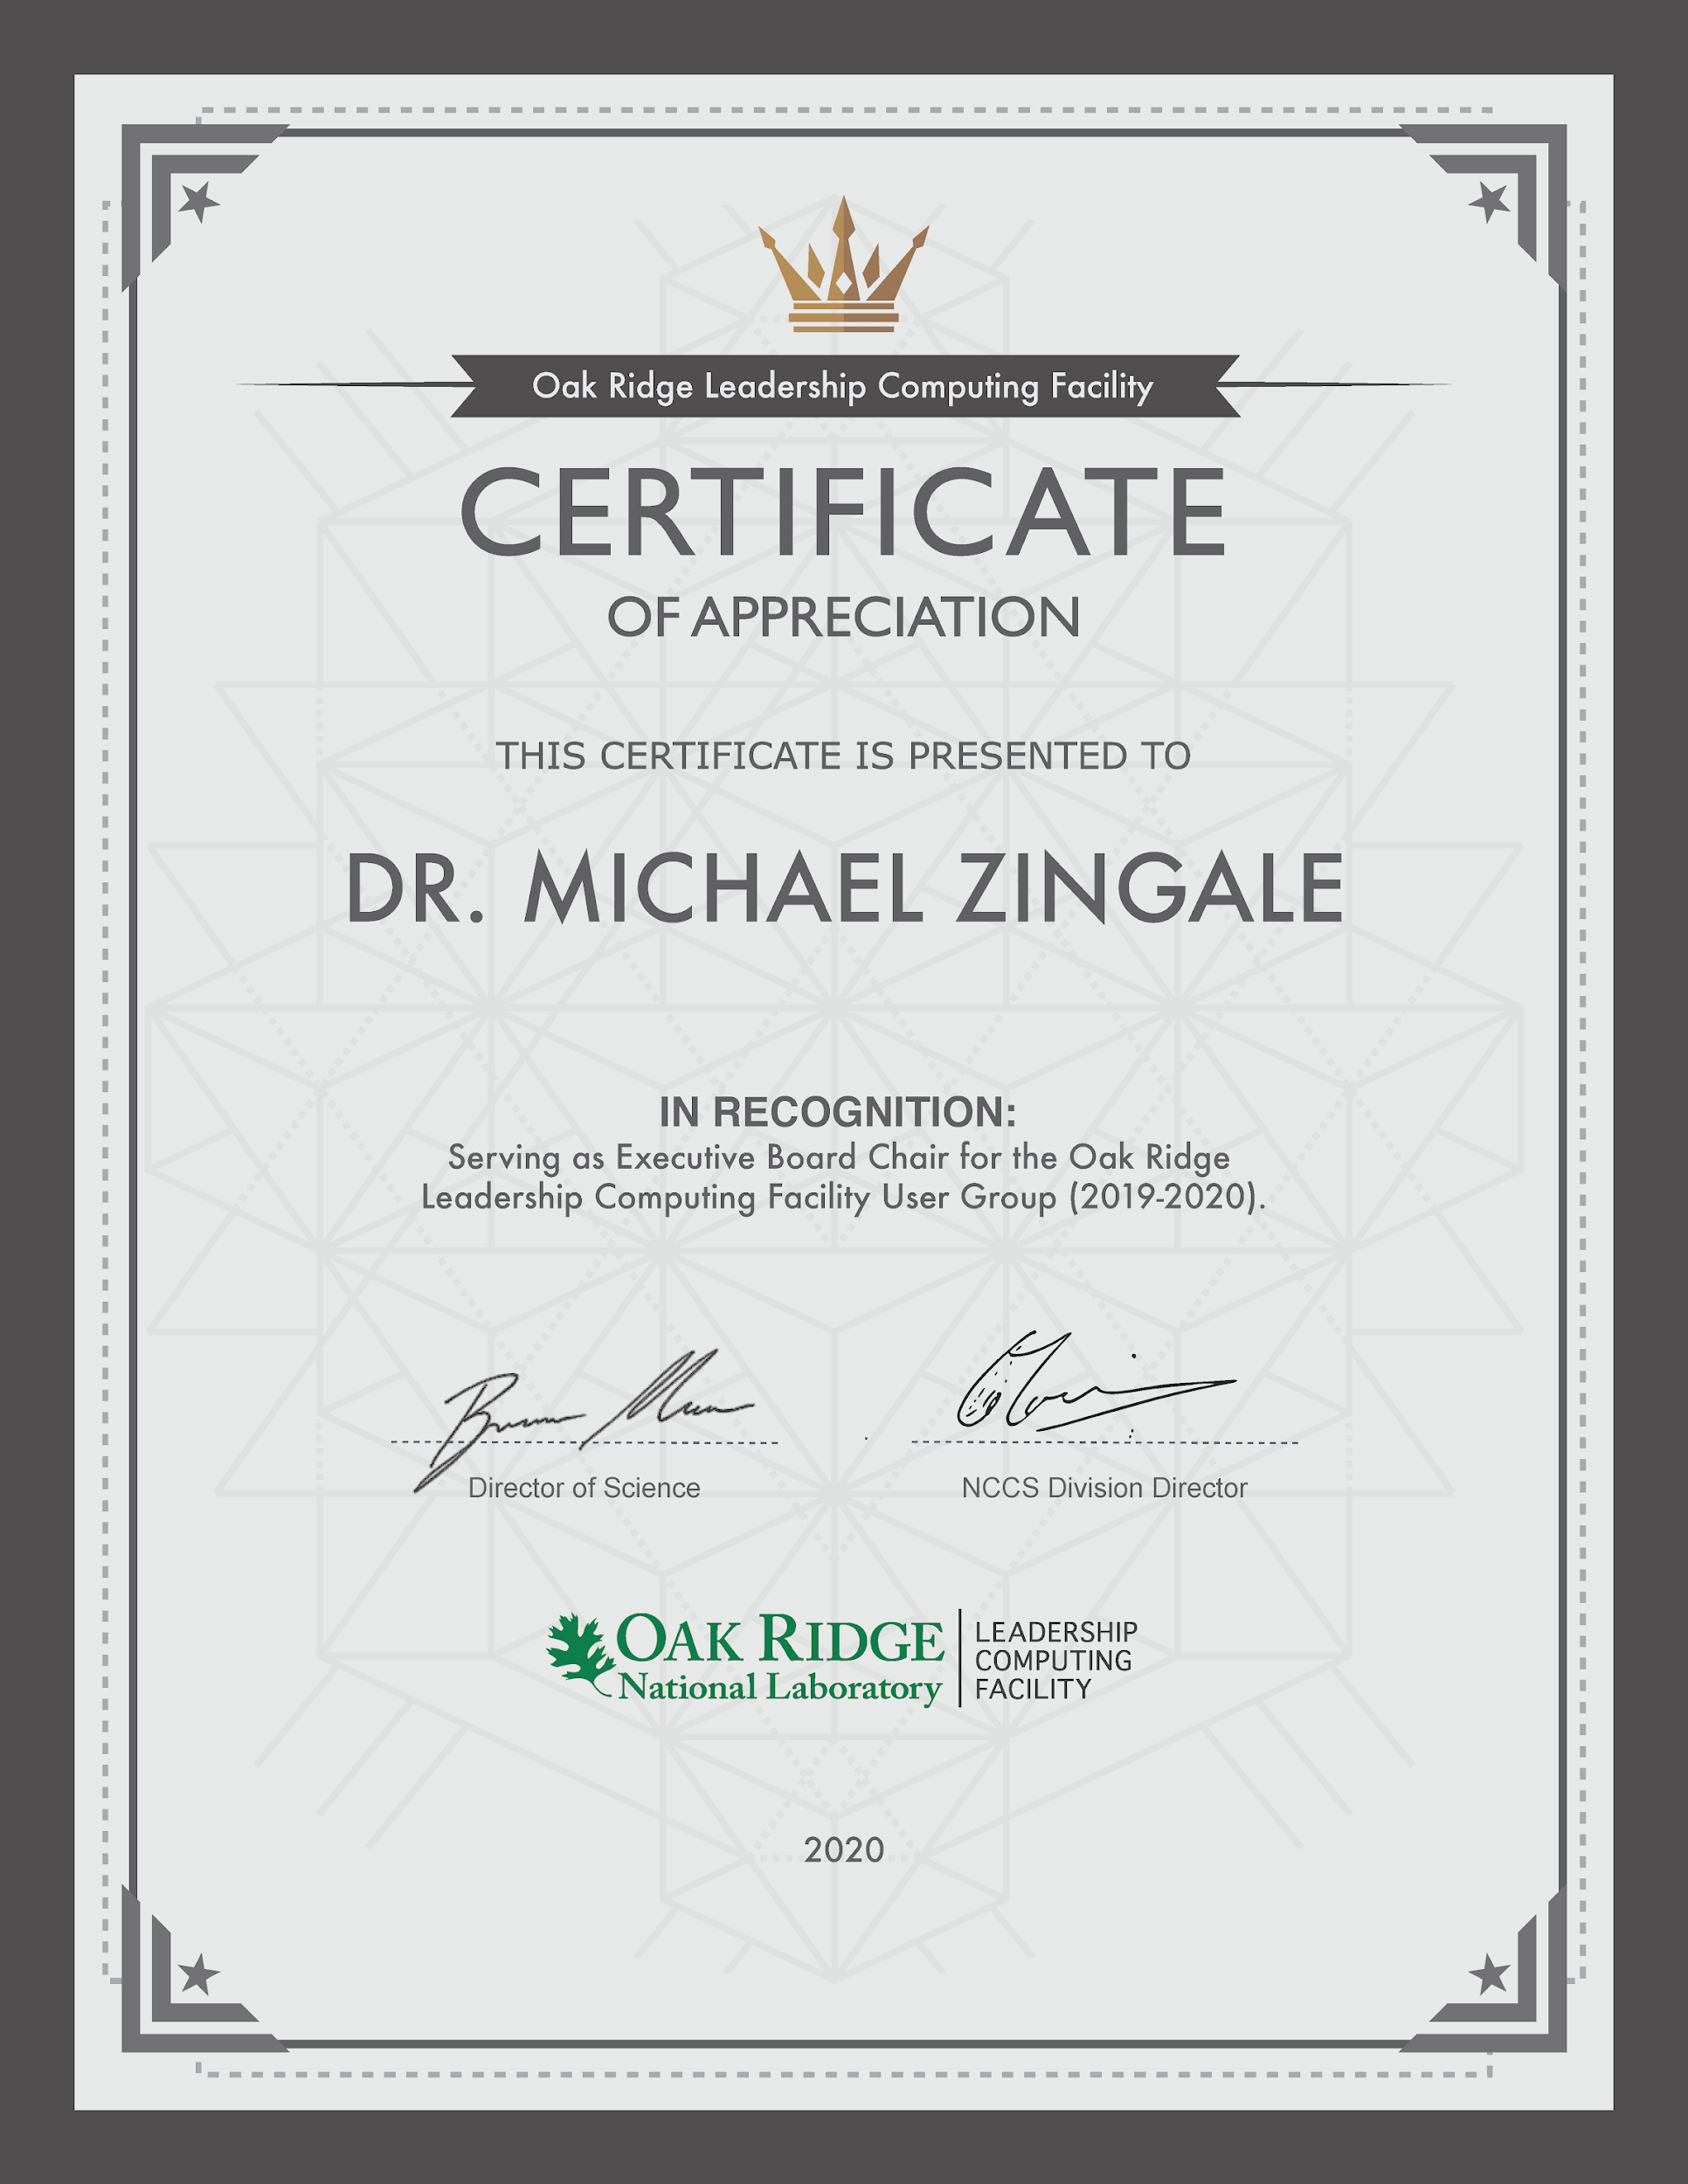
2020 OUG Exiting Board Chair and Members
A big thank you to Mike Zingale for finishing his tenure as Chair
And also a big thank you for our exiting board member for their service:
  Joe Oefelein (Georgia Tech)
  James McClure (Virginia Tech)
  Abhishek Singharoy (Arizona State U.)
  Balint Joo (JLAB)
Welcome to Sarat Sreepathi as the new Chair this year

Slide 4
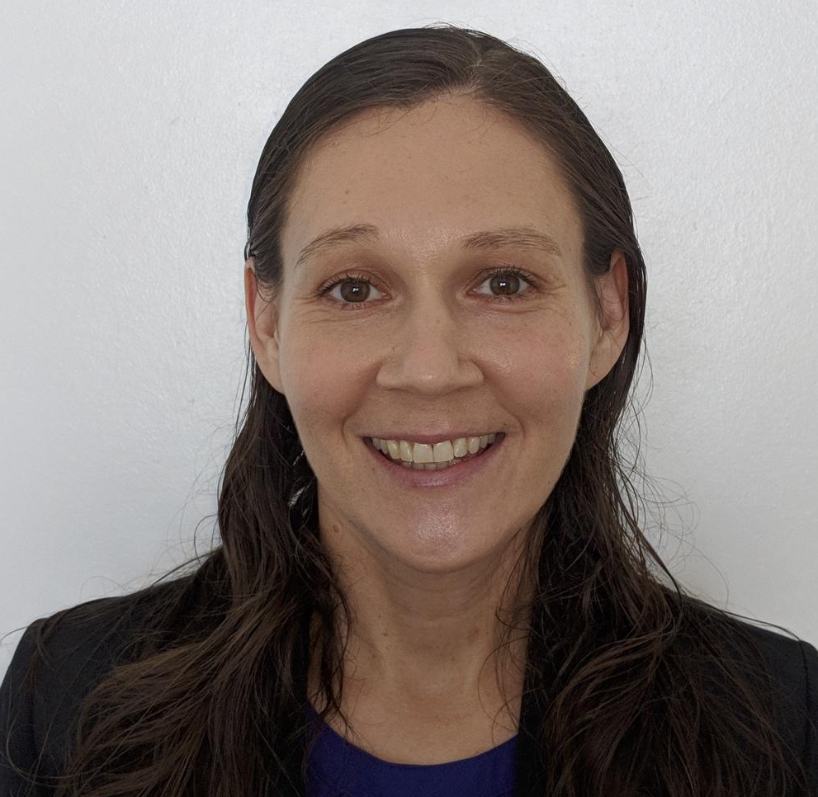
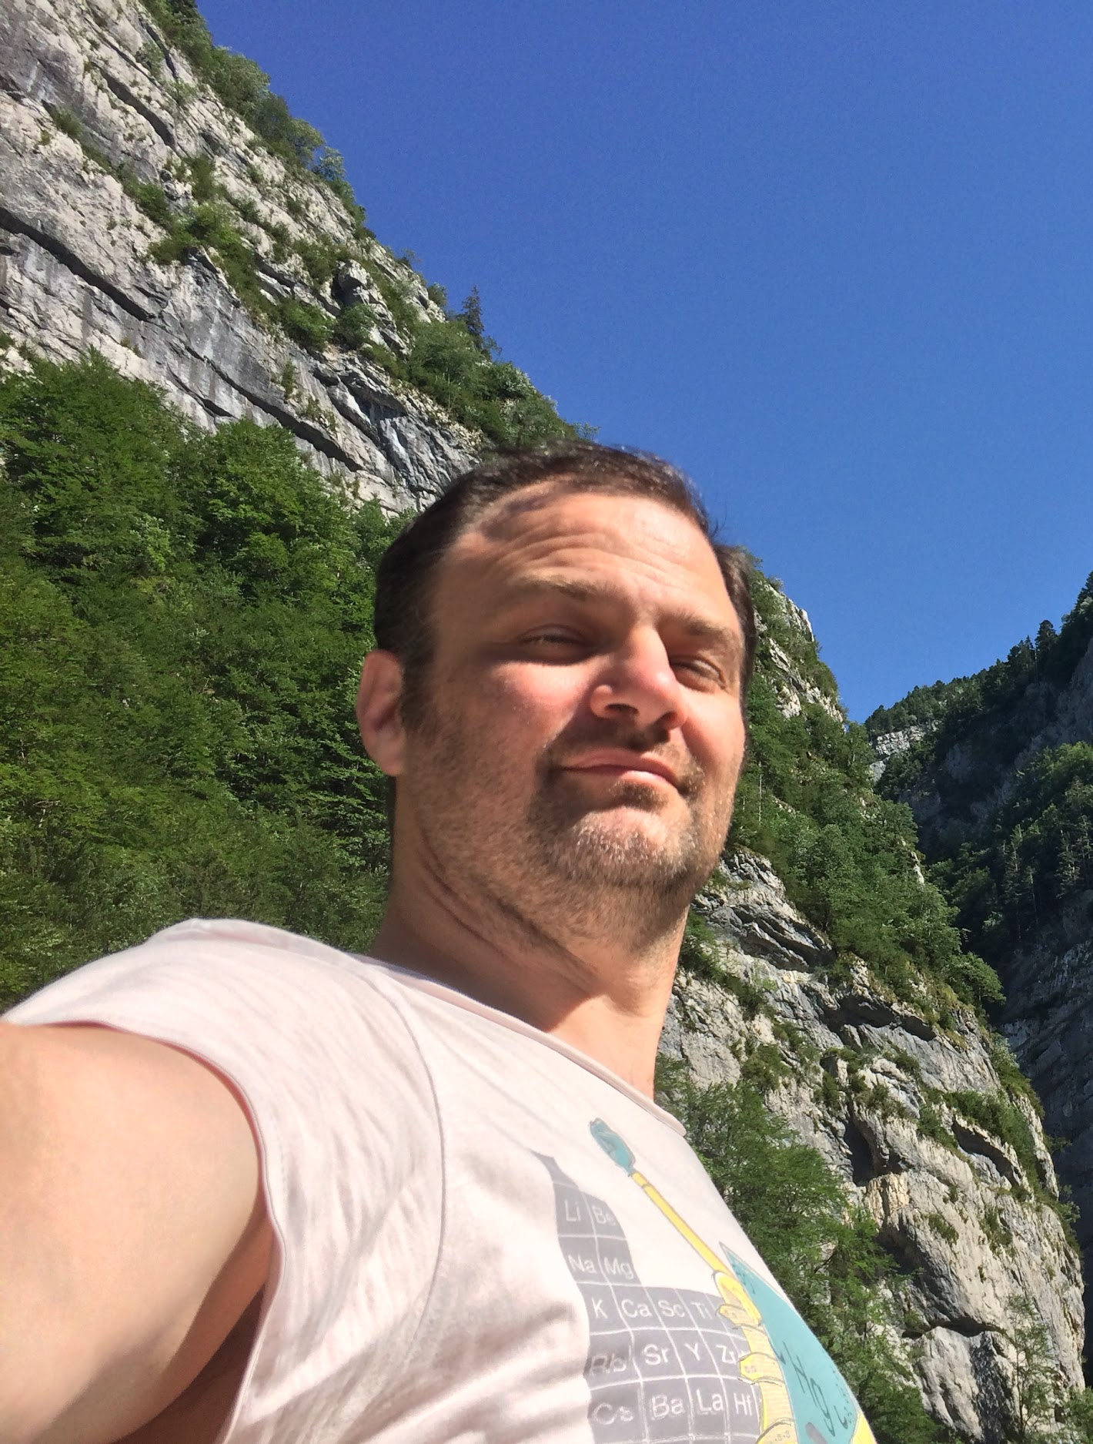
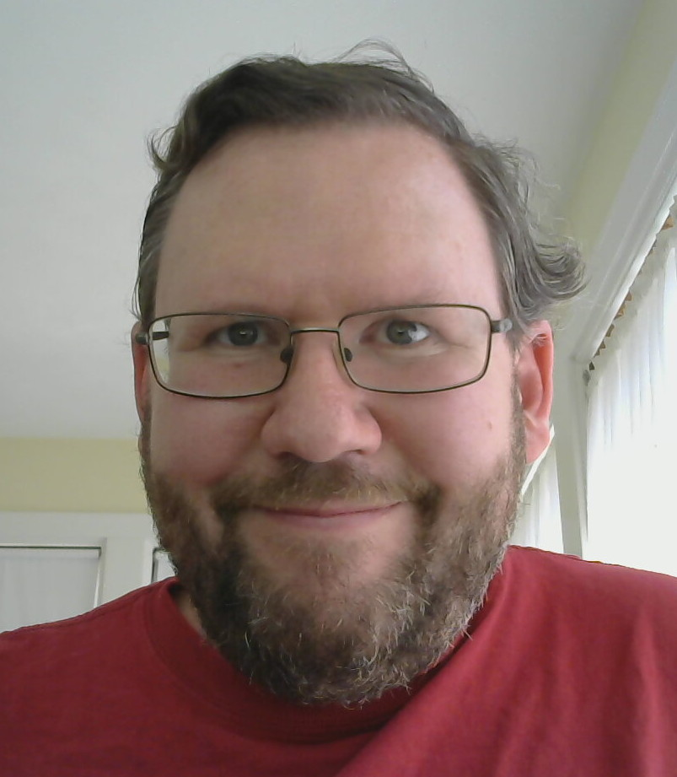
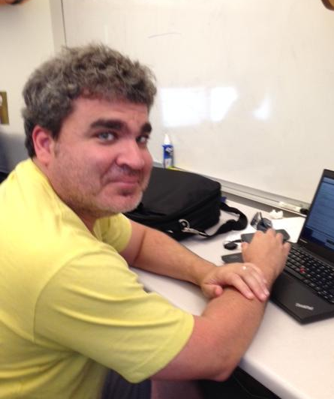
Welcome to Our New OUG Executive Board Members
Emily Belli is a research scientist in the Fusion Theory and Computational Science group at General Atomics. Her research focuses on analytic and numerical studies of plasma turbulence and transport in tokamaks. She has been a developer of HPC codes for fusion research with a wide international user base for over 15 years.
André Walker-Loud (LBNL) and collaborators utilize OLCF to determine the structure and reactions of protons and neutrons directly from the Standard Model of particle physics, relevant to our understanding of the size of the proton, the neutron lifetime, the formation of nuclei, and hopefully, the content of dense nuclear matter relevant to neutron stars and stellar explosions, among other forefront questions in fundamental nuclear physics.
Scott Callaghan is a computer scientist at the Southern California Earthquake Center. His research focuses on scientific workflows and seismic hazard analysis through large suites of earthquake simulations. Scott is also involved in a number of HPC education and outreach efforts. He has been a member of the HPC community since 2005 and an active OLCF user since 2012.
Michael ZIngale is an Associate Professor in the Department of Physics and Astronomy at the State
University of New York (SUNY) Stony Brook, working in the Astronomy Group. He is a current OUG board, where he has served as chair and given a few tutorials in the user's meetings.

