Slide 1
ML/DL stack on Summit: IBM WML CE
Junqi Yin
Advanced Data and Workflow
Oak Ridge Leadership Computing Facility

Slide 2

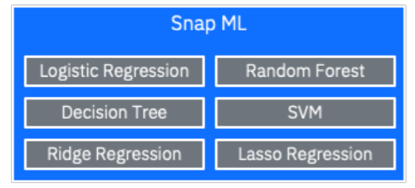





IBM WML CE on Summit
Multi-node Multi-GPU ML/DL
cuDF cuML
Machine learning
Dask, CuPy, XGBoost
Deep learning
DALI
Apex
IBM LMS
TensorRT
Frameworks
Plugins and Tools

Slide 3
Performance reference: ResNet50 on ImageNet
Nodes | Mini-batch size | Top-1 Val accuracy | Training time (min)
16 | 12288 | 0.750 | 27
32 | 12288 | 0.766 | 17
64 | 15360 | 0.763 | 12
TF.distribute & Horovod
code: TensorFlow distributed example

Slide 4
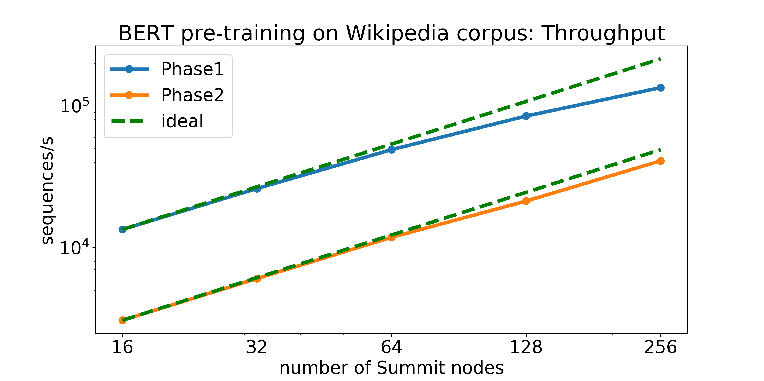
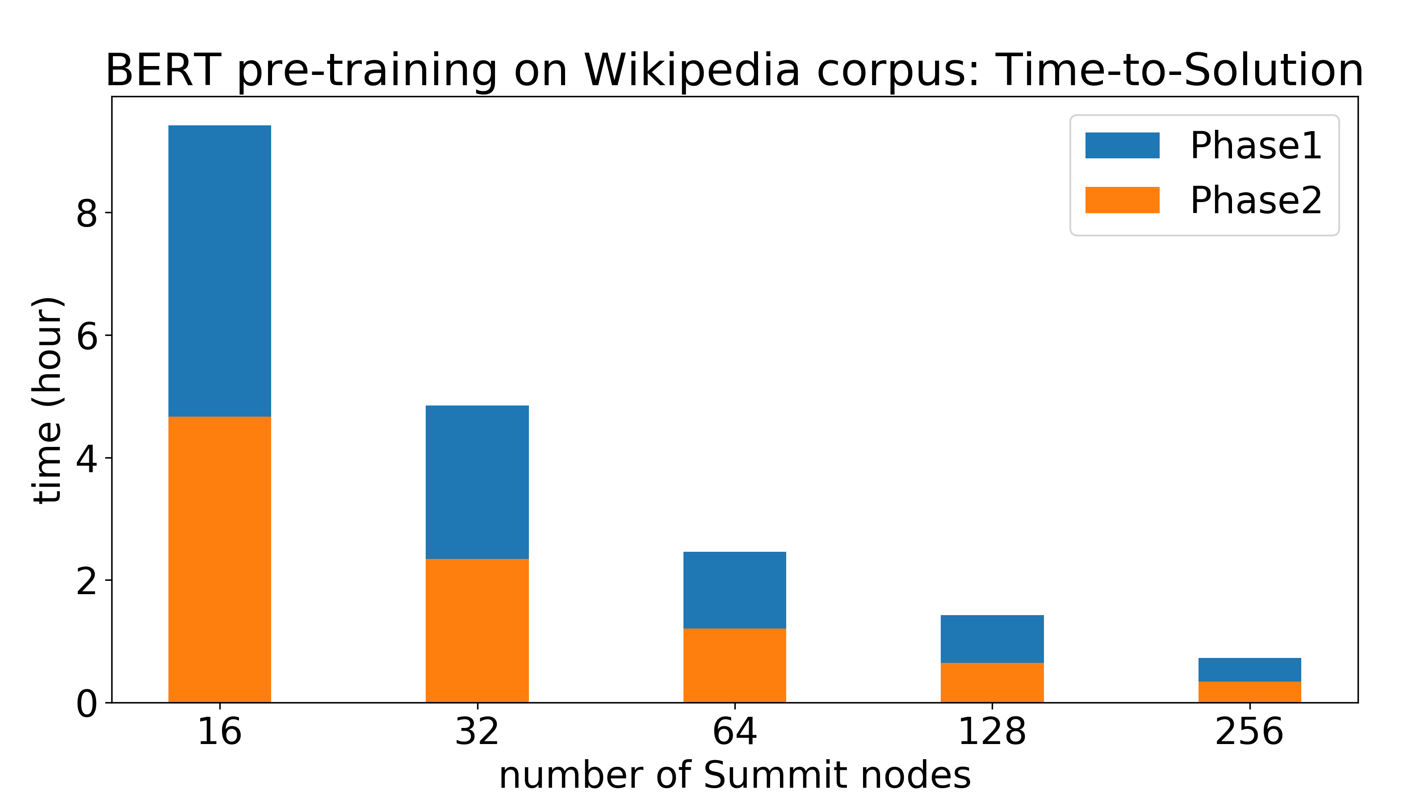
Performance reference: BERT on Wikipedia
Throughput: 63% (phase1) 83% (phase2)
Time-to-Solution: ~64min on 1536 V100 vs ~76min on 1024 TPUv3 (arXiv:1904.00962)
code: PyTorch BERT example
Apex DDP

Slide 5
IBM WML CE on Summit
Distributed ML support
Rapids : PCA, Kmeans, Random Forest, …
SnapML : SVM, Decision Tree, Regression, …
Distributed DL support
TensorFlow (v1 & v2): distributed.strategy, +Horovod
PyTorch: DDP, +Apex, +Horovod
Documentation and examples
https://docs.olcf.ornl.gov/software/analytics/ibm-wml-ce.html
https://code.ornl.gov/olcf-analytics/summit/distributed-deep-learning-examples
Other resources (public conda channel)
https://public.dhe.ibm.com/ibmdl/export/pub/software/server/ibm-ai/conda/#/

