Slide 1
Frontier: The OLCF Exascale System
Status Update
2020 OLCF User Meeting
June 3, 2020

Slide 2
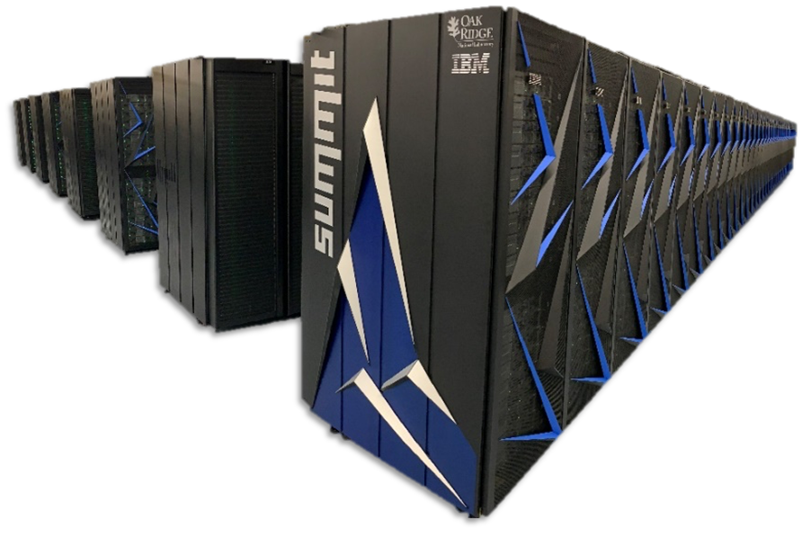
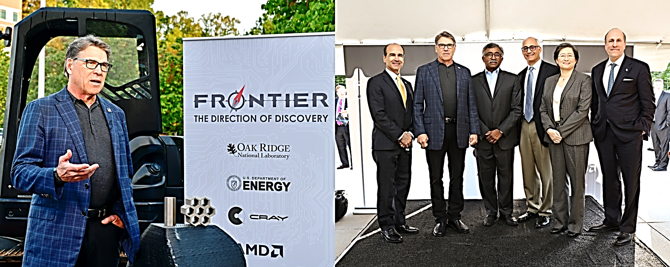
Summit entered production in January 2019
Early science achievements include two Gordon Bell finalists
131 participated in the Intro to Summit Workshop in February 2019
Exceeded all operational targets for 2019
Frontier was publicly announced on May 2019
Notes:
Replace with WBS

Slide 3
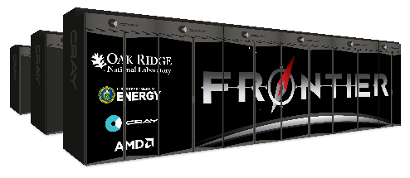
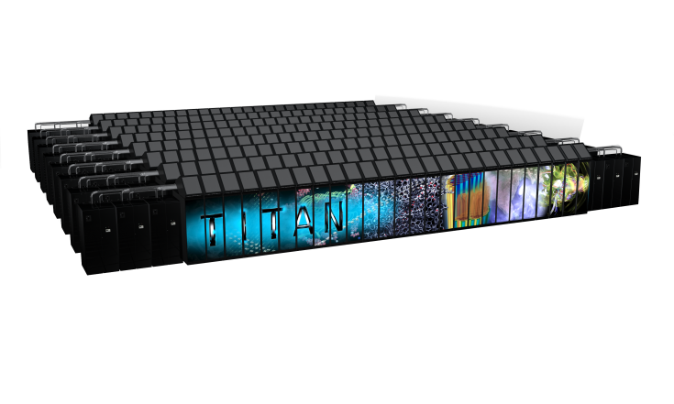
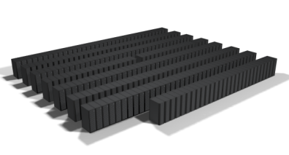

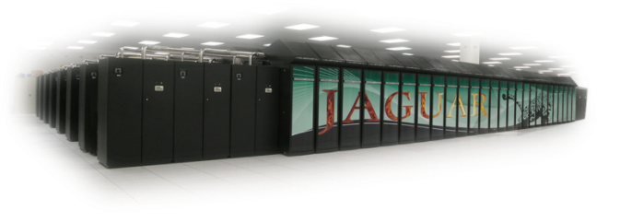
Frontier will meet the mission need for an increase in application performance by advancing the OLCF’s accelerated node roadmap.
10¹⁸
10¹⁷
10¹⁶
10¹⁵
Frontier
>1,500 PF
Hybrid GPU/CPU
Summit
200 PF / 3,300 PF (FP16)
Hybrid GPU/CPU
Titan:
27 PF
Hybrid GPU/CPU
Jaguar
2.3 PF
Multi-core CPU
2010
2012
2017
2021

Slide 4
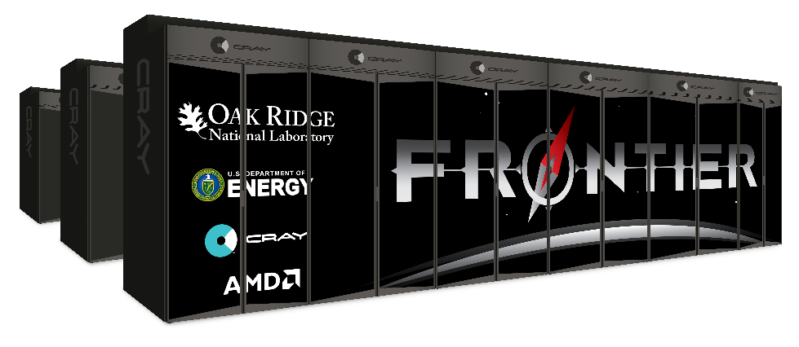
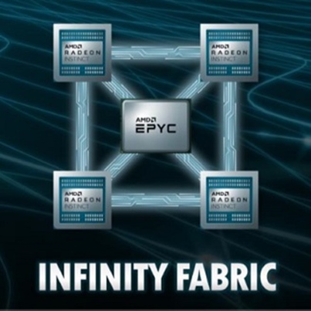
Frontier Overview
Partnership between ORNL, Cray, and AMD
The Frontier system will be delivered in 2021
Peak Performance greater than 1.5 EF
Composed of more than 100 Cray Shasta cabinets
  Connected by Slingshot™ interconnect with adaptive routing, congestion control, and quality of service
Node Architecture:
  An AMD EPYC™ processor and four Radeon Instinct™ GPU accelerators
    purpose-built for exascale computing
  Fully connected with high speed AMD Infinity Fabric links
  Coherent memory across the node
  100 GB/s injection bandwidth
  Node local NVM storage
Researchers will harness Frontier to advance science in such applications as systems biology, materials science, earth sciences, energy production, additive manufacturing and health data science.

Slide 5
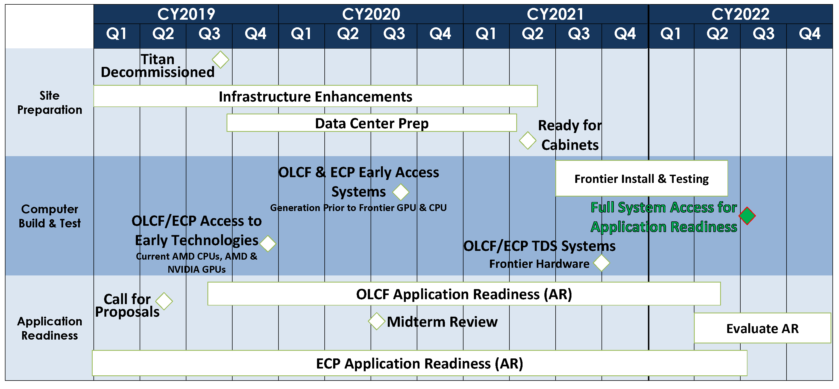
Frontier Timeline

Slide 6
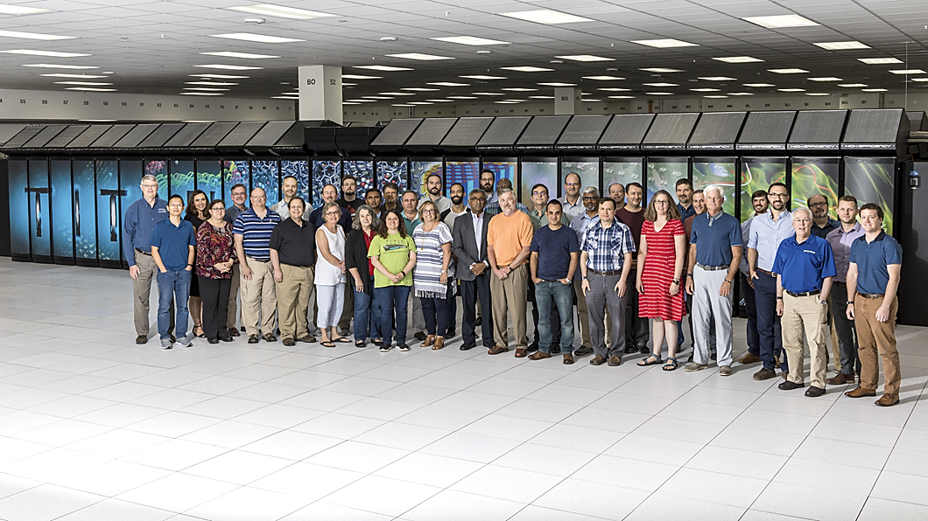
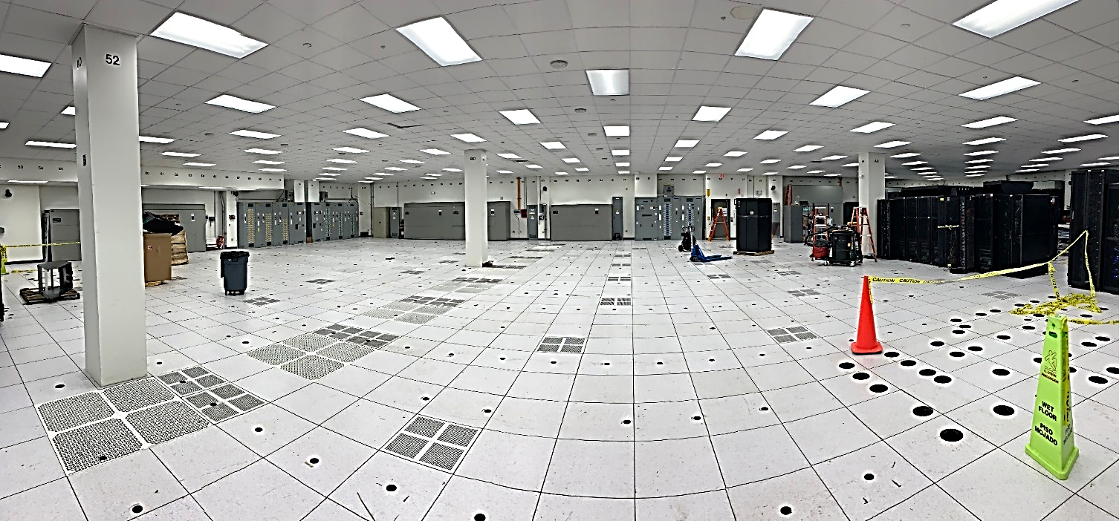
Making way for Frontier
Titan was shut down for the last time on August 2, 2019. Over its life, Titan:
  Executed more than 2.8M jobs
  Delivered 27B core-hours to users
  896 unique projects
  >1,000 publications
Titan and supporting infrastructure decommissioned and removed
Relocated offices laboratories in buildings 5600 and 5800 for new electrical room and central energy plant
Notes:
Replace with WBS

Slide 7
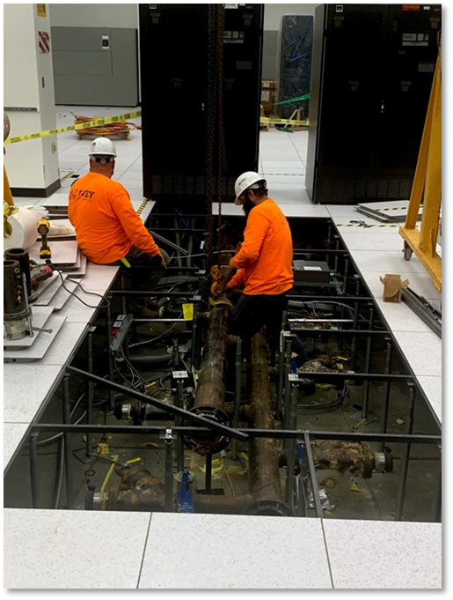
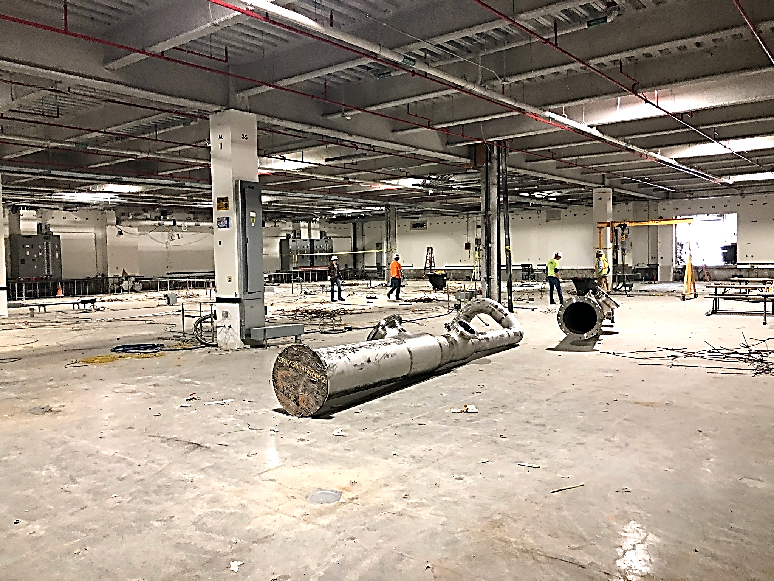
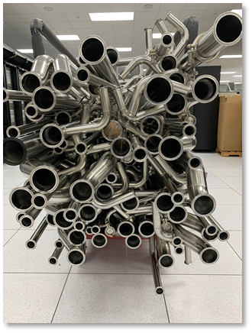
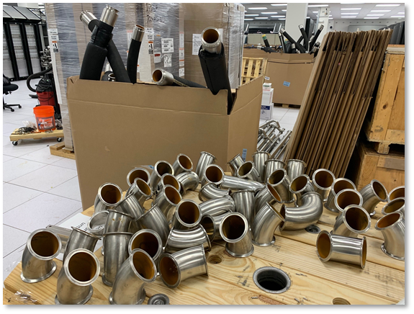
Data center is on track for the Frontier delivery in 2021
Notes:
Replace with WBS

Slide 8
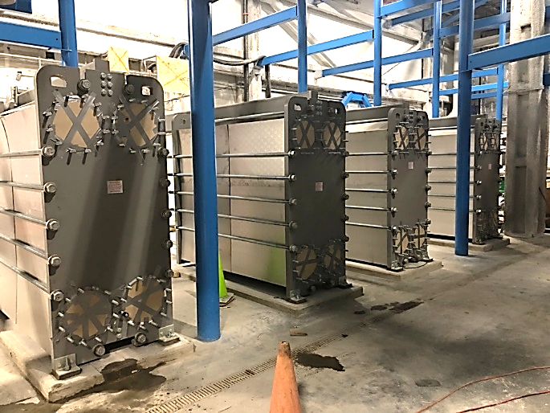
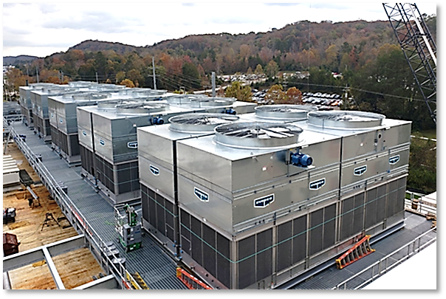
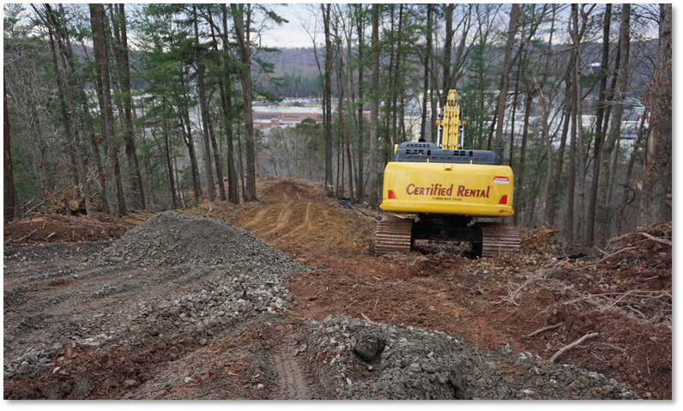
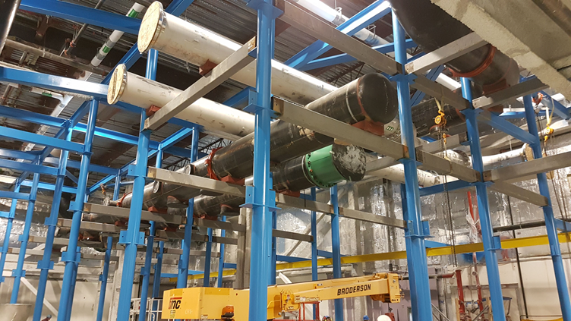
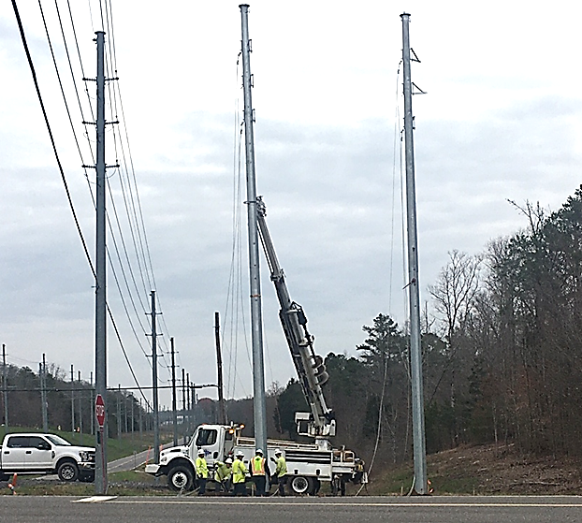
Power and cooling upgrades are on track for the Frontier delivery in 2021
Notes:
Replace with WBS

Slide 9
Frontier Programming Environment
To aid in moving applications from Summit to Frontier, ORNL, Cray, and AMD will partner to co-design and develop enhanced GPU programming tools designed for performance, productivity and portability.
This will include new capabilities in the Cray Programming Environment and AMD’s ROCm open compute platform that will be integrated together into the Cray Shasta software stack for Frontier
In addition, Frontier will support many of the same compilers, programming models, and tools that have been available to OLCF users on both the Titan and Summit supercomputers
Summit is a premier development platform for Frontier

Slide 10
Frontier Portable Programming with HIP
HIP (Heterogeneous-compute Interface for Portability) is an API developed by AMD that allows developers to write portable code to run on AMD or NVIDIA GPUs. It is a wrapper that uses the underlying CUDA™ or ROCm platform that is installed on a system
The API is very similar to CUDA so transitioning existing codes from CUDA to HIP is fairly straightforward.
AMD has developed a “hipify” tool that automatically converts source from CUDA to HIP.
Developers can specialize for the platform to tune for performance or handle unique cases.
OLCF has made HIP available on Summit so that users can begin using it prior to its availability on Frontier

Slide 11
Artificial Intelligence and Machine Learning on Frontier
Closely integrating artificial intelligence with data analytics and modeling and simulation will drastically reduce the time to discovery by automatically recognizing patterns in data and guiding simulations beyond the limits of traditional approaches.
Frontier will have a fully optimized, scalable data science suite in addition to the Cray Programming Environment Deep-learning plugin that provides support for Apache Spark, GraphX, MLib, Alchemist frameworks, and pbdR.
Like Summit, Frontier will be fine tuned to run AI workloads

Slide 12
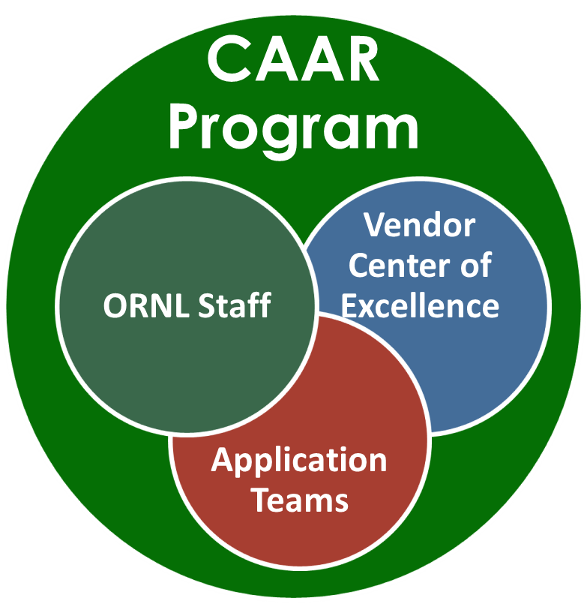
The Center for Accelerated Application Readiness (CAAR)
Built on the successful programs for OLCF-3 (Titan) & OLCF-4 (Summit)
The Frontier CAAR Program is already in place
Active development on 20 science applications for Frontier
OLCF
Astrophysics | CHOLLA
MD | NAMD
Materials Science | LSMS
Biology | CoMet
Fluid Dynamics | GESTS
Nuclear Physics | NUCCOR
Plasma Physics | PIConGPU
Subsurface Flow | LBPM
ECP
Astrophysics | ExaStar
Astrophysics | ExaSky
HEP | LatticeQCD
Chemistry | NWCHEMeX
Chemistry | GAMESS
Combustion | PELE
Fission | ExaSMR
Fusion | WDMApp
Climate | E3SM
Additive Manufacturing | ExaAM
Biology | ExaBiome
Electric Grids | ExaSGD
Notes:
Partnership between application developers, OLCF Scientific Computing staff and Vendor Center of Excellence
Successful projects require the expertise and time commitment of the developers
Most effective way to deal with actively-developed applications
Best mechanism to move ported code back into the main repository
Projects will consist of application porting and early science phases

Slide 13

Questions?
ORNL / Cray / AMD Partnership

