Slide 1
Coming Soon: Andes, the new OLCF Analysis Cluster
Clay England

Slide 2
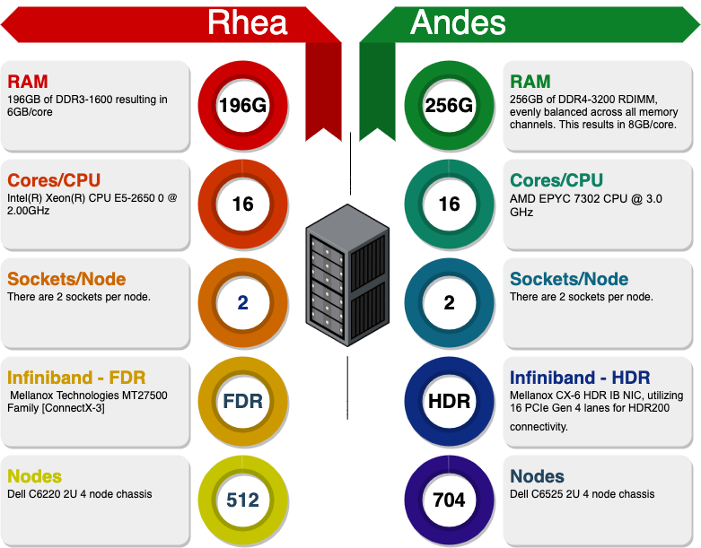
Upgrade from Rhea to Andes
Projected deployment July 2020

