Slide 1

A new self-service web application for OLCF end-users
Adam Carlyle
Lead Engineer, Support Software

Slide 2
What is ?
A new web application being deployed soon at the OLCF
A self-service portal for OLCF principal investigators and end-users
A replacement for site currently at https://users.nccs.gov

Slide 3
Goals For
Help principal investigators and end-users make data-driven decisions about their OLCF projects
Reduce administrative burden on principal investigators and end-users resulting from OLCF project ownership or membership

Slide 4
Features
Basic information about your Projects, Users, Allocations, etc.
Status tracker for user account applications
One-click PI approvals for pending user applications
Easy project renewals for existing PIs
Easy user account renewals for existing users
Queryable reports and graphs for project metrics
Role-based app permissions, controlled by PIs

Slide 5
Features
Basic information about your Projects, Users, Allocations, etc.
Status tracker for user account applications
One-click PI approvals for pending user applications
Easy project renewals for existing PIs
Easy user account renewals for existing users
Queryable reports and graphs for project metrics
Role-based app permissions, controlled by PIs

Slide 6
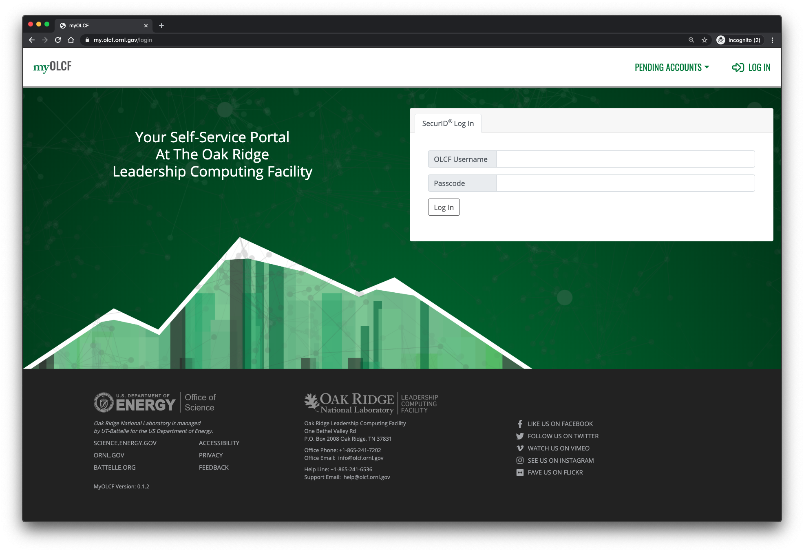

Slide 7
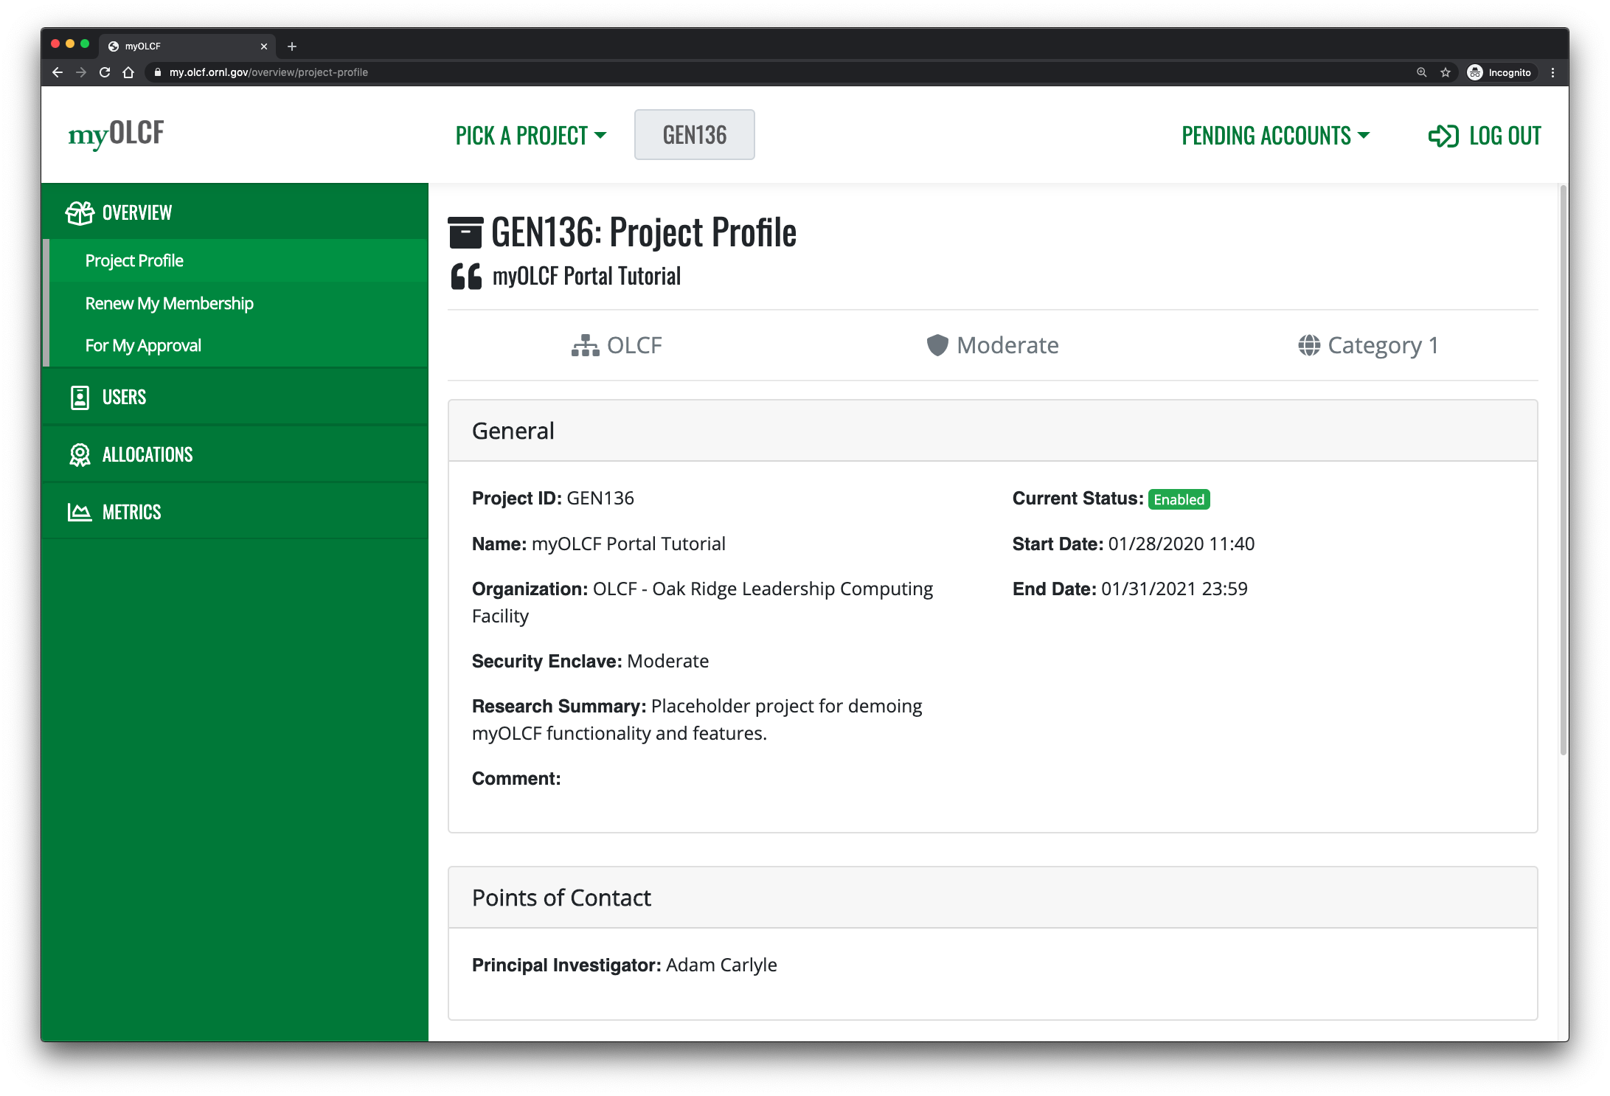
The service they offer is being able to setup MailChimp so that the sender can be an ORNL email address and all of the DMARC requirements, etc. are obeyed.

Slide 8
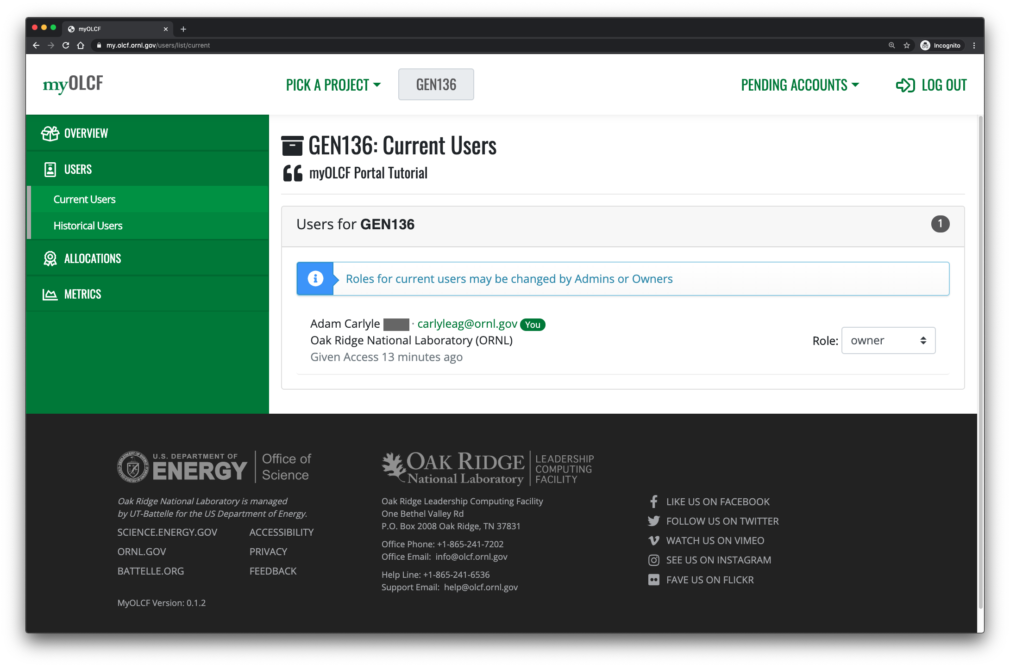

Slide 9
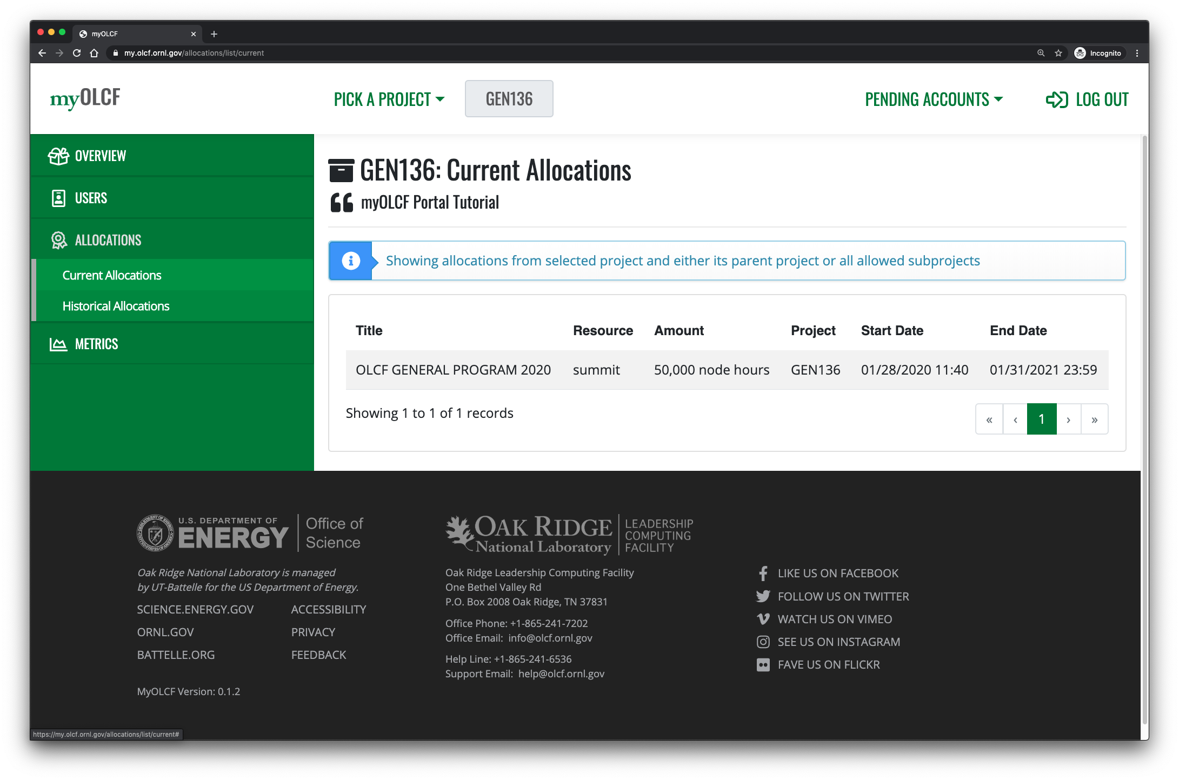

Slide 10
Features
Basic information about your Projects, Users, Allocations, etc.
Status tracker for user account applications
One-click PI approvals for pending user applications
Easy project renewals for existing PIs
Easy user account renewals for existing users
Queryable reports and graphs for project metrics
Role-based app permissions, controlled by PIs

Slide 11
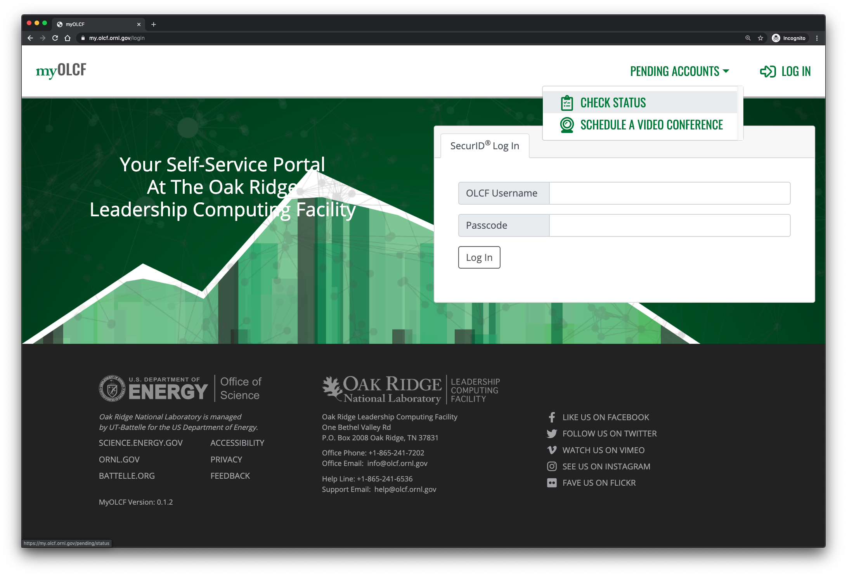

Slide 12
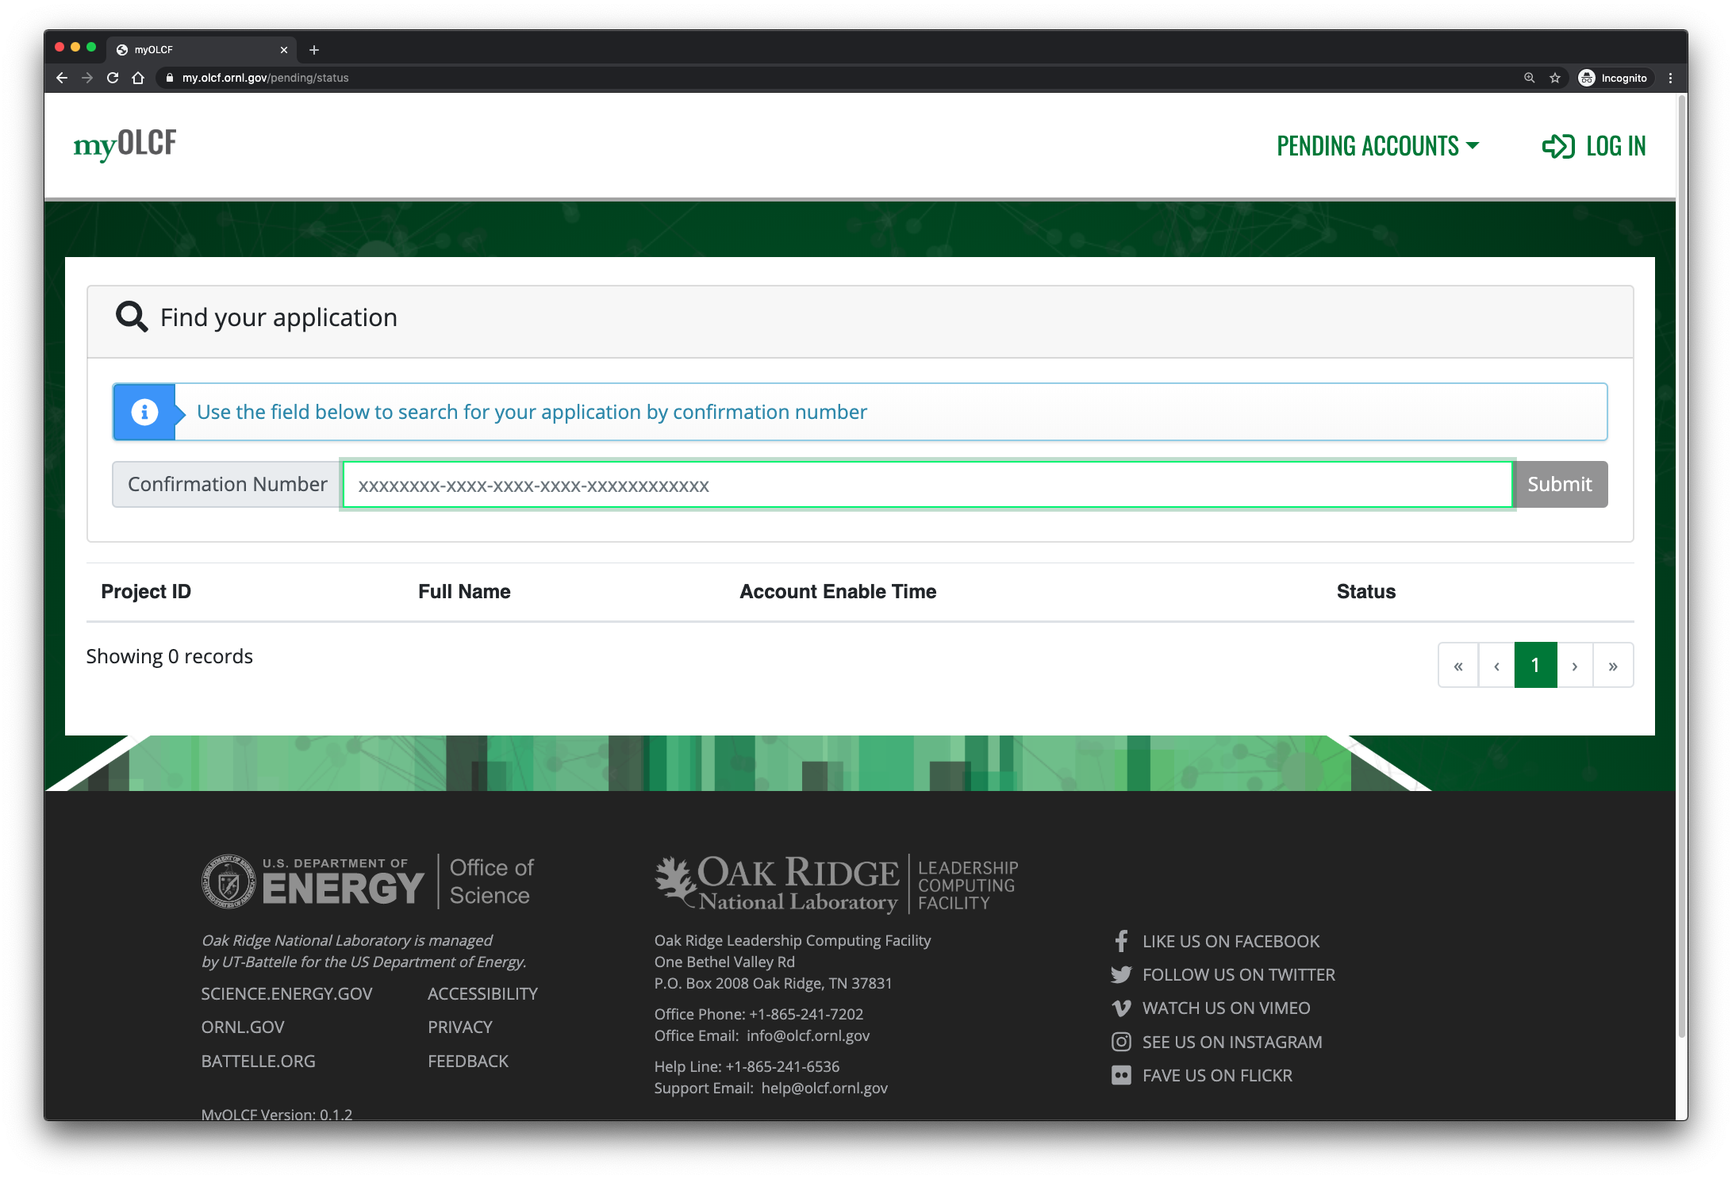

Slide 13
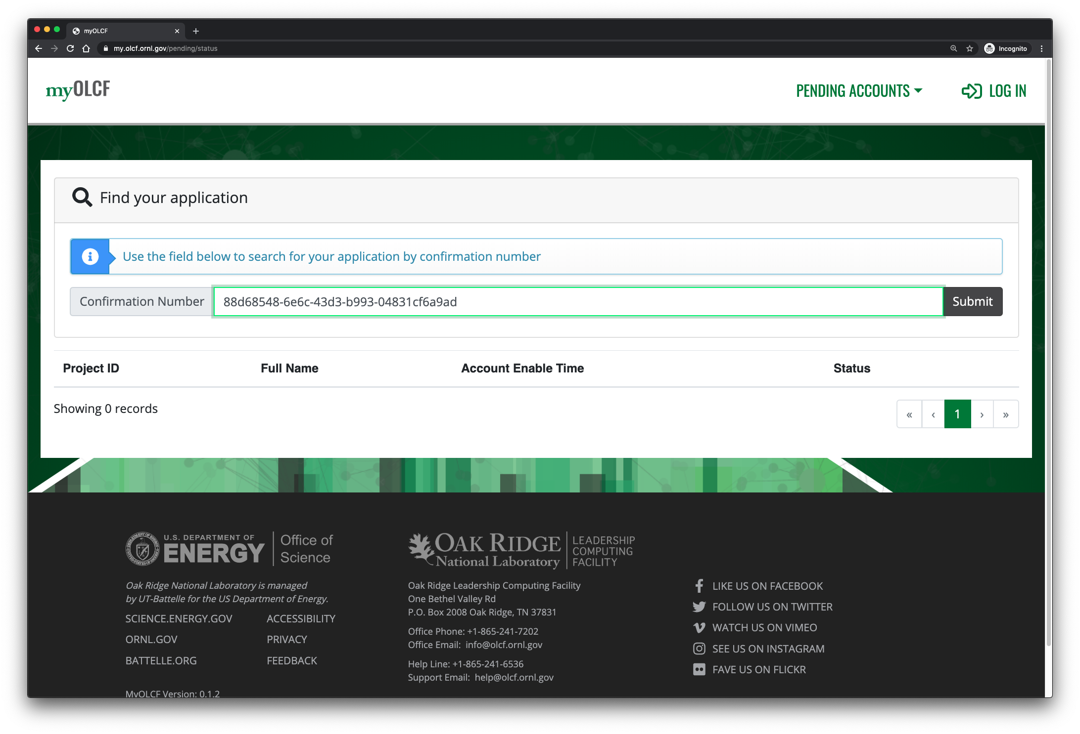

Slide 14
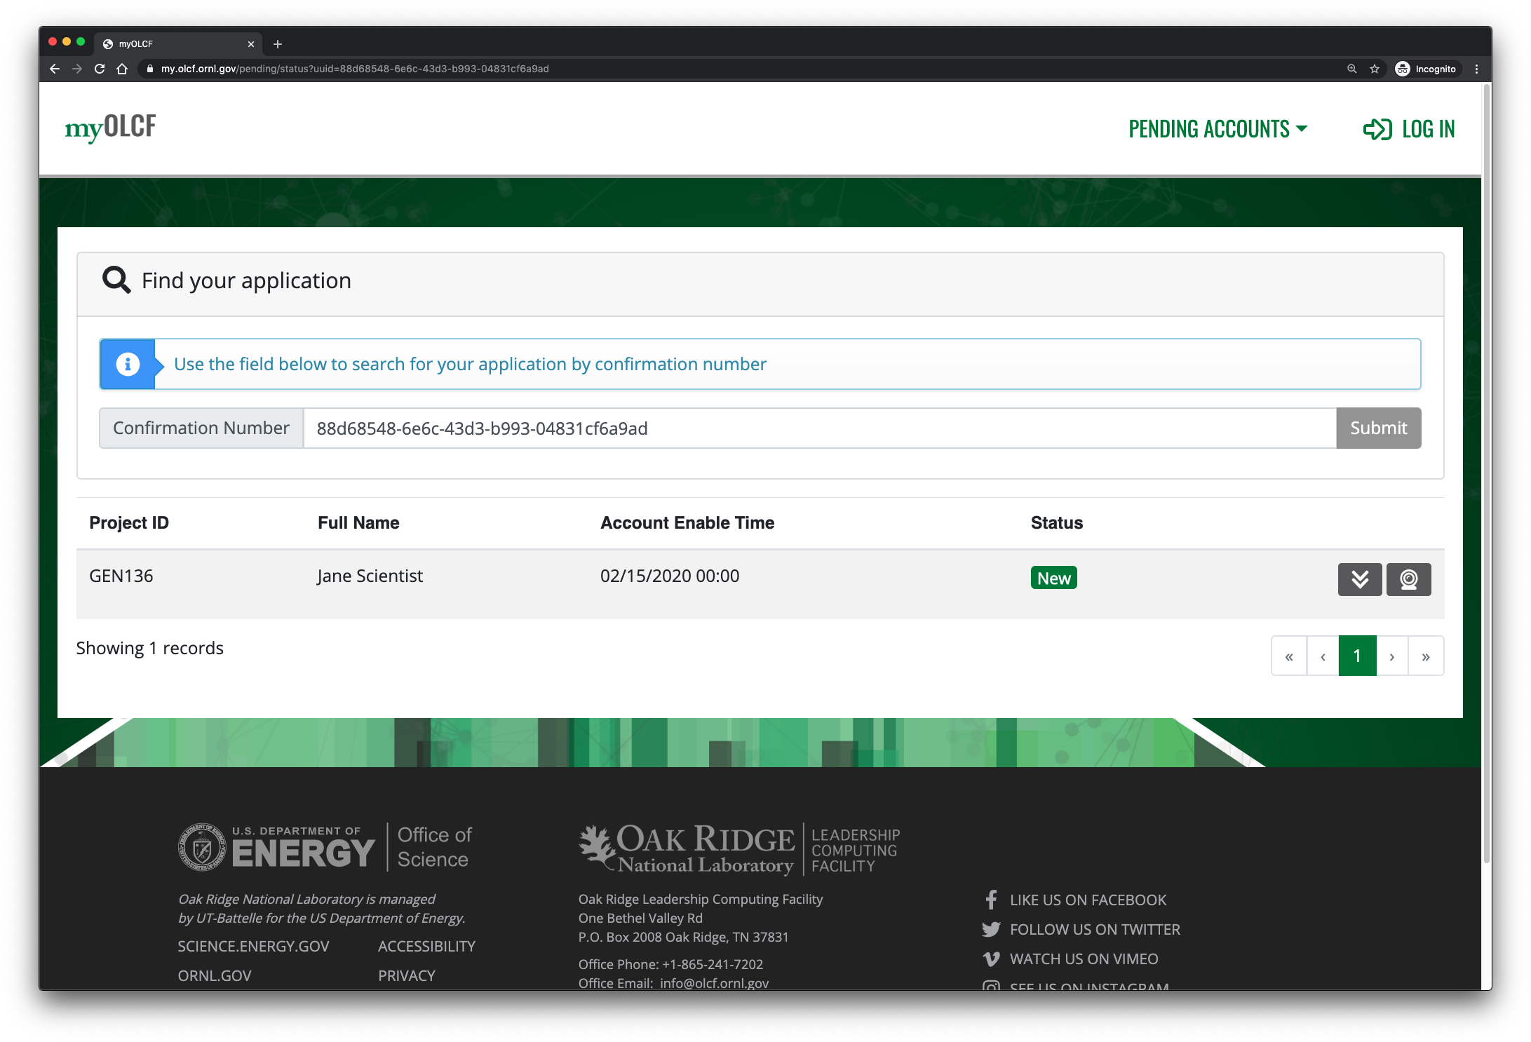

Slide 15
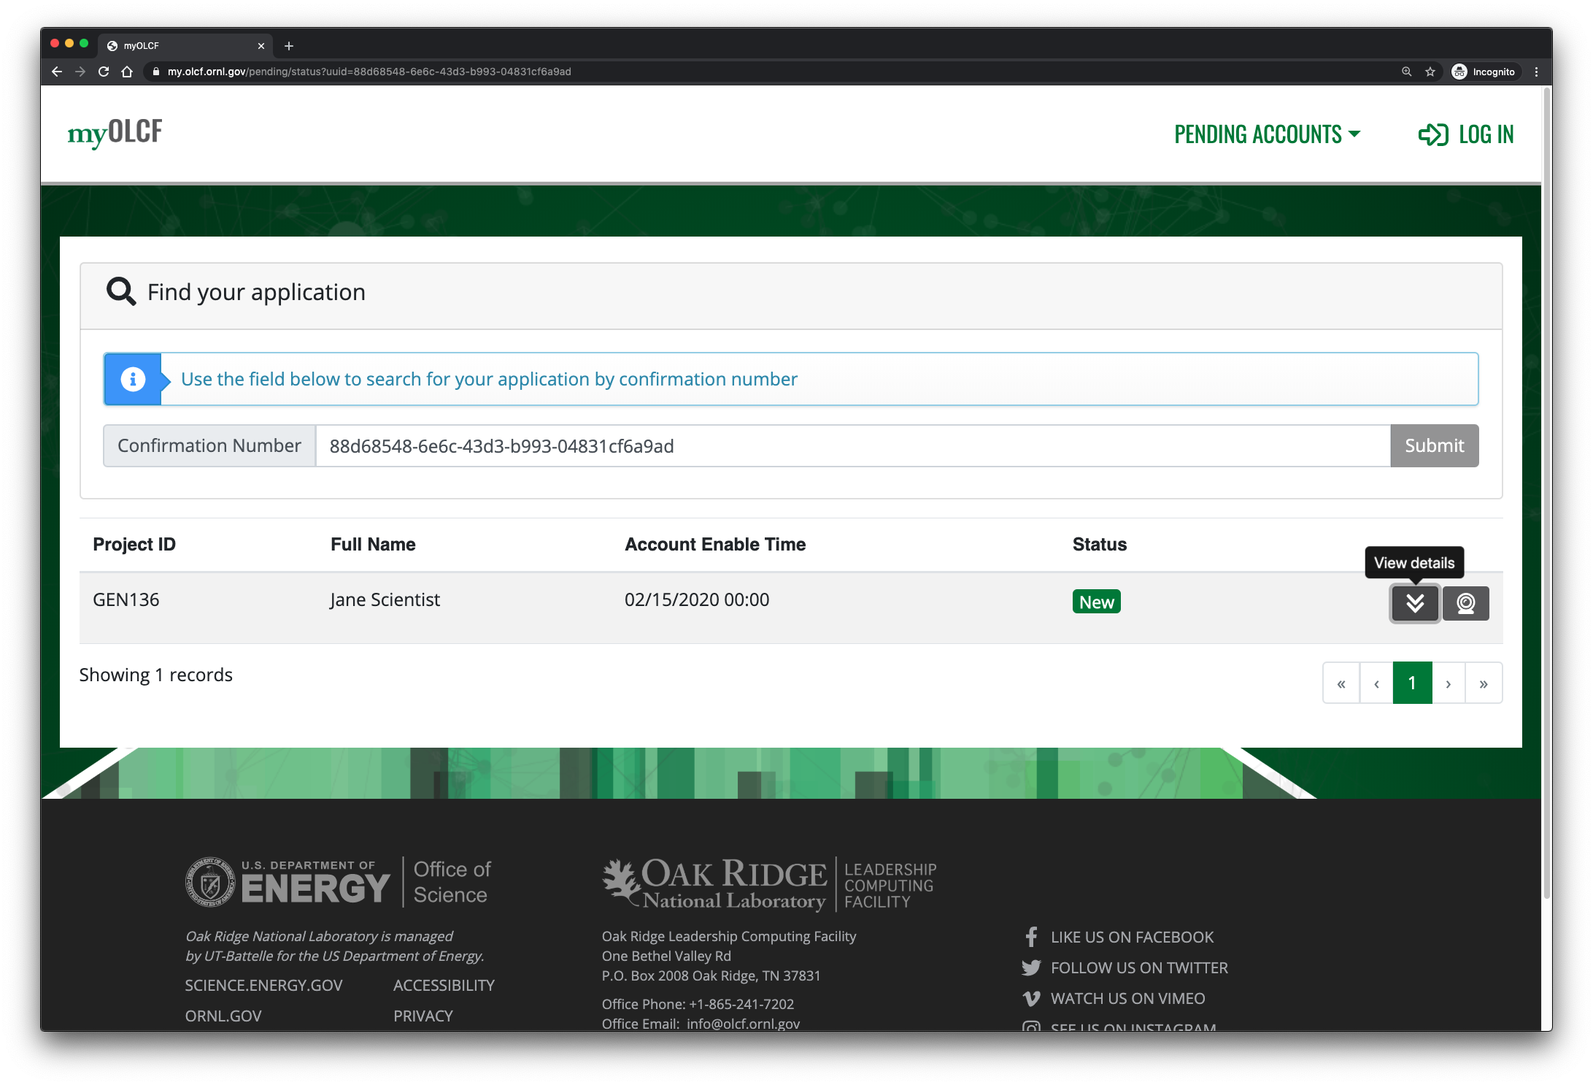

Slide 16
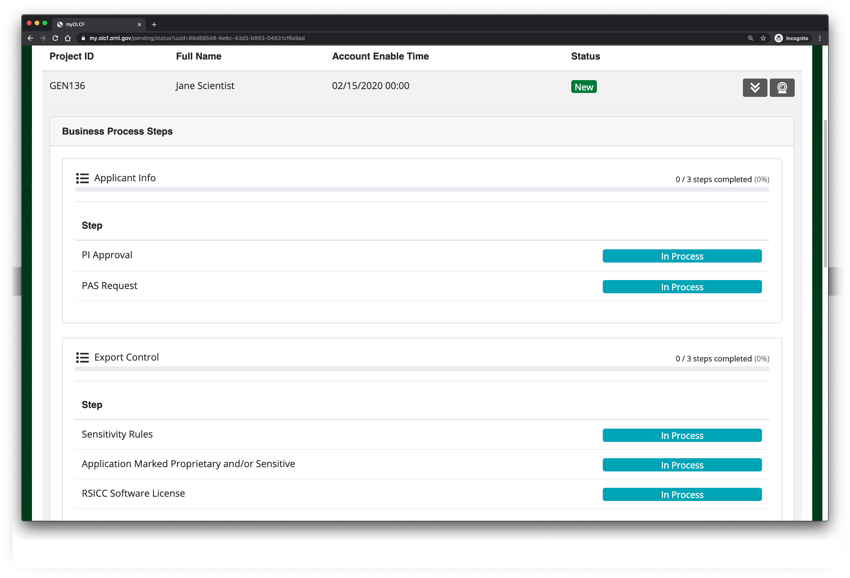

Slide 17
Future
Application will be under continuous development for the foreseeable future
  RSA Token verification video conference scheduling
  User profile management (e.g. Addresses, Phones, etc)
  Re-allocation of award hours across subprojects
Feedback and suggestions welcome

