Slide 1
OLCF Operational Highlights
Presented to 2020 OLCF User Meeting
Don Maxwell HPC Systems Task Lead
June 4, 2020

Slide 2
2019 was a historic year for the OLCF
Closed out the OLCF-4 project for acquiring and siting the Summit system
Early science results on Summit included two Gordon Bell finalists
Began operation of Summit for the user programs
Operated and supported Titan and Summit with both exceeding operational metrics
Moved equipment, labs, and people in preparation to begin construction for the Frontier system
Began the OLCF-5 project to acquire and site the Frontier system
Notes:
Replace with WBS

Slide 3
OLCF HPC and Lustre System Status (retired Aug 2019)
 |  |  |  |  | Computational description
System | Production date | Type | CPU | GPU | Nodes | Node configuration | Memory configuration | Inter-connect
Titan | 2013 May 31 | Cray XK7 | 2.2 Ghz AMD Opteron 6274 (16-core) | 732 MHz NVIDIA K20X (Kepler) | 18,688 | 16-core SMP + 14 streaming multi-processor (SM) GPU (hosted) | 32 GB DDR3-1600 and 6 GB GDDR5 per node; 598,016 GB DDR3 and 112,128 GB GDDR5 aggregate | Gemini (Torus)
Eos | 2013 Oct 3 | Cray XC30 | 2.6 GHz Intel E5-2670 (8-core) | None | 736 | 2 × 8-core SMP | 64 GB DDR3-1600 per node, 47,104 GB DDR3 aggregate | Aries (Dragon-fly)
 |  |  |  |  | External Parallel File System
System | Production date | Storage system configuration |  |  | File system configuration | Inter-connect
Spider II | 2013 Oct 3 | 36 DDN SFA12K40X; 20,160 HDD; 40 PB (raw); block-level performance: 1.4 TB/s read; 1.2 TB/s write |  |  | 2 instantiations: /atlas1 and /atlas2; 288 OSS; OSTs: 1008 file system, Total: 2016 OSTs; 16 PB (formatted) each; total: 32 PB; Lustre server: 2.8; Lustre Client: 2.8 | FDR IB
Notes:
I won’t go over all the specifics on this slide, but I have this information in here for reference, and to highlight 3 specific resources that were retired in August of 2019 – Titan, EOS, and our Spider 2 / Atlas filesystem. All of these were in production for just over 6 years, with a good bit of overlap to our current OLCF-4 resources—Summit and Spider 3 / Alpine. The operational performance figures I’ll be going over in just a moment for these systems has been calculated on a reporting period of Jan 1 – Aug 2 2019.

Slide 4
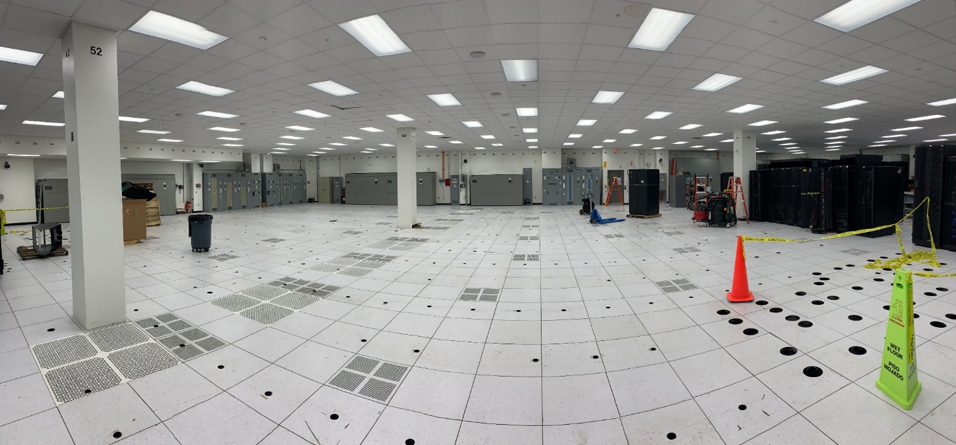
Making way for Frontier
Titan was shut down for the last time on August 2. Over its lifetime, Titan:
Executed more than 2.8M jobs
Delivered 27B core-hours to users
896 unique projects
>1,000 publications
Notes:
Replace with WBS

Slide 5
OLCF HPC and GPFS System Status
 |  |  |  |  | Computational description
System | Production date | Type | CPU | GPU | Nodes | Node configuration | Memory configuration | Inter-connect
Summit | 2019 Jan 1 | IBM | 3.45 GHz IBM Power9 (22-core) | 1530 MHz NVIDIA V100 (Volta) | 4608 | IBM Power9 CPUs (2/node) + NVIDIA V100 Volta GPUs (6/node) | 512 GB DDR4 and 96 GB HBM2 per node; >10 PB DDR4 + HBM + Non-volatile aggregate | Mellanox EDR 100 G Infiniband (non-blocking Fat Tree)
 |  |  |  |  | External Parallel File System
System | Production date | Storage system configuration |  |  | File system configuration | Inter-connect
Spider III | 2019 Jan 1 | 77 IBM ESS; 32494 10 TB HDD; 250 PB (usable); block level performance; 2.5 TB/sec peak (RW) |  |  | Single namespace/Alpine | EDR IB
HPSS | ~1996 | Tape: SpectraLogic Tfinity tape library; 85× TS1155 tape drives; 9041 15 TB tape media; Disk cache: 3 DDN SFA 14KX controllers; 2520 12 TB HDD; peak performance: 13.5 GB/s; storage capacity: 134 PB |  |  | Single HPSS namespace | 40 GbE and EDR IB

Slide 6

Business Results: IBM AC922 (Summit)
Measurement |  | 2019 target | 2019 actual | 2020 target | 2020 actual^{b}
Scheduled availability |  | 85% | 99.92% | 90% | 99.02%
Overall availability |  | 80% | 98.52% | 85% | 98.23%
MTTSI (hours) |  | NAM | 616 | NAM | 512
MTTSF (hours) |  | NAM | 2,918 | NAM | 903
Total usage | Node-hours usedª | NAM | 31,144,061 | NAM | 14,752,397
 | Node-hours available | NAM | 39,924,230 | NAM | 16,572,105
Capability usage: INCITE projects |  | NAM | 39.79% | NAM | 40.15%
All projects |  | 30% | 47.54% | 35% | 38.17%
ªDoes not include usage recorded during an outage ^{b}Jan-May 2020
OLCF exceeded all CY19 OA targets for Summit
Notes:
Ok, so moving onto Summit. Just like Titan we have assigned metrics for scheduled and overall availability, and for capability usage (**NOTE—per the OA guidance, shouldn’t this metric target be 30% for a new system?). Considering the fact that Summit is a new system and introduced a tremendous amount of changes from a hardware vendor perspective, job scheduler, and others, I’m actually very pleased with these numbers. As you can see, we achieved scheduled and overall availability numbers that would exceed targets for even a mature system, as would our capability usage figure.

Slide 7
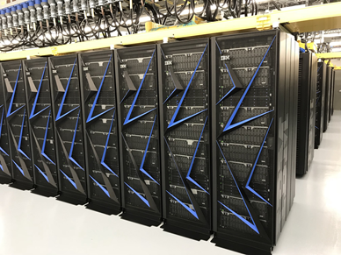
Business Results: Spider III Filesystem (Alpine)
Measurement | 2019 target | 2019 actual | 2020 target | 2020 actualª
Scheduled availability | 90% | 99.53% | 95% | 98.88%
Overall availability | 85% | 98.18% | 90% | 98.21%
MTTI (hours) | NAM | 277 | NAM | 448
MTTSF (hours) | NAM | 581 | NAM | 601
ªJan-May 2020
OLCF exceeded all CY19 OA targets related to file systems
Notes:
**NOTE: Why are we at 90% and 85% instead of 85/80 like Summit?
In 2019, we deployed our Spider 3 / Alpine filesystem and like Summit, there were a lot of shifts from an admin perspective—the biggest of which was a transition from a Lustre-based scratch filesystem to one using GPFS. There are some advantages that we’ve realized due to the change. This new filesystem offers a single namespace and capacity and performance on the order of 10X that of its predecessor, but we are also seeing better single client performance (~24GB/sec on a single Summit node), and better small file I/O due to the way smaller I/Os are aggregated on the client just to name a few. There are also some administrative benefits that I won’t dive into that include such things as automatic failover between storage servers, the GPFS ”disk hospital” which more quickly and accurately identifies slow or failing disks, and the fact that GPFS filesets allow audit capabilities on a per project basis and close integration with our internal RATS (resource allocation tracking system) to track utilization and provide reports, etc.
With all that said , our numbers in 2019 for this new filesystem were very good. High 90% both scheduled and overall availabitliy.

Slide 8
Capability Usage (Summit) IBM AC922
Leadership usage | CY19 target | CY19 actual | CY20 target | CY20 actualª
INCITE | NAM | 39.8% | NAM | 40.2%
ALCC | NAM | 52.7% | NAM | 34.7%
All projects | 30% | 47.6% | 35% | 38.2%
ªJan-May 2020
2019 Capability Usage (47.6% average) demonstrates effective scheduling policy and application workload (large, scalable jobs)
Leadership-class jobs must use no less than 20% of the available Summit nodes, and receive a +10 day aging boost from scheduler
OLCF further boosts (+15d) the largest (>60%) jobs
Summit scheduling policy
Bin | Min nodes | Max nodes | Walltime hours | Aging boost (days)
1 | 2,765 | 4,608 | 24.0 | 15
2 | 922 | 2,764 | 24.0 | 10
3 | 92 | 921 | 12.0 | 0
4 | 46 | 91 | 6.0 | 0
5 | 1 | 45 | 2.0 | 0

Slide 9
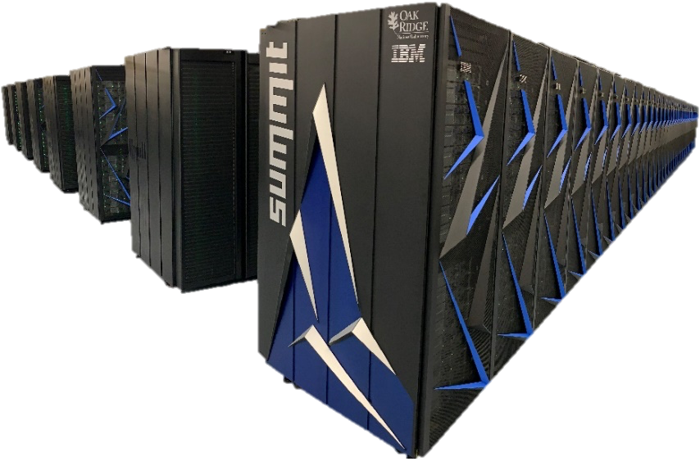
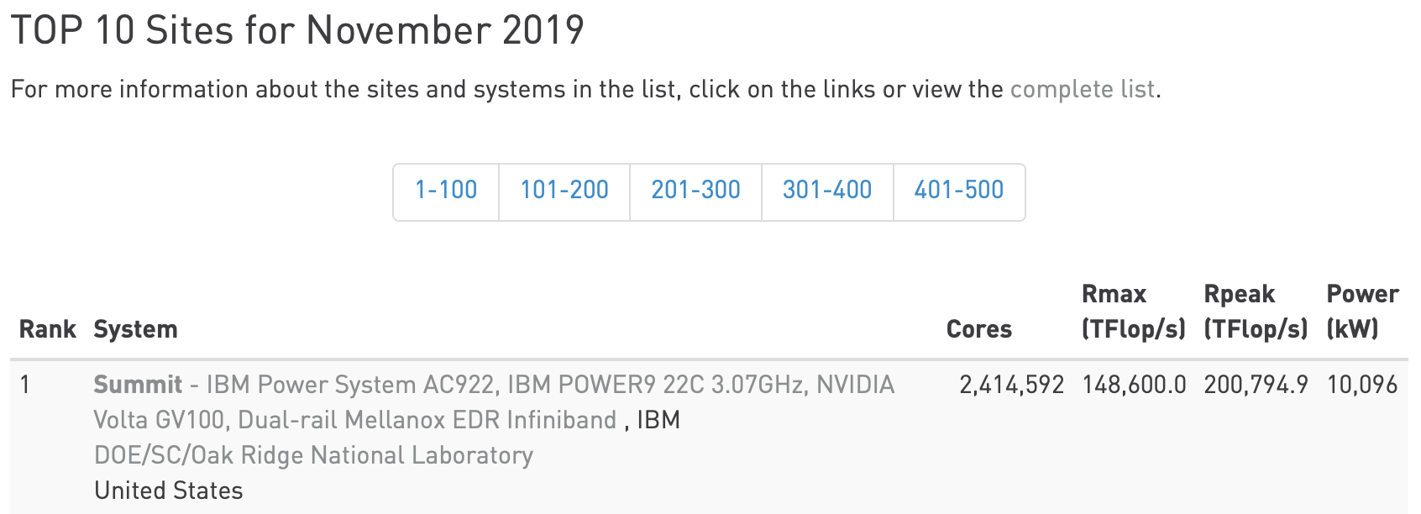
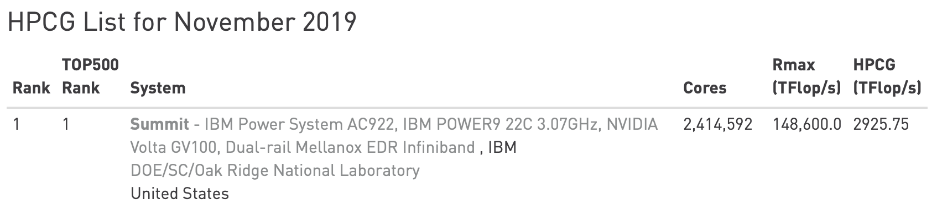
2020 Operational News
Summit IBM HPC Software Stack Upgrade
Target for release is June 19th
Software Updates
(Subject to change based on IBM Regression Testing)
RHEL 8.1
CUDA 11
MOFED 4.9
Updates to LAPACK, LAPACKE, and LAPACK GPU support in ESSL
GDRCopy support in Spectrum MPI
JSM
Improved GPU Binding options
Support for multiple SMPI installs with a single JSM
3 New COVID-19 Cabinets for Summit
Hardware has the following improvements for COVID workloads:
2 TB DDR4 CPU memory
32 GB HBM2 memory per GPU
6.4 TB NVMe Flash Drive
Separate queue to keep current and new cabinets partitioned
Debug queue added to Summit
Summitdev Decommission
Power 8 Test and Development Machine
Available December 2016
Decommission September 2020
Uses common home areas and Alpine so files will be available from other OLCF systems

