Slide 1
Big, Deep, and Smart Data in Imaging – Towards Nanoscience 2.0
Sergei V. Kalinin
Institute for Functional Imaging
of Materials
Guiding the design of materials tailored for functionality

Slide 2

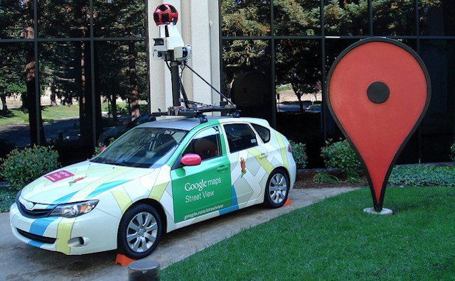
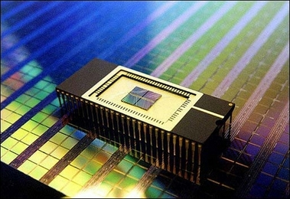
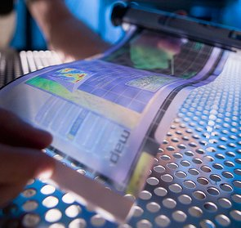

Opportunities in Materials Science
Renewable energy, self-driving cars, transparent displays, new memory technologies
Need for new materials not being met by classical approach
Notes:
Make first slide opening – put some pictures of solar cells, cars, etc (Julia Greer style). Space elvator if you want. Amd then put Ceder Nature Mat paper (just cut and paste from pdf)
So this slide is opportunity. Next is limitaitons
When you talk, make message very clear.
------
Good afternoon everyone. Materials have driven new technology, and continue to do so at a frantic pace today. They are required to meet the energy challenges of our time, to solve social problems such as traffic and road fatalities, and for consumer goods including better, faster memory devices and transparent and flexible screens for electronics. However, the traditional paradigm for discovering new materials is outdated. Traditionally, people would synthesize new materials based on a combination of serendipity, intuition, and knowledge of the related compounds. However, with increasing complexity of the materials that are beign synthesized, the possible combinations also increase exponentially and this approach is no longer viable. Therefore, we need a new method, which was first introduced about a decade ago – that is, predicting properties by merging data science with first principles calculations.

Slide 3
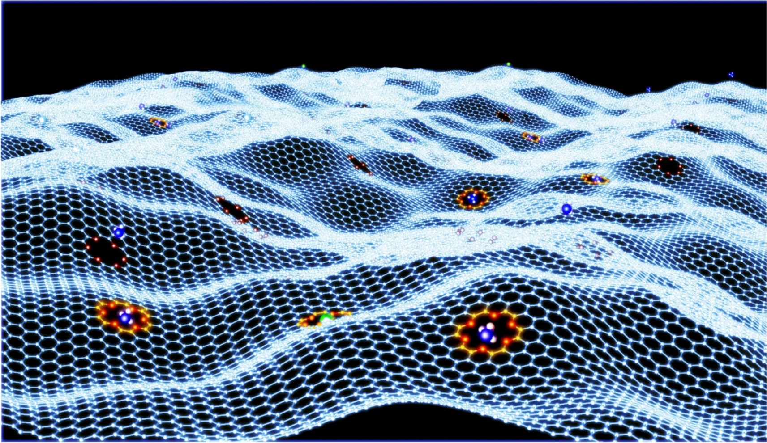
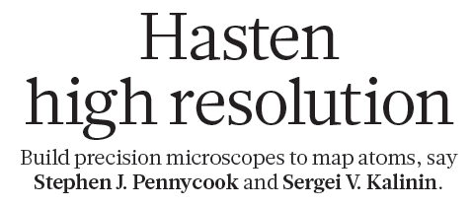
More than imaging
J.J. Guo et al., Nat. Comm. 5, 5389 (2014)
Nature 515, 487 (2014)
Atomic positions can be determined to <10-pm precision
Bond length: Chemical reactivity, catalytic activity
Bond angles: Magnetism
and transport
Configurations
and repeating elements?
Notes:
The concept we propose is a “genome” that has one strand being atomic and mesoscopic imaging, and another theory, with big data playing a role of the binding groups. Connections are unsupervised learning, correlative learning, image recognition, supervised learning

Slide 4
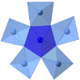
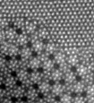

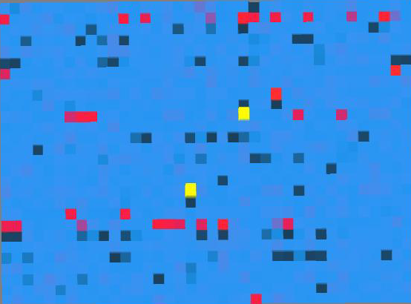
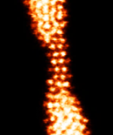
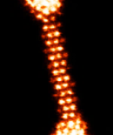
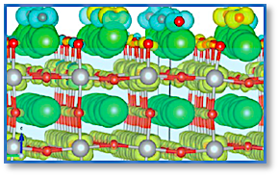
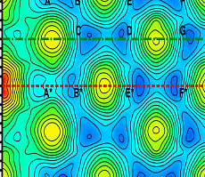
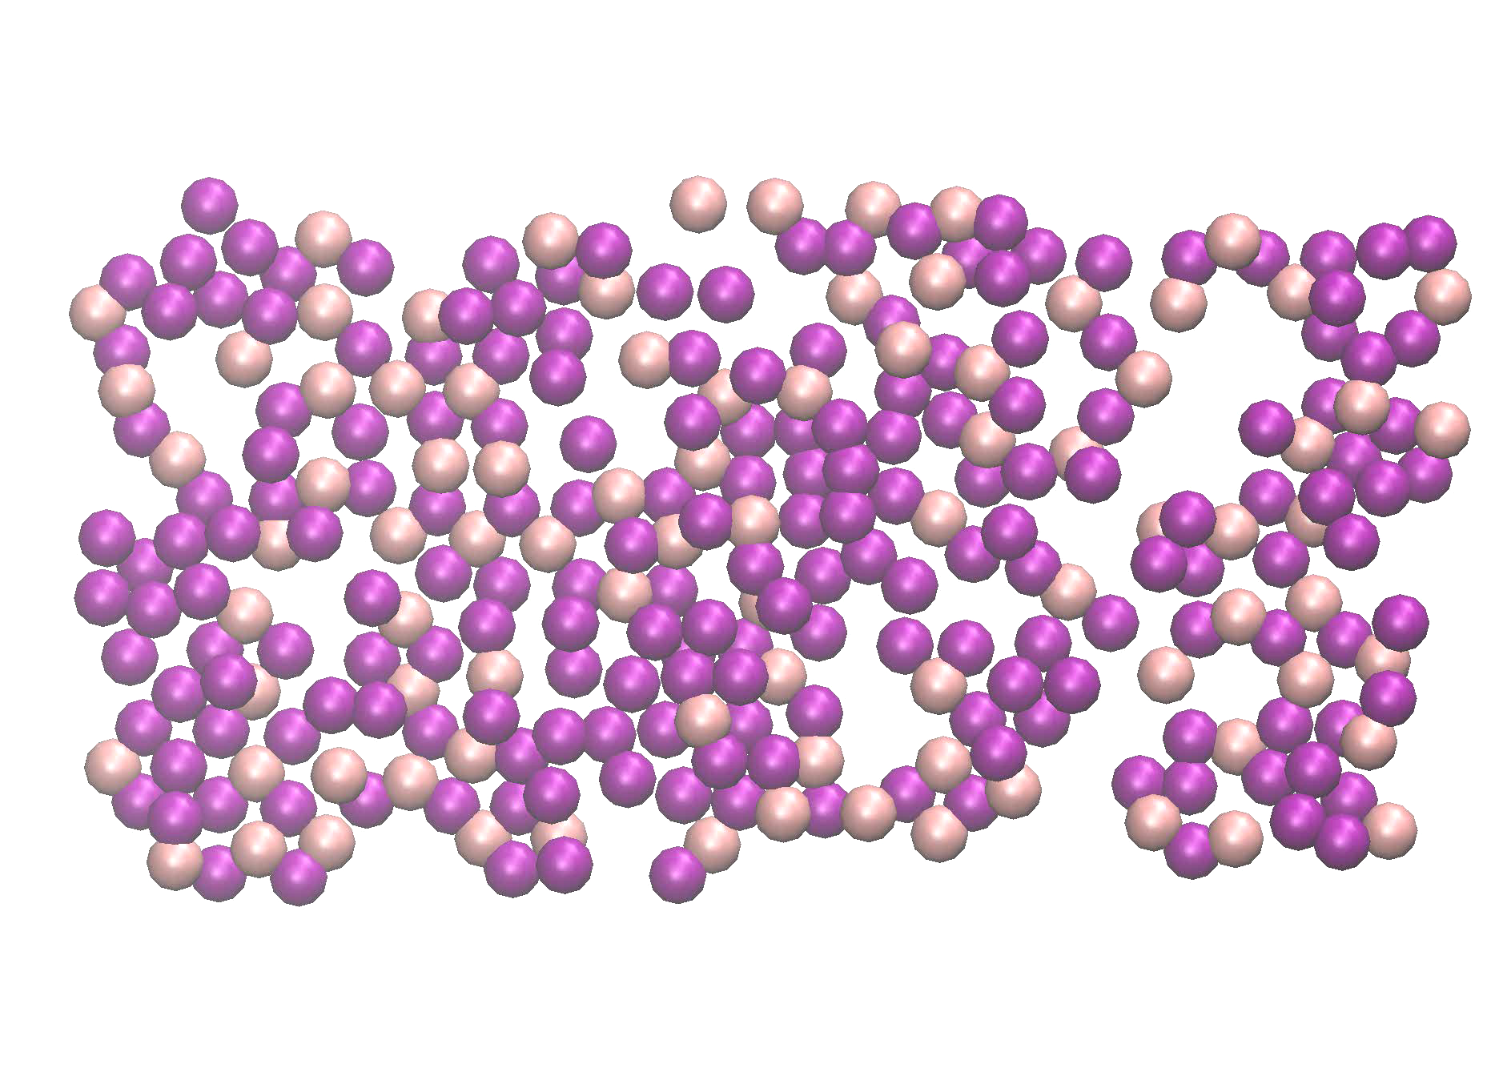
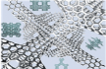
Dynamic matter: information dimension
Static matter
Functional matter
Imaging
Dynamic matter
Controlled matter
Big data
Unsupervised
learning
Correlative
learning
Image
recognition
In-situ Control
Electronic Structure
Ab Initio dynamics
Molecular Dynamics
Theory
Multiscale
Notes:
The concept we propose is a “genome” that has one strand being atomic and mesoscopic imaging, and another theory, with big data playing a role of the binding groups. Connections are unsupervised learning, correlative learning, image recognition, supervised learning

Slide 5
Imaging: What do the atoms do?
Our scientific paradigm is shifting
  Classical concept
  Synthesis
  Characterization
  Theory
  Computation
  Expanding to include
  Data mining
  Correlative functional imaging
  Local theory-experiment matching of multi-dimensional (multi-modal), spatially and temporally resolved information
  Institute for Functional Imaging of Materials (IFIM)
  Develop new imaging probes and workflows based on synergy
  between imaging disciplines
  Bridge physical imaging with theory via big data
  and data analytics to design new materials
  Leverage ORNL strengths in
    Physics and chemistry on the atomic scale in real space
    Mesoscale structure and functional probing
    Big data and predictive theories
Notes:
What is new now compared to the past? Why is it opportunity
Imaging becomes a source of quantitative measurements, rather then just pictures
Caveat: we have a lot of data, but relatively high noise.
Need to find ways to get use it, complement with functional probing, and link to local and global properties

Slide 6
Approach
Physics: Why something happens
1. Big data:
How does
it happen?
2. Deep data: How can
we understand?
3. Smart data: How can
we do better?
Unsupervised learning, clustering, and visualization
Biggest hurdle: Language/ elementary tools
Physics informed data analytics/ supervised methods
Biggest hurdles: Mathematical framework,
scalability of computational tools
Feedback
and expert/AI systems
Biggest hurdles: Don’t know
where to start,
but it is possible

Slide 7
Level 1: Big data in imaging

Slide 8
Imaging:
A. Borisevich
Q. He
Sample:
V. Guilants
Image analysis:
S. Jesse
A. Belianinov
Notes:
Figure 2. Two phase Mo-V-M-O (M = Nb, Ta, Te and/or Sb). (a) M1 and M2 mixed phase STEM image. (b) k-means clustering results for 6 neighbor, sort by distance metric case. (c) k-means clustering results for 6 neighbor, sort by angle metric case. (d) FFT of image in (a). (e) 50 member neighborhood of the image in (a). (f) 6 member neighborhood of the image in (a). (g) Dendrogram for the 6 neighbor, sort by distance metric case.

Slide 9

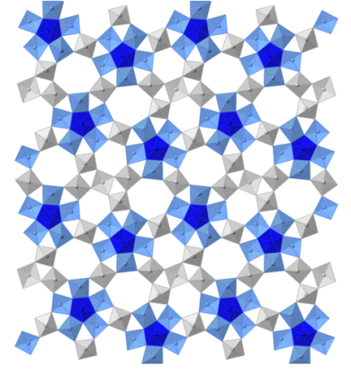
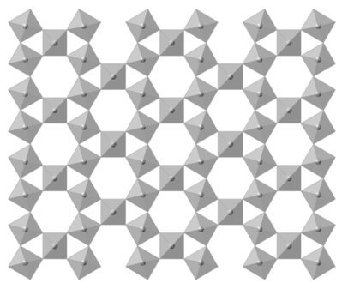
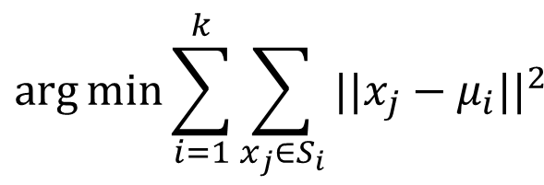
Normal Modes Analysis
Principal Component Analysis
PCA transforms the data such that the greatest variance by any projection lies on the first coordinate
K-means Clustering
Chemistry
Physics
k-means clustering aims to partition the n observations into k sets (k ≤ n) S = {S₁, S₂, …, S_{k}} so as to minimize the within-cluster sum of squares
$$\arg{\min{\sum_{i=1}^{k}{\sum_{x_{j}∈S_{i}}{{||x_{j}−μ_{i}||}^{2}}}}}$$

Slide 10
Local Chemistry: K-means
All Clusters
Cluster II
Cluster I
Cluster III

Slide 11
Local Physics: PCA
Raw Data
Clustering
13
3
2
2
PC I
11
PC II
-3
PC III
-2
PC IV
-2

Slide 12
Image Analytics: Enabling the Discovery
Image based analysis for quantitative improvement of Molybdenum–Vanadium based complex oxide catalysts for propane ammoxidation
Identification of new phases undetectable by visual inspection
Link to catalytic properties?
Q He, J Woo, A Belianinov, VV Guliants, A Borisevich; ACS nano, DOI: 10.1021/acsnano.5b00271, (2015)

Slide 13
Local property mapping
STM image of FeSeTe at L-He
Superconductive gap map
2.3
3 nm
1.5
3 nm
0
Filtered STM Image
Local unit cell volume
a
b
15°
a
The defect preserves lattice continuity, but is associated with change in molar volume and lattice parameter - Guinier-Preston zone. Superconductivity is suppressed at the defect.
Notes:
13

Slide 14
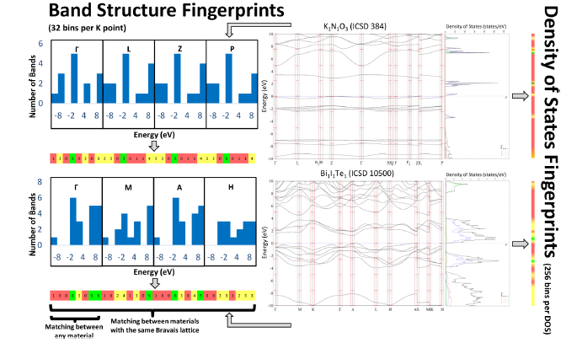
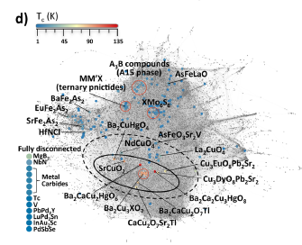
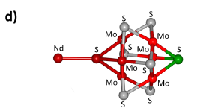
Materials Carthography
Curtarolo:
Electronic structure fingerprints
Structural elements favorable for superconductivity
Key to rational materials design

Slide 15
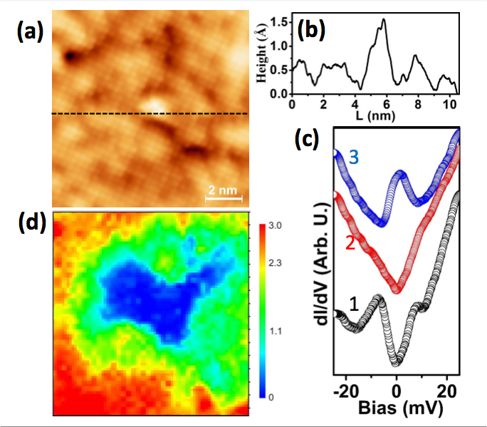
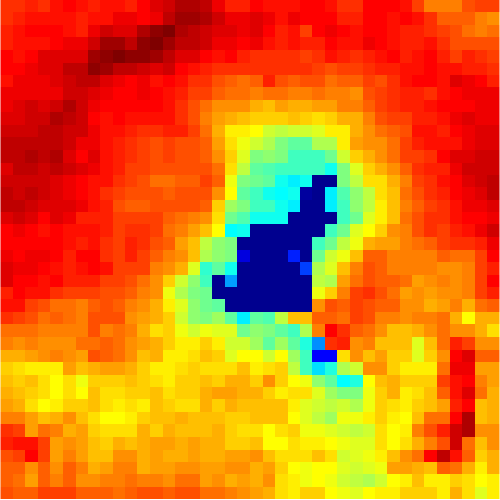
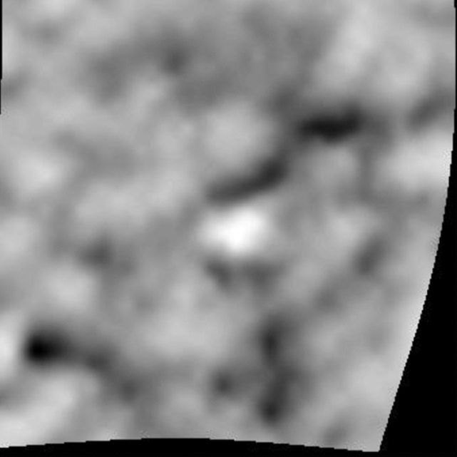
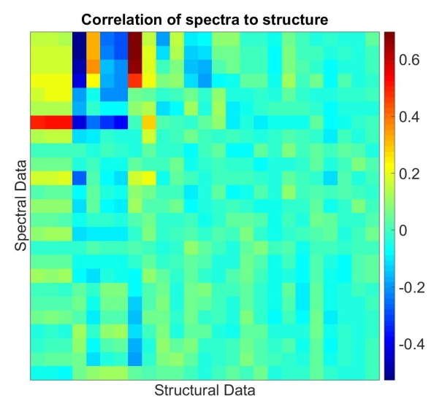
Local structure-property coupling
Surface atomic structure
Tunneling spectral image
T. Gianfrancesco, CIRE student (supported by this proposal)
Structure descriptors:
Atom height
Molar volume
….
Electronic property descriptors:
PCA components of spectra
Superconductive gap
….

Slide 16
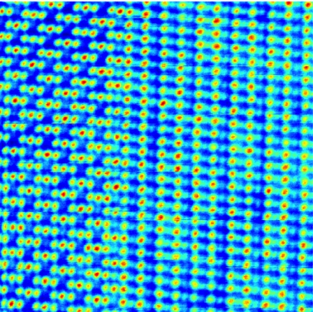
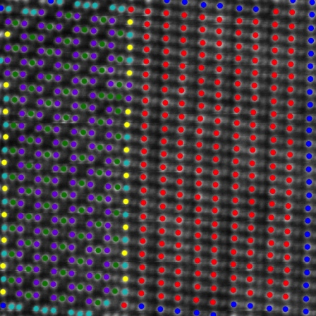
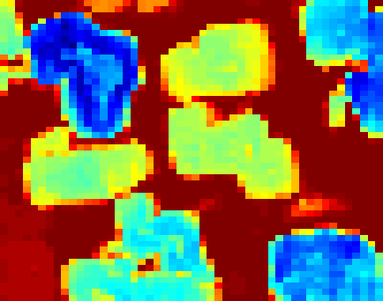
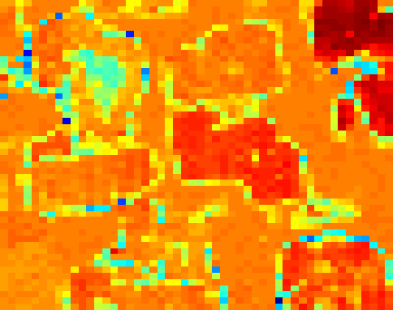
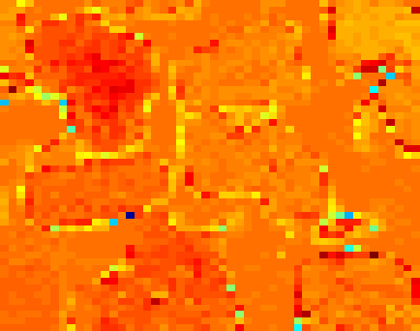
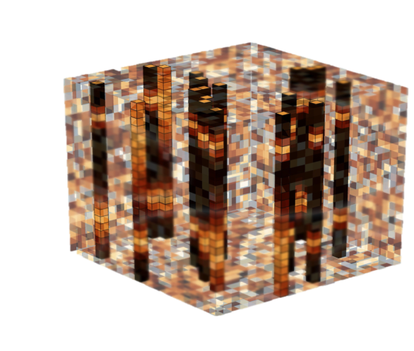
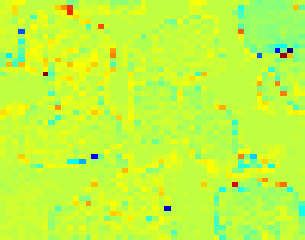
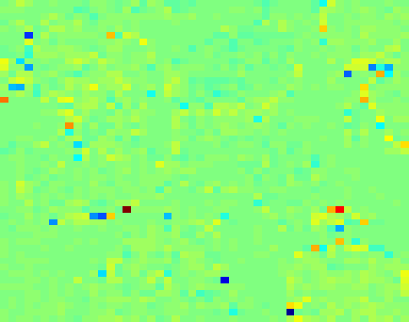
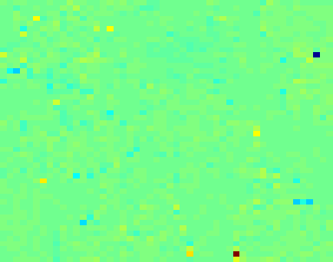
Atomic-Scale Structure and Functionality
Image
Positions
Physics
Genomic
Library
Phase
2
Structure
Identify &
Classify
Structure
Analysis
Phase 1
Register & Deconvolute
Spectra
Physics and chemistry on single defect level
Multivariate
Analysis
3D
4D
5D
Properties
Scattering methods: completeness of library
Macroscopic properties: averaging rules
Need new language:
What are structural descriptors?
How do we define local symmetry, phases and ferroic variants?
How do we introduce and quantify translational symmetry?
What do we learn:
Structure-property relationship on single atom, molecule, and defect level
Libraries of structure-property relationships
Feedback to theory through microscopic degrees of freedom

Slide 17
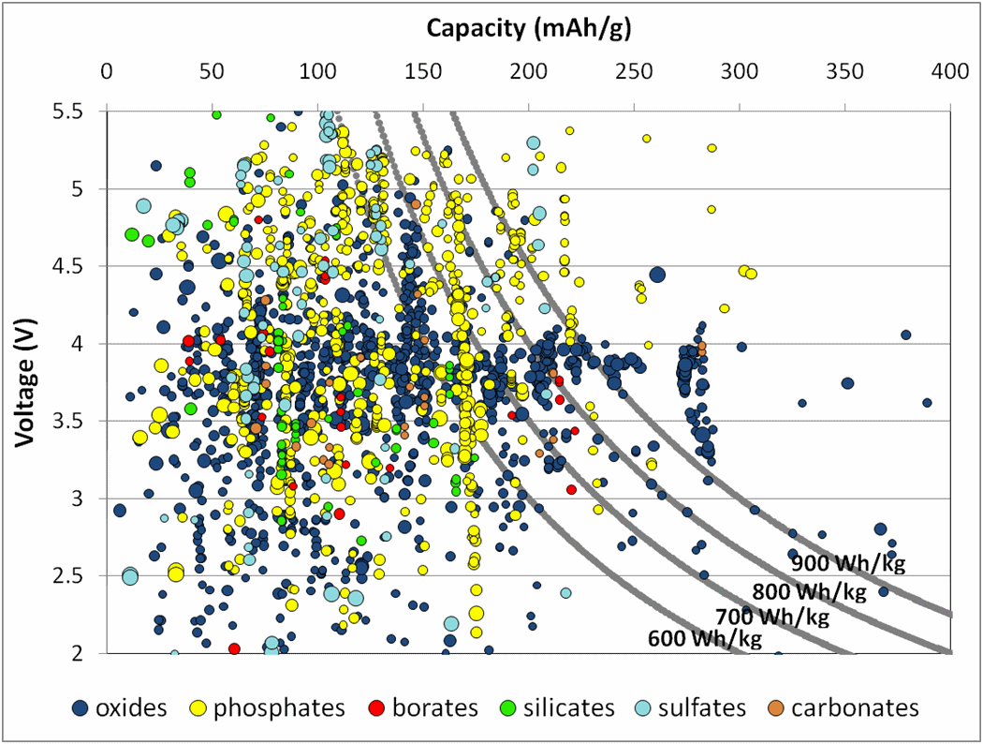
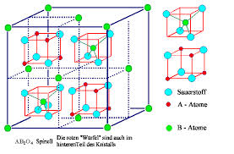
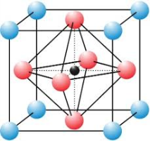
Materials Genome
Big data in theory: new opportunities for science (Materials Genome)
Many functionalities are defined on length scale well above unit cell
Spinel
Perovskite
Problems:
Both number of combinations and computational complexity diverge exponentially with system size
No feedback from experiment/theory refinement
Practical realization
Notes:
http://ascr-discovery.science.doe.gov/feature/jain2.shtml
http://commons.wikimedia.org/wiki/File:Perovskite_ABO3.jpg
http://www.tf.uni-kiel.de/matwis/amat/def_en/kap_2/basics/b2_1_6.html

Slide 18
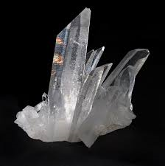
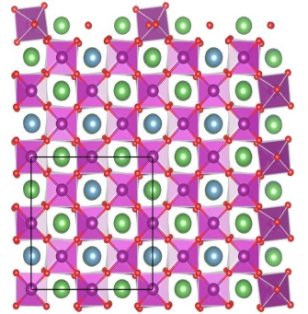
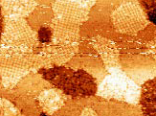
Imaging to genome
Classical approach: Synthesis → Characterization → Theory
Bulk Crystal
Chemical Space
Functional Properties
T_{m}
γ
Y
P
Ρ
…
Big data from imaging:
“Stochastic” library
Need:
Functional probes
High-resolution structural imaging
Theoretical models
Big/Deep/smart data
φ (x,y,V,…)
Y (x,y,V,…)
P (x,y,V,…)
…
Future:
Libraries of preferred local configurations: what is relevant
Structural + functional imaging: stochastic combinatorial libraries
Refining the theory
Notes:
http://ascr-discovery.science.doe.gov/feature/images/jain_fig1.gif

Slide 19
Level 2: Deep Data
“Theoretical microscope”
Physics-constrained unmixing
Inverse problems

Slide 20
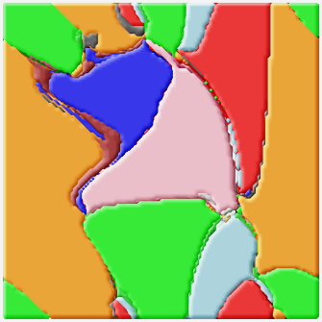
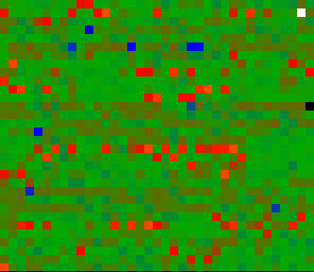
From Atomic to Mesoscale
Atomistic Simulation
Nanoscale
Mesoscale
Information compression
Coarse graining
Theoretical microscope
Mesoscale Imaging
Atomistic Imaging
Bayesian inference
Coarse graining
Can we develop approach to extract relevant macroscopic parameters from simulations based on their significance (e.g. via Fischer information)
Can we refine and improve these predictions by factoring in experimental data (via Bayesian inference)
Theory driven and experiment and history informed materials design

Slide 21
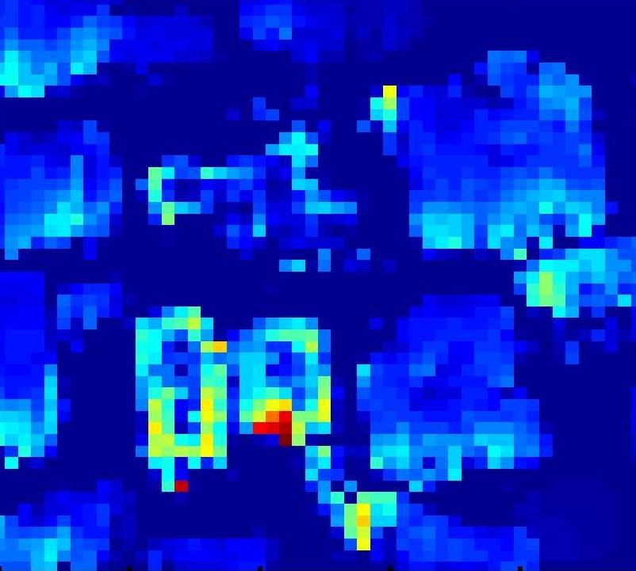
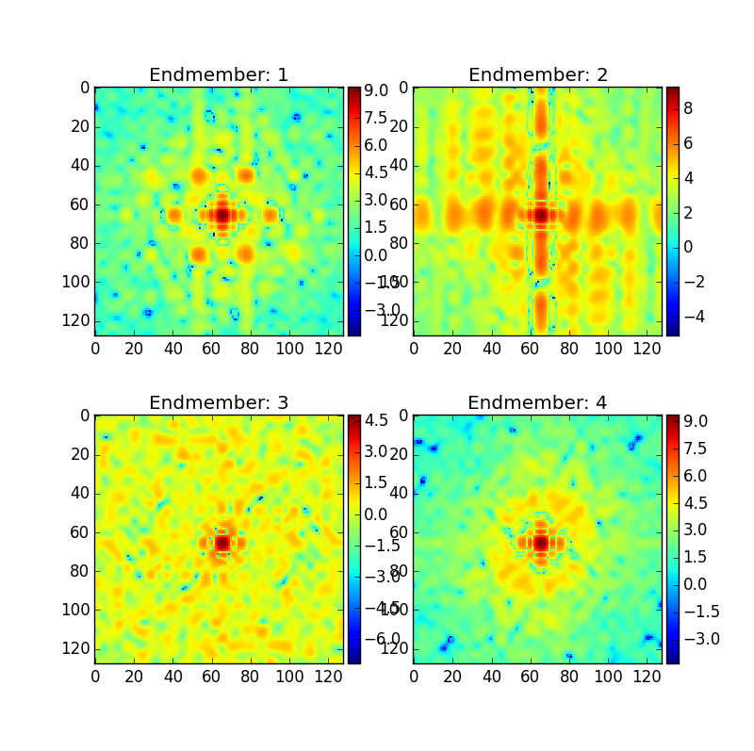
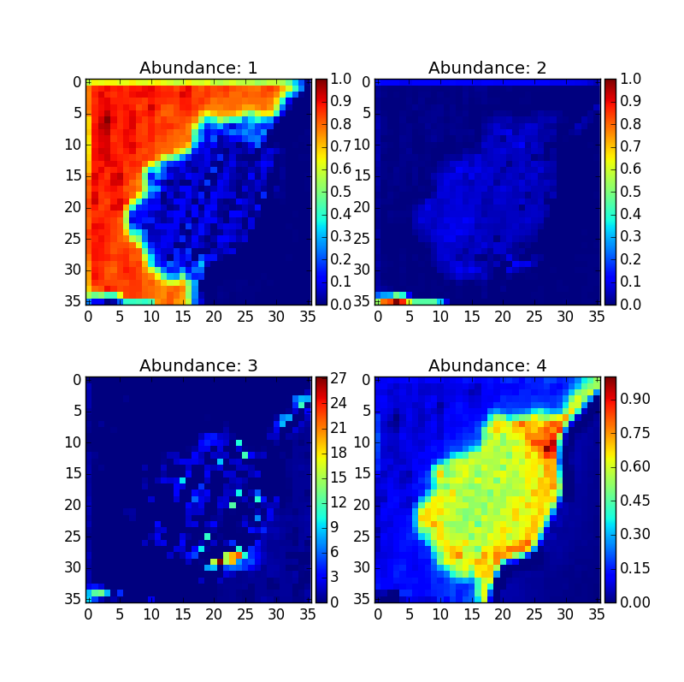

Physics-constrained un-mixing
Vasudevan et al
submitted
Real space
Spectral space
5
V_{p}
1
Current-voltage
curves
at each location
0
Current (nA)
Voltage (V)
-5
0
1
2
0
y
time (s)
4D dataset
I = f(x, y, V, V_{p})
x
Fitting to physical models
$I=b∙V^{2}$
Extracting
Physical meaning
Eigenvector 1
Loading 1
CFO
BFO
R₁
R₂
R₂
Strelcov et al,
ACS Nano 2014, 2015
R₁
Bottom electrode
A
Eigenvector 2
Loading 2
Un-mixing with user-defined constraints on the endmembers or loading maps
Combined spatial and spectral unmixing
Incorporate physics (symmetry, non-negativity, material parameter/models, etc.)
Needs

Slide 22
Approach
0. Getting big data: making imaging tools a part of data infrastructure
Physics: Why something happens
1. Big data:
How does
it happen?
2. Deep data: How can
we understand?
3. Smart data: How can
we do better?
Unsupervised learning, clustering, and visualization
Biggest hurdle: Language/ elementary tools
Physics informed data analytics/ supervised methods
Biggest hurdles: Mathematical framework,
scalability of computational tools
Feedback
and expert/AI systems
Biggest hurdles: Don’t know
where to start,
but it is possible

Slide 23
Chemistry
Materials
Science
Mass Spectrometry
Optical
Imaging
Data Analytics
Atom Probe
Tomography
Global
Security
Data Modeling
INSTITUTE FOR FUNCTIONAL
IMAGING OF MATERIALS
Chemical
Imaging
Electron
Microscopy
Biology
Scanning
Probe
Microscopy
Neutron
Imaging
Biomedical
Technology
Environment
Level 0: Getting big data

Slide 24
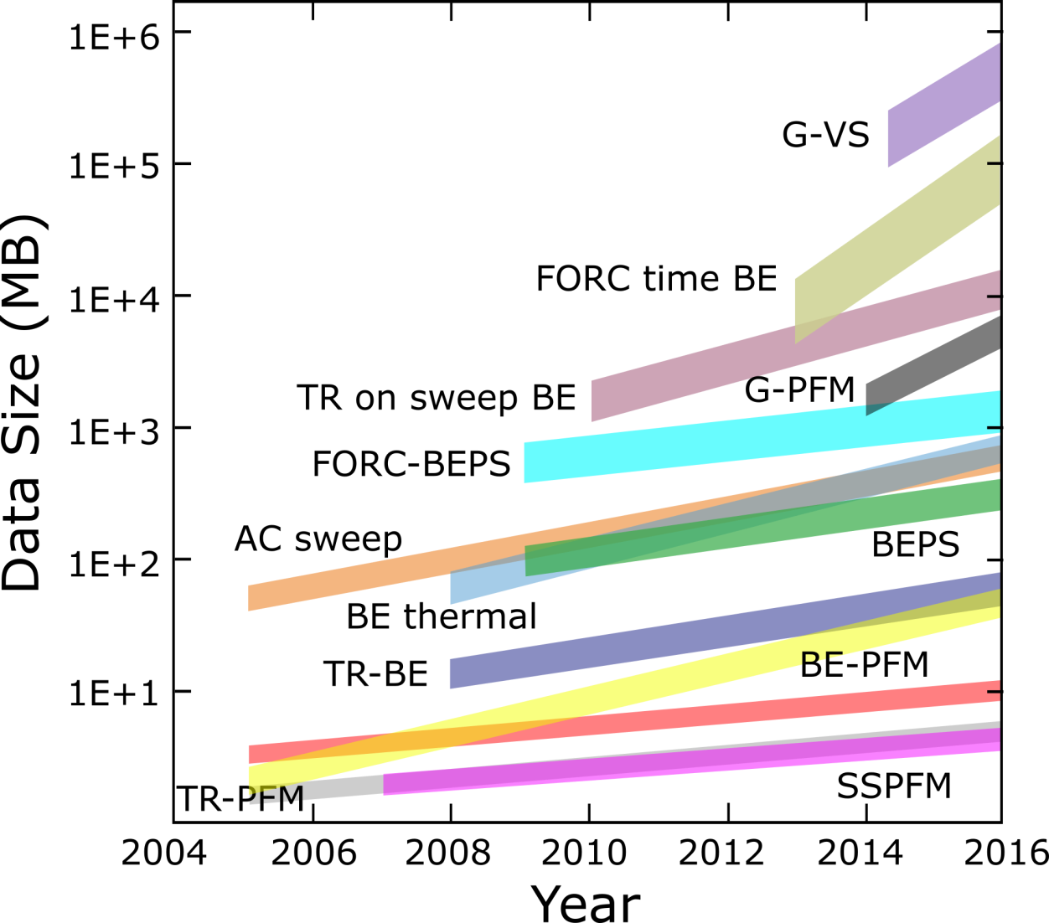
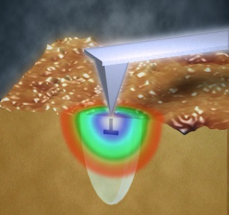
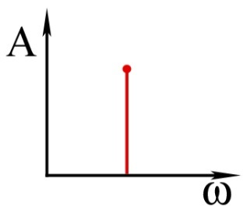
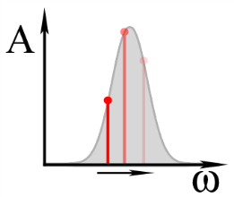
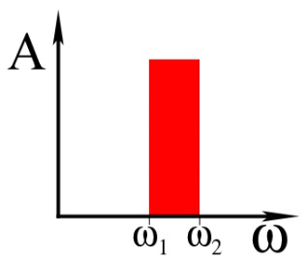
Data Generation and Utilization in SPM
Probing local phase transitions requires high (3,4,5,6) D data sets
We realized we are doing big data
Kalinin, Jesse, Proksch, Information Acquisition & Processing in Scanning Probe Microscopy, RD Mag 2008
Single frequency methods:
Band excitation:
Instrumental limit: photodetector bandwidth (~10 MHz) x DAQ performance (32 Bit)
Single frequency/heterodyne: lock-in compression to ~ 1 kHz
Band excitation: 10² bins at ~ 1 kHz = 100 kHz
We are losing 99% of data!

Slide 25
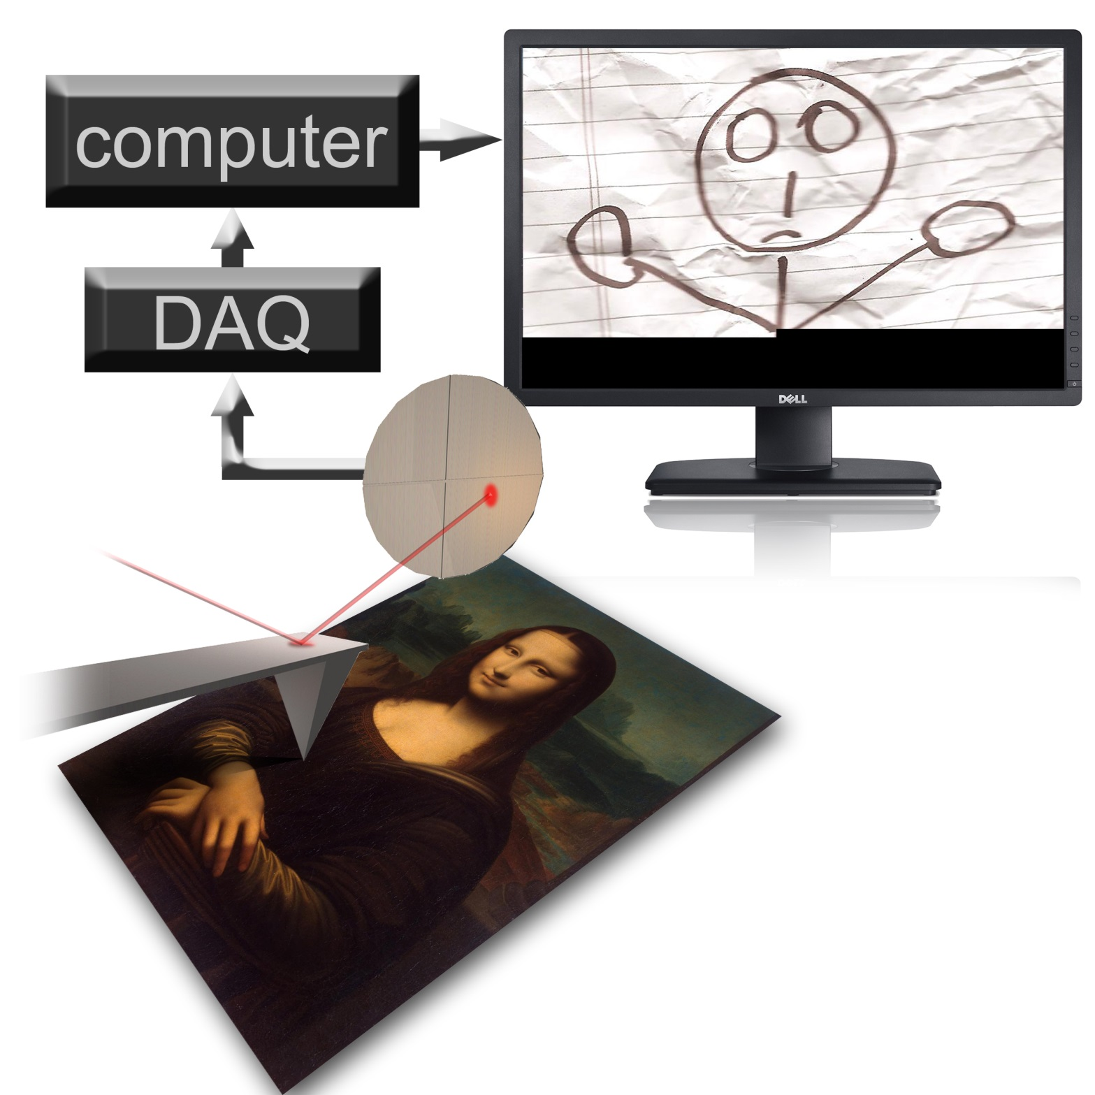
Concept and implementation by Stephen “Leonardo” Jesse

Slide 26
G-mode SPM
Full information capture, lossless compression, and storage of the data stream from the photodetector allowing for:
Recovery of classical SPM
Information theory based analytics and estimating information loss/completeness of classical methods
Physics based analytics
For many SPM modalities, ~1,000 increase of imaging speed
Enables totally new imaging modes
But: need for data analytics and direct streaming to HPC
Platform # PCs | Desktop All 5% |  | Supercomputer All 5%
Data size | 4 GB |  | 27 GB
Duration | ~ 48 hrs | ~ 1 min | 19 min | 8 min
Memory | 40 GB | 6 GB | 173 GB | 115 GB
A. Belianinov et al., Nat. Comm 6, 6550 (2015)

Slide 27

Concept and implementation by Stephen “Leonardo” Jesse

Slide 28







Big Data in Scanning Transmission Electron Microscopy
STEM for fast data generation:
quantification of beam interaction (pulses),
In-situ movies,
focal series
2D and 3D ptychography
electron beam
Sub-Å probe
To scan coils
Specimen
Advanced
DAQ
CADES
Fast Direct
Electron
Detection
2D Ptychography
192X192 pixel locations
384X384 pixel scatter-grams
192²X384²= 5X10⁹ data points/scan

Slide 29

Data Generation in Electron Microscopy
NSRC Workshop on Big, Deep, and Smart Data in Imaging: June 2015, ORNL
Instrumental limit: Electron flux (2 10⁸ e/s) x detector performance (1 Bit/electron)
Detectors: Information per electron?
Storage, visualization, and curating
ORNL Solution: BEAM infrastructure

Slide 30




Classical Instrumental Research Paradigm
SPM: 30,000+ platforms worldwide:
Large weakly connected instrumental network
(S)TEM: ~100s top level machines,
much stronger integrated community
Weeks - months
ms
min
Instrument
Control/data acquisition
Researcher
Community
Social networking/education
Publications/citations
Only small fraction of data stream from the instrumentation is captured
Only small fraction of captured data is analyzed, interpreted, and put in the context
Human-machine interaction during acquisition is often slow and can be non-optimal
Human interpretation of data is limited: bias and ignoring serendipity
Information propagation and concept evolution in scientific community is extremely slow and affected by non-scientific factors

Slide 31

Research Paradigm at Facilities such as CNMS
CNMS Researcher
Instrument
Control/data acquisition
User Researcher
Community

Slide 32


Research Paradigm at Large Facilities
(geographically) Single large data generation node
Full capture of instrumental data stream
Cloud-based processing and dimensionality reduction
Community-wide analytics

Slide 33


Imaging in the Cloud
Multiple geographically-distributed data generation node
Full capture of instrumental data stream /compression/curation
Coordination of protocols and data/metadata across the cloud
Cloud-based processing and dimensionality reduction
Community-wide analytics

Slide 34



Slide 36








Ptychography: the D scanning-scattering data set
Bismuth Ferrite Domain Boundary
electron beam
Advanced DAQ
To scan coils
Sub-Å imaging + Direct Electron Detection + Big data analysis enables effective STEM-ptychography.
Next step: recover physical Information including strain, internal fields, orientation etc.

Slide 37




Supporting real-time image analytics
STEM/EELS
Transfer files to HPC storage and convert data to HDF5 format
Massively parallel Image processing/ feature detection
Massively parallel electronic structure calculation
High throughput image capture
Multi-modal:
-High-angle annular dark field (HAADF) detector
- Electron energy loss spectroscopy
- O(1000) of images per experiment
Data motion via BBCP/GridFTP
Data conversion from DM3 stacks to HDF5 slices
Standard data format (HDF5)
Data layout conducive to HPC algorithms
Denoise Image
Identify atoms
Identify lattice
Thousands of images/sec
Built on MPI+Fortran
Near linear scaling – some limitations as file counts get extremely large
Massively parallel study of hundreds to thousands of individual configurations
Calculation of electronic structure
Based on Density Functional Theory
0(1000) of configurations
Minutes
Seconds
Seconds
Minutes

Slide 38
Level 3: Smart Data
- Supervised Learning
- Context
- History

Slide 39
From Human Expert to Automatic Systems
Expert
Control
Synthesis of expertise: factor in human expert knowledge
E
X
P
E
R
T
Decision making
Automatic
Expert System
User
Model
Experimental data
Context search: published results data mining/social networks
Future:
Automated analysis of routine data
Identification of anomalies
Initial training of new practitioners
Data centers: information based on knowledge
Timeline

Slide 40



Smart data: Google car, cancer screening, expert systems
Understanding
adapt
seed
Data
act
scale
Statistical measures of orientation of texture
for the detection of architectural distortion
in prior mammograms of interval-cancer
J. Electron. Imaging. 2012;21(3):033010-1-033010-13. doi:10.1117/1.JEI.21.3.033010
Notes:
(a) Node map for the mammogram shown in Fig. 2. The asterisks (*) represent the peak positions automatically detected in the node map. The numbers next to the asterisks indicate the peaks in descending order of magnitude. (b) The 30 ROIs, each of size 128×128 pixels (except at the edges), obtained by using the peaks detected in the node map. (c) ROIs after FP reduction by using selected features from the set H1, the ANN classifier, and the leave-one-image-out method. Only the top six ROIs are shown in the image at the associated sensitivity of 80% obtained with 5.5 FP/image. The numbers outside the parentheses correspond to the ranking based on the discriminant values obtained by the ANN classifier, and the numbers within the parentheses represent the earlier ranking obtained by phase portrait analysis.
Examples about machine learning
Tourassi
Cancer diagnostics
Google Car
Cat identification

Slide 41
Expert evaluation of direct and indirect past knowledge
What makes us a community: structure, correlations, and success in scientific world
S.V. Kalinin and A. Maksov
arXiv:1502.03439
Indirect link
Subject
Theory link
Behavior link
Method link
Material link
Timeline

Slide 42


Citation and semantic analysis of publications
Rapid screening of community for major groups/directions
Evaluation of potential communities of interest (reviewers, latent users)
CiteScape: MRS Fall Tutorial

Slide 43
From Imaging to Making Stuff
Oxides
Films
Nitrides
PLD
ALD
Crystals
MOCVD
Ceramics
Sulphides
Continuous process monitoring: capture all degrees of freedom we can
Develop materials and synthesis specific schema
Implement across facilities/open format
Data mine prior work/crowd-source for information
Correlative analysis in specific areas/link to structural and thermodynamic data bases
Develop hierarchical clustering approach for materials/methods to integrate communities

