Slide 1
Legion Runtime System
Elliott Slaughter, Sean Treichler, Wonchan Lee, Zhihao Jia, and Alex Aiken
Stanford University
Michael Bauer
NVIDIA Research
Samuel Gutierrez, Galen Shipman, Dean Prichard, and Pat McCormick
Los Alamos National Laboratory

Slide 2
Heterogeneity
System Architecture for Titan (#2 on Top500)
~20,000 nodes
16 Latency-optimized cores
Good at running arbitrary code
Big, power-hungry
High-bandwidth, low-latency interconnect
32GB system memory
448 Throughput-optimized cores
Good at adding and multiplying
Cheap, power-efficient
6GB dedicated memory
~1GB “zero-copy” memory
(carved out of system memory)

Slide 3
Heterogeneous Heterogeneity
Titan
~20,000
Trinity / Cori
~10,000
~10,000
Summit
~3,500
Aurora
~50,000

Slide 4
Programming System Goals
High Performance
We must be fast
Performance Portability
Across many kinds of machines and over many generations
Programmability
Sequential semantics, parallel execution

Slide 5
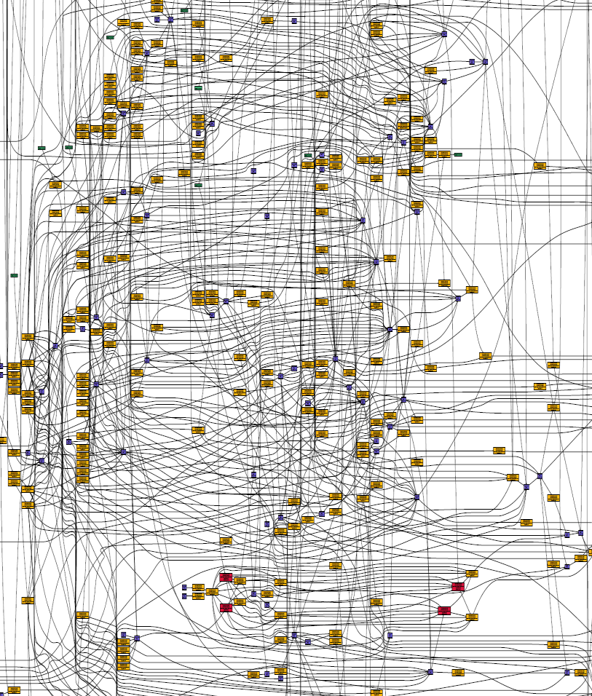
Can We Fulfill These Goals Today?
Yes
… at great cost:
Who will schedule the graph?
(High Performance)
Who will re-schedule the graph for every new machine?
(Performance Portability)
Who is responsible
for generating the graph?
(Programmability)
Today: programmer’s responsibility
Tomorrow: programming system’s
responsibility
Task graph for one time step on one node…
… of a mini-app
Notes:
This is a graph of operations and dependencies in an application. This may not be expressed explicitly in most of today’s systems (i.e. MPI), but it is there, implicitly in the programmer’s head. For example, two operations without a common dependence can be scheduled in parallel onto different processors.

Slide 6
Legion: Tasks & Regions
A task is the unit of parallel execution
I.e. a function
Task arguments are regions
Collections
Rows are an index space
Columns are fields
Tasks declare how they use their regions
task saxpy(is : ispace(int1d), x,y: region(is, float), a: float )
where reads(x, y), writes(y)
0
2.72
1
3.14
2
42.0
3
12.7
4
0.0
Notes:
“Collections, which you can think of as being like arrays of structs”

Slide 7
Example Task
task saxpy(is: ispace(int1d), x: region(is, float),
y: region(is, float), a: float)
where
reads(x, y), writes(y)
do
for i in is do
y[i] += a*x[i]
end
end

Slide 8
Regions
Regions can be partitioned into subregions
Partitioning is a primitive operation
Supports describing arbitrary subsets of a region

Slide 9
Partitioning
N
W
P
S
p₁
p₂
p₃
s₁
s₂
s₃
g₁
g₂
g₃
w₁
w₂
w₃
Notes:
Unique to Legion: multiple partitions, hierarchy

Slide 10
Tasks
Tasks can call subtasks
Sequential semantics, implicit parallelism
If tasks do not interfere, can be executed in parallel
task foo(x,y,z: region(…))
where reads writes(x,y,z) do
bar(y,x)
bar(x,y)
bar(x,z)
bar(z,y)
end
task bar(r,s: region(…)) where reads(r), writes(s)
Notes:
Borrow task names from S3D

Slide 11

Deferred Execution
task foo(x,y,z: region(…))
where reads writes(x,y,z) do
bar(y,x)
bar(x,y)
bar(x,z)
bar(z,y)
end
task bar(r,s: region(…)) where reads(r), writes(s)
Legion Runtime
bar(y,x)
bar(x,y)
bar(x,z)
bar(z,y)
Notes:
Callback to first graph

Slide 12
Mapping Interface
Mapper selects:
Where tasks run
Where regions are placed
Mapping computed dynamically
Decouple correctness from performance
rc
rw
rn
rw1
rw2
rn1
rn2
x86
$
N
U
M
A
D
R
A
M
x86
$
t1
t3
t5
x86
$
N
U
M
A
t2
t4
x86
$
CUDA
12
FB

Slide 13
Regent: A Legion Language
Easy to use and significantly less code
Type checker for Legion semantics
Compiler matches performance of hand-written Legion (including kernels: vectorization, GPU, etc.)
task saxpy(is : ispace(int1d), x: region(is, float),
y: region(is, float), a: float)
where reads(x, y), writes(y) do
for i in is do
y[i] += a*x[i]
end
end
Notes:
Solves the three prlblems: much easier syntax to learn, enforces all semantic requirements through compile time checking, support for generating efficient kernel code (e.g., vectortization) since it is a compiler, now the right way to learn Legion even if you plan to use the C++ API

Slide 14
S3D: Task Parallelism
One call to Right-Hand-Side-Function (RHSF) as seen by the Legion runtime
Called 6 times per time step by Runge-Kutta solver
Width == task parallelism
H2 mechanism (only 9 species)
Heptane (52 species) is significantly wider

Slide 15
S3D: Performance Portability
Keeneland: “experimental” system
S3D communication patterns made mapping decision hard
“obvious” mapping was terrible
best mapping was input-dependent
Trivial to try all CPU/GPU combinations and dynamically choose best

Slide 16
S3D: Scalability
Titan
Heptane, 64³ points/node
1.9x
2.8x

Slide 17
S3D: Advancing Science
Simulated “Primary Reference Fuel” mechanism
Too computationally intensive until now
Switched machines halfway through
Performance-tuned for new machine in hours
Titan
Piz Daint
3.9x
4.0x
4.0x
7.2x
Notes:
hiding latency

Slide 18
Regent: Proxy Applications
Circuit: unstructured graph
MiniAero: 3D unstructured mesh
PENNANT: 2D unstructured mesh
Running on Piz Daint

Slide 19
Legion Summary
The programmer
Describes the structure of the program’s data
Regions
The tasks that operate on that data
The Legion runtime
Guarantees tasks appear to execute in sequential order
Ensures tasks have the correct versions of their regions
The Regent language
Type system checks correctness of programs
Significantly easier to use, less code
Compiler matches performance of hand-written Legion

Slide 20
Questions?

Slide 21
More on Permissions
Tasks declare permissions on regions
task bar(r: region(…)) where reads(r)
task bar(r: region(…)) where writes(r)
task bar(r: region(…)) where reduces +(r)

Slide 22
And Coherence
Tasks declare coherence of regions
With respect to sibling tasks
task bar(r: region(…)) where exclusive(r)
task bar(r: region(…)) where atomic(r)
task bar(r: region(…)) where simultaneous(r)

Slide 23
Atomic Coherence
task foo(x: region(…)) where reads(x), writes(x), exclusive(x)
do
bar(x)
bazz(x)
end
task bar(r: region(…)) where reads(r), writes(r), atomic(r)
task bazz(r: region(…)) where reads(r), writes(r), atomic(r)

Slide 24
Simultaneous Coherence
task foo(x: region(…)) where reads(x), writes(x)
do
bar(x)
bazz(x)
end
task bar(r: region(…)) where reads(r), writes(r), simultaneous(r)
task bazz(r: region(…)) where reads(r), writes(r), simultaneous(r)

Slide 25
Simultaneous Coherence
Progressive relaxation of coherence
Exclusive > Atomic > Simultaneous
Simultaneous coherence
Implies programmer involvement in managing concurrency
Additional primitives
acquire(r), release(r), phase barriers
An example of “opening the hood”
Programmer takes responsibility for coordination between tasks using simultaneous coherence

Slide 26
Legion Architecture
applications
mappers
type system
Regent (compiler)
DSL compilers
Bishop (compiler)
data model/ partitioning
Legion (runtime)
func/perf verif tools
Realm
Isometry
(DMA)
POSIX
pthreads
CUDA
GASNet
libnuma

