Slide 1
Introduction to HPC Debugging with Allinea DDT
Nick Forrington
forringtonnr@ornl.gov

Slide 2
Debugging is hard!
“Everyone knows that debugging is twice as hard as writing a program in the first place. So if you're as clever as you can be when you write it, how will you ever debug it?”
Brian Kernighan, "The Elements of Programming Style”

Slide 3
Debugging in general
Inspect values
Identify variables/data of interest
Hypothesize about potential cause

Slide 4
HPC Debugging: Additional Challenges
Remote system
Batch systems
Large code bases
Parallelism => complexity
Large, distributed data sets

Slide 5
Can we reduce the complexity?
Reproduce at a smaller scale?
Reduced data set may not trigger the problem?
Is the problem related to the size?
Is probability stacking up against you?
Debugging at scale is a necessity

Slide 6
Print statement debugging
The original debugger
Allows inspection of program state
Diagnose the problem from evidence and intuition
Can be a long slow process
Particularly if trying to find code locations
Edit/Compile/Run cycle
Fails at modest scale
Too much output
Matching output between processes
Run
Insert print statements
View output
Identify area of interest
Compile

Slide 7
Allinea Forge
Allinea Forge: a modern integrated environment for HPC developers
Allinea DDT + Allinea MAP
Productively debug code with Allinea DDT
Enhance application performance with Allinea MAP
Scalable
Tested at full scale on Titan
Supports various programming model/languages
C/C++, Fortran, CUDA
MPI, OpenMP, OpenACC
Available on OLCF systems
module load forge
Allinea Forge – 164,868 processes

Slide 8
HPC Debugging: Solutions
Remote system
Remote Client gives a local GUI – no remote graphics lag
Batch systems
Launch with minimal modification to existing batch scripts
DDT can restart a program within an existing session
“Offline mode” allows batch debugging
Large code base
Source code navigation – jump to class / function / etc.
Display version control information
Parallelism
Manage and control groups of processes simultaneously
Inspect program location and data across processes to identify outliers
Large, distributed data sets
Compare data across processes
Array viewer allows inspection of multi-dimension and distributed arrays

Slide 9
Demo

Slide 10
Quick and Easy Profiling with Allinea MAP
Nick Forrington
forringtonnr@ornl.gov

Slide 11
The Uncomfortable Truth about Applications
caption

Slide 12
Code optimization can be time consuming
Change code
Insert timers
Run code
Analyse result
Image source: xkcd.com/1445/
Notes:
Efficient tools can help you focus on the most important bottlenecks.

Slide 13
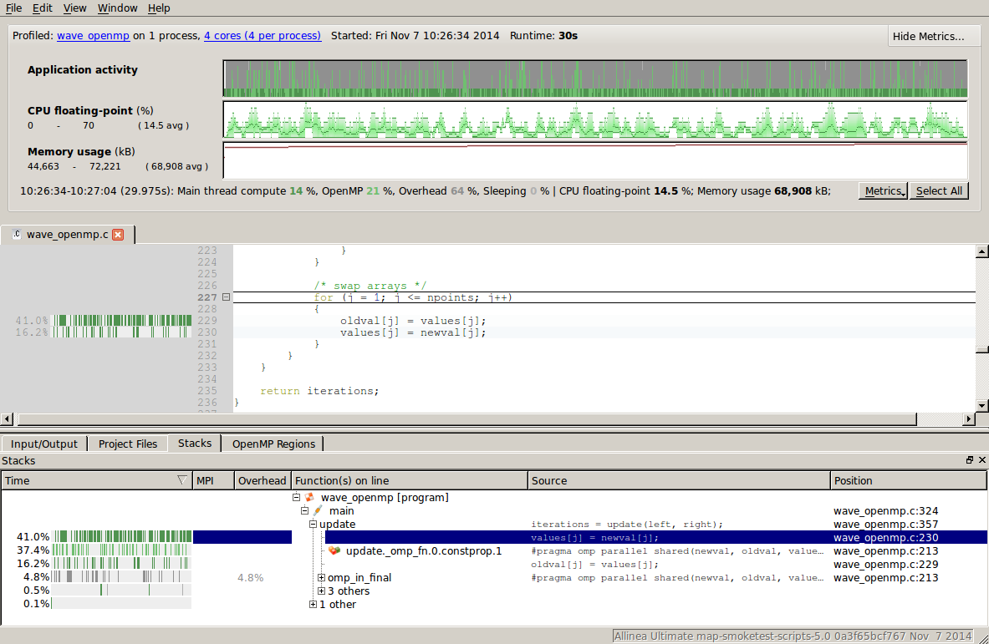
Allinea MAP in a nutshell
Small data files
No profiling configuration
No instrumentation
<5% runtime overhead

Slide 14
How Allinea MAP is different
Adaptive sampling
Sample frequency decreases over time
Data never grows too much
Scalable
Same scalable infrastructure as Allinea DDT
Handles very high core counts, fast
Instruction analysis
Categorizes instructions sampled
Knows where processor spends time
Thread profiling
Core-time not thread-time profiling
Identifies lost compute time
Integrated
Run for as long as you want
Merges sample data at end of job
Shows vectorization and memory use
Detects OpenMP issues
Part of Forge tool suite
Profiling within your code
Zoom and drill into profile
Notes:
Scalable
Use compute power at end of job to reduce data in to usable size
Thread profiling
Core-time => show time cores aren’t being utilised
Shows OpenMP synchronisation time
Integrated
Reduced setup

Slide 15
6 Steps To Improve Performance
Get a realistic test case
Performance on real data matters
Keep the test case for reference and re-use
Profile your code
Add “-g” flag to your compilation
Run with a profiler
Look for the significant
Is there any unexpected significant time use?
What is the nature of the problem?
Compute? I/O? MPI? Thread synchronization?
Display the metrics that show the problem best
Apply brainpower to solve
MPI – can you balance the work better?
Compute – is memory time dominant – can you improve layout?
Think of the future
Try larger process or thread counts to watch for scalability problems
Keep the profile (.map file) for future comparison
Which part/phase of the code dominates time?

Slide 16
Allinea MAP and other performance tools: a great synergy
Simple optimization with Allinea MAP
Characterize performance at-scale with a lightweight tool
Prepare optimization strategy with Allinea MAP
Identify loop(s) to instrument
Fine tune the code with tracing tool
See which lines of code are hotspots
Identify common problems with MAP
Identify performance counter(s) to record
Document performance issues to communicate to profiling experts
Retrieve low-level details using Score-P/Vampir, nvprof, etc
Fix up CPU usage to make the code fly

Slide 17
Preparing your program for profiling
Linking (on Titan)
$ module load forge
$ module load map-link-static # or map-link-dynamic
Re-link your program
Should I recompile?
Debug information (-g) required to display source code.
Caveats:
PGI: If using -g and -O, line number information may be inaccurate.
Cray: -g disables most optimizations – use -G2 instead.
Issues with source code locations?
Include frame headers (e.g. --eh-frame-hdr)
Function Inlining (e.g. -fno-inline)

Slide 18
How to run MAP
Modify existing job submission script
$ source $MODULESHOME/init/bash
$ module load forge
$ map --profile aprun …
Submit to the queue
$ qsub submit.qsub
Open the result
$ map ./output.map
Use the remote client

Slide 19
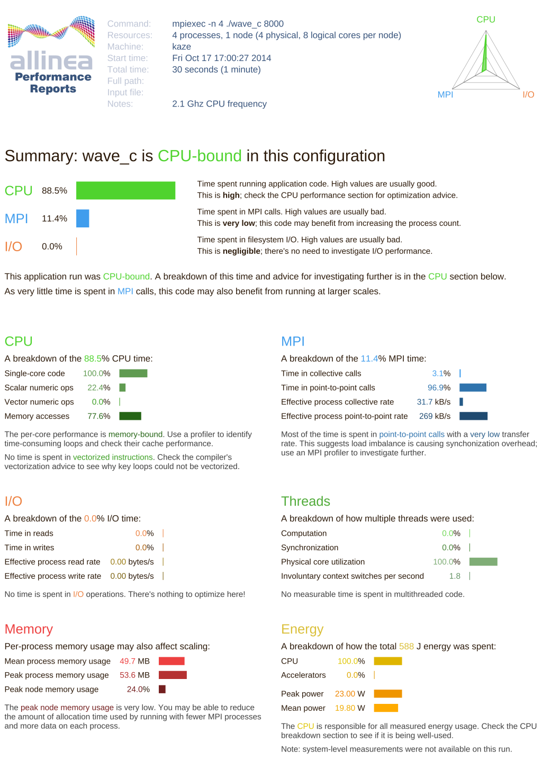
Bonus: Summarize with Performance Reports
$ module load perf-reports
$ perf-report file.map
caption

Slide 20
Demo

