Slide 1
Computational Challenges in Nuclear Coupled-Cluster theory
OLCF User Meeting
2016, May 24
Gustav R. Jansen

Slide 2
Collaborators
Gaute Hagen (ORNL)
Thomas Papenbrock (UTK, ORNL)
Micah Schuster (ORNL)

Slide 3
Outline
The atomic nucleus.
The Schrödinger equation.
NUCCOR.
Illustrated example.
Implementation strategies.
Implementation details.

Slide 4
The nucleus

Slide 5
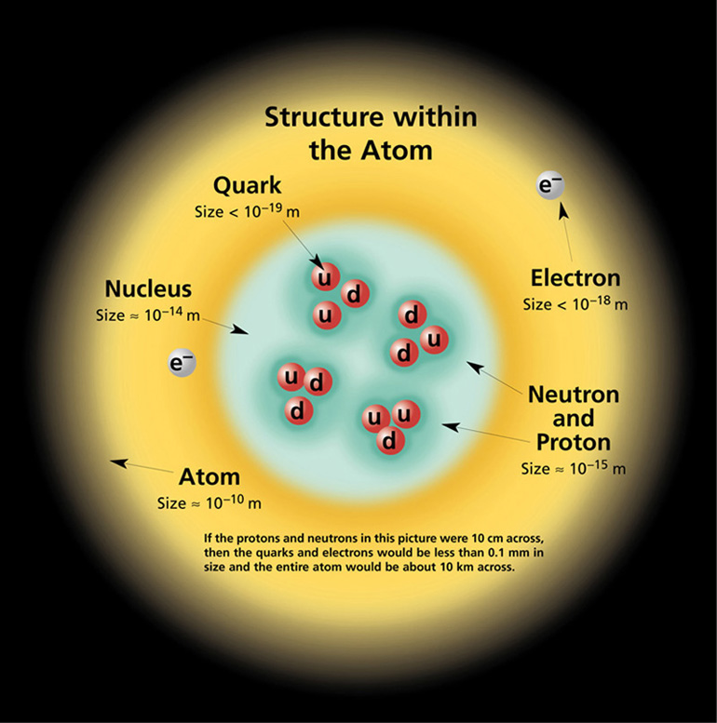
A question of scale
Courtesy of the university of Oregon

Slide 6
Nuclear properties
Mass
Size
Separation energies
Structure
Shell evolution
Magicity
Spectroscopy
Excitation energies
Collective motion
Rotation
Vibration
Radioactive decay
Particle emission
$β$ - decay
$(0ν)ββ$- decay

Slide 7
The Schrödinger equation

Slide 8
The nuclear Schrödinger equation
Solution techniques
Differential equation
Integro-differential equation
Set of non-linear equations
Eigenvalue equation
Monte Carlo simulation
Lattice calculation
$$HΨ=EΨ$$
Notes:
The Hamiltonian is the energy operator: The sum of kinetic and potential energy
E is the total energy
Psi is the wavefunction
Only 2 problems

Slide 9
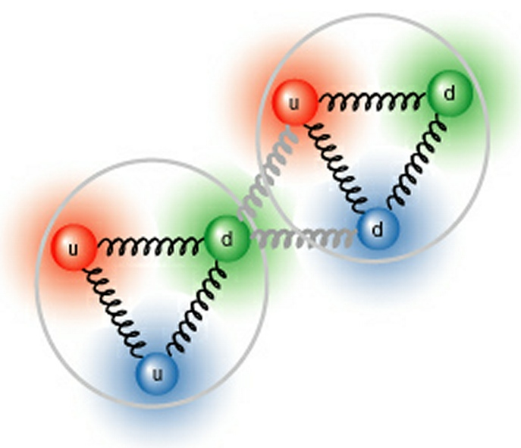
The model
Forces acting between point particles
F
Complicated many-body forces
Three-nucleon forces are crucial!
Notes:
We want forces that act between point particles
Nucleons are color neutral (almost)
Average distance between nucleons about the same as the size of the nucleon
Weak residual interaction (Left over from the creation of neutral particles.
Threebody forces

Slide 10
Outstanding challenge
Constrain the nuclear Hamiltonian
Current best practices
Functional form from chiral effective field theory.
Parameters called low-energy constants fitted to data.
Results in two- and three-body terms.
Problems
Best fit describe small nuclei, but large errors in large nuclei.
Controversy about the expansion order.
Also questions about additional terms in the expansion.

Slide 11
Back to the Schrödinger equation
$$HΨ=EΨ$$

Slide 12
The basis
Quantum mechanics
$$\left({N \atop A}\right)$$
Fermions
Notes:
Particles can only exist in discrete states
Approximation determines how many states are allowed
Typically determined by the maximum energy
Fermions: Particles obey Pauli exclusion principle
Each state can only be occupied by one identical particle
Leads to n choose A as the size of the matrix: How many ways to place A particles in N states

Slide 13
Basis size
Notes:
Exponential in A and N
Need 5000 states for converged solutions

Slide 14
NUCCOR

Slide 15
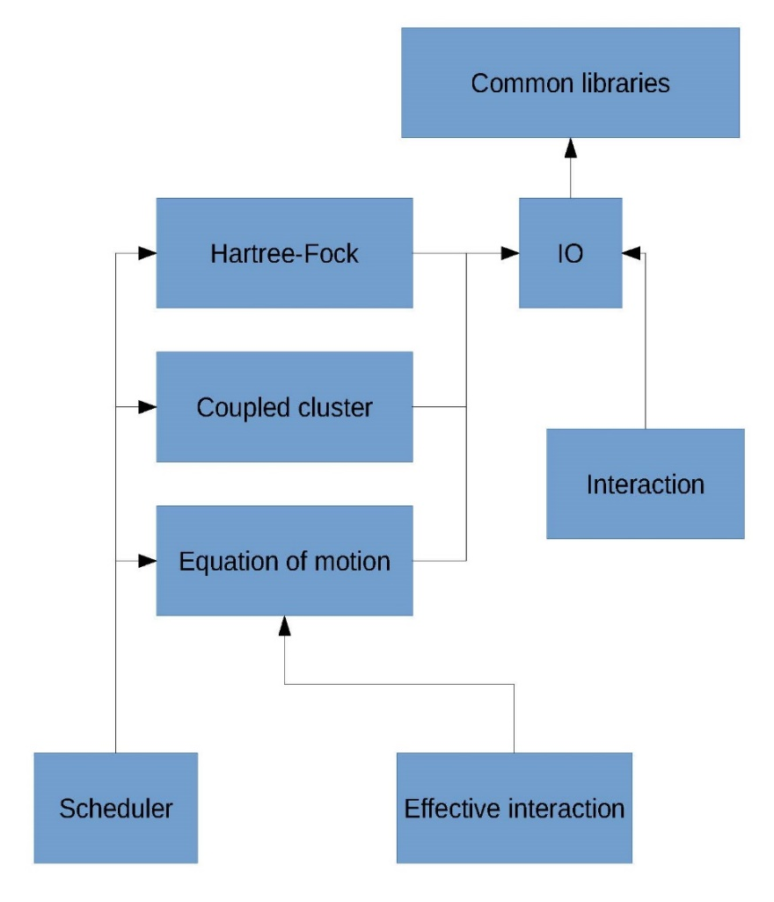
NUCCOR (Nuclear Coupled-Cluster Oak Ridge)
INCITE project for Nuclear Structure and Reactions led by James P. Vary from Iowa state University.
Selected as a CAAR project at OLCF in 2015.
Runs on Titan (MPI+OpenMP+Cuda).
Written in Fortran + Cuda C.
About 100.000 lines of code
Scales to full Titan using an ensemble-based workflow.

Slide 16
How do we use Titan
Parallelism
Hybrid scheme( MPI/OpenMP/Cuda).
Each task is computed by a team of MPI ranks where each rank is using a number of OpenMP threads and some kernels offloaded to a GPU.
Dependencies
Tasks organized in a tree structure.
Scheduling determined by
Complexity of task.
Data in memory.
Critical path first.
Dual mode
Serial mode
Tasks computed one by one.
All ranks contribute.
Parallel mode
Tasks computed in parallel.
One MPI rank used for scheduling purposes.
Checkpoints for restart capabilities.
Task scheduler

Slide 17
The NUCCOR toolchain
Interaction
Hartree Fock
CCSD
1
*
1
1
1
CCEI
L-CCSD(T)
1
1
3
1
*
1
*
Shell model
Expectation values
1
1
1
*
EOM
*
1
*
Shell model expectation values
Effective operators
*
1

Slide 18
Outstanding challenge
Three-body forces
Current best practices
Use three-body forces as large as possible, then extrapolate.
Various approximation schemes to reduce the number of elements.
Normal-ordered two-body approximation.
Problems
Larger nuclei requires larger model spaces.
Improved precision requires larger model spaces.
Evidence suggests that the residual three-body force contributes about 1% to the total binding energy.

Slide 19
Memory requirements
Notes:
Focus on one problem that involves threebody forces.

Slide 20
Example

Slide 21
Hartree-Fock
Non-linear equations
Similarity transformation
Reduce
I/O
Eigenvalue system
Converged?
No
Yes
Similarity transformation
Reduction
I/O

Slide 22
Block-sparse structure
Similarity transformation and reduction performed on one block at the time

Slide 23
Similarity transformation
$$V_{HF}$$
$$M$$
$$V$$
$$M^{−1}$$
=
Transformation matrix constructed from minimal data.
Result too large to store on a node.
Reduce data by 3-5 orders of magnitude.
No communication until all ranks have finished with reduction.

Slide 24
Implementation strategies

Slide 25
Approach
Drop-in blas library
Pros
Similarity transformation rich in blas-3 operations.
Uses streams to overlap data movement and computation.
Minimal changes to code gives 2.5x speedup.
Cons
No reuse of data on device.
Partial results are always transferred to host and back again.
Reduction step can not be performed on device.

Slide 26
Approach
OpenACC and CuBlas
Pros
Data on device can be reused.
Partial results can be kept on device.
Except from calls to CuBlas, minimal changes to code.
Cons
Opened up a can of worms.

Slide 27
Can of worms
Deep copy with nested data structures.
More lines of directives than actual code.
Couldn’t compile with the cray compiler (bugs?).
Fortran 2003/2008 issues.
Buggy in Cray.
More buggy in PGI.
Poor OpenACC support in GCC.
Difficult to expose parallelism in current algorithms.
Current model: Fortran + Cuda C

Slide 28
Approach
Fortran + Cuda C
Pros
Data on device can be reused.
Partial results can be kept on device.
Access to everything in the Cuda toolkit.
Can create optimized kernels where needed.
It compiles and runs.
Cons
Invasive changes to code.
Invasive changes to build system.
No performance portability.

Slide 29
Implementation details

Slide 30
Open-source implementation
For especially interested individuals
https://code.ornl.gov/nuccor/linalg_solver
Contains NUCCOR data structures.
Device and host memory supported.
Test case with a single dgemm.
Performed using matmul, blas and Cublas.
Minimally documented.
Cumbersome build system.

Slide 31
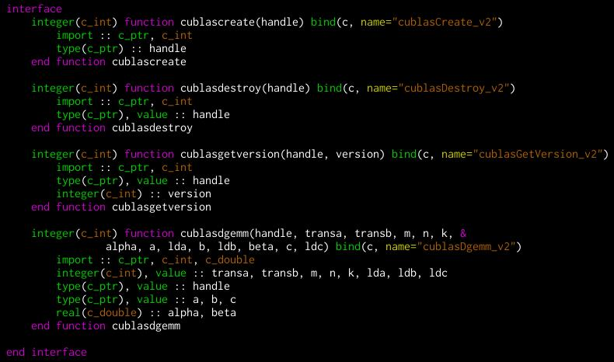
Interface to cublasDgemm

Slide 32
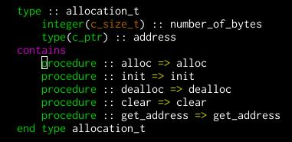
Access to device memory

Slide 33
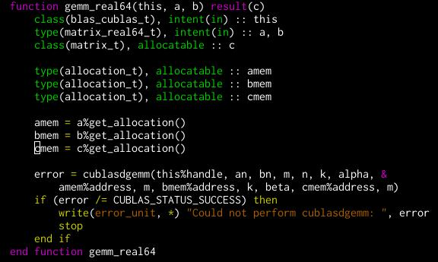
Actual call to cublasDgemm

Slide 34
Problem
How can we reduce code duplication while still remaining portable?
Current approach
Encapsulate architectural details with an object-oriented approach.
Create abstraction layer for blas or other algorithm classes.
Makefile directives for optional compilation.
Compiler directives in a few factory modules.
Specific implementations chosen at runtime.

Slide 35
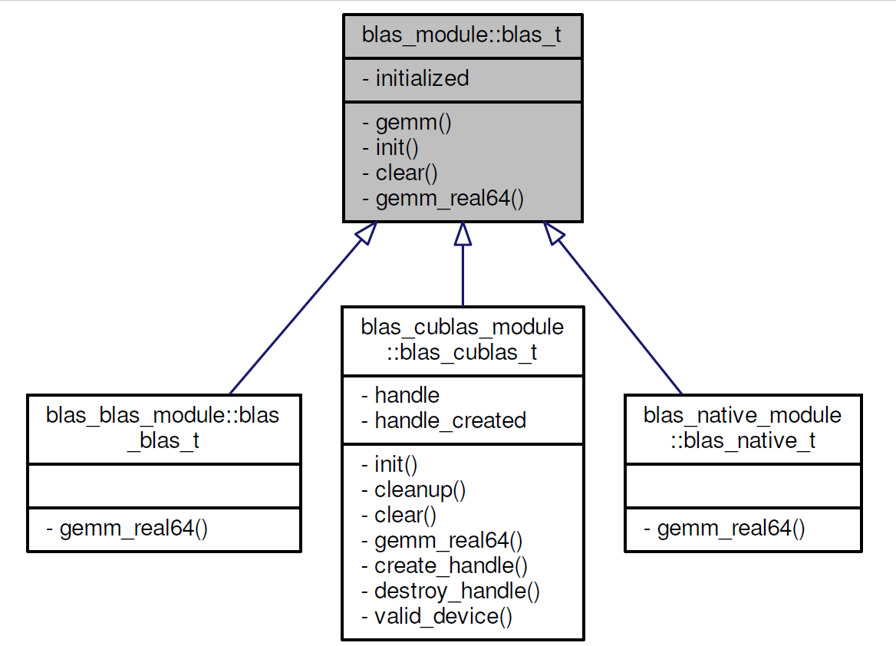
Blas abstraction overview

Slide 36
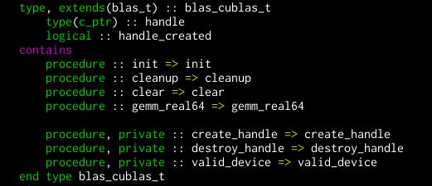
Blas implementation

Slide 37
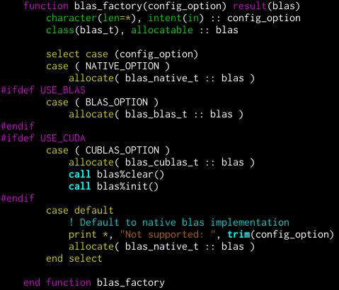
Blas selection

Slide 38
Remaining issues
Running out of device memory.
Memory allocation is slow.
Need a dedicated memory manager.
Asynchrounous execution.
Use streams and events to schedule data transfers and kernels.
Memory manager must support delayed allocation/deallocation.
Do not deallocate until transfer is ready.
Need a simple task manager.
Schedule host tasks that depends on data transfers.
Run kernels on both device and host.
Need a more advanced task manager.

Slide 39
Final note
Simultaneous optimization track.
Focus on algorithms and symmetries.
 | New algorithms | GPU porting
Time spent | 20% | 80%
Speedup | 15x | 2.5x

Slide 40
Summary
Work in progress.
Lack of mature tools/models for (performance) portability.
Fortran + Cuda C is our only option.
Specifically gcc >= 5.2.0.
Need memory and task manager for asynchronous execution.
Proof-of-concept mini-app available for download.
https://code.ornl.gov/nuccor/linalg_solver

Slide 41
Questions?
Gustav R. Jansen
jansengr@ornl.gov
This work was partly supported by the Office of Nuclear Physics, U.S. Department of Energy (Oak Ridge National
Laboratory), under Contracts No. DE-FG02-96ER40963 (University of Tennessee) and No.DE-SC0008499
(NUCLEI SciDAC-3 Collaboration), and the Field Work Proposal ERKBP57 at Oak Ridge National Laboratory.
An award of computer time was provided by the Innovative and Novel Computational Impact on Theory and
Experiment (INCITE) program. This research used resources of the Oak Ridge Leadership Computing Facility
located in the Oak Ridge National Laboratory, which is supported by the Office of Science of the Department of
Energy under Contract DE-AC05-00OR22725 and used computational resources of the National Center for
Computational Sciences, and the National Institute for Computational Sciences.

